Slide 1
Howard County’s APFO
Presentation to Howard County APFO Task Force, 7/1/2015
Jeff Bronow, Chief
Division of Research
Howard County DPZ

Slide 2
Growth Management Framework
(recap from presentation on 6/17/2015)
Growth Management Policy overview
Historical change in population & land use
Development Monitoring System
Household and population projections
Fiscal Impact Analysis

Slide 3
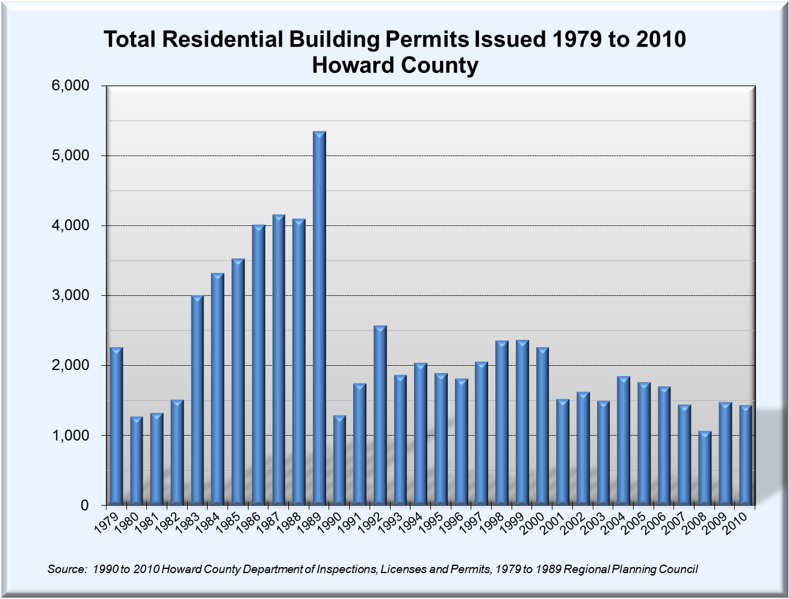
1979 to 1989
3,078 Avg.
1990 to 2000
2,025 Avg.
2001 to 2010
1,539 Avg.

Slide 4
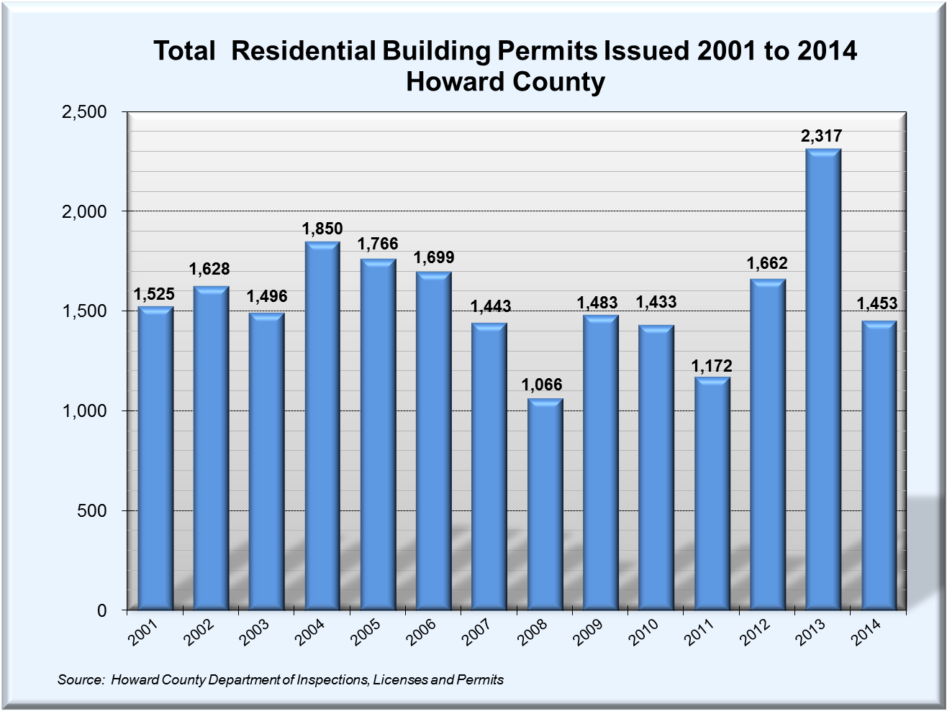
2011 to 2014
2001 to 2010
1,651 Avg.
1,539 Avg.

Slide 5
The Grand Bargain
Ray Wacks, former Budget Director, would always refer to “The Grand Bargain”
1992 APFO Committee decision: institute a road excise tax along with growth control measures
County will plan for and build schools and other infrastructure
School impact fees or proffers would not be part of APFO

Slide 6
APFO Overview
There are 3 test associated with APFO –
1) Allocations, 2) Schools, 3) Roads
Allocations test is conducted at initial plan stage approval. For comprehensive plans, test conducted at plan submission (R-A-15, NT, PGCC, MXD)
School test conducted once plan has allocations.
For roads test, traffic study must be conducted, and adverse impacts must be mitigated by developer

Slide 7
Housing Unit Allocations
The annual number of allocations is based on the General Plan – PlanHoward 2030
1 allocation = 1 dwelling unit no matter type
Allocations pace development so county government can plan and provide for capital facilities
Each year the County Council adopts a new 10 year allocation chart (derived from PlanHoward 2030)
Allocations are given out by Designated Place Types & other specialty pools

Slide 8
Housing Unit Allocations
Allocations can be phased (forced or voluntarily)
Projects must meet plan submission milestone dates or allocations are voided
Once all allocations are taken for an area, then plans go into a waiting bin
Come of bin on a first come, first serve basis
May grant up to 120% of available allocations in current allocation year for flexibility
Rolling average is used to maintain General Plan targets

Slide 10
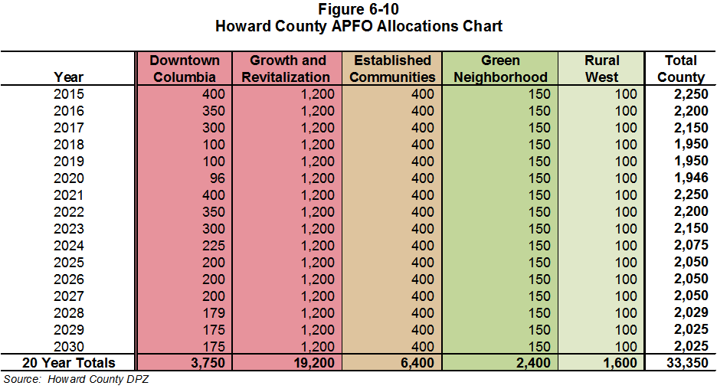
PlanHoward 2030 Allocations

Slide 11
Housing Unit Allocations
Only 35% of Growth & Revitalization allocations can be used in any one Planning Area
There is also a Shared Established Communities and Growth & Revitalization allocation area – a common pool that can be used by either area based on any unused allocations from either area that are added annually per the rolling average process
Both these provisions were added by County Council amendment

Slide 13
County Council to Adopt on July 6

Slide 14
Allocation Waiting Bin Status

Slide 15
Housing Unit Allocations - History
Started in 1992 with six school regions.
After 2000 General Plan, moved to fixed planning areas – Columbia, Elkridge, Ellicott City, Rural West, Southeast, (Senior East)
In 2003 (2006 allocation year) added Route 1
In 2006 (2009 allocation year) added MIHU
In 2007 (2010 allocation year) added Green Neighborhood
In 2010 (2013 allocation year) added DT Columbia
In 2013 (2016 allocation year) adopted PlanHoward 2030 Designated Place Types

Slide 16
Housing Unit Allocations - History

Slide 17
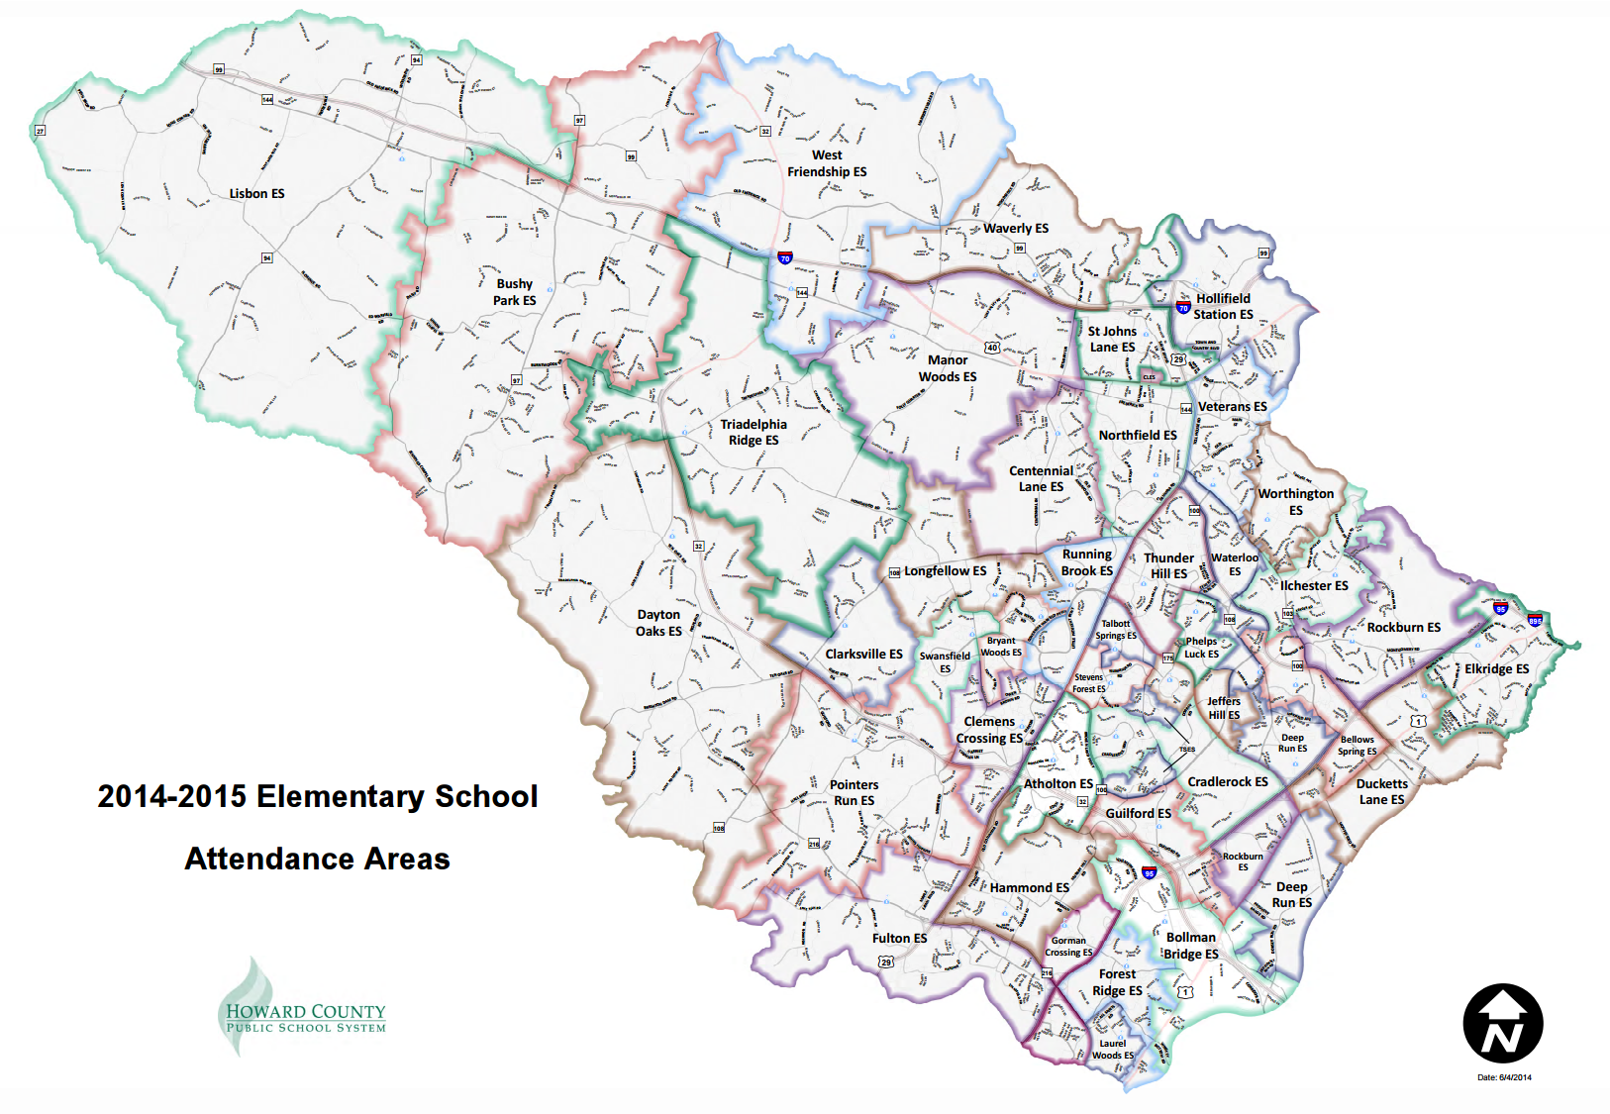

Slide 20
Housing Unit Allocations – History

Slide 21
Open/Closed Schools Test
This test is taken after allocations are received.
There are 3 tests that a project must pass –
1) open elementary school district
2) open elementary school region
3) open middle school district (added after GP 2000)
Must pass all three or go in waiting bin
Can be held up for a maximum of 4 years
Each year the County Council adopts a new open/closed school chart. Failed projects re-tested
Chart is created & approved by the HCPSS

Slide 22
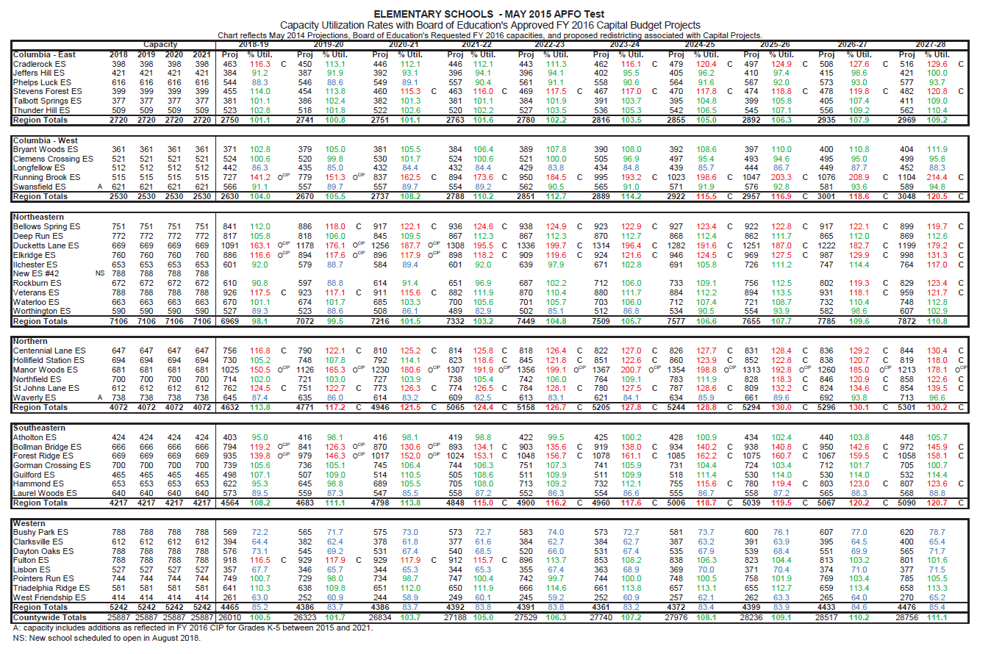

Slide 23
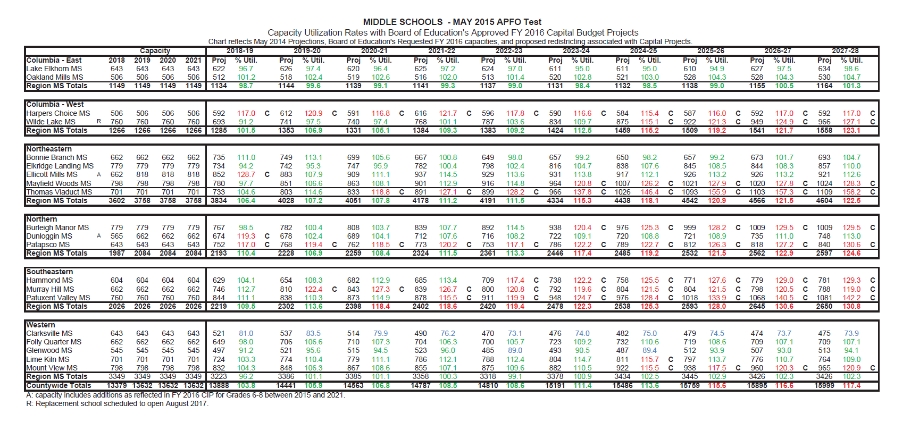

Slide 24
O/C School Waiting Bin Status

Slide 25
O/C School Waiting Bin Status

Slide 31
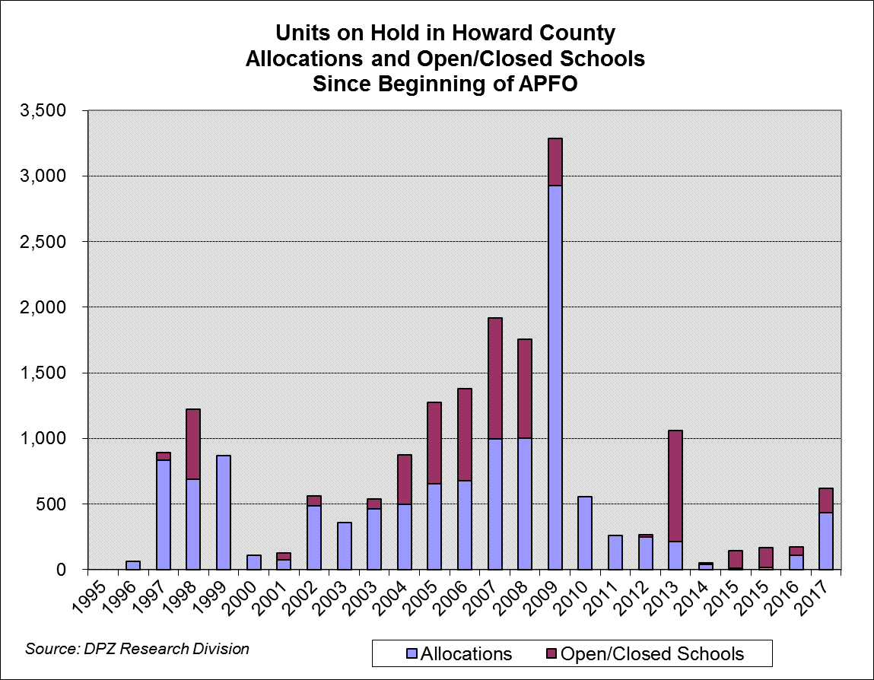

Slide 32
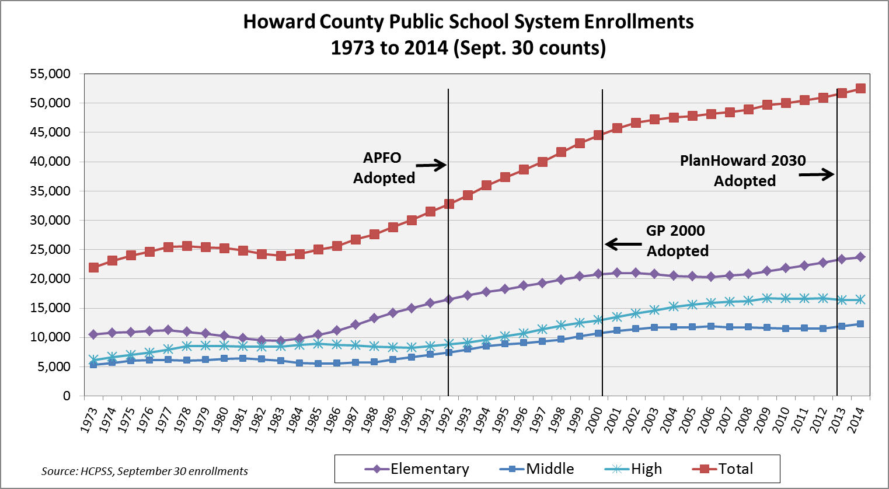

Slide 33
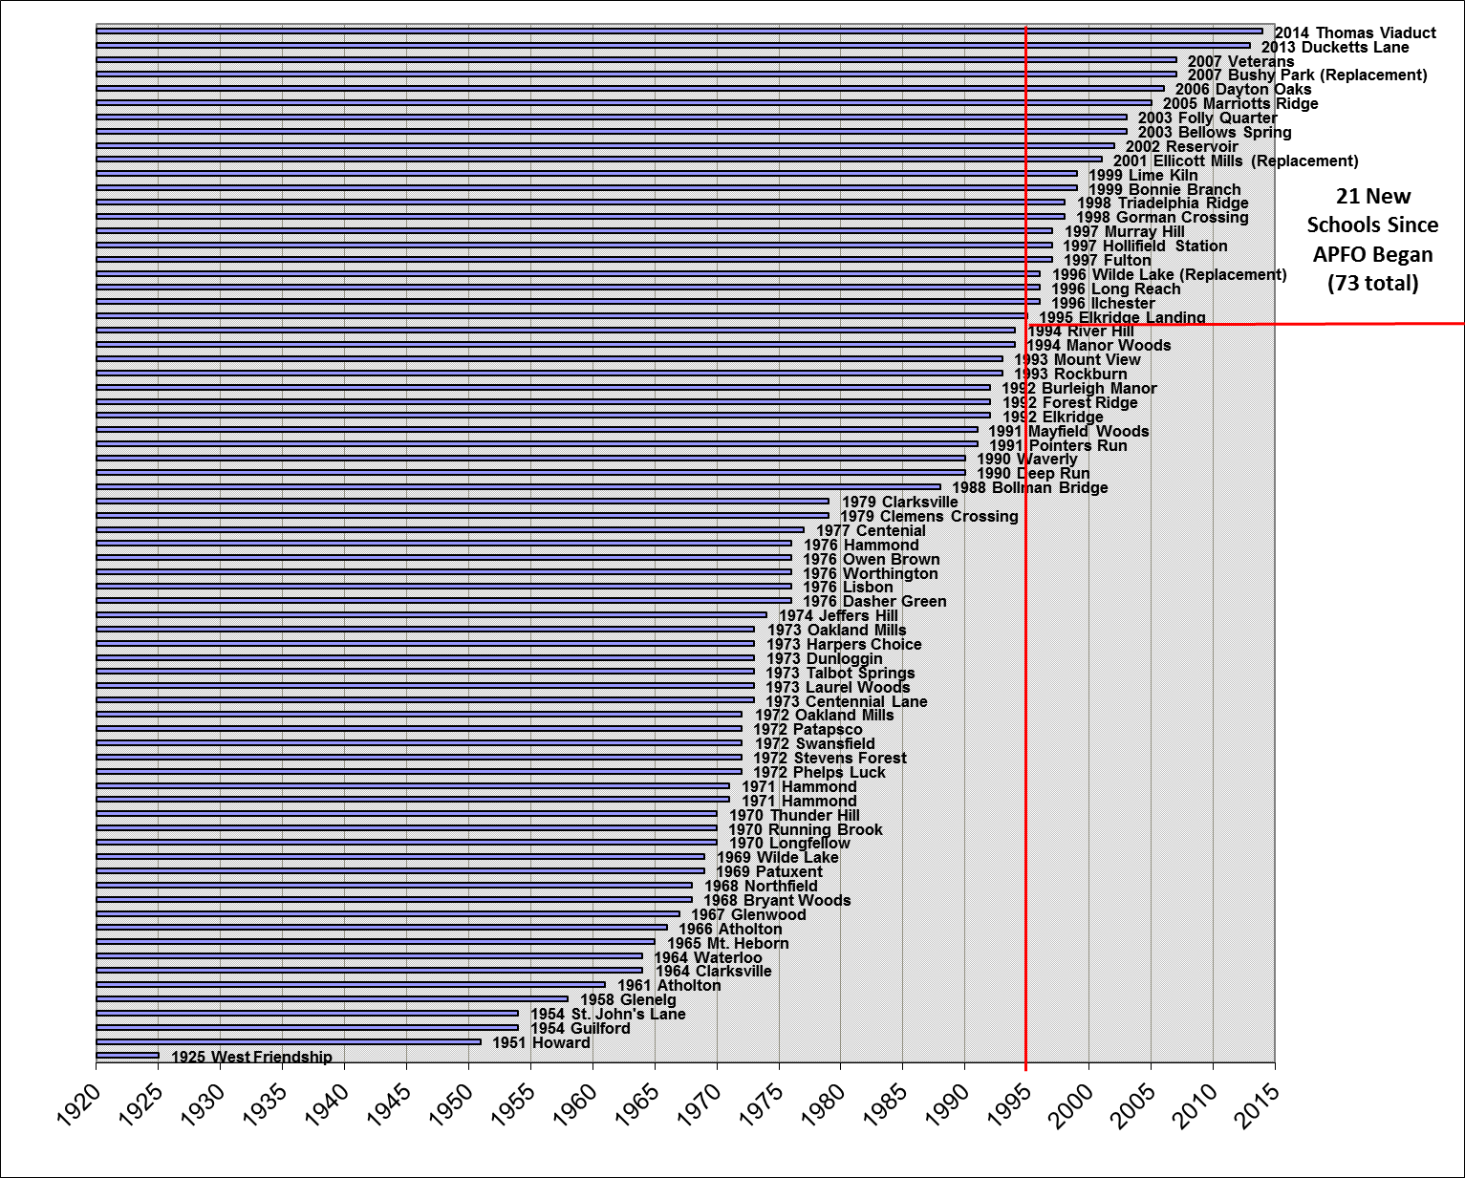

Slide 34
APFO Exemptions
Single lot exemption in Rural West
Single lot exemption for family member
Single lot exemption for financial hardship
Mobile home park replacement units
Redevelopment sites replacing occupied units
No Schools test for age-restricted units
Special affordable housing opportunities (by CC resolution can move ahead, but allocations are counted)

Slide 35
APFO Provisions Taken Out
One lot exemption in the east (taken out around ‘03)
Advancing of Route 1 allocations by allowing a developer to provide land for school or other public facility (Oxford Square did this)
Route 1 advancing taken out in 2012 with Adoption of PlanHoward 2030 when Route 1 set-aside allocations were no longer a category

Slide 36
Summary
APFO has worked to slow growth in areas of high demand.
New infrastructure can be planned and paid for and built with a known 20 year growth pace.
APFO has granted some relief and has given the HCPSS extra time to plan, redistrict and build schools (21 new schools since 1995) & additions.

Slide 37
Issues and Considerations
If a particular school had been closed to development, may have helped, but not necessarily, due to: 1) high birth and yield rates, 2) turnover of existing housing.
Programmatic changes such as reduced class size and full day kindergarten has increased level of service and should be taken into consideration when evaluating crowding.
APFO impacts new development only – can’t control existing house turnover & programmatic changes.

