Slide 1

Rebuilding #ECStrong:
Working Together on a Path to rECovery
Community Forum on
Rebuilding and the Environment

Slide 2
Steve Brigham public engagement associates

Slide 3
ALLAN Kittleman
Howard County Executive
Video

Slide 4
Purpose
A focus on the long-term flood recovery process with an emphasis on Rebuilding and the Environment
Review project idea generation process; opportunity to propose additional projects
Discuss what’s applicable from EPA’s Vermont and Cedar Rapids flood case studies

Slide 5
Unique Elements of Tonight’s Process
Facilitated table discussions (staff volunteers)
Fast cycle feedback – themes & examples
Electronic keypad polling

Slide 6
Agenda
Table Introductions & Polling
Presentation: EPA’s Flood Resilience Checklist / Q&A
  Table Discussion: What 2-3 ideas did we find most compelling from the presentation that seem most applicable to the rebuilding and long-term recovery of Ellicott City?
Overview: Generation of Project Ideas Process
  Table Discussion: How well do the project idea “themes” represent the kinds of projects we need to consider during recovery?
  Brainstorm – your project ideas
Themes & Examples from the Table Discussions
Final Polling & Next Steps

Slide 7
Community Engagement Process
Toward a Master Plan for a Resilient Town
Generate Ideas
from Community
Stakeholders
Gather
Ideas from
the Public
Prioritize & Implement
Non-Master Plan Projects*
Develop
Master Plan
for the Watershed with Public Input
Completed October 2016
Present – Winter 2017
Ongoing
Spring –
Fall 2017

Slide 8
Inputs to Master Plan: Current Efforts
Tiber Hudson Corridor Assessment
Flood Case Study
Hydrology and Hydraulic Study
Community Engagement
Master Plan Process
Spring – Fall 2017

Slide 9
Table Discussion

Slide 10
Table Introductions
Share your answers to THREE Questions:
What is your name?
Where do you live?
What do you love most about Ellicott City?
START BY SILENTLY WRITING YOUR RESPONSE TO #3 ON A SINGLE POST-IT NOTE.

Slide 11

Using Your Keypad
Press the button of your choice
When you get the green light, you vote has been received
If you make a mistake, just vote again
For multiple-choice votes, enter all choices, one after the other, with a green light after each
For ‘‘10’’, press 0
X
X

Slide 12
What is your relationship to Ellicott City? (press all that apply)
I live there
I work there
I own a business there
I shop there
I worship there
I own property there
Other
44 of 85

Slide 13
Do you have an Ellicott City Address?
Yes
No
47 of 85

Slide 14
How long have you lived, worked or regularly visited (shopped, dined, worshiped) in Ellicott City?
I don’t live, work, or regularly visit Ellicott City
Less than 5 years
5 – 10 years
11 – 20 years
More than 20 years
48 of 85

Slide 15
How often do you visit Old Ellicott City?
Daily - I live or work there
I visit weekly
I visit 2-3 times per month
I visit every few months
I visit a couple of times a year
I visit rarely
47 of 85

Slide 16
How important is it to you to rebuild Old Ellicott City?
Very Important
Moderately important
Slightly important
Not at all important
43 of 85

Slide 17
Report back from Table Introductions

Slide 18
Senior Policy Analyst
U.S. Environmental Protection Agency Office of Sustainable Communities
Mr. Kevin Nelson

Slide 19

EPA’s Tools for Flood Recovery and Resilience
Rebuilding #EC Strong: Working Together on a Path to rECovery
November 10, 2016

Slide 20
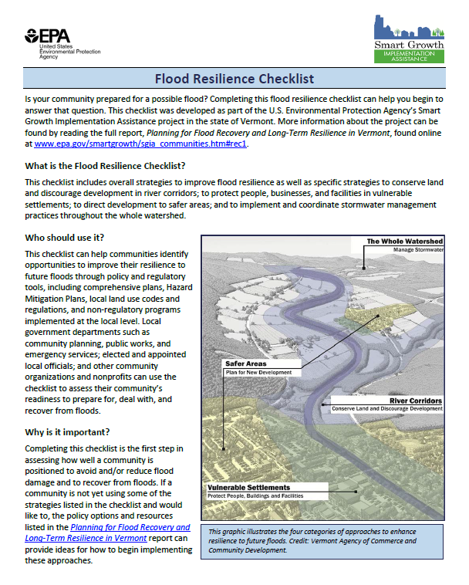
Flood Resilience Checklist:
A Tool for Communities
Developed from a Smart Growth Implementation Assistance project in Vermont, to assist in the wake of Tropical Storm Irene
Based on the framework that we used to assess local plans, policies, and regulations in two Vermont communities
Adapted so that any community can assess whether their plans and policies will help them become more resilient
Tool is being refined/expanded through Building Blocks for Sustainable Communities program

Slide 21
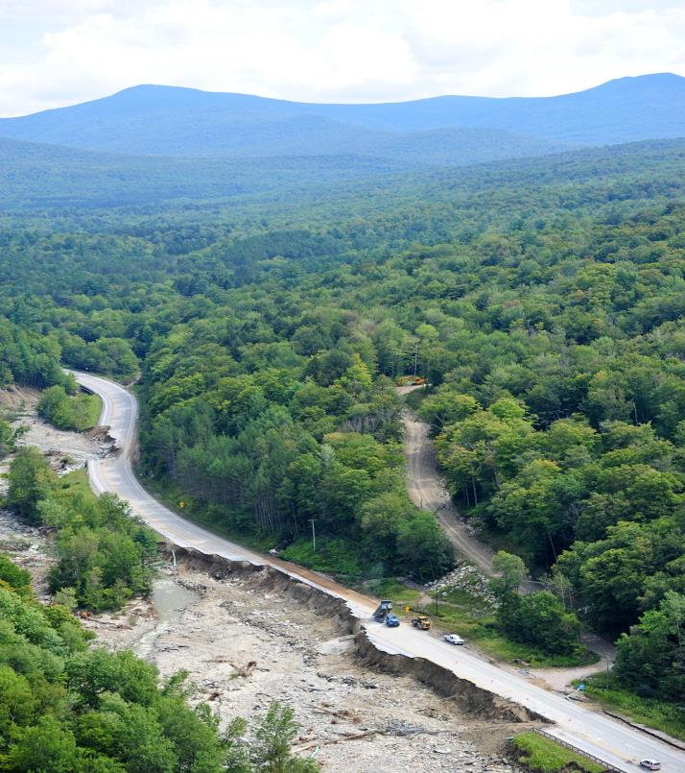
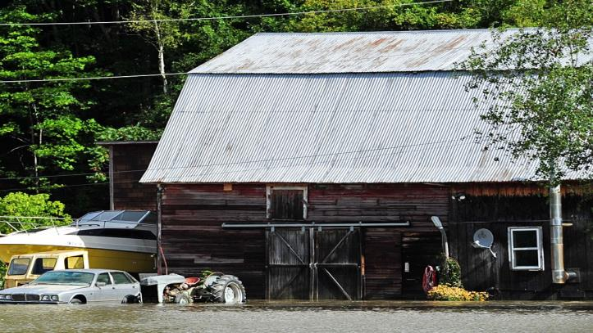
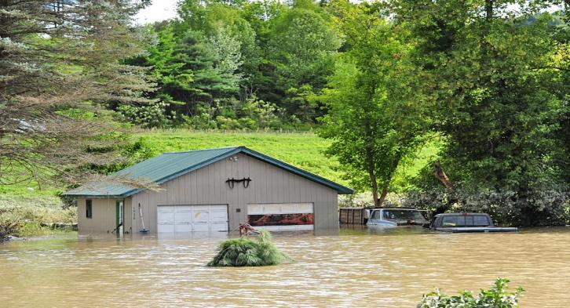
Flood Resilience in Vermont
In August 2011, flooding & erosion from Tropical Storm Irene devastated communities across Vermont
The state asked for help identifying smart growth strategies to help communities become more resilient to future flooding through their local plans, policies, & regulations
Where and how we build (and rebuild) our communities will affect our ability to withstand disasters in the future.
Photos: Lars Gange and Mansfield Heliflight

Slide 22
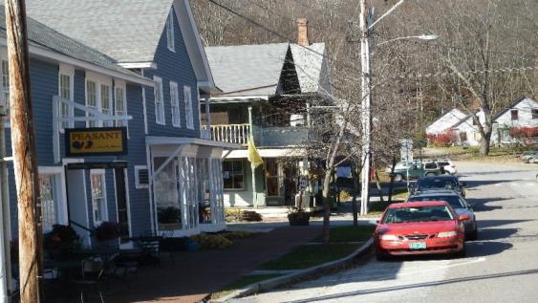
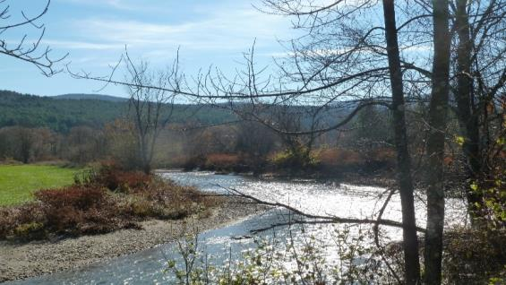
EPA’s Assistance to Vermont
EPA’s Office of Sustainable Communities and EPA Region 1 provided assistance through the Smart Growth Implementation Assistance program
Partners: FEMA (through our MOA), state agencies, Mad River Valley Planning District, Friends of the Mad River, Central Vermont Regional Planning Commission
Photos: Richard Amore, Courtesy of the State of Vermont

Slide 23
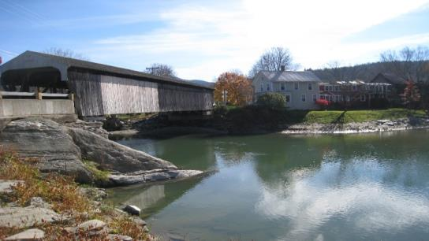
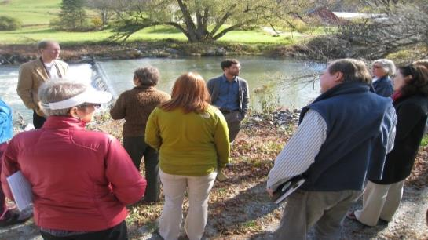
EPA’s Assistance to Vermont
Team of national experts in land use planning and disaster recovery and resilience assessed state and local plans and policies
In October 2012, toured flood-affected communities in the Mad River Valley and participated in a community workshop and state agency meetings
Refined policy options in the final report, Flood Resilience Checklist, and state agency report
Photos: EPA
Notes:
EPA and FEMA brought together a team of national experts in land use planning and disaster recovery and resilience to assess state and local plans and policies
In October 2012, toured flood-affected communities in the Mad River Valley and participated in a community workshop and meetings with state agencies to present initial ideas
Refined/developed policy options in the final report, Flood Resilience Checklist, and state agency report

Slide 24
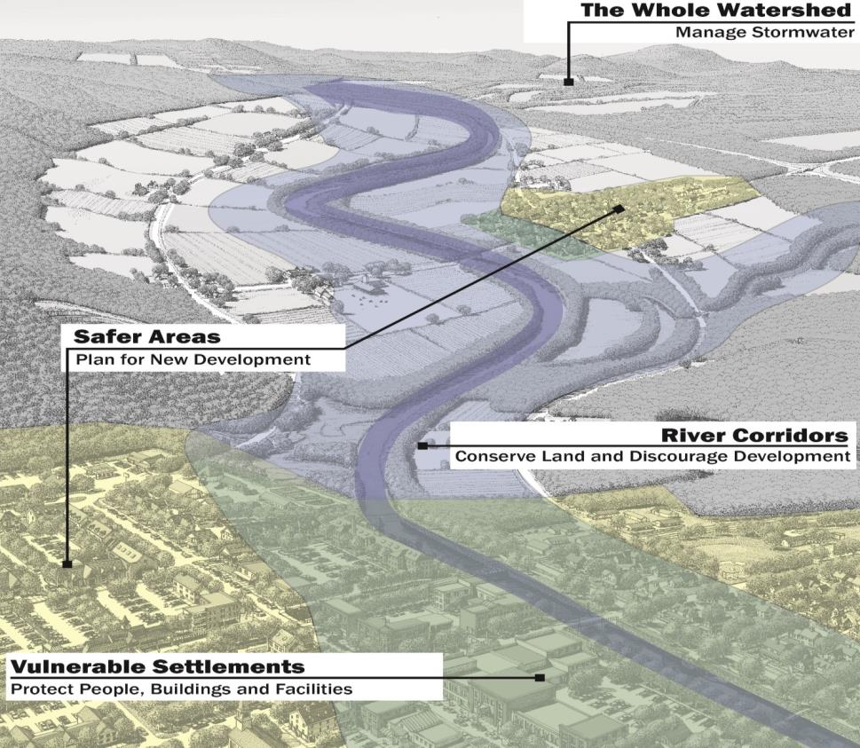
Vermont SGIA:
Local Land Use Policies for Resilience
Reviewed local plans, policies, and regulations, including:
  Local comprehensive plans
  Local Hazard Mitigation Plans
  Development regulations
  Building codes
  Stormwater management ordinances
  Regional plans
Developed strategies for increasing flood resilience, using a new framework

Slide 25
Mad River Valley:
Local Land Use Policies for Resilience
River Corridors
Protect and conserve undeveloped land in river corridors through conservation easements, buyouts, and transfer of development rights programs
Use farmland management BMPs to reduce impacts to farmers and downstream communities

Slide 26
Mad River Valley:
Local Land Use Policies for Resilience
Vulnerable Settlements
Upgrade building codes and development regulations to better protect development in flood-prone areas
Consider relocation if risks of staying outweigh the challenges of moving

Slide 27
Mad River Valley:
Local Land Use Policies for Resilience
Designate new growth areas and prioritize infrastructure investments in safer locations
Encourage compact, walkable development
Safer Areas

Slide 28
Mad River Valley:
Local Land Use Policies for Resilience
Use green infrastructure practices, such as rain gardens and permeable pavement, throughout the watershed
Retain existing tree canopy and conserve existing forestland
Avoid development on steep slopes and use stream buffers
The Whole Watershed

Slide 30
Flood Resilience Checklist:
Overall Strategies: Selected Questions
Do you have a local comprehensive plan that guides future growth?
  Does it include a hazard element or flood planning section?
  Does it identify flood-prone areas?
  Were emergency response personnel part of the process developing the plan?
Do you have a local Hazard Mitigation Plan?
  Does it cross-reference the local comprehensive plan?
  Was the local planner/zoning administrator involved in writing the HMP?
Do all community plans require or encourage green infrastructure techniques? Do they consider impacts of climate change on flood-prone areas?
Do you participate in the National Flood Insurance Community Rating System?

Slide 31
How Can You Use This Checklist?
The current version of the Checklist (and the full report) is currently available on our EPA website, for any community to use:
http://www.epa.gov/smartgrowth/smart-growth-implementation-assistance-project-summaries#vermont
The checklist has been expanded/revised through EPA’s Building Blocks for Sustainable Communities program to include coastal community considerations and additional green infrastructure approaches.
New version of the checklist was piloted in 5 communities in 2015, eventually will be available online.
    Mobile, Alabama
    Newburyport, Massachusetts
    New Paltz, New York
    Santa Ynez Band of Chumash Indians, California
    Scituate, Massachusetts
  http://www.epa.gov/smartgrowth/building-blocks-sustainable-communities

Slide 32
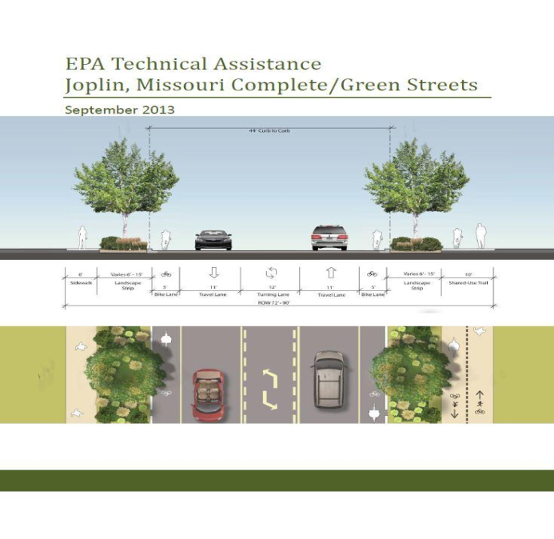
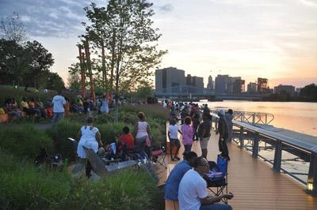
Application of Green Infrastructure
Plazas, Parks, and Public Places – 2015
National Award for Smart Growth Achievement
Riverfront Park
Newark, New Jersey
Community input was integral to the design of this park, built on a formerly contaminated site. The park reconnects Newark to its river for the first time in decades and is attracting economic development in the adjacent downtown, giving a working-class neighborhood a beautiful and much-needed place to play and relax, and preserving open space along the river that can protect neighborhoods from flooding.

Slide 33
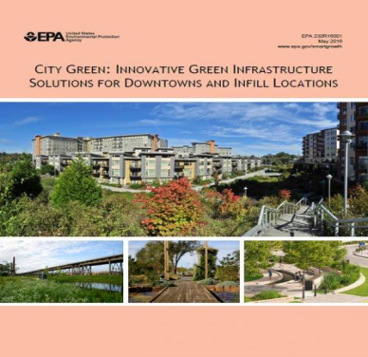
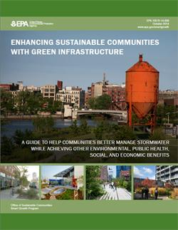
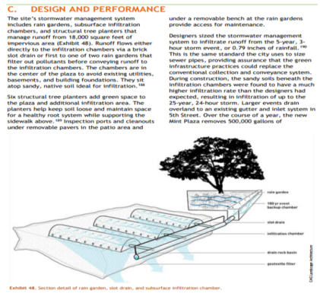
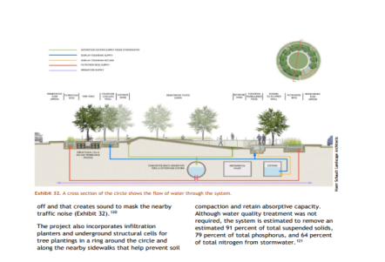
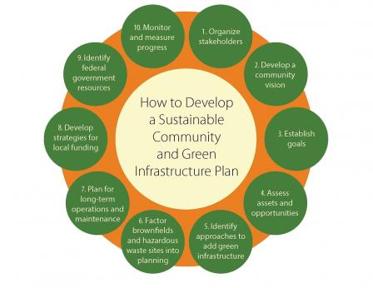
Application of Green Infrastructure
https://www.epa.gov/sites/production/files/2016-06/documents/city_green_0.pdf

Slide 34
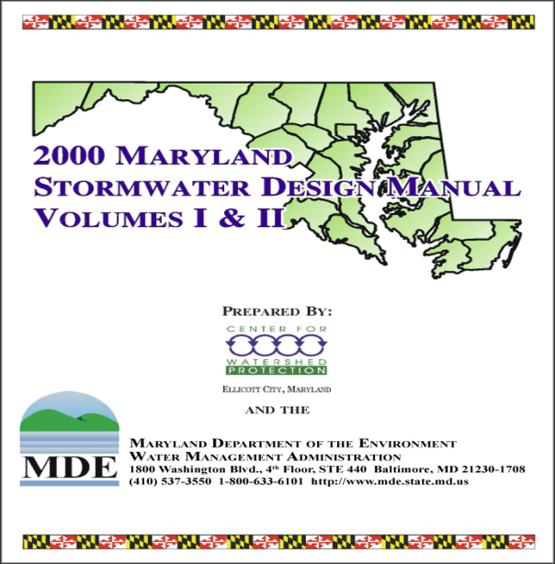

State-Level Efforts
The Iowa Smart Planning Act was signed into law on April 26, 2010.This bill has three components:
Articulates ten Iowa Smart Planning Principles for application in local comprehensive plan development and public investment decision-making,
Provides comprehensive planning guidance for cities and counties, and
Establishes the Iowa Smart Planning Task Force with various responsibilities.
Iowa Smart Planning Principles:
Collaboration.
Efficiency, Transparency and Consistency.
Clean, Renewable and Efficient Energy.
Occupational Diversity.
Revitalization.
Housing Diversity.
Community Character.
Natural Resources and Agricultural Protection.
Sustainable Design.
Transportation diversity.
https://www.epa.gov/sites/production/files/documents/iowa_climate_adaptation_report.pdf

Slide 35
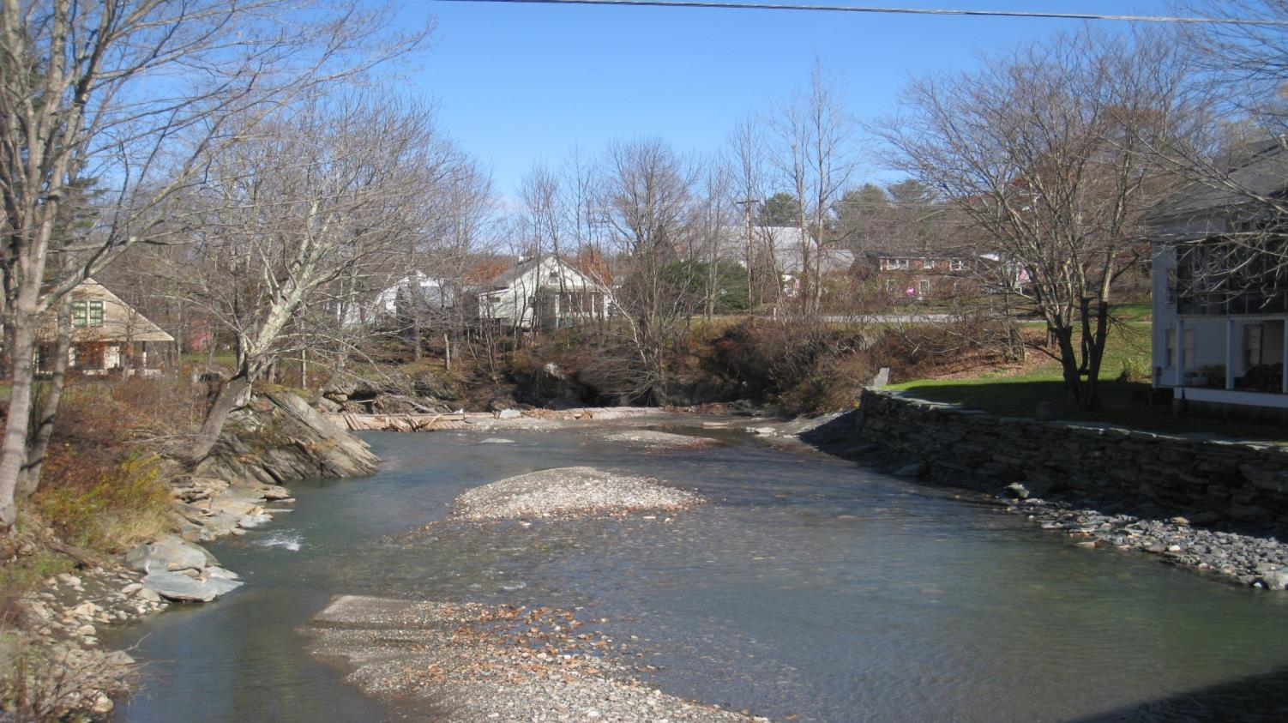
For More Information:
Full report and Flood Resilience Checklist available at:
http://www.epa.gov/smartgrowth/smart-growth-implementation-assistance-project-summaries#vermont
Kevin Nelson, previously with EPA Office of Sustainable Communities
202-712-0191
Stephanie Bertaina, EPA Office of Sustainable Communities
bertaina.stephanie@epa.gov
202-566-0157

Slide 36
Q & A

Slide 37
Table Task on Rebuilding
& Environment

Slide 38
Table Discussion
What 2-3 ideas did we find most compelling from the presentation that seem most applicable to the rebuilding and long-term recovery of Ellicott City?

Slide 39
Overview of Project Ideas
& Environment pillar

Slide 40
Joseph herr
Recovery Manager

Slide 41
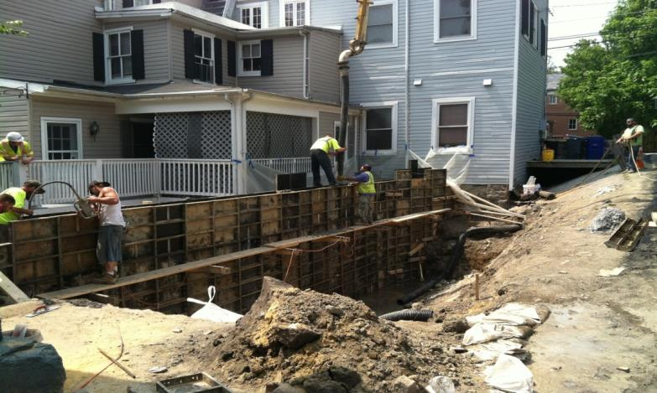
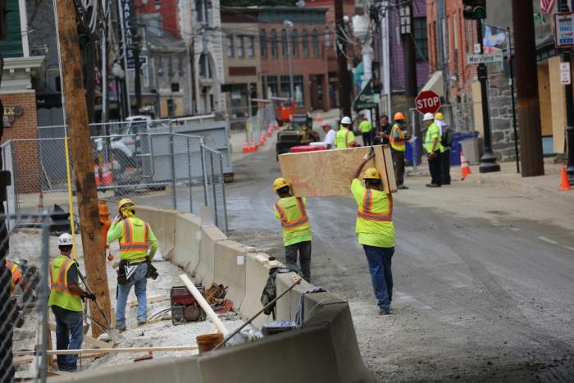
In Progress or Completed Projects

Slide 42
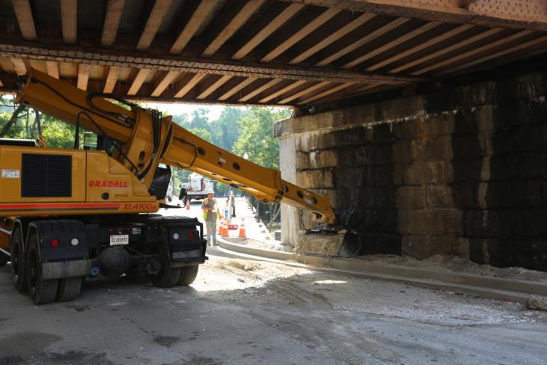
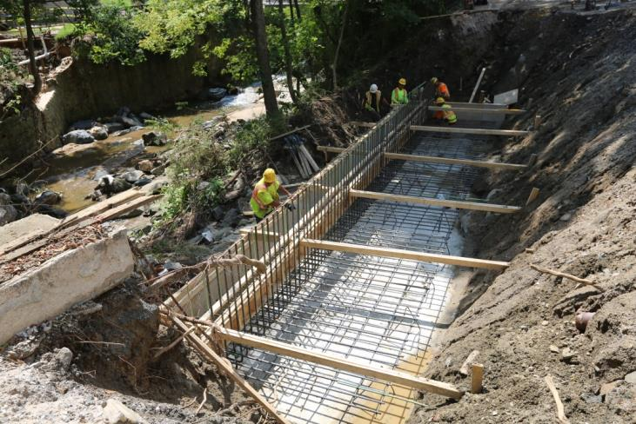

Slide 43
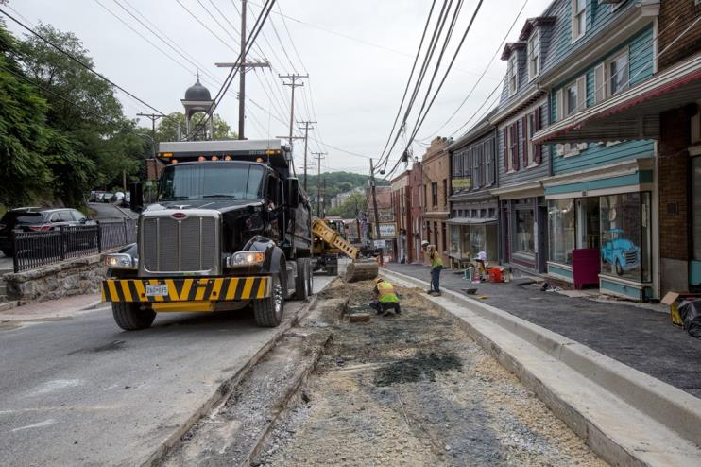
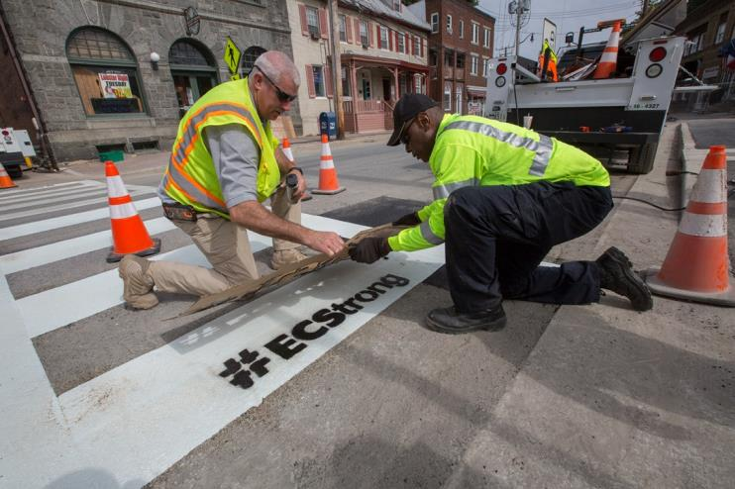

Slide 44
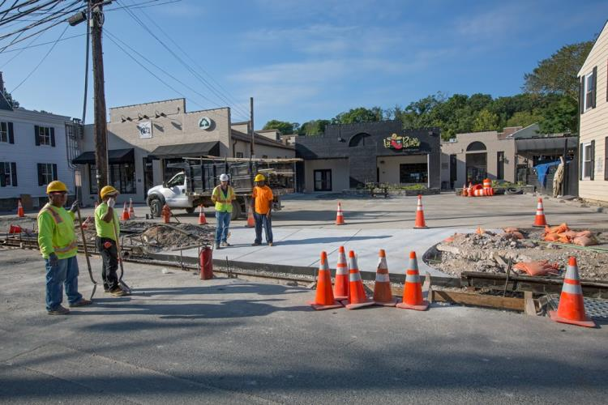
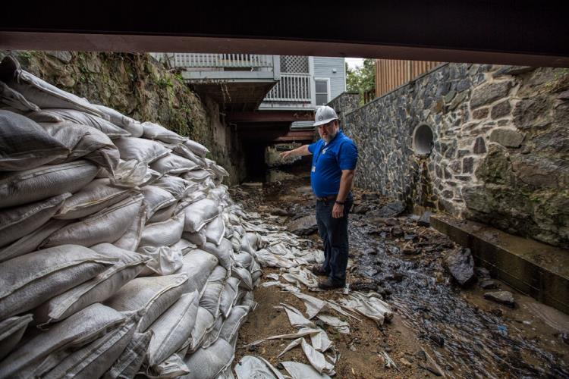

Slide 45
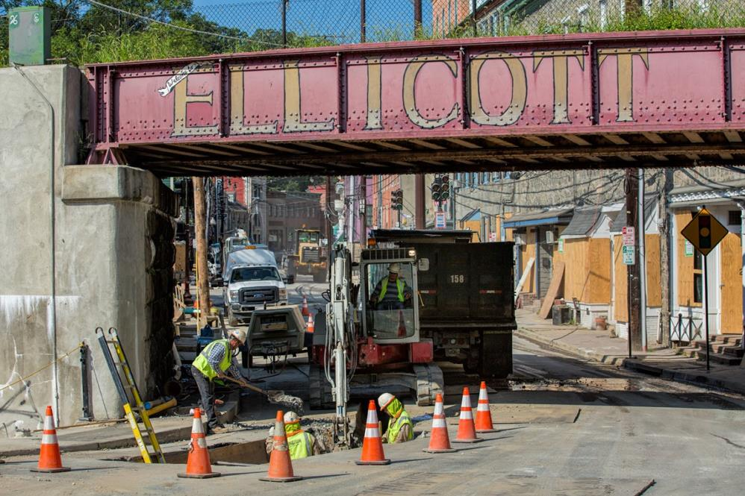

Slide 46
Engineers/ Designers
Flood Study
Ideas to be assessed in a long-term process
Master Plan Spring through Fall 2017
Economic Recovery
Meeting Nov. 10
County’s Senior Staff
Meeting Dec. 1
Flood Work Group
Plan Implementation
Ready to go strategies
CAG Members
Meeting Dec. 10
Implementation
Historic Preservation

Slide 47
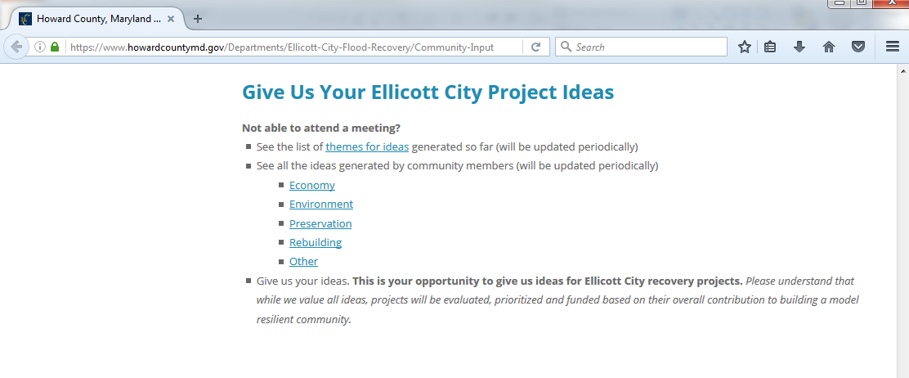
Screenshot of project ideas on website
Contribute Online At: www.ECstrong.org

Slide 48
Project Idea Themes
Rebuilding/Infrastructure
Parking areas
Sidewalks
Utilities
Retention
Public amenities
Channel improvements
Transit
Streets
Flood gate
Environment
Native planting
Improving open space
Stormwater management
Environmental education
Economy
Business preparedness
Public access to historic sites
Small business assistance
Marketing and branding of Main Street
Arts and entertainment district
Preservation
Historically appropriate restoration and rehabilitation
Historical education
Historic building maintenance
Other
Healing
Public safety
Regulatory measures
Expand County staff dedicated to flood mitigation and preparedness
Flood insurance

Slide 49
Table Discussion
Rebuilding and the Environment

Slide 50
Rebuilding and Environment
REBUILDING: Rebuild Historic Ellicott City with an emphasis on resilient infrastructure through flood mitigation
ENVIRONMENT: Pursue and implement projects that ensure the continued vitality of our natural resources in pursuit of a sustainable quality of life

Slide 51
Rebuilding and the Environment
How well do these rebuilding and environment themes represent the kinds of projects we will need to consider during recovery?
What critical themes seem to be missing in either of these categories?

Slide 52
Individual Task
Fill out Project Idea template; hand to table facilitator

Slide 53
Theme Team

Slide 54
Compelling & Applicable Ideas for EC Recovery: THEMES
Stormwater management through stricter regulations, green infrastructure, retention, etc.
Better upstream and upland water management
Utilize multi-tier approach involving all levels of government
Have Howard County complete the EPA flood checklist
Stricter policies on future development that lessens negative impact

Slide 55
Critical Ideas/Themes Missing
Review impact of Main St. and sidewalk
  Repairing/rebuilding where the water is going
Access to the river as an amenity and mark with plaques
Maximize outdoor seating
Small tree planting to break up asphalt
Make river buffers wider

Slide 56
Who do you think has a responsibility for reducing flooding risk? PRESS ALL THAT APPLY
Federal Government
State of Maryland
Howard County Government
The people in the area affected (myself, my neighbors)
Other
30 of 85

Slide 57
What are things I’m ready to commit to doing to help the environment and the rebuilding process? (press all that apply)
Volunteer my time to clean up the streams or storm drains
Landscape my property to accommodate stormwater
Install a rain barrel(s) at my home or business
Stay involved in the master plan process
Donate to organizations working to rebuild Ellicott City
Prepare a household flood plan/flood proof ground floor
Other
30 of 85

Slide 58
Monica Fabbri, Secretary
Ellicott City – Long Term Recovery Committee (EC-LTRC)

Slide 59
Bill Withers, Board member
Ellicott city partnership (Ecp)

Slide 60
Julija Sajauskas, Director
Roger Carter community Center

Slide 61
Next Steps
Oct 18
Nov 10
Nov 26
Dec 1
Dec 10
Master Plan Process
Spring – Fall 2017
Most Impacted
Rebuilding & Environment
Small Business Saturday
Rebuilding & Economic Development
Rebuilding & Historic Preservation

Slide 62
Visit us at www.ECstrong.org
Thank you!

