Slide 1

Linda Hamill
410-491-7214
Linda1980@mediacombb.net

Slide 2

Visit SSA Website or Call!
www.ssa.gov
-or-
1-800-772-1213
TTY 1-800-325-0778
Notes:
You may wish to use this slide to introduce our online services offered on the next slide.

Slide 3
History - Social Security’s Programs
1935
Retirement Insurance
1939
Survivors Insurance
1956
Disability Insurance
Notes:
At the height of the Great Depression, President Roosevelt was able to obtain support for the Social Security Act. Social Security legislation was passed in 1935. At that time, the program was solely a retirement program. The extremely high unemployment rate highlighted the vulnerabilities of older workers in America. During tough economic times, older workers tended to be the last hired, the first fired. The need for a social safety net became more apparent and Social Security Retirement Insurance became a reality. The basic tenets of this social insurance program are to provide:
Individual Equity – You earn the benefits you receive. The more you earn, the higher your benefit will be.
Social Adequacy – Social Security provides a financial foundation which protects all workers.
In 1939, a year before Social Security began paying monthly retirement benefits, the social safety net expanded with the Survivors Insurance Program. Again during difficult economic times, the vulnerability of widows(ers) and children became even more apparent.
In 1956 the Social Security Disability Insurance Program became law. Then, as now, for most workers in America Social Security is the only comprehensive disability insurance policy that they have.
The Social Security program has largely realized its’ goals. And almost 15 million workers and family members currently receive Social Security disability and survivors insurance benefits.

Slide 4
Other Programs
1965
Medicare
1972
Supplemental Security Income
2003
Medicare
Part D
Notes:
In 1965, Medicare was added to the Social Security legislation. This program is the medical coverage you get when you turn 65 or become disabled.
In 1972, the Supplemental Security Income program was created. SSI is a program based on need for those that are 65 or older, blind or disabled. Prior to 1972, each State had its own similar program. Since Social Security had a network of offices across the country and already administered programs based on age or disability, responsibility for SSI was shifted to the Social Security Administration. Although SSI is administered by Social Security, the SSI benefit payments and the administrative costs of running the program come from general tax revenue and not Social Security taxes.
In 2003, Medicare Part D legislation was passed, In 2006 the Plan, or Medicare Part D, went into effect, helping to meet drug costs for millions of Medicare beneficiaries.

Slide 5
Medicare Coverage
Part A Hospital Insurance
    Covers most inpatient hospital expenses.
2017 Deductible $1,316.00
Part B Supplementary Medical Insurance
    Covers 80% doctor bills & other outpatient medical
    expenses after 1st $183 in approved charges.
    2017 Monthly Premium ^{$134.00}
Part D Medicare Prescription Drug Plan
    Covers a major portion of prescription drug costs
    for Medicare beneficiaries.
Notes:
You may wish to remind your audience that there is no monthly premium for Part A if they are insured for retirement benefits.
Many people question the need to file for Part B of Medicare. They should be reminded that their health insurance when they retire will pay only after Medicare pays. Many supplemental plans actually require people to file for Part B. The Medicare premium that beneficiaries pay represents 1/4 of the actual cost; the federal government covers the balance of the cost.
Part D Medicare Prescription Drug Plan covers a major portion of prescription drug costs for Medicare beneficiaries. Average monthly premium $27.35.

Slide 6
Other Programs
1965
Medicare
1972
Supplemental Security Income
2003
Medicare
Part D
Notes:
In 1965, Medicare was added to the Social Security legislation. This program is the medical coverage you get when you turn 65 or become disabled.
In 1972, the Supplemental Security Income program was created. SSI is a program based on need for those that are 65 or older, blind or disabled. Prior to 1972, each State had its own similar program. Since Social Security had a network of offices across the country and already administered programs based on age or disability, responsibility for SSI was shifted to the Social Security Administration. Although SSI is administered by Social Security, the SSI benefit payments and the administrative costs of running the program come from general tax revenue and not Social Security taxes.
In 2003, Medicare Part D legislation was passed, In 2006 the Plan, or Medicare Part D, went into effect, helping to meet drug costs for millions of Medicare beneficiaries.

Slide 7
Supplemental Security Income
Who Can Get SSI?
  Age 65 or older
  Blind - any age
  Disabled - any age
  Limited income
  Limited resources
Notes:
2007 Individual Couple
Federal Payment Standard $623/mo. $934/mo.
Resource Limits $2,000 $3,000
SSI paid over 7 million recipients in 2006… over 1 million elderly and about 6 million disabled (including about 1 million children).

Slide 8

Are You Eligible to Receive Social Security?
Are you old enough?
  Age 62
Have you worked enough?
  10 Years (40 Credits)
Example: To earn a credit in 2017, you must earn at least $1,300 (or $5,200 to earn all four.) Earning 40 credits throughout your working life will qualify you for a retirement benefit.
Notes:
Although we have not officially used the phrase “quarters of coverage” since 1978, many workers still refer to credits as quarters. Prior to 1978, a worker earned a quarter of coverage for any calendar quarter in which they earned $50 or more in Social Security wages. Beginning in 1978, wages were reported to Social Security on an annual basis via the W-2 form. We have no idea and it doesn’t matter when in the year the wages were earned.
In 2007, when a worker earns $4,000 or more, he or she has earned their 4 credits for the year ($1,000/credit).
Since a worker only needs 40 credits throughout his or her working career, it is relatively easy to become insured (vested) for a Social Security Retirement Benefit.
In the year 2007, the Maximum Earnings Taxable is $97,500.
www.socialsecurity.gov/pressoffice/factsheets/colafacts2007.htm

Slide 9
In Addition to the Retiree,
Who Else Can Get Benefits?
Your Spouse
At age 62
At any age if caring for child under 16
or disabled
Divorced spouses may qualify
Your Child
Not married under 18
(under 19 if still in high school)
Not married and disabled before age 22
Notes:
If a spouse is caring for a child under age 16 of the worker, the spouse could qualify regardless of age. When the youngest child turns 16, the spouse’s benefit will stop, even though the child’s benefit will continue.
A divorced spouse could receive a benefit as long as he or she was married at least 10 years. It is possible that more than one spouse could receive a benefit, without penalty or reduction.

Slide 10
How Social Security Determines Your Benefit
Social Security benefits are based on earnings
Step 1 Your wages are adjusted for changes in wage levels
Step 2 Find the monthly average of your 35 highest
earnings years
Step 3 Result is “average indexed monthly earnings”
Notes:
This slide provides an overview of the first step that we use in computing a benefit. We are looking for the highest 35 years during a worker's lifetime of earnings, regardless of when earned.
This formula also makes clear how a worker who qualifies for a retirement benefit with just 10 years of work would have a low benefit payment. Since we are looking for their highest 35 years, in this example, we would be adding in 25 zero years. Needless to say, this worker would be receiving a lower benefit. There is, however, no such thing as a minimum benefit.

Slide 11
Full Retirement Age
Year of Birth Full Retirement Age
1937 65
1938 65 & 2 months
1939 65 & 4 months
1940 65 & 6 months
1941 65 & 8 months
1942 65 & 10 months
1943 – 1954 66
1955 66 & 2 months
1956 66 & 4 months
1957 66 & 6 months
1958 66 & 8 months
1959 66 & 10 months
1960 & later 67
Notes:
The increase in full retirement age was the result of the 1983 Amendments. Full retirement age increases apply to all Retirement Benefits and to Survivors Benefits. Although, we at Social Security have always used the term “full” retirement age, you may find that some people now refer to “full retirement age” as “Normal Retirement Age”.
The Medicare eligibility age of 65 has not changed.
Regardless of your full retirement age, reduced benefits can still be paid as early as age 62.

Slide 12


You Can Work & Still Receive Benefits-2017
You Can If You Make More,
If You Are Make Up To Some Benefits Will
Be Withheld
Under Full
Retirement Age $16,920/yr. ($1,410/mo.) $1 for every $2
The Year Full Retirement
Age is Reached $42,880/yr. ($3,740/mo.) $1 for every $3
Month of Full Retirement
Age and Above No Limit No Limit
Notes:
In the year that an individual reaches full retirement age, they are subject to a different annual earnings test. In that year, for the months prior to attaining full retirement age, individuals can earn up to $34,440/year ($2,870/mo.) without affecting their benefits. For every $3 in earnings above the limit, one dollar in benefits will be withheld. At full retirement age there is no limit on the amount beneficiaries can earn without affecting their benefit payments.
The annual retirement earnings test exempt amounts are increased annually by the average increase in wages in the U.S.

Slide 13
Should I start collecting benefits at age 62?
Are you working??
$2,000 Full Retirement Age
X 75%
$1,500 per month at age 62 X 48 months = $72,000.00
$72,000.00 divided by $500 = 144 months

Slide 14
Social Security
Age 70?
$2,000 Age 66- Full Retirement Age
X 32% (8% per yr)
$2,640
Not Receiving $96,000 between age 66 and 70 to gain $640.00 per month.
$96,000 divided by $640 = 150 months
82 ½ yrs old to break even

Slide 15
Were you born 1/2/54 or earlier?
An option at Full Retirement Age:
  restrict your own benefit, and
  file on your spouse’s work record to receive 50% of his/her full benefit provided he/she is receiving benefits or met the requirement to file and suspend before 5/5/16.
  This will allow your benefit to increase at 8% each year between FRA and age 70.

Slide 16
When to File?
Age 62 – depending on wages
January of year you attain full retirement age
Full Retirement Age – regardless of wages
Age 70 – No later than
Check out benefits on current/prior spouses (living or deceased)
NO RIGHT OR WRONG

Slide 17
Who Can Get Survivors Benefits?
Widow or Widower:
Reduced benefits at age 60
If disabled as early as age 50
At any age if caring for child under 16 or disabled
Divorced widows/widowers may qualify
Your Child if:
Not married under age 18 (under 19 if still in high school)
Not married and disabled before age 22
Notes:
You may wish to explain how a widow or widower can receive a survivors benefit at age 60 and then switch to a benefit on his or her own work record at age 62. Or, how a widow or widower could receive a reduced survivors benefit at age 60 and then file for an unreduced benefit on his or her own work record at full retirement age.
Regardless of the change in full retirement age, a widow(er) can still receive 71-1/2% at age 60

Slide 18
Prepare for Your Retirement
Thank you
Linda Hamill
H- 410-491-7214
1-800-772-1213
TTY 1-800-325-0778
www.ssa.gov
Notes:
It is important to remind all people over the age of 62 to contact us before January about filing for benefits. Since there is no retroactivity, if “charge off” months are involved, they may have to file in January, even if they plan to stop working some months after January. Based on their estimate of earnings, we will be able to advise them exactly when they should file.
All new applicants will be paid their benefit on the 2nd, 3rd, or 4th Wednesday of the month.
Social Security beneficiaries who retire abroad or who receive both Social Security and Supplemental Security Income (SSI) payments will receive their Social Security payments on the third of each month, as under prior practice.

Slide 19
Ask these questions

Slide 20

Who Gets Benefits from Social Security?
55 Million People
10.6 million Disabled Workers,
6.3 million
Widows/ Widowers
1.9 million
Children of Deceased Workers
38.4 million Retired Workers
6/2006
Notes:
This graph is an overview of the number of beneficiaries that we pay. Currently, about one in every six people in America is receiving a Social Security benefit. It can be used to reflect the fact that the majority of our beneficiaries are retired.
It also represents the fact that Social Security is more than retirement...it is a family protection plan (almost 1/3 of the beneficiaries are disabled, dependants of disabled, or survivors).

Slide 21
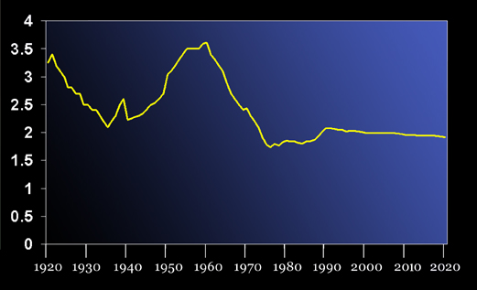

U.S. Birth Rate 1920-2020
Children Per Woman
Notes:
This graph represents another demographic problem confronting Social Security’s future. As the chart shows, the fertility rate in 1920 was about 3.2 children for all women of childbearing age. During the depression the rate declined dramatically. After World War II a major increase in the fertility rate took place - the baby boom generation. Since 1960, there has been a major decline in the rate. This means there will be fewer future workers to support this large generation of baby boomer retirees.

Slide 22

Social Security’s Online Services
Retirement & Disability Applications
Retirement/Survivors/Disability Planner
Medicare Card Replacements
Request a Statement
Request a Benefit Verification Letter
Change of Address
Notes:
Depending on your audience, you may wish to briefly describe the quick calculator, online calculator and the detailed estimate.

Slide 23
Who Can Get Medicare?
65 & older
-or-
Receiving Social Security disability
benefits at least 24 months
-or-
Permanent kidney failure
-or-
Amyotrophic Lateral Sclerosis (ALS)
Notes:
You may wish to remind your audience that although the full retirement age has been increased above age 65, Medicare eligibility is still age 65.

Slide 24

When Can I Sign Up for Medicare?
Medicare Enrollment Periods:
  Initial - at age 65
  Special - if still working
  General - January-March
Notes:
The Initial Enrollment Period starts 3 months before the month that you turn age 65 and extends 3 months past the month that you turn 65. If you are not receiving benefits, you should inquire about filing for Medicare 3 months prior to turning age 65 so that your coverage can start the month you turn 65. If you are receiving benefits, you will receive your Medicare card generally about a month before turning age 65, reflecting your Part A and Part B coverage (most people choose Part B, even though it's optional).
The Special Enrollment Period is for people (and their spouses) who continue to work past age 65. Since Medicare pays second after their employer group health plan pays first, they are not required to file for Part B. Since Medicare pays second there may be no need for Part B coverage. It is extremely important for workers to check with their employer group health plan for specific guidance. For this reason, they are offered a special period in which to file for Medicare. As a general rule, we can recommend that people file for Part A 3 months prior to turning age 65, and then on the day they stop working call SSA to file for Part B.
The General Enrollment Period is for those people who missed their Initial or Special Enrollment Periods. The window to file is January to March with coverage not beginning until July. Anyone filing in the General Enrollment Period will be assessed a 10% penalty for each year after the Initial period.

Slide 25
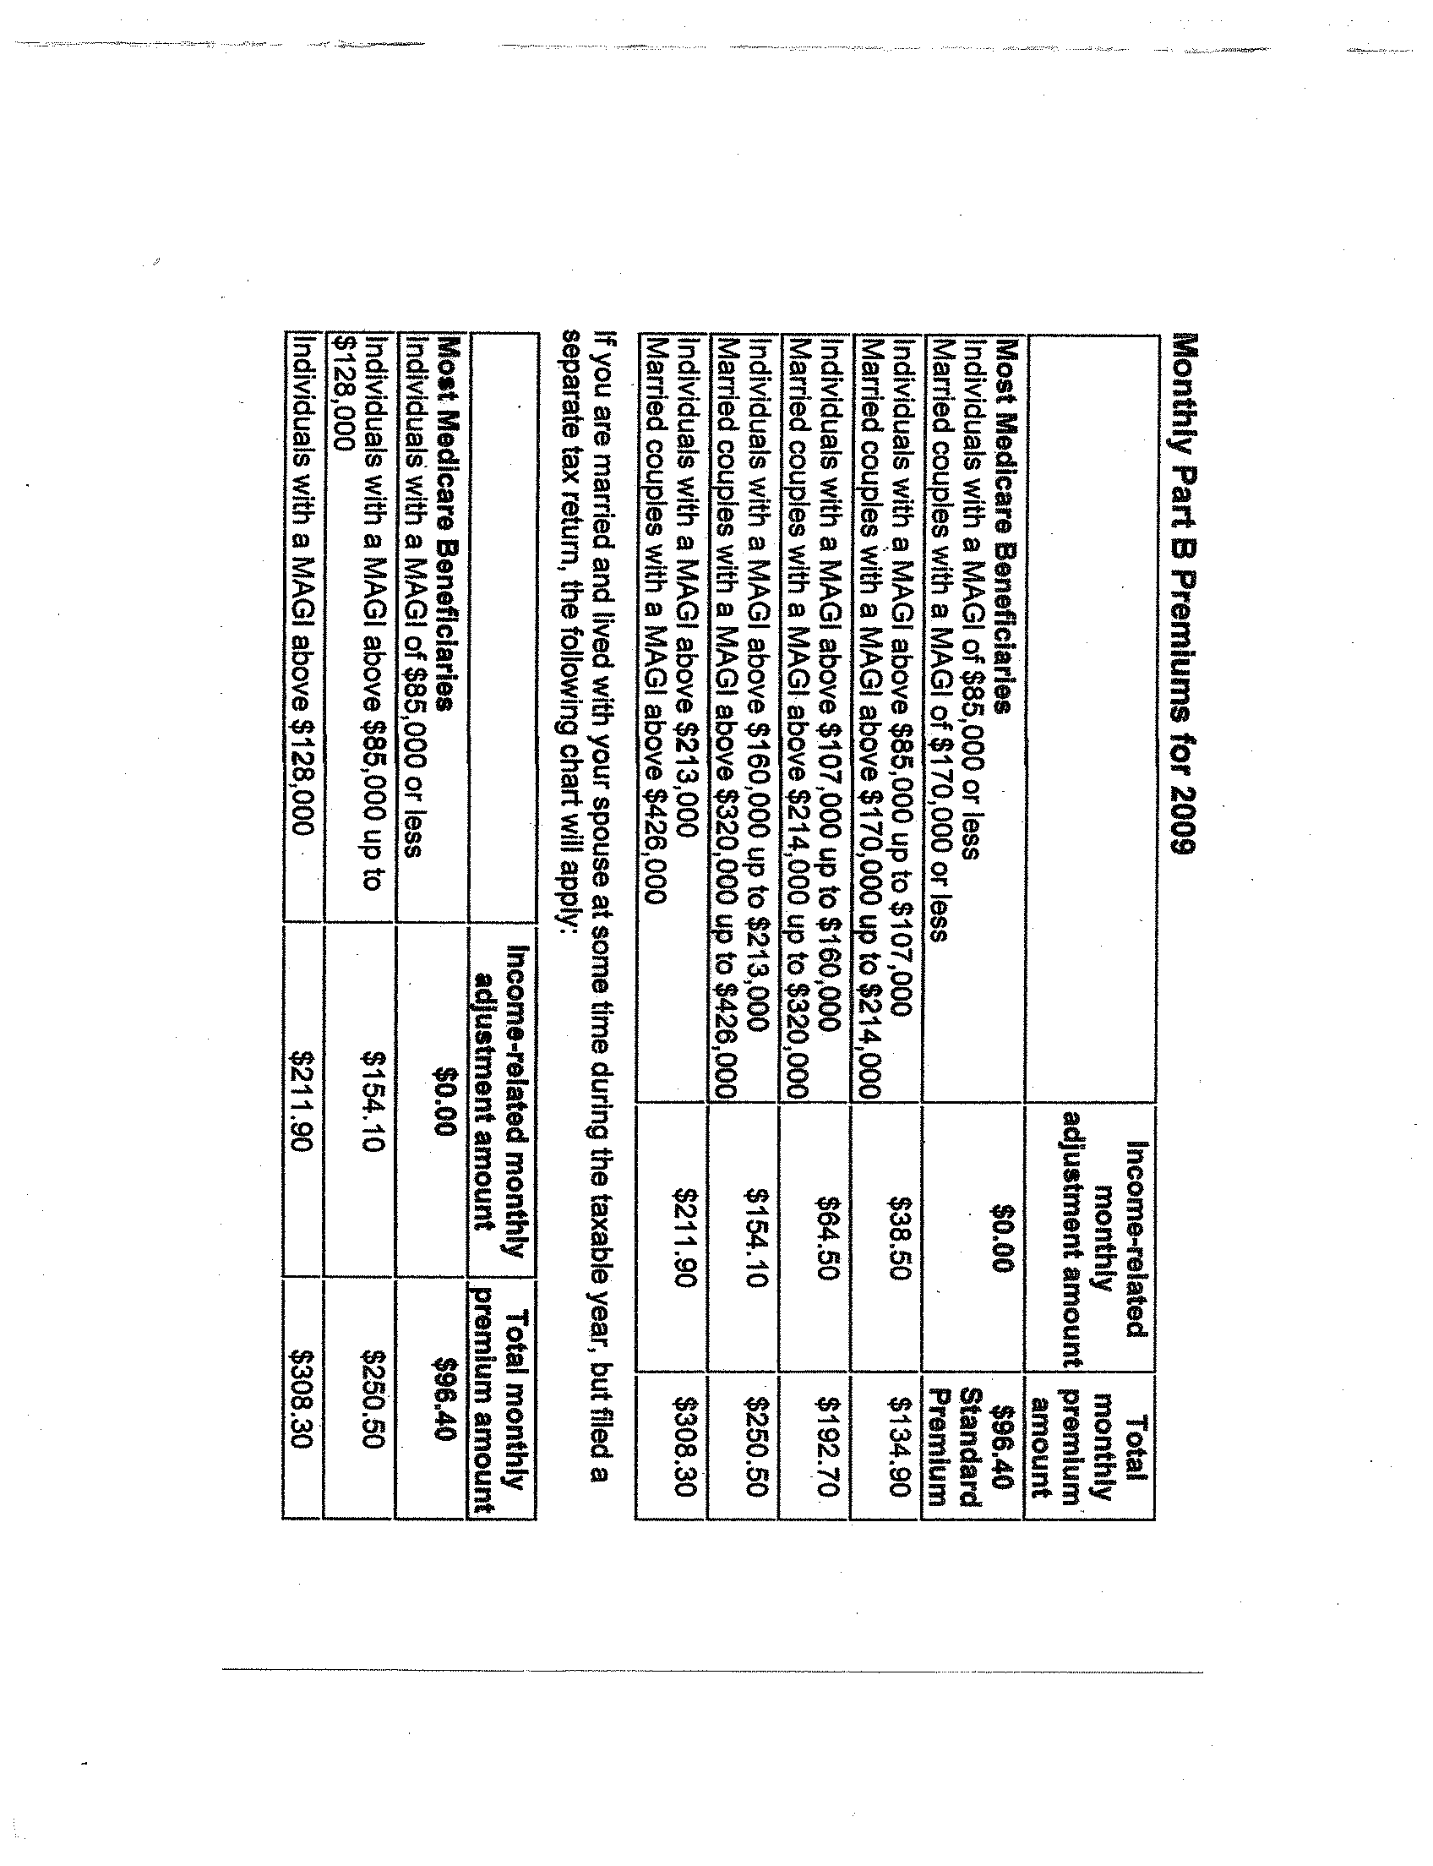
Monthly Part B Premiums for 2012
If Your Yearly Income in 2010 was |  | You pay
File Individual Tax Return | File Joint Tax Return
$85,000 or less | $170,000 or less | $99.90
above $85,001 up to $107,000 | above $170,001 up to $214,000 | $139.90
above $107,001 up to $160,000 | above $214,001 up to $320,000 | $199.80
above $160,001 up to $214,000 | above $320,001 up to $428,000 | $259.70
above $214,000 | above $428,000 | $319.70

Slide 26
For More Information
1-800-MEDICARE
(1-800-633-4227)
TTY 1-877-486-2048
www.medicare.gov

Slide 27
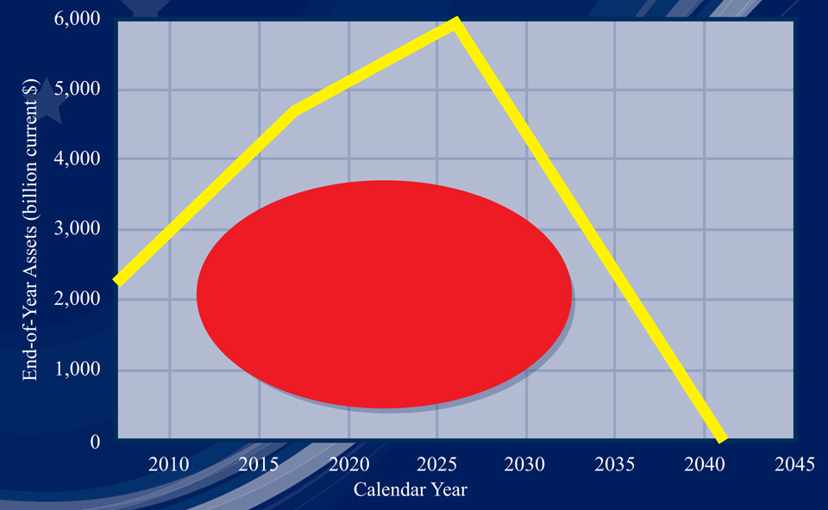
27
In 2017, Social Security Will Begin Paying
More in Benefits Than is Collected in Taxes
At exhaustion in 2041,
only about 75% of
benefits could be paid.
Notes:
After 2041, only about 75% of benefits could be paid if no changes are made.

Slide 28
Social Security’s Disability Definition:
A medical condition preventing substantial
work for at least 12 months, or expected to
result in death. The determination also
considers age, education & work experience.
Notes:
The actual disability definition makes the clear distinction between SSA’s disability requirements compared to other disability programs, such as Veterans and Workman’s Compensation.

Slide 29


Who Can Get Disability Benefits?
Worker
Must have paid into Social Security five out of last 10 years
Spouse
At age 62
At any age if caring for child
under 16 or disabled
Divorced spouses may qualify
Notes:
The discussion of factors of entitlement is rather direct. SSA’s disability definition is based on your medical condition and the fact that you are not expected to be able to do any work for at least 12 months or your condition is terminal. This work determination is based on your age, education and work experience.
For people that pay into Medicare only (e.g., CSRS employees), and not Social Security, it is important to remember that they should file for a Social Security disability decision, since they could become eligible for Medicare 25 months after we otherwise could have paid them a cash benefit.
After becoming eligible for a disability benefit, the law requires us to review the continuing disability (CDRs) generally every 3 to 7 years, depending on the severity of the disability.

Slide 30

Who Can Get Disability Benefits?
Child
Not married under age 18
(under 19 if still in high school)
Not married and disabled
before age 22
Notes:
The children’s category is offered here as in the Retirement and Survivors Benefits Sections.

Slide 31
Prepare for Your Retirement
Thank you
Linda Hamill
1-800-772-1213
TTY 1-800-325-0778
www.socialsecurity.gov
Notes:
It is important to remind all people over the age of 62 to contact us before January about filing for benefits. Since there is no retroactivity, if “charge off” months are involved, they may have to file in January, even if they plan to stop working some months after January. Based on their estimate of earnings, we will be able to advise them exactly when they should file.
All new applicants will be paid their benefit on the 2nd, 3rd, or 4th Wednesday of the month.
Social Security beneficiaries who retire abroad or who receive both Social Security and Supplemental Security Income (SSI) payments will receive their Social Security payments on the third of each month, as under prior practice.

Slide 32
America Is Getting Older
U.S. Population Age 65 & Older
70 Million
2030
(19% of total
population)
38 Million
2007
(12% of total
population)
11 Million
1946
(7% of total
population)
Notes:
This slide is offered as a graphic representation of the impact of changing demographics. The combined pressures of a massive baby boom generation
and increasing life expectancy will result in an American population with almost
20% of our projected population over the age of 65 by the year 2030.

Slide 33
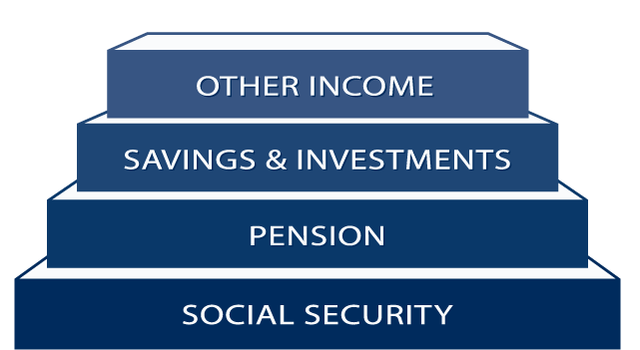
A Foundation for Planning Your Future
33
Notes:
Social Security provides a foundation on which to build retirement security.

