Slide 1

Planning Board
Workshop
August 6, 2019

Slide 2
Agenda
What is a General Plan?
Why an Update?
Context
Preliminary Plan Objectives
Process
Q and A

Slide 3
What is a General Plan?
PlanHoward 2030 is our long-range plan for all of Howard County
Guides decisions related to development, land preservation, changing demographic and employment trends, neighborhood sustainability, capital projects, County services
Basis for land use decisions made by the Planning Board, County Council, and Zoning Board

Slide 4
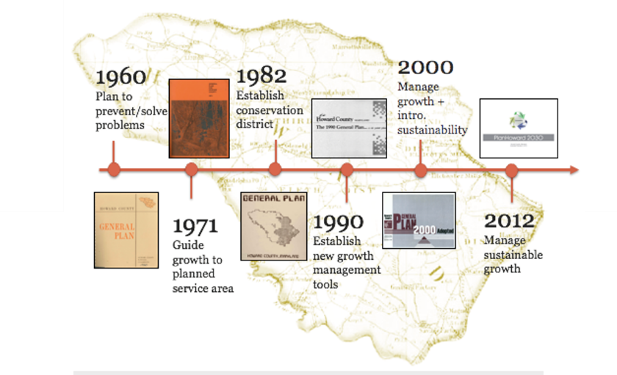

Slide 5
Why an Update?
PlanHoward 2030 is scheduled for an update
2017-18 assessment of the County's zoning and land development regulations identified policy issues
Key issues: concerns about the character and quality of development, neighborhood infill projects, the adequacy of public infrastructure, and environmental protection
Notes:
over 50 public meetings (over 700 comments)

Slide 6
Context
Howard County is largely built out with limited greenfield opportunities
PSA (Public Service Area) divides the county:
  West is primarily agricultural land and low-density residential
  East is established suburban communities, commercial, industrial and employment corridors
  Columbia has urbanizing town center with a mix of high density residential, commercial and employment uses

Slide 7
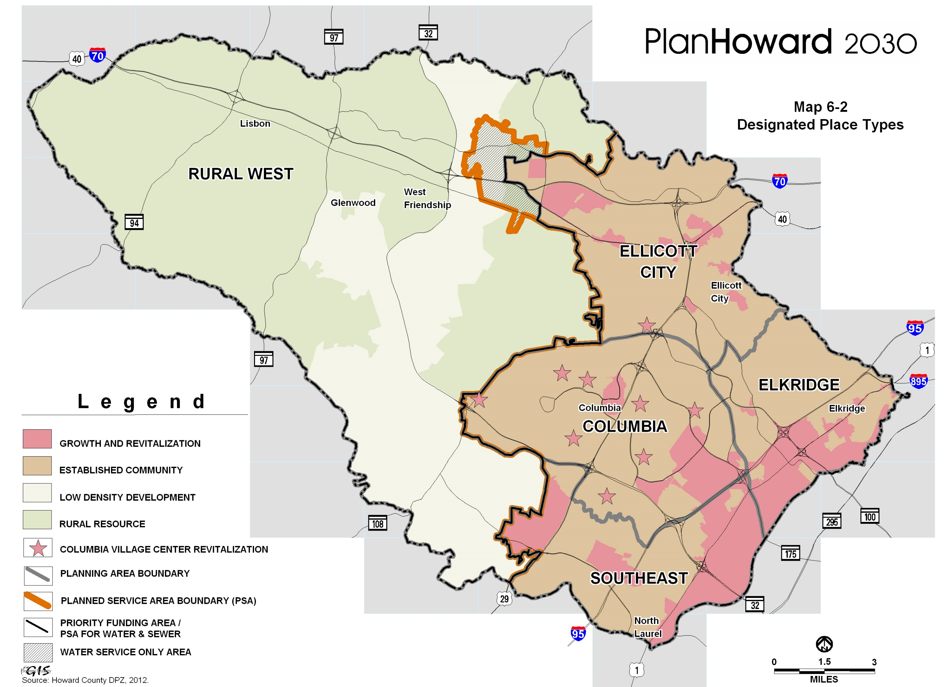

Slide 8
Context
Future growth will be characterized by infill and redevelopment
Consider location, quality, and design of future development
Based in fiscal realities to ensure economic vibrancy
Notes:
Key piece will be to look at the fiscal impacts of growth scenarios to see how it affects our local economy and county services

Slide 9
Plan Objectives
Physical approach to planning – functional, flexible, and based in economic reality
Innovative public outreach/communications strategy
Educate the public through learning techniques and communicate long range implications of comp planning
Notes:
Proactively and positively communicate with the public so they understand and can participate in every step of the process, with an emphasis on those historically underrepresented in planning efforts.
2) Present information in an engaging and understandable manner through both traditional and modern approaches such as; interactive and visual tools, video, social media, web and on-line platforms, media relations, outreach, and other tactile communications

Slide 10
Plan Objectives
Evaluate the fiscal and economic impacts of growth
  - guide future zoning decisions
  - identify areas to preserve, enhance and transform
Conduct a targeted market analysis
Address environmental challenges and natural threats
  - identify policies and strategies for a resilient community
Notes:
Market Analysis – we know residential demand will remain strong in Howard county and regionally so we expect the Plan to focus on future demand of office, industrial, employment, and commercial uses in the context of our regional location and economy.
Concurrent Housing Master Plan that will look at housing types and affordability

Slide 11
Plan Objectives
Focus on the character and quality of infill development, redevelopment, and environmental protection
Provide guidance for a future Unified Development Code
Plan for economic, transportation and demographic trends; climate and market changes
Is forward thinking vision for the County with corresponding policies and guidance to implement the Plan over the next 20 years
Notes:
Emerging Trends- autonomous vehicles (artificial intelligence), on-line retail, automated employment, natural disasters, renewable energies, etc.

Slide 12
New Town Framework
Development Regulation Assessment recommended new approaches to the New Town zoning regime
Need to develop a planning framework for New Town prior to any zoning changes that:
  Defines the character that makes Columbia unique and incorporates Rouse principles
  Identifies areas to preserve, enhance and transform
Notes:
What is the character that makes Columbia unique
How can it be preserved and allow for redevelopment over the next 20 years
What is the future of the major commercial/industrial corridors
How to address an aging housing stock
What are opportunities for Gateway given its location and potential to be an economic driver

Slide 13
Process
Expressions of interest due August 21, 2019
Selection Committee will select up to three consulting firms/teams to submit Scopes of Service and Budget for the project
Concurrent informational meetings to help develop the scope and guide selection
Consultant selection November, 2019
Plan kick off – early 2020

Slide 14
Process
Howard Code Title 16, Subtitle 9 - Planning Board requires that:
  “….the Planning Board prepare general guidelines to be used by DPZ in the preparation and/or revision of the general plan.”
  The Council adopt the guidelines prior to formulation of the general plan
Notes:
Historically there is no standard format for these guidelines and the code is very general in its direction
Other jurisdictions – have a scope of work approved by PB, some have written procedures or public participation plans be adopted early on by PB or council

Slide 15
Process
Task 1: Develop a strategic framework for the planning effort that:
    Serves as a road map for the planning effort
    Address process and topics
    Is research driven and employs a combination of best practices and new approaches
    Tailored to Howard County’s unique needs
Notes:
We are proposing our approach include these procedural elements.
PB to consider that the first task once we hire a consultant would be to develop a strategic framework for the entire effort that would serve as guidelines
Framework or guidance would address process and topics; Cookbook of things to look at

Slide 16
Process
Strategic framework to be adopted by Council and Planning Board as an initial phase
Followed by drafting of plan over 18-24 months
Community engagement will occur throughout

Slide 17
Planning Q&A
1) What key elements or issues do you want to see included in the general plan update?
2) Are there any specific skills that the County should seek from a consulting team?
3) What do you think about having a detailed strategic planning framework as guidance for the process?
4) What are the critical elements of the public engagement process to consider?

