Slide 1

Zoning Regulation
Amendments (ZRA)
ZRA 183- Councilmembers
mary kay Sigaty & greg fox (Petitioners)

Slide 2
Background/History
 | Current Regulations
Mulch Manufacture | RC and RR – Conditional Use (not allowed on Ag Preservation) By-right in M-1 and M-2
Yard Waste Composting | Conditional Use in RC, RR and M-1 (not M-2)
Composting Facility | Category deleted was deleted so not allowed anywhere
Mulch Manufacture has remained a by-right use in M-1 and M-2
Composting Facilities are currently not permitted in any zoning district- needs to be addressed

Slide 3
Background/History
Wood Processing Task Force- (CR 74-2014)
Met July 2014- February 2015. Discussion topics included:
  Water pollution of wells, streams and groundwater
  Airborne pollutants
  Noise (equipment and trucks)
  Road and bridge damage
  Visibility of facilities from surrounding properties
  Fire hazards
  Scale on Ag Pres parcels
Majority Report- 18 categories of recommendations on NWWR and Composting

Slide 4
Background/History
Dayton Rural Preservation Society- submitted ZRA 160 August, 2015
Mulch Work Group (MWG) November 2015- March 2016
Participants :
  County technical staff (zoning, resource conservation, soil conservation, fire department, environmental services)
  2 individuals from farming community
  2 individuals from residential community
Purpose- sounding board for text amendments- became basis for ZRA 180

Slide 5
Background/History
May, 2017: ZRA 180 filed - drafted with input from:
  Fire and Rescue Services
  Howard Soil Conservation District
  Environmental Health Services
  DPZ Resource Conservation Division
  Economic Development Authority
  Office of Community Sustainability
July, 2017: CB 60 filed
November, 2017 CB 60 approved by Council (3-2) with amendments
December, 2017- amended CB 60 filed as ZRA 183

Slide 6
State Composting Regulations
Composting regulated by Maryland Department of the Environment (MDE) through General Permits and Individual Permits for Compost and Natural Wood Waste Processing.
MDE revised compost regulations in 2015- new regs. quite detailed and generally set rules for a General Permit.
County regulations intended to cover areas not regulated by MDE.
Notes:
General Permit - requires agreeing to a set of pre-published, detailed rules. A public hearing not required – you apply, you agree - permit issued.
Individual Permit - when rules either cannot be followed or will not be agreed to. You apply, you explain which rules you cannot follow and how the intent of the rules will be met, public meeting held - MDE considers issuing permit.
They apply to composting grass, leaves, vegetation, food scrap, manure, and in some cases animal carcasses.
Separate COMAR regulations apply to biosolids or sewage sludge.

Slide 7
Summary of On-Farm Exemptions
On-Farm Facilities
Exempt up to any size Composts only feedstocks generated on-site.* All compost used on-site.* 40,000 ft² exemption Feedstocks generated on-site* PLUS may accept Type 1 and manure/bedding off-site. Must have one of two agricultural plans that address certain aspects of the composting. No limitation on distribution of finished compost. 5,000 ft² exemption Pile height limits No limitation on feedstocks used or distribution of finished compost. Emergency animal mortality composting If approved by MDA.
  * “On-site” includes farm where composting takes place and other farms owned or controlled by same operator.
Notes:
Refer to Appendix A

Slide 8
Summary of Other Exemptions
Non-Farm Facilities
“Backyard” composting. Located at residence. Feedstocks generated onsite. Compost used onsite. 5,000 ft² exemption [SAME AS FOR FARMS]. Pile height limits apply. Animal mortality composting at government-managed site. For roadway or other maintenance. Composting at a solid waste acceptance facility (e.g. Landfill). Under Refuse Disposal Permit containing composting conditions.
Notes:
Included as Appendix A in staff report

Slide 9
Exemptions from Permits
Allowed by-right as accessory to principal farming operation
  Area <5,000 sf (50’ x 100’) – no permit.
  When all material is generated, composted, and used on farm – no permit.
  Farms where less than 40,000 sf is used “in support of composting” and where only vegetation and manure are composted and covered by a Nutrient Management Plan and other agricultural plans – no permit.
Notes:
These are exemptions relate to ZRA 183 because anything that doesn’t require an MDE permit is allowed by-right as an accessory use

Slide 10
Feedstock Types
Type 1
Yard waste (e.g. leaves, grass)
Type 2
Food scraps
Animal manure and bedding
Type 3
Sewage Sludge or Biosolids
Industrial food processing materials
Animal mortalities
Used diapers
Mixed municipal solid waste (MSW)
Compostable products
Non-recyclable paper
NWW
Natural Wood Waste (e.g. stumps, logs)
Notes:
Additionally, MDE classified different types of feedstocks which are then allowed in different types or (tiers) of facilities
Refer to page 5 of TSR

Slide 11
Facility Tiers
Tier 1
Accepts only Type 1 feedstocks
Tier 2 - Small
Type 1 and Type 2 feedstocks
Tier 3
Accepts Type 3 feedstocks (regardless of whether other feedstock types are also composted)
NWW Recycling Facility
Accepts only natural wood waste
Produces ≤ 10,000 cubic yards of compost per year
Tier 2 - Large
Type 1 and Type 2 feedstocks
Produces > 10,000 cubic yards of compost per year
NWW Recycling Facility Permit
Composting Facility (CF) Permit
(Unless subject to an exemption)
Refuse Disposal Permit or Sewage Sludge Utilization Permit
Notes:
Tier 1 Facility – composts grass, leaves and vegetation.
Tier II Small Facility – composts grass, leaves, vegetation, food scrap and manure. Generates less than 10,000 cy of product per year.
Tier II Large Facility – composts grass, leaves, vegetation, food scrap and manure. Generates more than 10,000 cy of product per year
Environmental protections get tighter with each step.

Slide 12
Regardless if permit required:
Apply to all composting facilities, even exempt ones.
A person may not engage in composting which will likely…
  Create a nuisance, harbor animals, cause an infestation of disease vectors.
  Cause air pollution or operate without a required air permit.
  Cause unpermitted discharge of pollutants to waters of the State.
  Harm the environment, create hazards to public health, safety, or comfort.

Slide 13
Proposed Text Amendments
ZRA 180 (CB 60 filed) |  |  | ZRA 183 (CB 60 as approved)
MDE Permit Not Required | MDE Tier I or Tier II Small Permit | MDE Tier II Large Permit | MDE Permit Not Required | MDE Tier I or Tier II Small Permit | MDE Tier II Large Permit
Accessory to principal use | By Permit < 3 acres accessory to a farm | Conditional Use - Up to 5 acres or 10 % | Accessory to principal use | By Permit < 3 acres accessory to a farm with 5% limit on retail sales | Not Permitted
 | All Other - Conditional Use - Up to 5 acres or 10 % |  |  | By Conidtional Use- up to 1 acre or up to 5 acres or 10% only if abutting an Interstate (does not need to be accessory to a farm)
Accessory to principal use | By Permit < 3 acres accessory to a farm | Not Permitted | Accessory to principal use | By Permit < 3 acres accessory to a farm with 5% limit on retail sales | Not Permitted
Accessory to principal use | By-Right | Conditional Use | Accessory to principal use | Conditional Use | Not Permitted
Accessory to principal use | By-Right | By-Right | Accessory to principal use | By-Right if don't abut residential | By Conditional Use if abuts residential
Accessory to principal use | By-Right | By-Right | Accessory to principal use | By-Right | By-Right
Notes:
Since the Planning Board reviewed this topic during the ZRA 180 deliberations, the TSR is structured in a way that compares both ZRA’s so the Planning Board is aware of what changes occurred beyond what they reviewed last time.
This presentation follows that trend and so staff is not going to focus on what is new or different from last time but I am happy to elaborate on anything along the way if the Board would like a refresher.
Reference Appendix C. To note: the text amendment that the PB reviewed as ZRA 180 was filed as CB 60. CB 60 was amended quite a bit through the course of deliberations and work sessions and the final bill that was approved is referred to as the amended CB 60, which is the same as ZRA 183.

Slide 14
Section 103.0 Proposed Definitions
ZRA 180 | ZRA 183
Adds definitions - Composting, Composting Facility, Natural Wood Waste Recycling and Natural Wood Waste Recycling Facility - align with COMAR | Adds same definitions except combines Composting and Composting Facilities Adds definition for Natural Wood Waste Recycling and Horticultural Nursery
Adds definitions - Sawmill, Bulk Firewood Processing Facility | No change
Horticultural Nursery: an agricultural operation primarily engaged in the growing, harvesting and primary processing of trees, shrubs and plants. Plant material shall be grown on the premises and may be purchased elsewhere at any stage of maturity for production on the premises. Horticultural nurseries may engage in accessory uses such as storage of plant materials and sale of products necessary for the health of the nursery stock.
Notes:
Clarifies that composting is allowed as an accessory use if no MDE permit is required
Adds definitions for NWW recycling to differentiate it from a facility and horticultural nursery which is a new term introduced through this legislation

Slide 15
Sections 104.0 (RC), 105.0 (RR), and 106.1 Preservation Easements
Amend Accessory Use Sections in RC, RR, and County Preservation Easements to:
Reference a new Special Farm Permit section (Section 128.0) for composting facilities accessory to a farming operation but require an MDE permit.
Accessory Use - a use that is customarily incidental to the principal use, serving no other use, and which is subordinate in area, intensity, and purpose to the principal use.
Amends 106.1 (County Preservation Easements) – Conditional Uses to allow NWWRF if accessory to a horticultural nursery
Notes:
These amendments are the same as ZRA 180 and amend the accessory use sections in RC, RR and County pres easement to….
However, there is one change for the CU section of 106.0 which pertains to county preservation easements. The term tree farm was replaced with horticultural nursery for NWWRF allowed on Ag Pres

Slide 16
Section 122.0 and 123.0
(M-1 and M-2)
Natural Wood Waste Recycling: Both ZRA’s and current regulations allow by-right in M-1 and M-2
Composting: see chart below
 | ZRA 180 |  |  | ZRA 183
 | MDE Permit Not Required | MDE Tier I or Tier II Small Permit | MDE Tier II Large Permit | MDE Permit Not Required | MDE Tier I or Tier II Small Permit | MDE Tier II Large Permit
M-1 | Accessory to principal use | By-Right | Conditional Use | Accessory to principal use | Conditional Use | Not Permitted
M-2 | Accessory to principal use | By-Right | By-Right | Accessory to principal use | By-Right if doesn't abut residential | By Conditional Use if abuts residential
Notes:
Note correction to appendix A
The difference is that ZRA 183 proposes to allow Tier I and Tier II Small composting facilities in M-1 only as conditional uses and rather than by-right in ZRA 180. Tier II would not be allowed in M-1 at all.
For M-2 ZRA 180 proposed to allow composting facilities by right. ZRA 183 only allows by right if they don’t abut residential- otherwise a CU

Slide 17
Section 104.0
Solid Waste (SW) Overlay
ZRA 180 | ZRA 183
Incorporates Tier I, Tier II and Tier III Composting Facilities into the Solid Waste Overlay District | Deletes Tier I and Tier II to avoid confusion since they are allowed elsewhere
Notes:
This more of a technical correction to avoid conflicts with other code sections

Slide 18
Section 128.0 Special Farm Permits
Allows Special Farm Permits for Tier I or Tier II-Small Composting Facilities- less than 3 acres
  Requires related MDE permits and operational plans be submitted to DPZ and Soil Conservation District evaluation
Amendments:
  On site retail sales: replaces limitation on types of vehicles with a limitation on yearly sales (< 5% of annual production)
  Nutrient Management Plan exemption if no outstanding IPA
  Require a site layout as part of permit application
  Verify compliance with permit requirements after 2 years
Notes:
A Special Farm Permit allows some oversight for facilities under 3 acres that don’t qualify for an MDE permit, yet primarily support a farming operation.
This allows for farms (only farms) to sell some finished compost with limitations
This section was amended in ZRA 183 to:
Replace the limitation of types of vehicles (was prohibition on commercial vehicles) with limitation on yearly sales – DPZ noted in staff report this is more difficult to enforce
Allows farmers to exceed the 5% if required by the nutrient management plan, but only if there is no outstanding Installment Purchase Agreement (IPA)- - DPZ will need to rely on the state to verity this requirement and may also be challenging to enforce will rely on Petition to explain the rationale for this
Requires a site layout be submitted and verification that the facility complies

Slide 19
Section 131.0
Conditional Uses
ZRZ 180 | ZRA 183
Deletes Yard Waste Composting CU category and replaces with Composting Facilities | No Change
Adds new CU category- Composting Facilities for Tier I and Tier II-small Composting Facilities in RR, RC and for Tier II-Large in RC, RR and M-1 | Composting category amended to delete Tier II large reference in RC/RR and include M-1, and M-2 properties abutting residential
Adds new CU category for NWWRF in RC, RR, and on ALPP properties if accessory to tree farm | Changes Tree Farm to Horticultural Nursery and amends size and location restrictions
Applies 17 conditions to new CU categories | Mostly same except for setbacks

Slide 20
Section 131.0
Composting Conditional Use
Description of Amendments:
Prohibits Composting Facility Conditional Use on MALPF and cluster subdivision preservation parcels, in addition to ALPP
Amends Maximum Use area related to size/ location:
  Less than 1 acre can be located anywhere in RC and RR
  Greater than 1 acre must abut an interstate and cannot exceed 5 acres or 10% of property
  Combined NWWR and Composting facilities are only allowed if property abuts an interstate and is located within 1 mile of an interchange
Deletes road frontage requirements consistent with new location requirements
Notes:
ZRA 180 only restricted size – the max use area could not exceed the lesser of 5 acres or 10% of the property. ZRA 183 restricts this further and adds location restrictions

Slide 21
Section 131.0
NWWRF Conditional Use
Apply ALPP restrictions for NWWRF Conditional Uses to MALPF
Prohibit NWWRFs on easements created through a cluster subdivision
Same maximum use area/location requirements as Composting for non-Ag Pres

Slide 22
Section 131.0- NWWRF on Ag Pres
ZRA 180 | ZRA 183
NWWRF must be accessory to tree farm, tree nursery or Christmas tree farm | NWWRF must be accessory to horticultural nursery
Use area is less than 15% of the area actively farmed in trees | Use area is less than 15% of the area in active production
Use area cannot exceed 2 acres | Use area cannot exceed 1 acre
Use area cannot exceed 2% of the easement | Retail sales cannot exceed 5% of annual production

Slide 23
Section 131.0 Conditional Use Criteria
Increase Setbacks:
  From existing dwellings on different lots: 300 ft to 500 ft
  200 ft from property line to 300 ft from residential lot

Slide 24
Section 131.0 Conditions
All other conditions remain the same:
  Evaluation by Howard Soil Conservation District
  Minimum lot size
  Compliance with State and other regulations
  Provisions for leachate and run-off disposal
  Restrictions on hours of operations
  Road capacity review
  Restricts on-site sales
  Remediation plan
  Setbacks, buffering, and screening

Slide 25
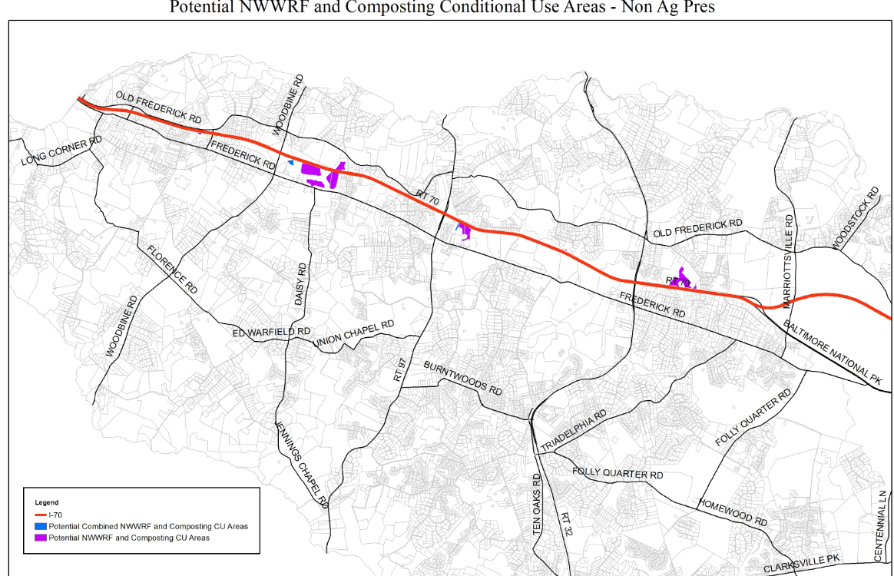
Eligible Sites
Notes:
Purple – abut and interstate and blue within 1 mile of an interstate interchange (combined facilities)

Slide 26
Recommendation
The Planning Board recommend approval of ZRA 183 to the County Council

