Slide 1

“REDEVELOP, CONNECT, PRESERVE”
PUBLIC BRIEFING
ROUTE 1 CORRIDOR MASTER PLAN
HOWARD COUNTY, MD
June 2019

Slide 2
U.S. Route 1 – “Redevelop, Connect, Preserve”
Public Meeting Agenda
2018-19 Public Workshop Recap – What we Heard you Say
Major Findings and Conclusions – What We’ve Learned
Develop, Connect and Preserve – What is the Vision for the Corridor?- Review of Route 1 Character Area Concepts
Implementation Strategies – How is This Time Going to be Different?
Work Station Discussions – What Are Your Thoughts?

Slide 3
PUBLIC WORKSHOP RECAP
“WHAT WE HEARD YOU SAY”

Slide 4
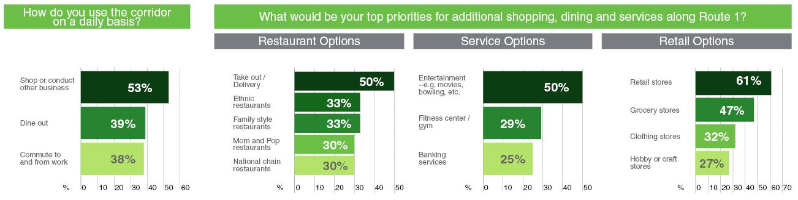
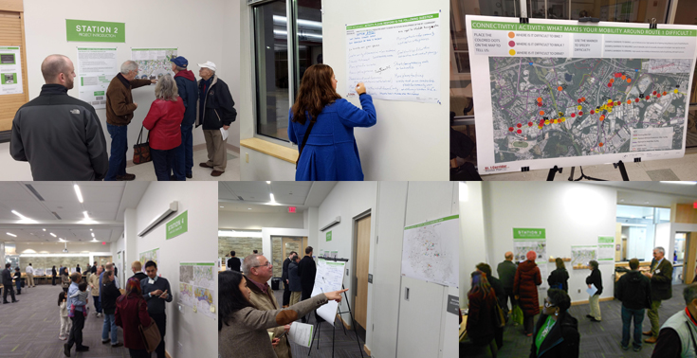
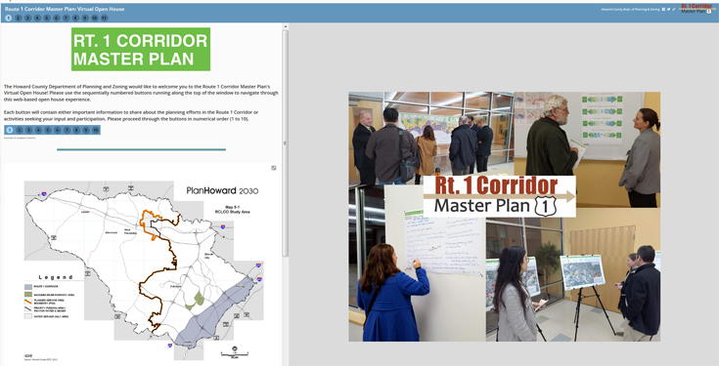
WHAT WE LEARNED FROM YOU | PUBLIC MEETINGS & ONLINE SURVEY RESULTS

Slide 5
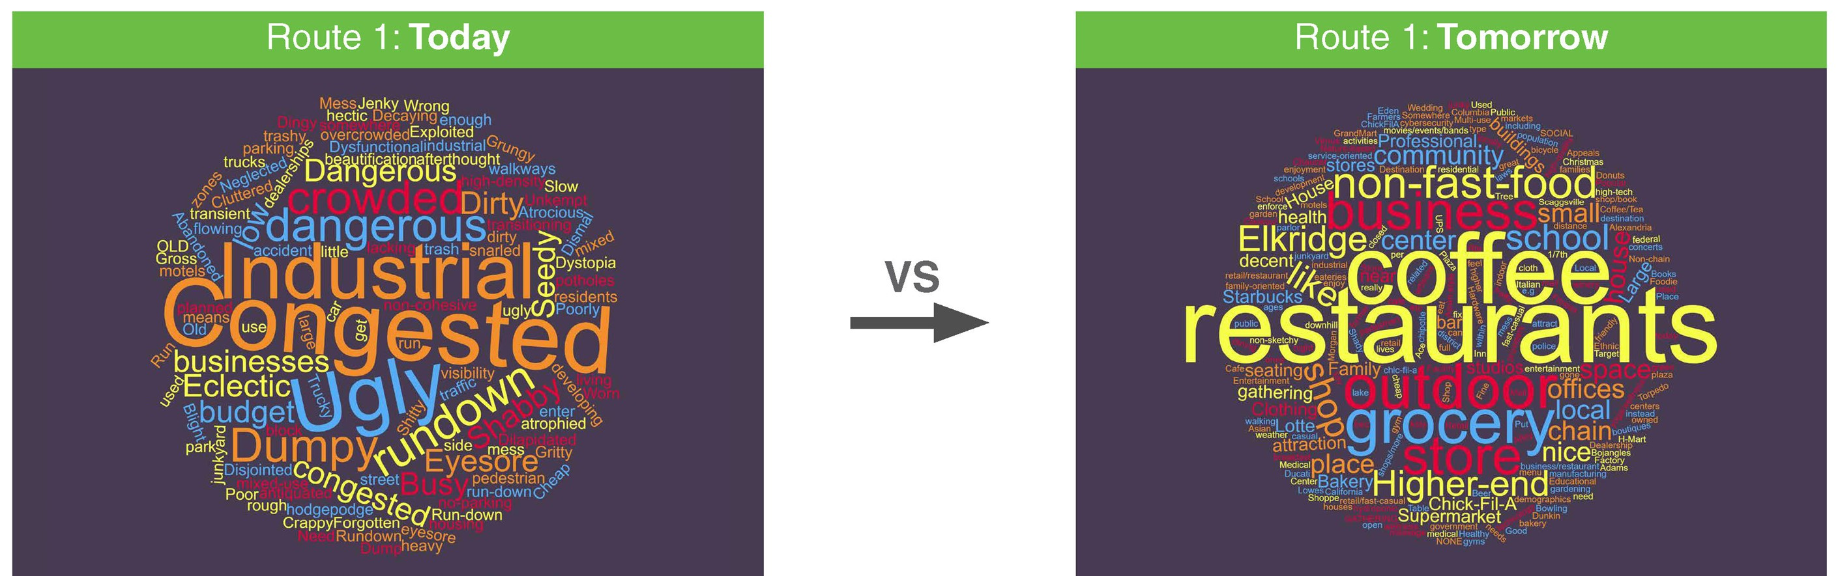
WHAT WE LEARNED FROM YOU | PUBLIC MEETINGS & ONLINE SURVEY RESULTS

Slide 6
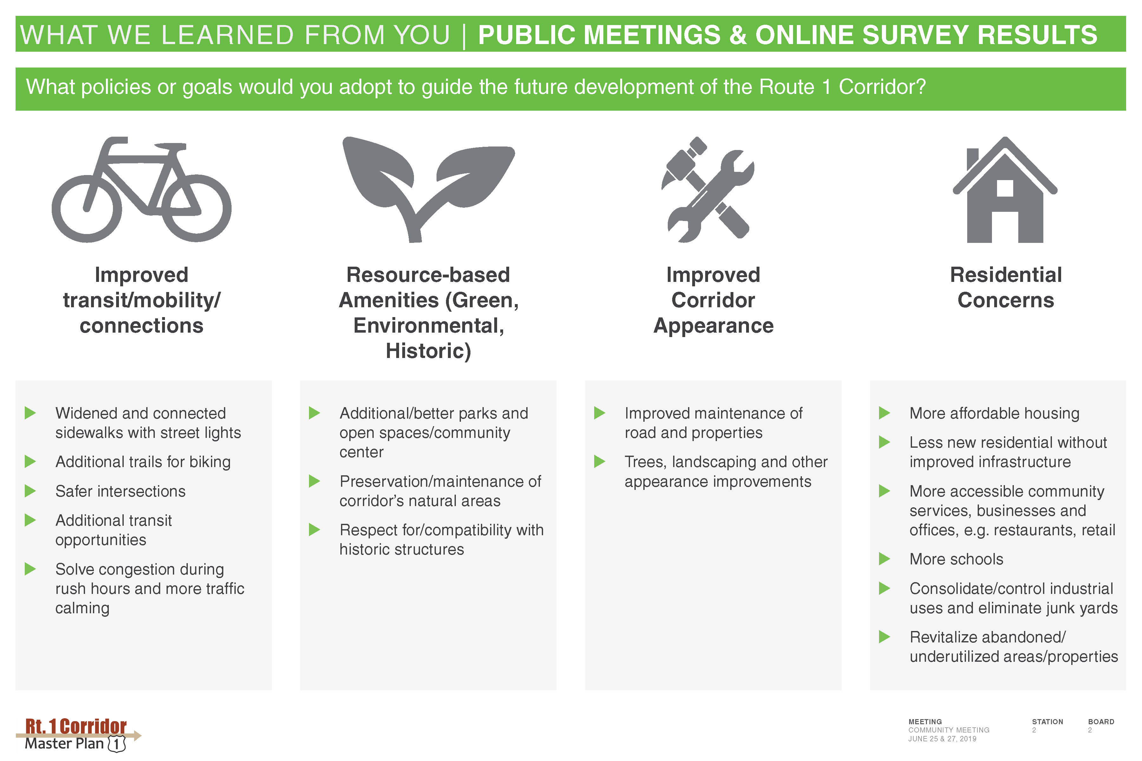
WHAT WE LEARNED FROM YOU | PUBLIC MEETINGS & ONLINE SURVEY RESULTS

Slide 7
MAJOR FINDINGS AND CONCLUSIONS

Slide 8
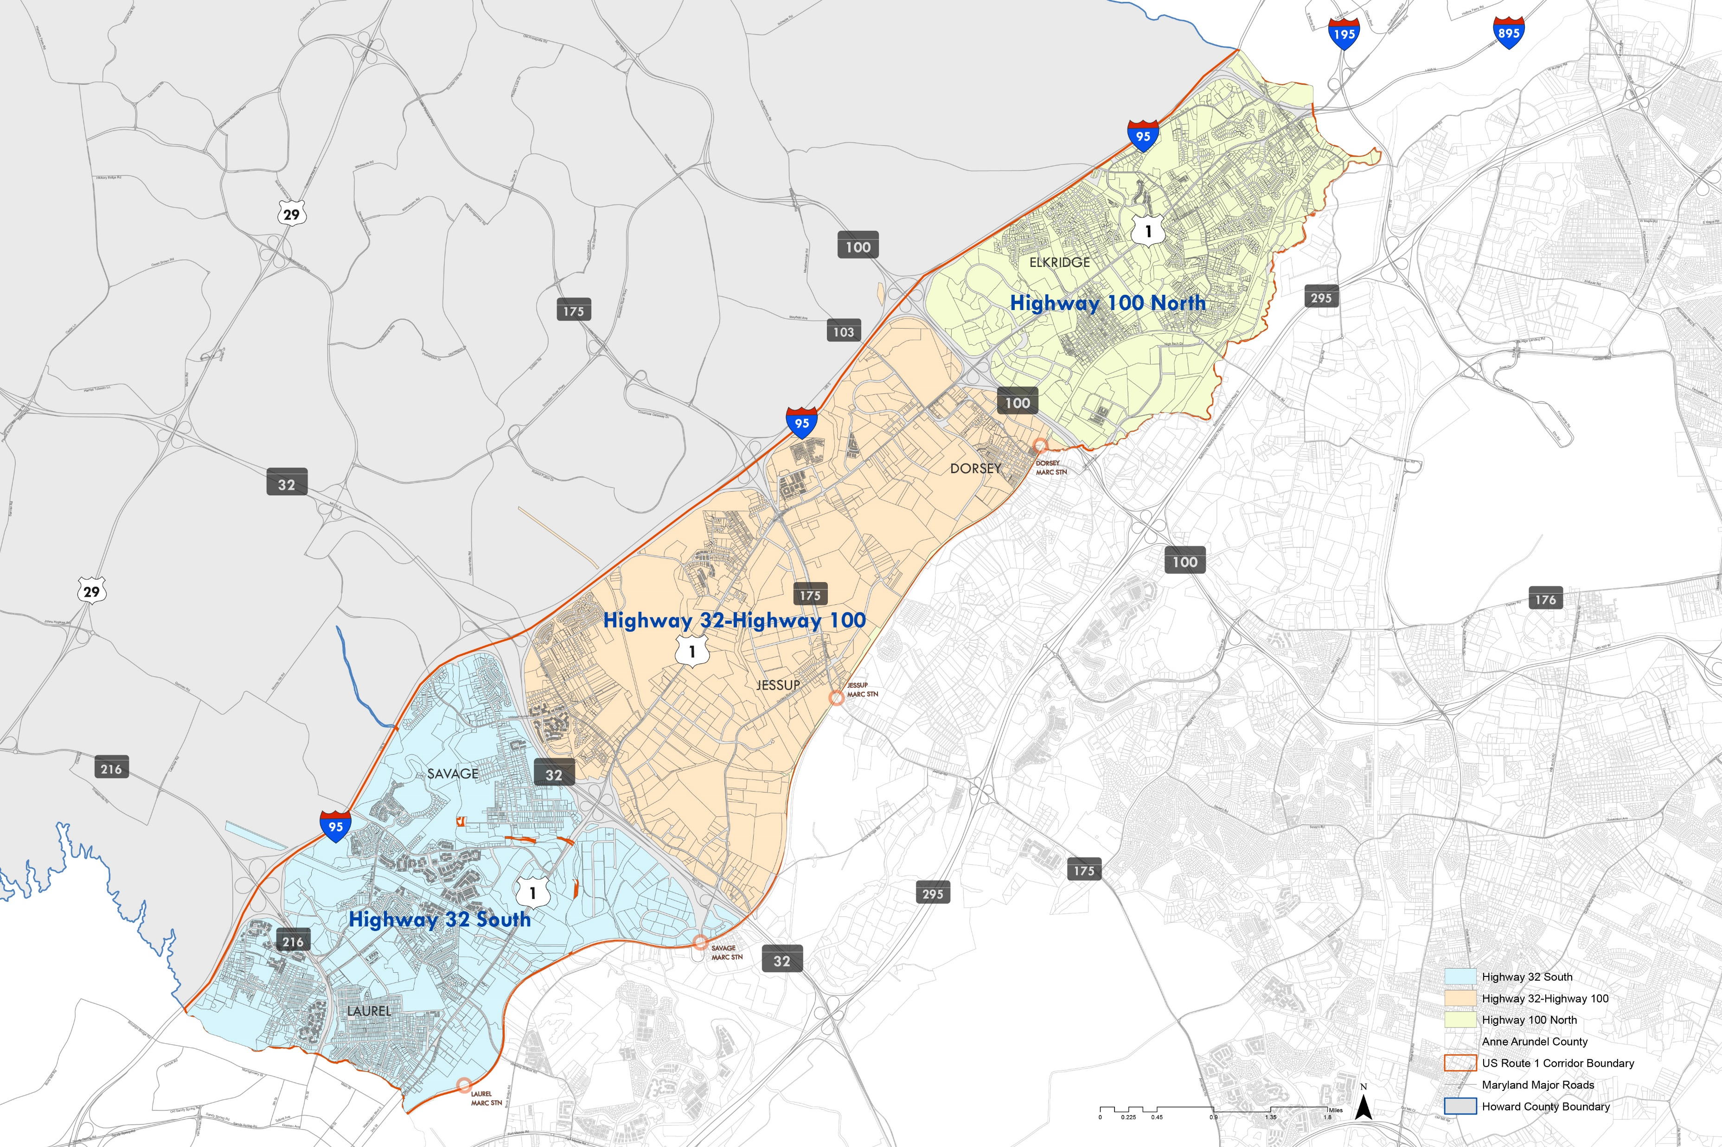

Route 1 Corridor Population
37,244 → 43,954 (+6,710; 1.8% ann.) 2000-2010
43,954 → 54,203 (+10,249; 2.9% ann.) 2010-2018
2000-2010
2010-2018
10,048 → 12,773 (+2,725; 2.7% ann.)
12,773 → 15,214 (+2,441; 2.4% ann.)
POPULATION TRENDS
7,541 → 9,442 (+1,901; 2.5% ann.)
9,442 → 14,847 (+5,405; 7.2% ann.)
19,655 → 21,739 (+2,084; 1.1% ann.)
21,739 → 24,142 (+2,403; 1.4% ann.)

Slide 9

ROUTE 1 CORRIDOR
Owner-occupied: +1,305 (1.5% ann.) Renter-occupied: +718 (1.6% ann.)
Owner-occupied: +1,881 (2.3% ann.)
Renter-occupied: +1,608 (3.8% ann.)
2000-2010
2010-2018
Owner-occupied: +496 (1.8% ann.)
Renter-occupied: +509 (5.5% ann.)
Owner-occupied: +506 (1.9% ann.)
Renter-occupied: +348 (3.0% ann.)
HOUSING TRENDS
Owner-occupied: +465 (2.7% ann.)
Renter-occupied: +179 (2.9% ann.)
Owner-occupied: +965 (5.6% ann.)
Renter-occupied: +924 (14.3% ann.)
Owner-occupied: +334 (0.8% ann.)
Renter-occupied: +41 (0.1% ann.)
Owner-occupied: +418 (1.1% ann.)
Renter-occupied: +320 (1.3% ann.)

Slide 10

Route 1 Corridor
<$35,000/yr: 2,411 (12.7%)
>$100,000/yr: 8,960 (47.2%)
Median: $94,141
2000-2010
2010-2018
<$35,000/yr: 821 (14.6%)
>$100,000/yr: 2,517 (44.8%)
Median Income: $89,834
HOUSEHOLD INCOMES
<$35,000/yr: 565 (11.6%)
>$100,000/yr: 2,532 (52.0%)
Median Income: $102,288
<$35,000/yr: 1,028 (12.1%)
>$100,000/yr: 3,899 (45.9%)
Median Income: $91,558

Slide 11
Apartment Sector (Tightening Supply)
Growing Slowly
Low Vacancy
Asking & effective rents rising steadily, with differences increasing
Warehouse/Distribution Sector (Rapid Growth)
Rising fast since 2013
Relatively high vacancy but slowly declining since 2013
Asking & effective rents rising slow
Industrial Sector (Rapid Growth)
Fast inventory growth
Steadily declining vacancy rate
Asking & effective rents increasing slowly
Office Sector (Higher Vacancy)
Inventory first declined 2015-2016, then rising fast since 2017
High vacancy rate though slowing stabilizing between 20%-25%
Asking rent just slightly rose, and effective rent almost unchanged
MARKET PERFORMANCE
Retail Sector (Slow Growth Since 2016)
Inventory stabilizes around 5.5 million SF after sharp rise 2013-2015
Low vacancy fluctuating around 5%
Asking & effective rents slowly rising, with differences almost unchanged

Slide 12
ROUTE 1 CHARACTER AREA CONCEPTS

Slide 13
CRITERIA FOR DESIGNATING CHARACTER SITES/AREAS
REDEVELOP
CLUSTER OF PARCELS
VACANT AND UNDERUTILIZED PARCELS
ALONG ROUTE 1 FRONTAGE
PROXIMITY TO NEW PUBLIC/PRIVATE INVESTMENT
PARCELS WITH APPROPRIATE DEPTH FOR PLANNED UNIT DEVELOPMENT
REDEVELOPMENT TIMING (SHORT/MEDIUM/LONG)
COMMUNITY FEEDBACK
CORRIDOR-WIDE THEMES
ROUTE 1 “NEIGHBORHOODS”
CLUSTER FUTURE GROWTH
MULTIMODAL CONNECTIVITY
CONTEXT COMPATIBLE LOCATIONS FOR RESIDENTIAL, COMMERCIAL AND INDUSTRIAL LAND USES
ENVIRONMENTAL AREA CONSERVATION/ENHANCEMENT
CONNECT
ADJOINING EXISTING DEVELOPMENT/COMMUNITIES
BOTH SIDES OF ROUTE 1
EXTENSION OF EXISTING STREET GRID
MULTIMODAL CONNECTIONS (SIDEWALKS, TRAILS, MULTI-USE PATHS, BIKE LANES/TRACKS, ETC.)
APPROACH
CHARACTER OF THE AREA (PLACEMAKING)
POTENTIAL LAND USES
CONNECTIVITY
PRESERVE
NATURAL RESOURCE AREAS (STREAM CORRIDORS, FLOODPLAINS, STEEP SLOPES, WETLANDS, WOODED/ FORESTED AREAS)
AREA ADJACENT TO NATURAL AREAS FOR EXPANSION
GREEN BUFFERS AND THRESHOLDS ALONG ROUTE 1
PARKS
EXISTING RESIDENTIAL COMMUNITIES
COMMUNITY FACILITIES AND LANDMARKS

Slide 14
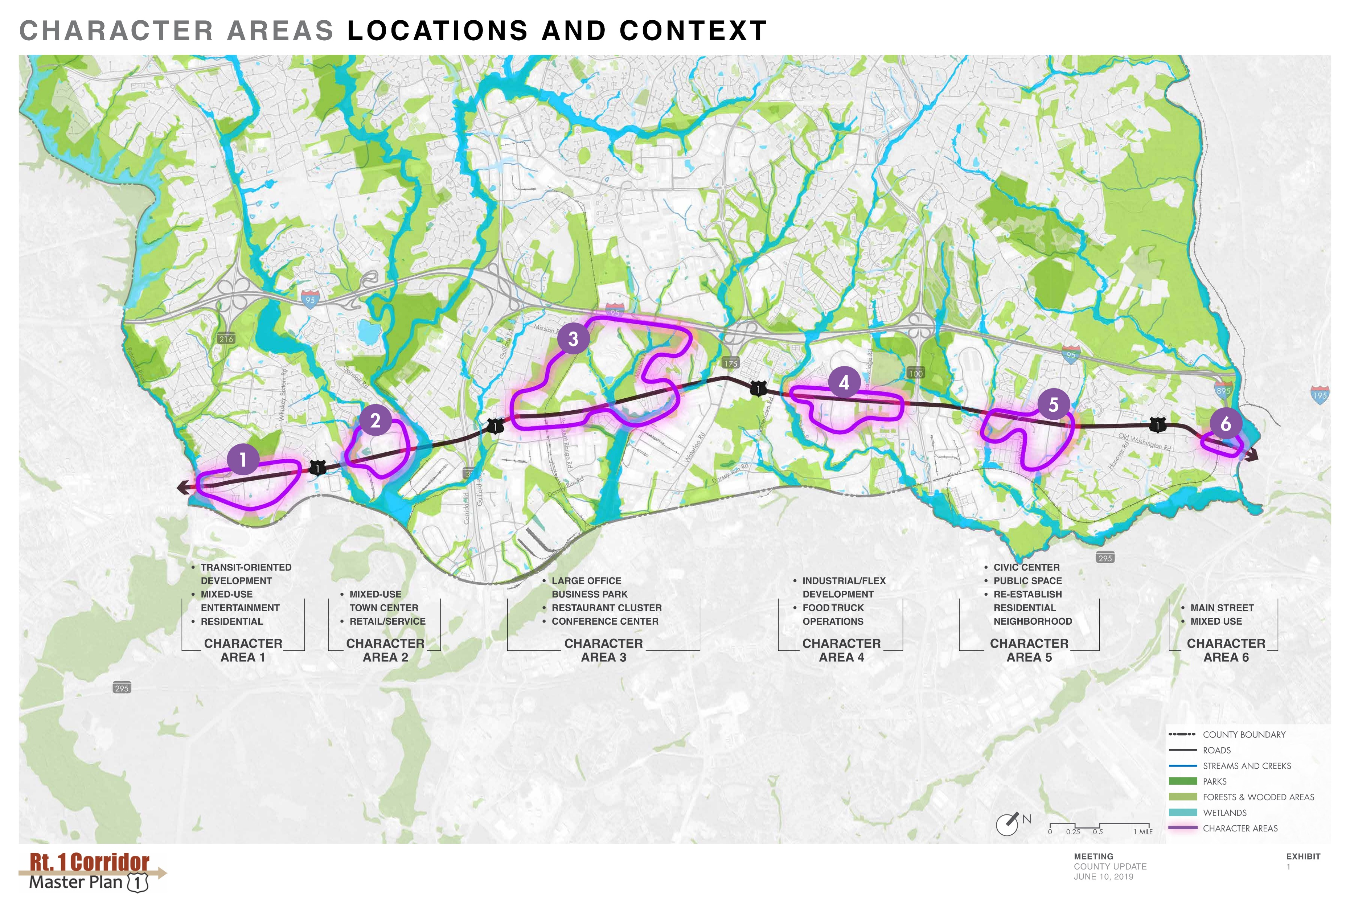
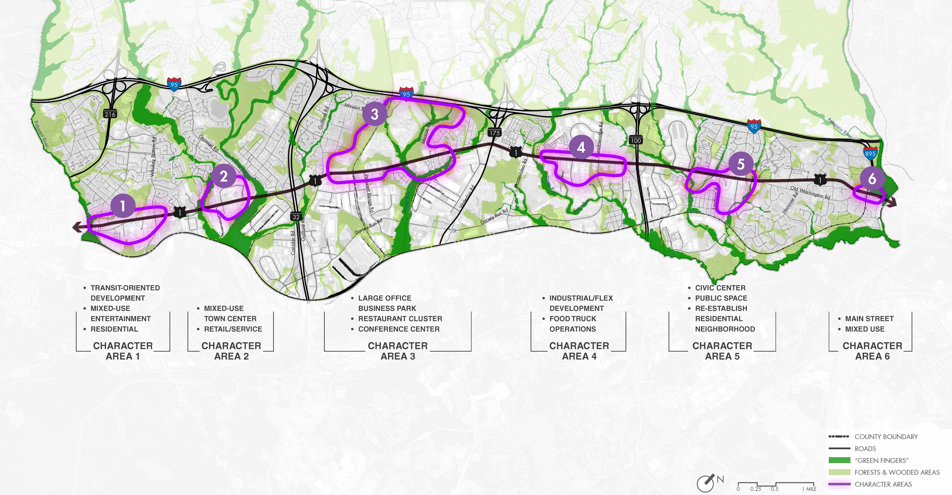

Slide 15
County Line to
Whiskey Bottom
  Preliminary Considerations
  Mixed use & entertainment
  Focal point at the south side of the corridor
  Build on the planned development of Laurel Park with entertainment oriented mix of uses
  Commercial
  Main street character
  Residential
  Medium to high density along route 1
  Laurel Park development
  Planned transit-oriented development
  Utilize the planned street grids for opportunity parcel development
  Gateway to Howard County
  Wayfinding signage, public art, gateway sculptural elements, public plazas, framed by buildings, etc.
  Enhanced Streetscape
  To activate streetscape areas adjoining potential mixed-use, entertainment and transit-oriented core along route 1.
CHARACTER AREA 1

Slide 16
  Preliminary Considerations
  Mixed-Use Town Center
  Corridor shopping and services
  Connect to Savage Mill trail and residential neighborhoods
  Grocery
  Food anchor for the surrounding residential neighborhood
  Light industrial/commercial
  Context compatible light industrial development
  Public Realm
  Wayfinding signage, public art, gateway sculptural elements, public plazas, framed by buildings, etc.
  Nature
  Connect to surrounding natural resources (trails, multi-use paths, etc.)
CHARACTER AREA 2
Hammond Branch to Gorman Road

Slide 17
  Preliminary Considerations
  Business/office park
  High quality office buildings (Class A)
  Organized by streets, public plazas and open spaces
  Integrate the stream corridors via trails, paths
  Hotel/hospitality with related commercial
  Multiple hotel sites
  Conference center
  Retail/restaurants
  Integrate with stream corridors and natural resource areas
  Commercial
  Suburban corridor commercial with enhanced streetscape and site development
  Public Realm
  Wayfinding signage, public art, gateway sculptural elements, public plazas, framed by buildings, etc.
  Connection
  Environmental area trial
  Rail trail
CHARACTER AREA 3
Quarry to Assateaque Drive

Slide 18
  Preliminary Considerations
  Light industrial
  Context compatible light industrial (1 floor with garage doors at the back)
  Flex office space, showroom facilities
  Commercial & food truck cluster
  Formalized space to house variety of food trucks and food offerings
  Celebrate corridor’s industrial (distribution) character with wayfinding, signage and public art
CHARACTER AREA 4
Blue Stream Drive to Route 100

Slide 19
  Preliminary Considerations
  Library
  Utilize the activity generated by the new library as an “anchor” for creating a civic node
  Civic uses
  Walkable campus-like setting with green spaces for outdoor community gathering
  Signature buildings framing route 1 and internal streetscape and open spaces
  Recreation
  Indoor recreation uses (fields, courts, etc.) With outdoor amenities that seamlessly connects civic campus with adjoining residential neighborhoods
  Residential
  Low to medium density residential that connects to adjoining existing residential neighborhoods
  Connect to trails and/or multi-use paths along route 1 and stream corridors
  Enhanced streetscape
  To activate streetscape areas and connect both sides of route 1
  Wayfinding signage, public art, gateway sculptural elements, public plazas, framed by buildings, etc.
  Connection
  To surrounding neighborhoods
CHARACTER AREA 5
Troy Hill Drive to Rowanberry Drive

Slide 20
  Preliminary Considerations
  Mixed-Use
  Mom & pop businesses, restaurants, some residential redevelopment
  Civic
  Education/learning
  Placemaking
  Retain special places
  Connection
  Easily accessible parks/open space
  Walkable neighborhood
CHARACTER AREA 6
Old Washington Road
to Main Street

Slide 21
TRANSPORTATION CONNECTIONS

Slide 22
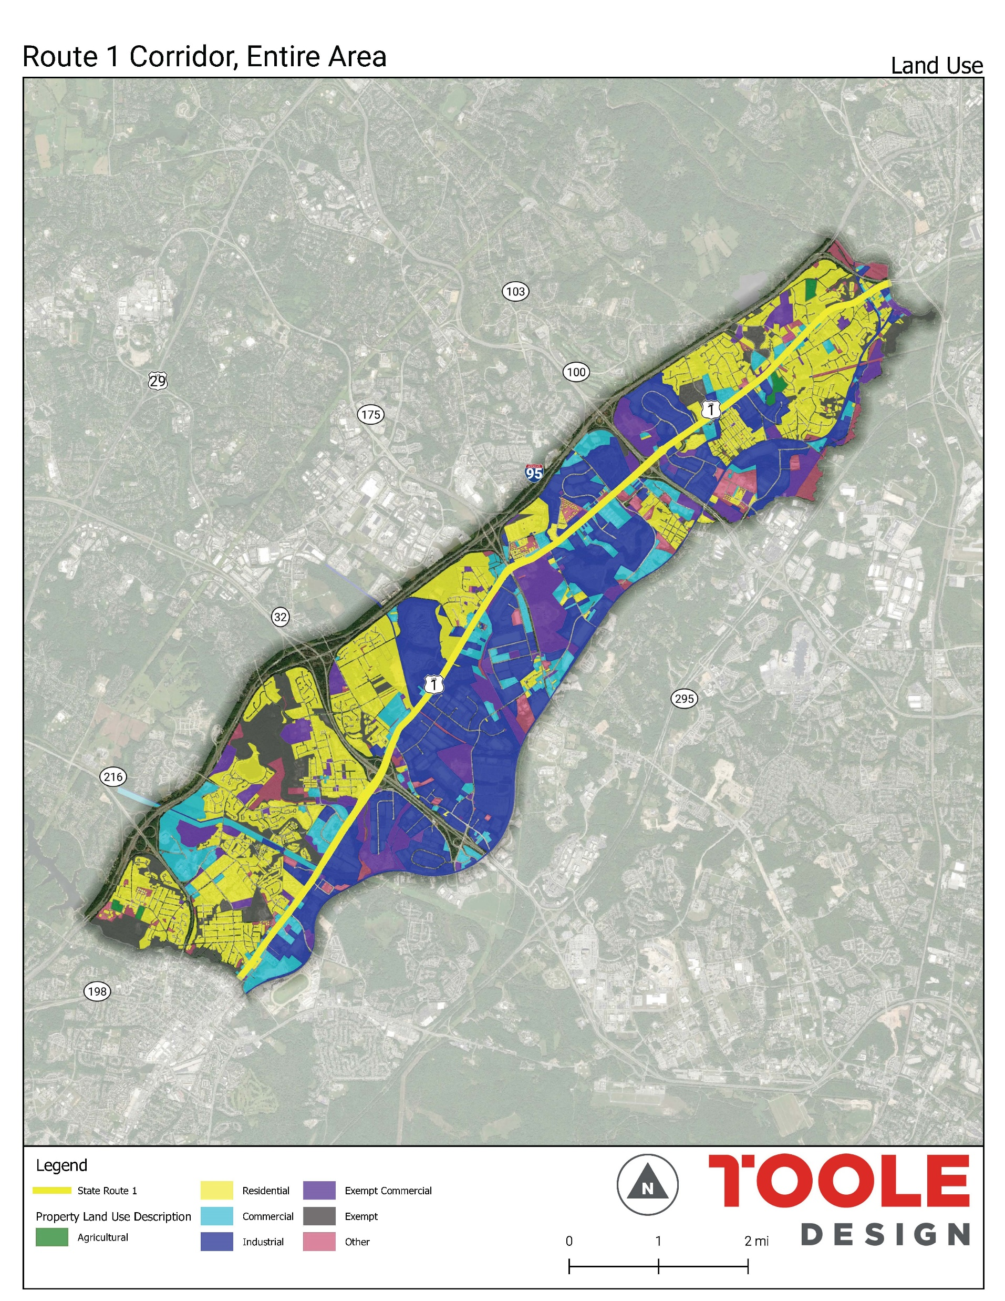
LAND USE
Residential uses are concentrated west and north of the corridor
Industrial Uses are concentrated east the corridor
A number of industrial uses within residential areas can be potential areas for development

Slide 23
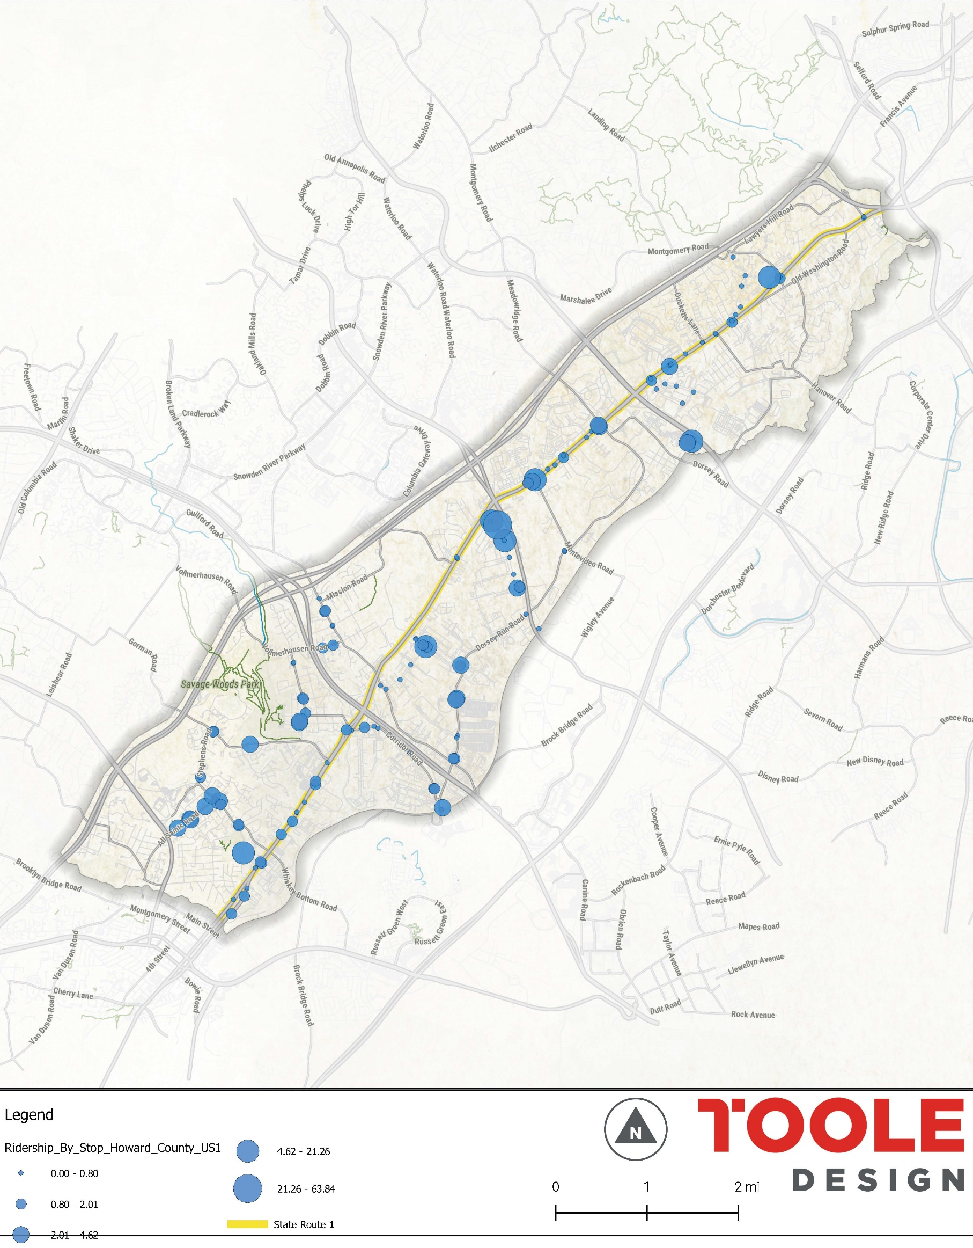
SIDEWALK GAPS
Sidewalks are a limited feature along Route 1 especially on the southside section.
Land use patterns reflect on the sidewalk patterns except in the north section
There are major gaps around bus stops with high ridership
Potential areas for near-term retrofits

Slide 24
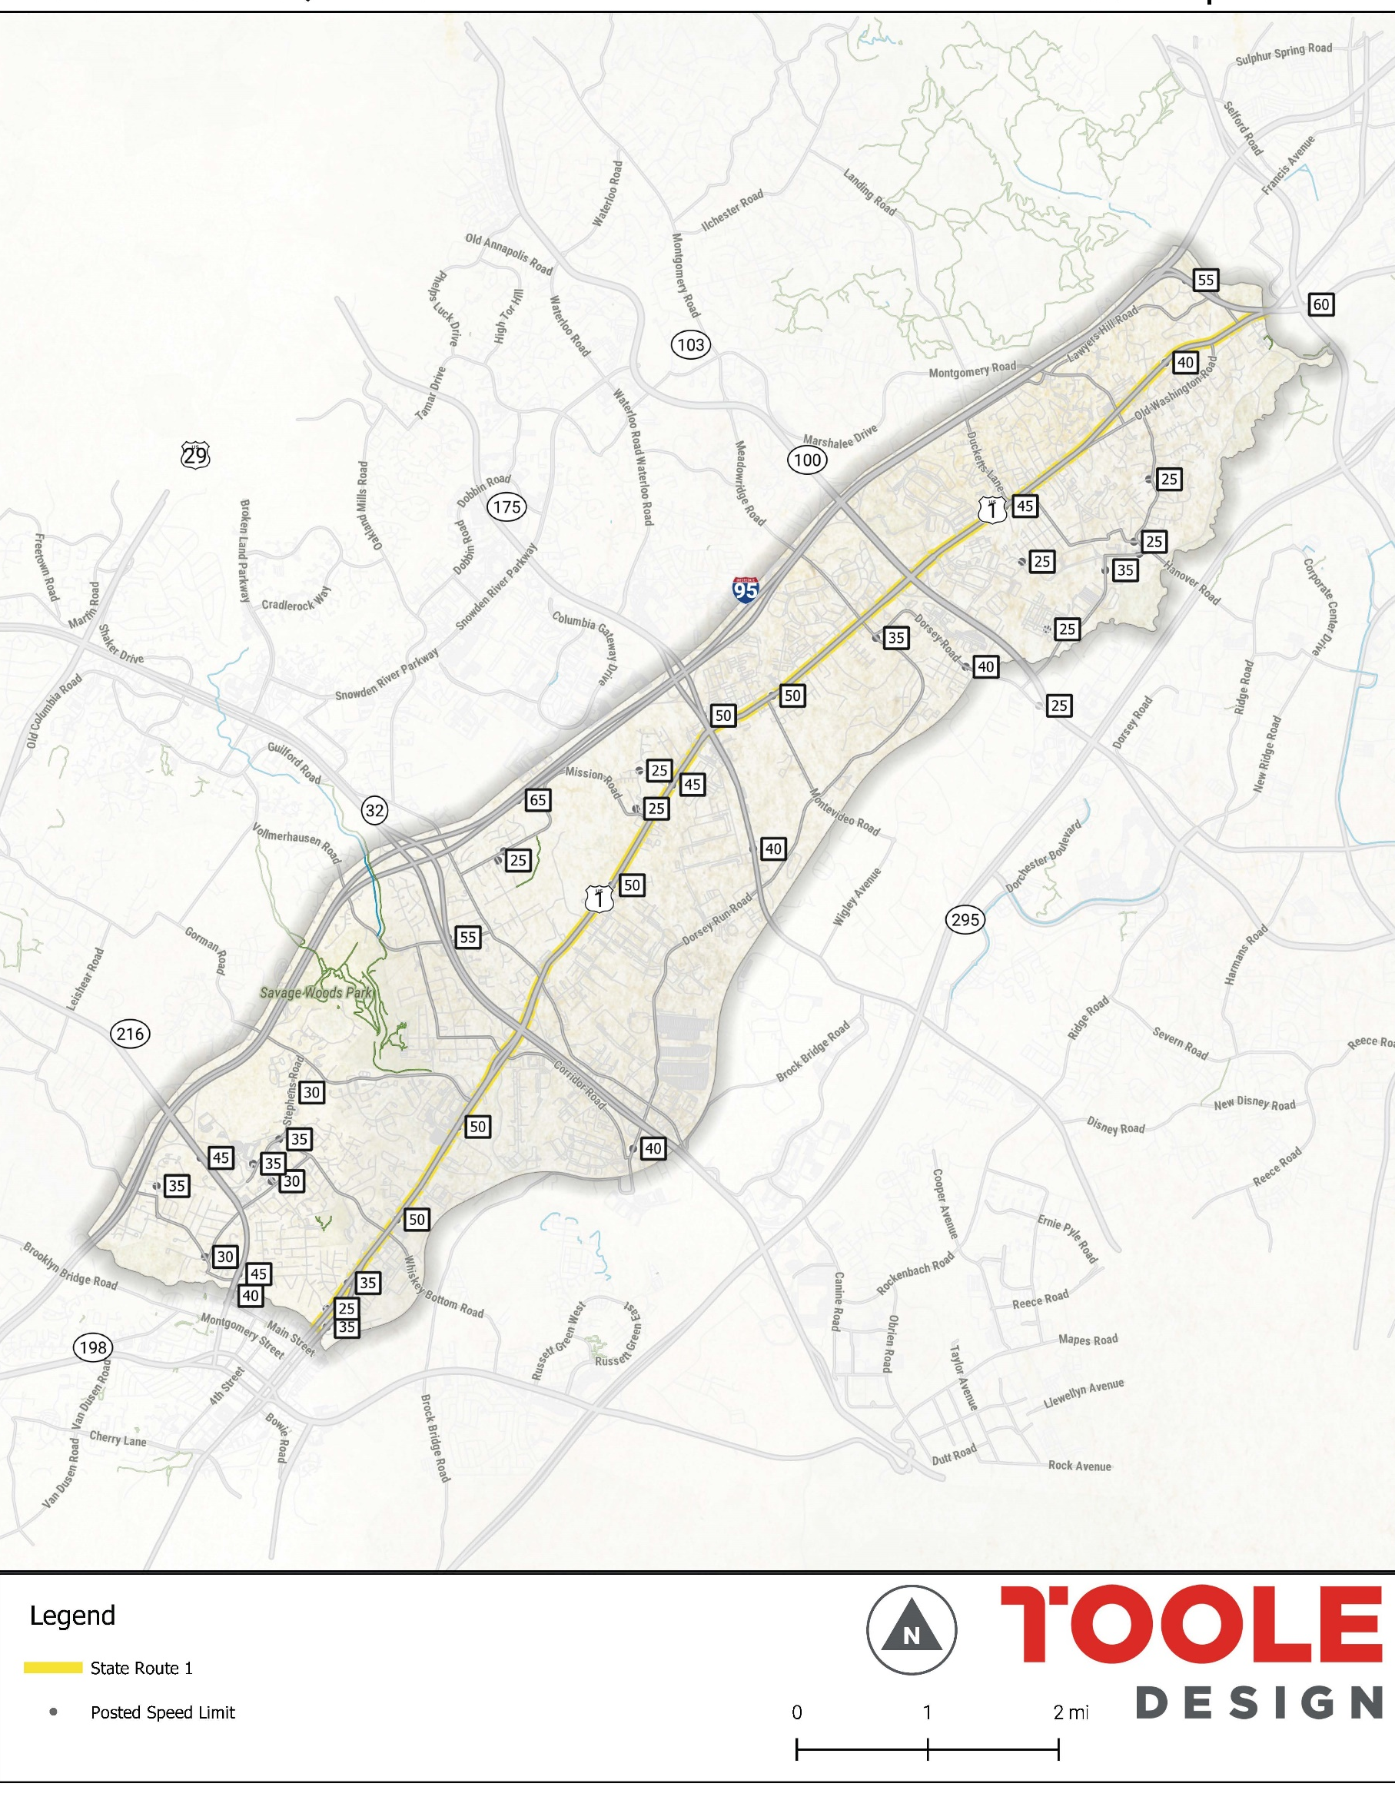
SAFETY
Locational discrepancy between all crashes: vehicular, pedestrian and bike crashes
High bike and pedestrian crashes are in areas with a denser residential character and lower posted speeds
Area with actual speed higher than posted speed

Slide 25
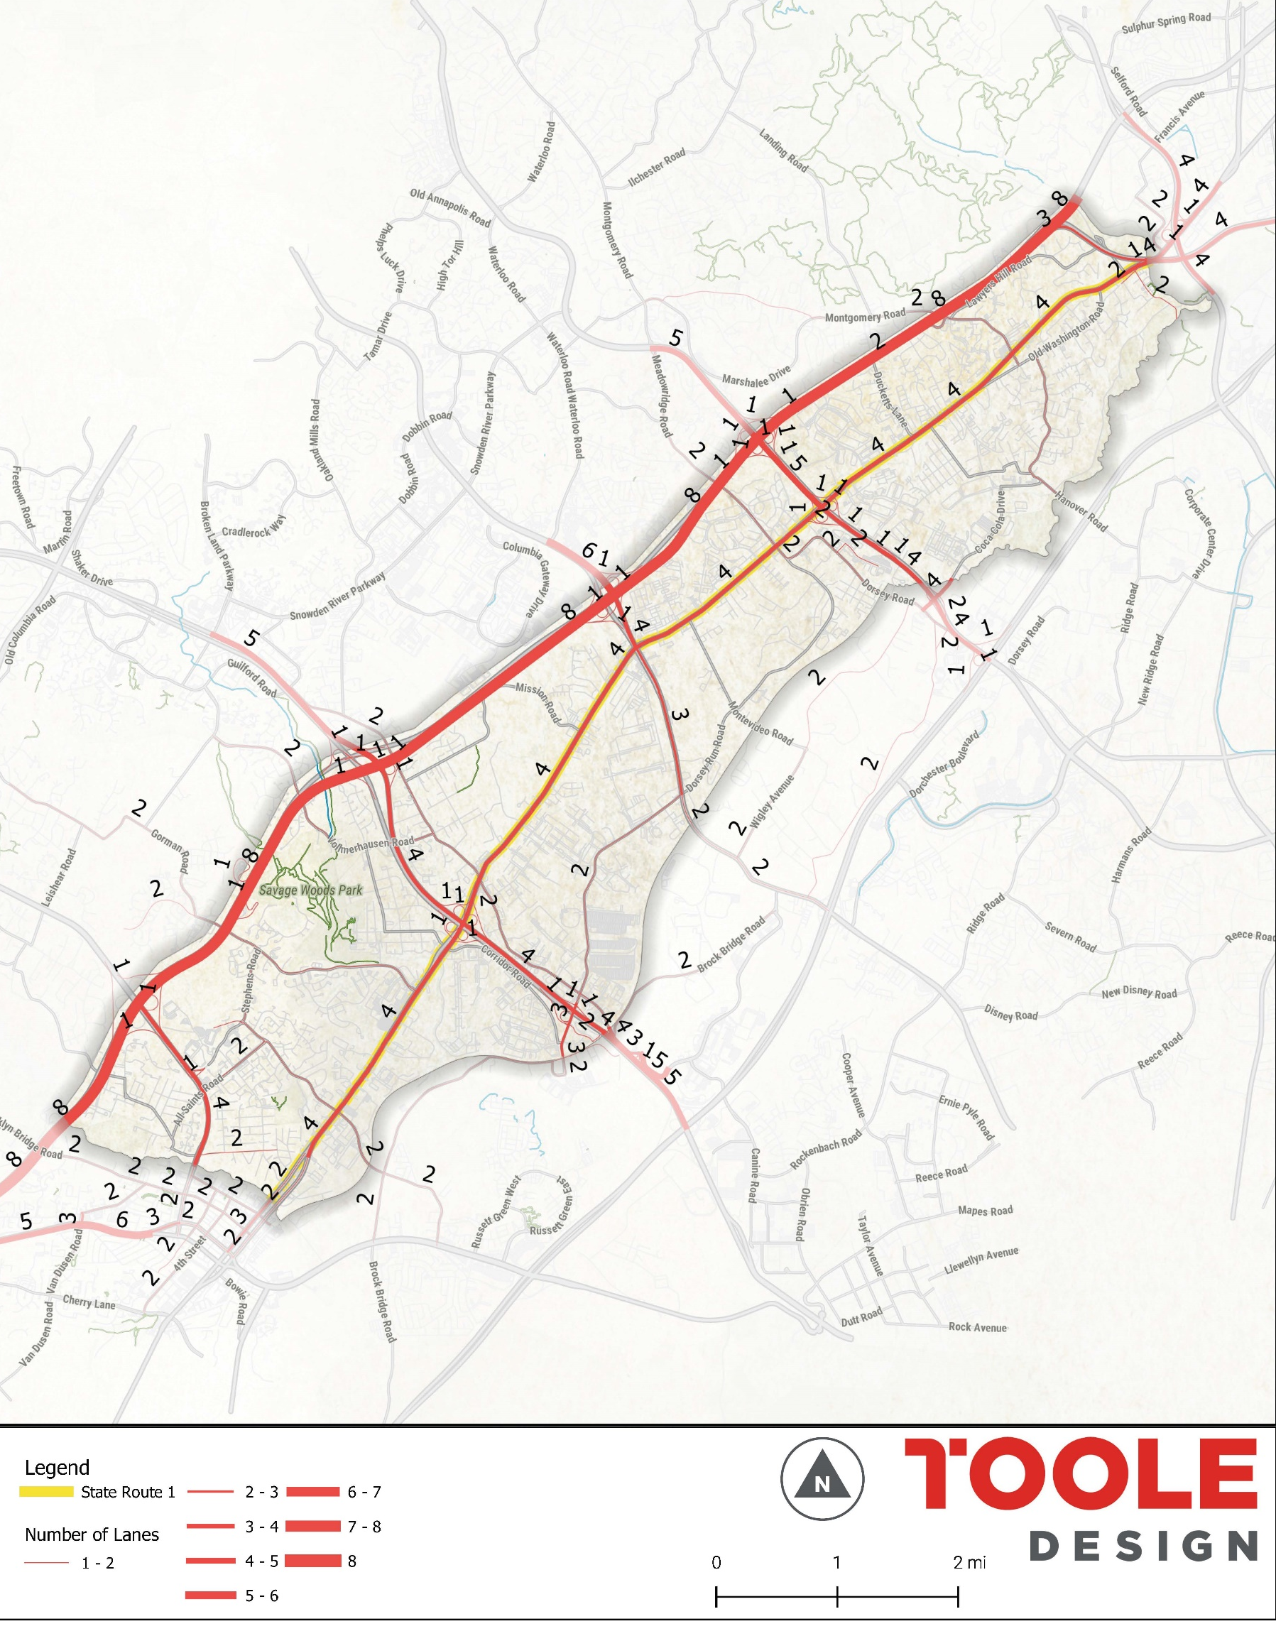
TRAFFIC VOLUMES
Traffic volumes vary along Route 1 and tend be close to major routes
Number of lanes almost consistent along the whole route
Is there a potential for road diets in certain focus areas?

Slide 26
PRELIMINARY CONSIDERATIONS

Slide 27
HOW IS THIS TIME GOING TO BE DIFFERENT?
Previous Strategy Initiatives Focused on Transportation and Regulatory Initiatives
US 1 Corridor Improvement Strategy (2008)
Transportation Physical + System Improvements
Local Transportation System:
Build prescribed roadway and path connections
Connect internal roadways
Provide continuous bike and pedestrian routes
Design for multimodal activity
Transportation System Improvements (US Route 1):
Typical Sections:
widening to six lanes through most of Howard County
raised median
continuous bike lanes, landscaping, sidewalks, & parking design
Property Access:
reducing single-use driveways on US 1
concentrate truck access to major, full-access intersections
Regional Intersection Improvements
Route 1 Manual (2009 update of the 2004 Manual)
Corridor Zoning districts:
Nonconforming uses and noncomplying design
Corridor employment district
Transit oriented development district
Corridor activity center (CAC)
Continuing light industrial district
Streetscape, Site & Building design guidelines:
Street furniture and pedestrian amenities
Road network
Building location
Parking areas
Trash enclosures
Building height
Building mass and articulation
* Transportation System Improvements (US Route 1):
Typical sections from 2008 SHA Strategy incorporated into
Manual

Slide 28
ROUTE 1 IMPLEMENTATION THEMES
Funding
Organizational Leadership &
Partnerships
Funding
Placemaking
& Public Realm
Corridor
Revitalization
Transportation & Safety
Character Area Redevelopment Strategies
Funding
Funding

Slide 29

CONSIDERATIONS FOR ORGANIZATIONAL LEADERSHIP
“MANAGING AND LEADING ROUTE 1 REVITALIZATION”
Goal: To manage growth and redevelopment along the Route 1 Corridor in a way that:
Provide local residents with a higher level of shopping and services,
Promotes development that’s fiscally responsible,
Grows the County’s tax base and employment base,
Improves the condition and visual appeal of Route 1
Action: Create a “Envision Route 1 Partnership” to facilitate desired redevelopment
Action: Appoint a series of Business/Citizen Advisory Committees to address key redevelopment issues:
Housing and Affordability
Transportation Improvements & Safety
Real Estate Redevelopment
Public Facilities and Amenities

Slide 30

CONSIDERATIONS FOR PARTNERSHIPS
Goal: To identify suitable areas to accommodate the relocation of some Route 1 businesses to areas off Route 1
Action: To work with property owners and real estate professionals to enhanced land conditions along Route 1
Goal: To work with real estate community to assemble key land parcels for future redevelopment and public parks/amenities
Action: Explore tools such as a Route 1 Land Bank to assemble, hold and redevelop land in conjunction with other stakeholders along the corridor
Action: Coordinate with property owners, nonprofits and developers to identify key properties to future redevelopment

Slide 31
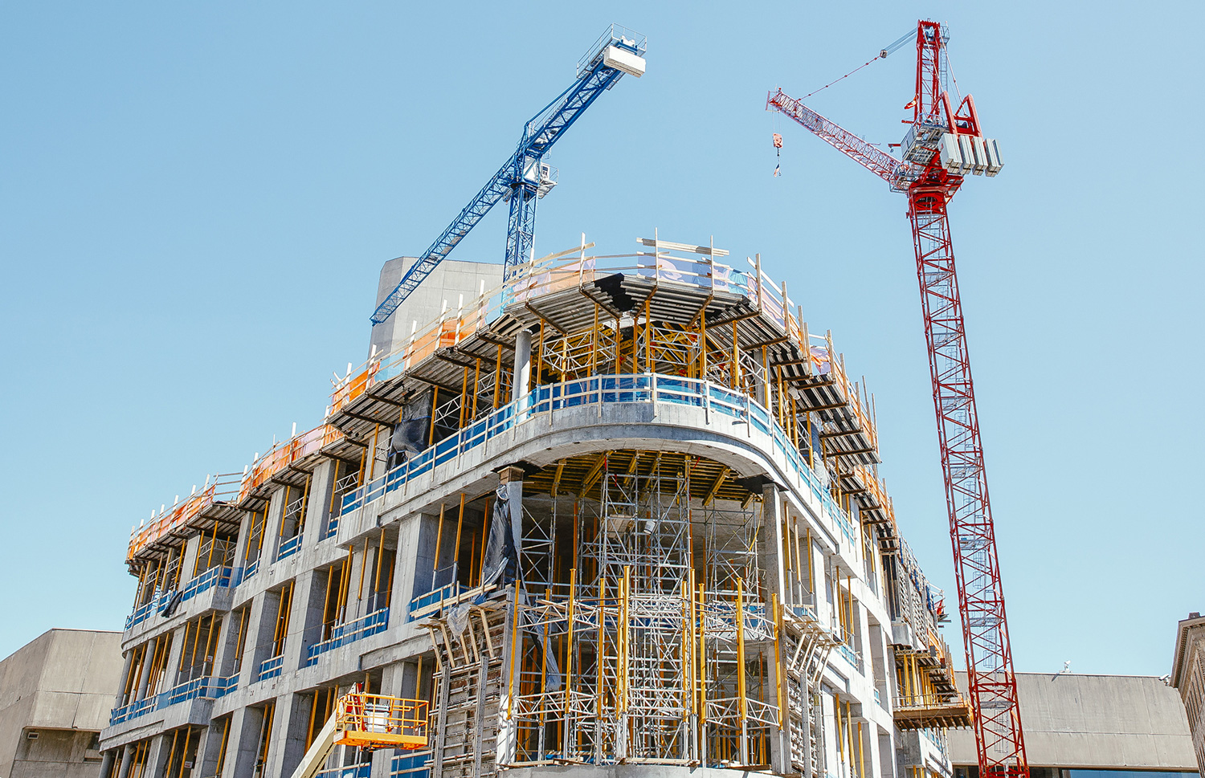
CHARACTER AREA REDEVELOPMENT STRATEGIES
Goal: To initiate redevelopment in strategic opportunity areas where catalyst redevelopment is possible
Action: Create partnerships with real estate development companies interested in Route 1 redevelopment
Action: Develop funding and regulatory incentives to encourage redevelopment
Action: Plan transportation and infrastructure improvements to support redevelopment as needed

Slide 32

CONSIDERATIONS FOR CREATIVE FUNDING SOLUTIONS
Goal: Develop financing for use at designated Character Areas to facilitate the public infrastructure in these areas
Action: Explore TIF Districts based on known redevelopment plans for areas that are ready for redevelopment
Goal: Create new funding mechanisms to support publicly-funded capital improvements along the corridor
Action: Explore mechanisms such as local option sales tax for economic development

Slide 33
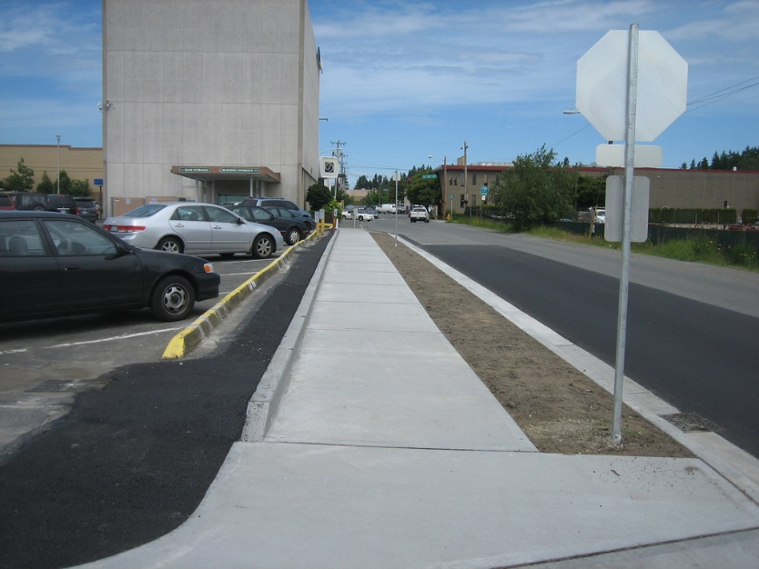
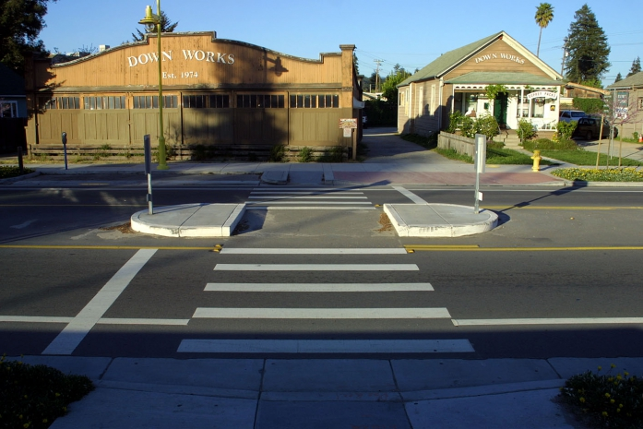
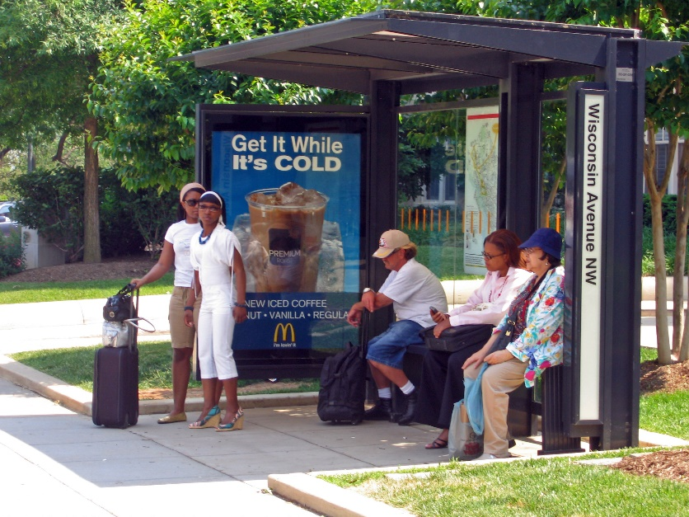
TRANSPORTATION & SAFETY
(NEAR-TERM STRATEGY)
Fill sidewalk gaps
Provide immediate connectivity improvements by enhancing paved shoulder via lane diets and road diets, physical buffer, etc.
Provide enhanced bus shelter amenities
Implement pedestrian crossing improvements
Improve wayfinding
Other safety and speed management improvements
    Slow turn turning vehicles
    No Turn on Red

Slide 34
TRANSPORTATION & SAFETY
(MID-TERM STRATEGY)
Balance multimodal needs
Improve safety for everyone, all ages all abilities
Implement transportation infrastructure improvements that create a recognizable node of activity
Foster Transit-Oriented Development
Identify opportunities to enhance regional multimodal connectivity

Slide 35
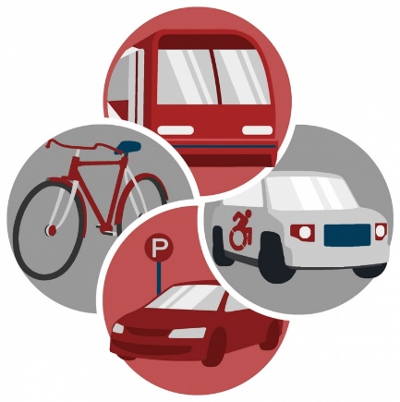
ROUTE 1 LONG-TERM STRATEGIES
Strategy | Proposed Criteria
Redefine minimum lane widths along corridor | 10.5-11 foot motor vehicle travel lanes
Redefine a flexible Level of Service (LOS) Along Corridor | Aim for a lower LOS in targeted locations
Lower desired motor vehicle speed | 25 miles per hour in targeted locations
Reevaluate Pedestrian crossing needs | Accounting for existing, latent, and future demand
Identify road diet thresholds | Follow SHA allowable thresholds
Redefine setback requirements | Balancing sense of place and crash considerations
TRANSPORTATION

Slide 36
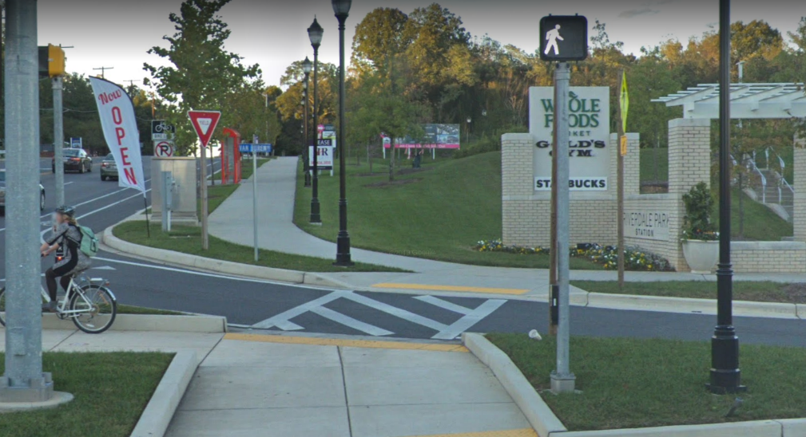
CASE STUDY
RIVERDALE PARK STATION
Constructed in 2017
Connectivity
  Wide shared-use path along Route 1
  Riverdale and College Park MARC stations access
  Internal parallel routes
Safety and Comfort
  New traffic and ped signals
  Curb extensions and ADA ramps
  Truck apron
  Road Diet
Sense of Place
  Separation between existing industrial uses while maintaining pedestrian and bicycle access

Slide 37
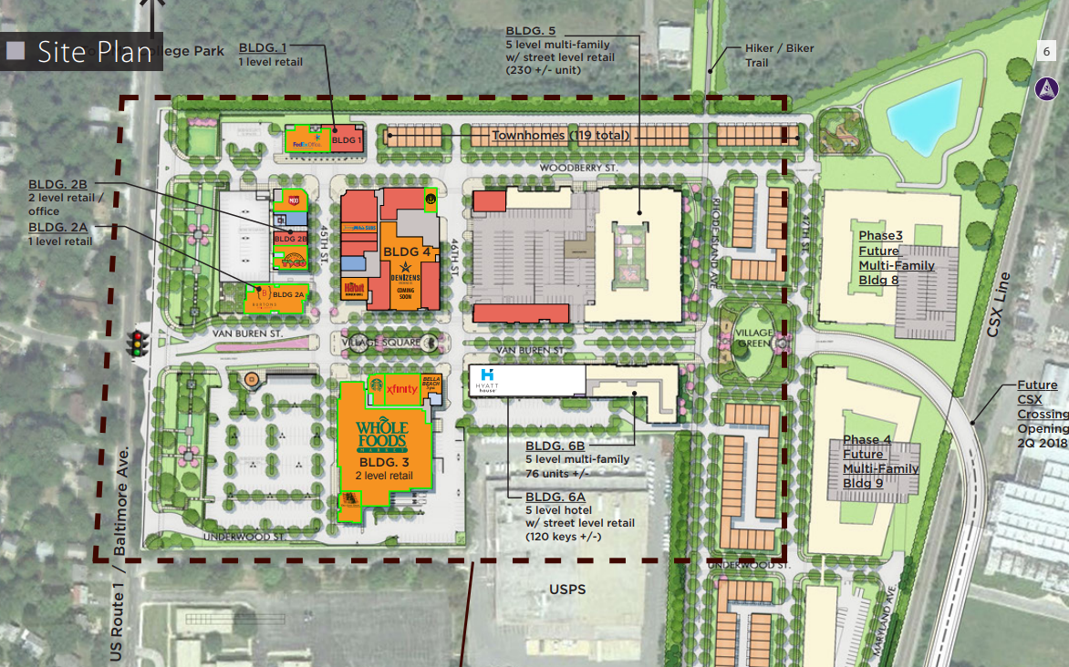
Case Study:
Riverdale Park Station
6621 Baltimore Ave (Route 1), Prince George’s County, Mixed Use, Constructed 2017

Slide 38
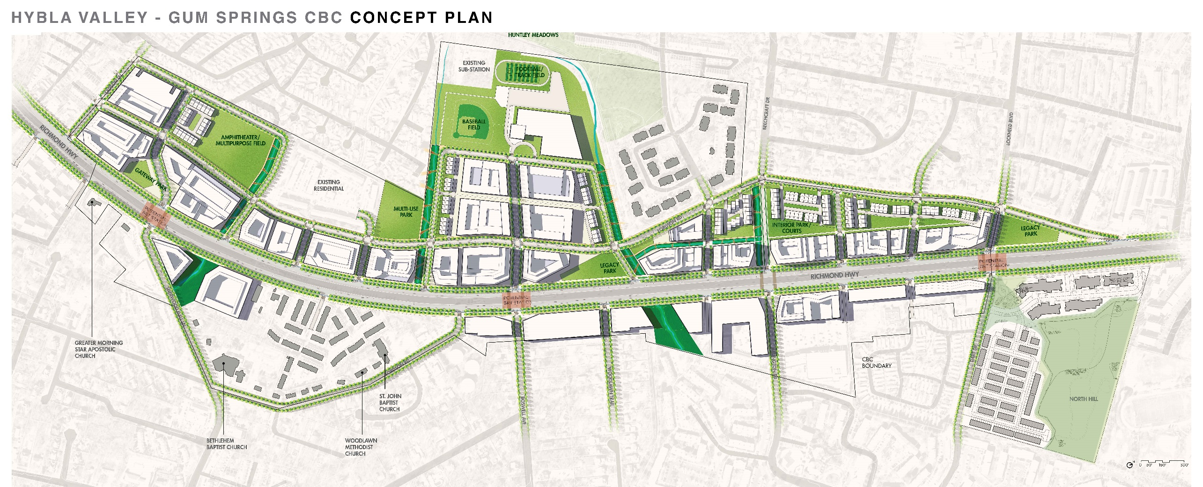
PLACEMAKING AND PUBLIC REALM
(CORRIDOR REVITALIZATION CASE STUDIES)
Route 1 Richmond Highway
(Fairfax County, VA)
Hull Street Corridor (City of Richmond and Chesterfield County, VA)
Roswell Road Corridor (Sandy Springs, GA)

Slide 39
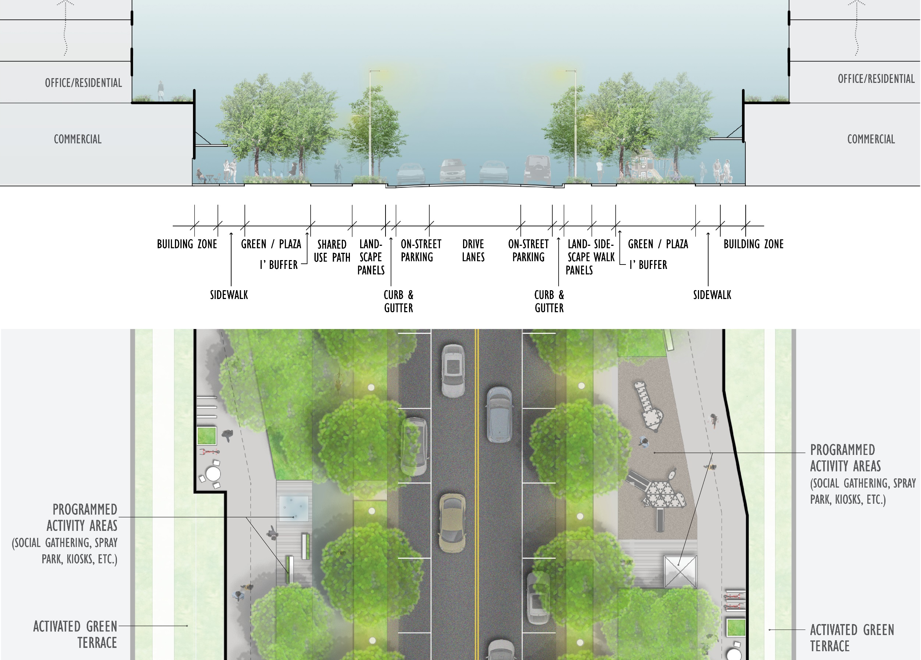
IMPLEMENTATION STRATEGIES | LAND USE & URBAN DESIGN – SIMILAR PROJECTS

Slide 40
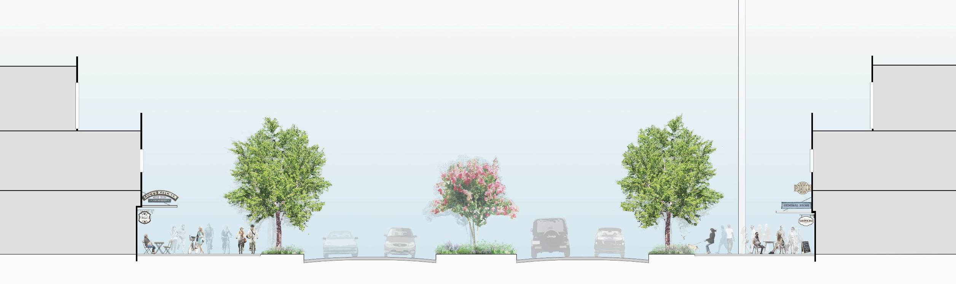
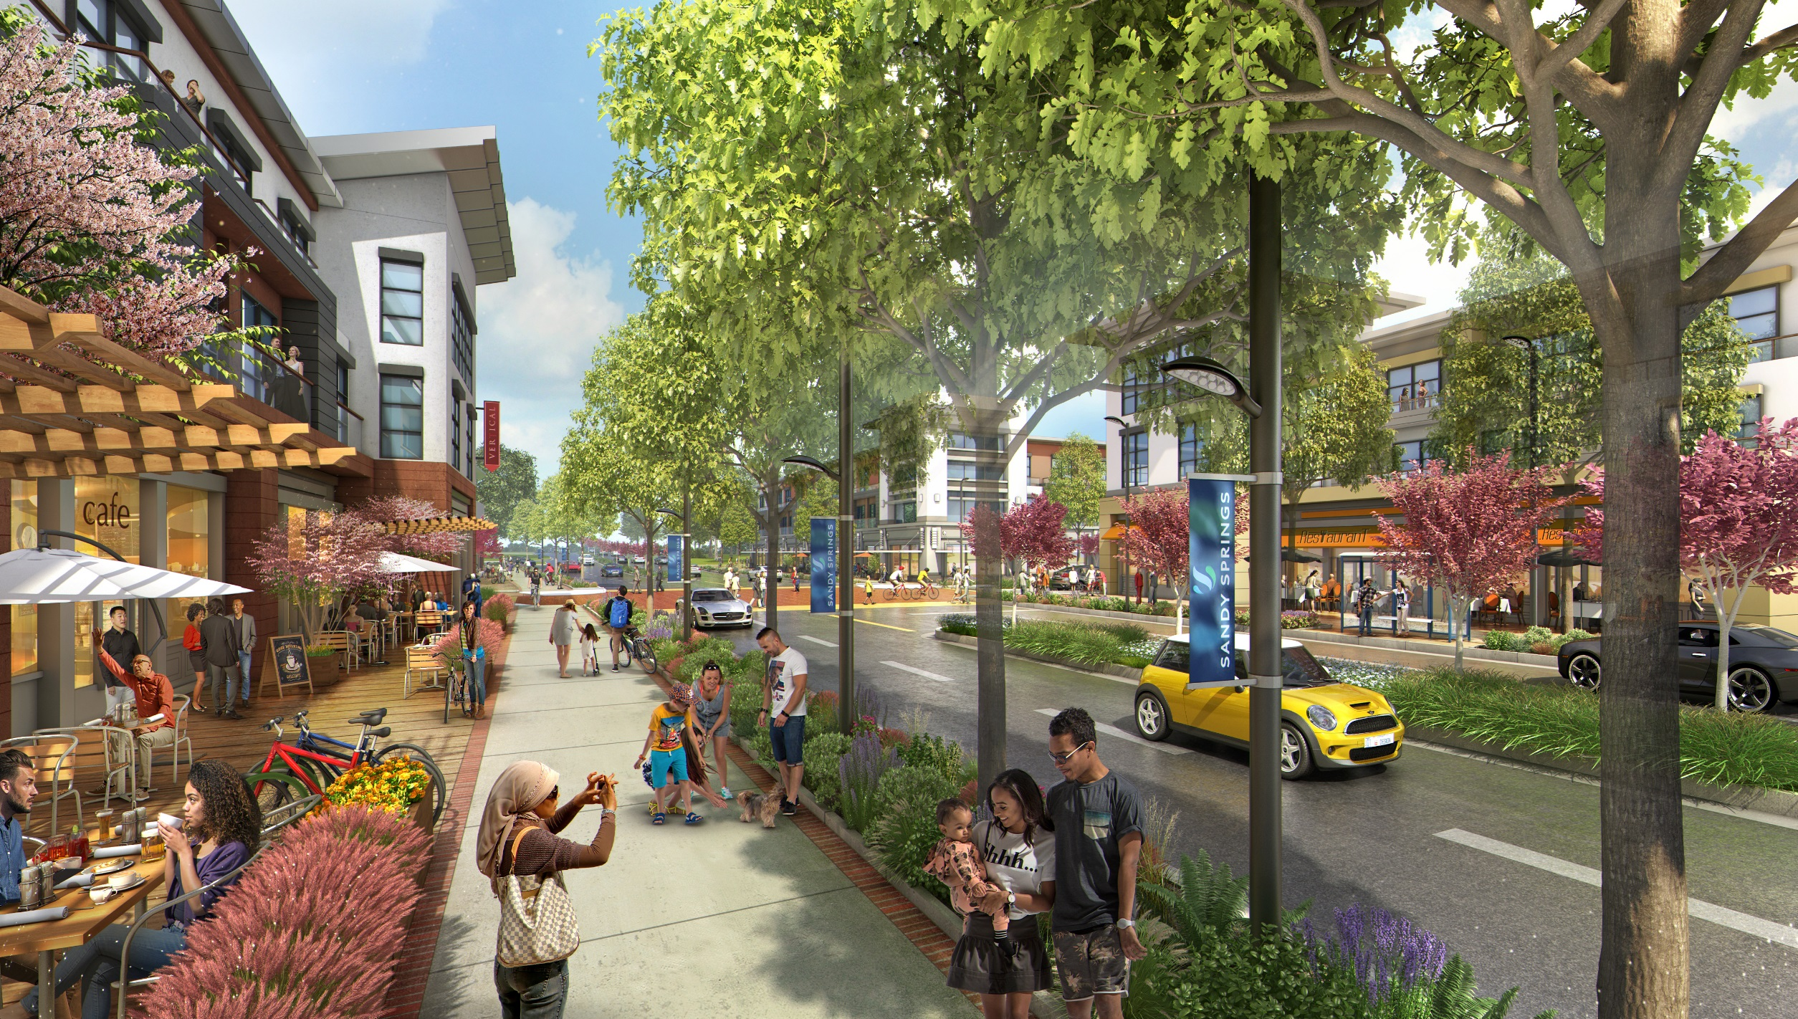
IMPLEMENTATION STRATEGIES | LAND USE & URBAN DESIGN – SIMILAR PROJECTS

Slide 41
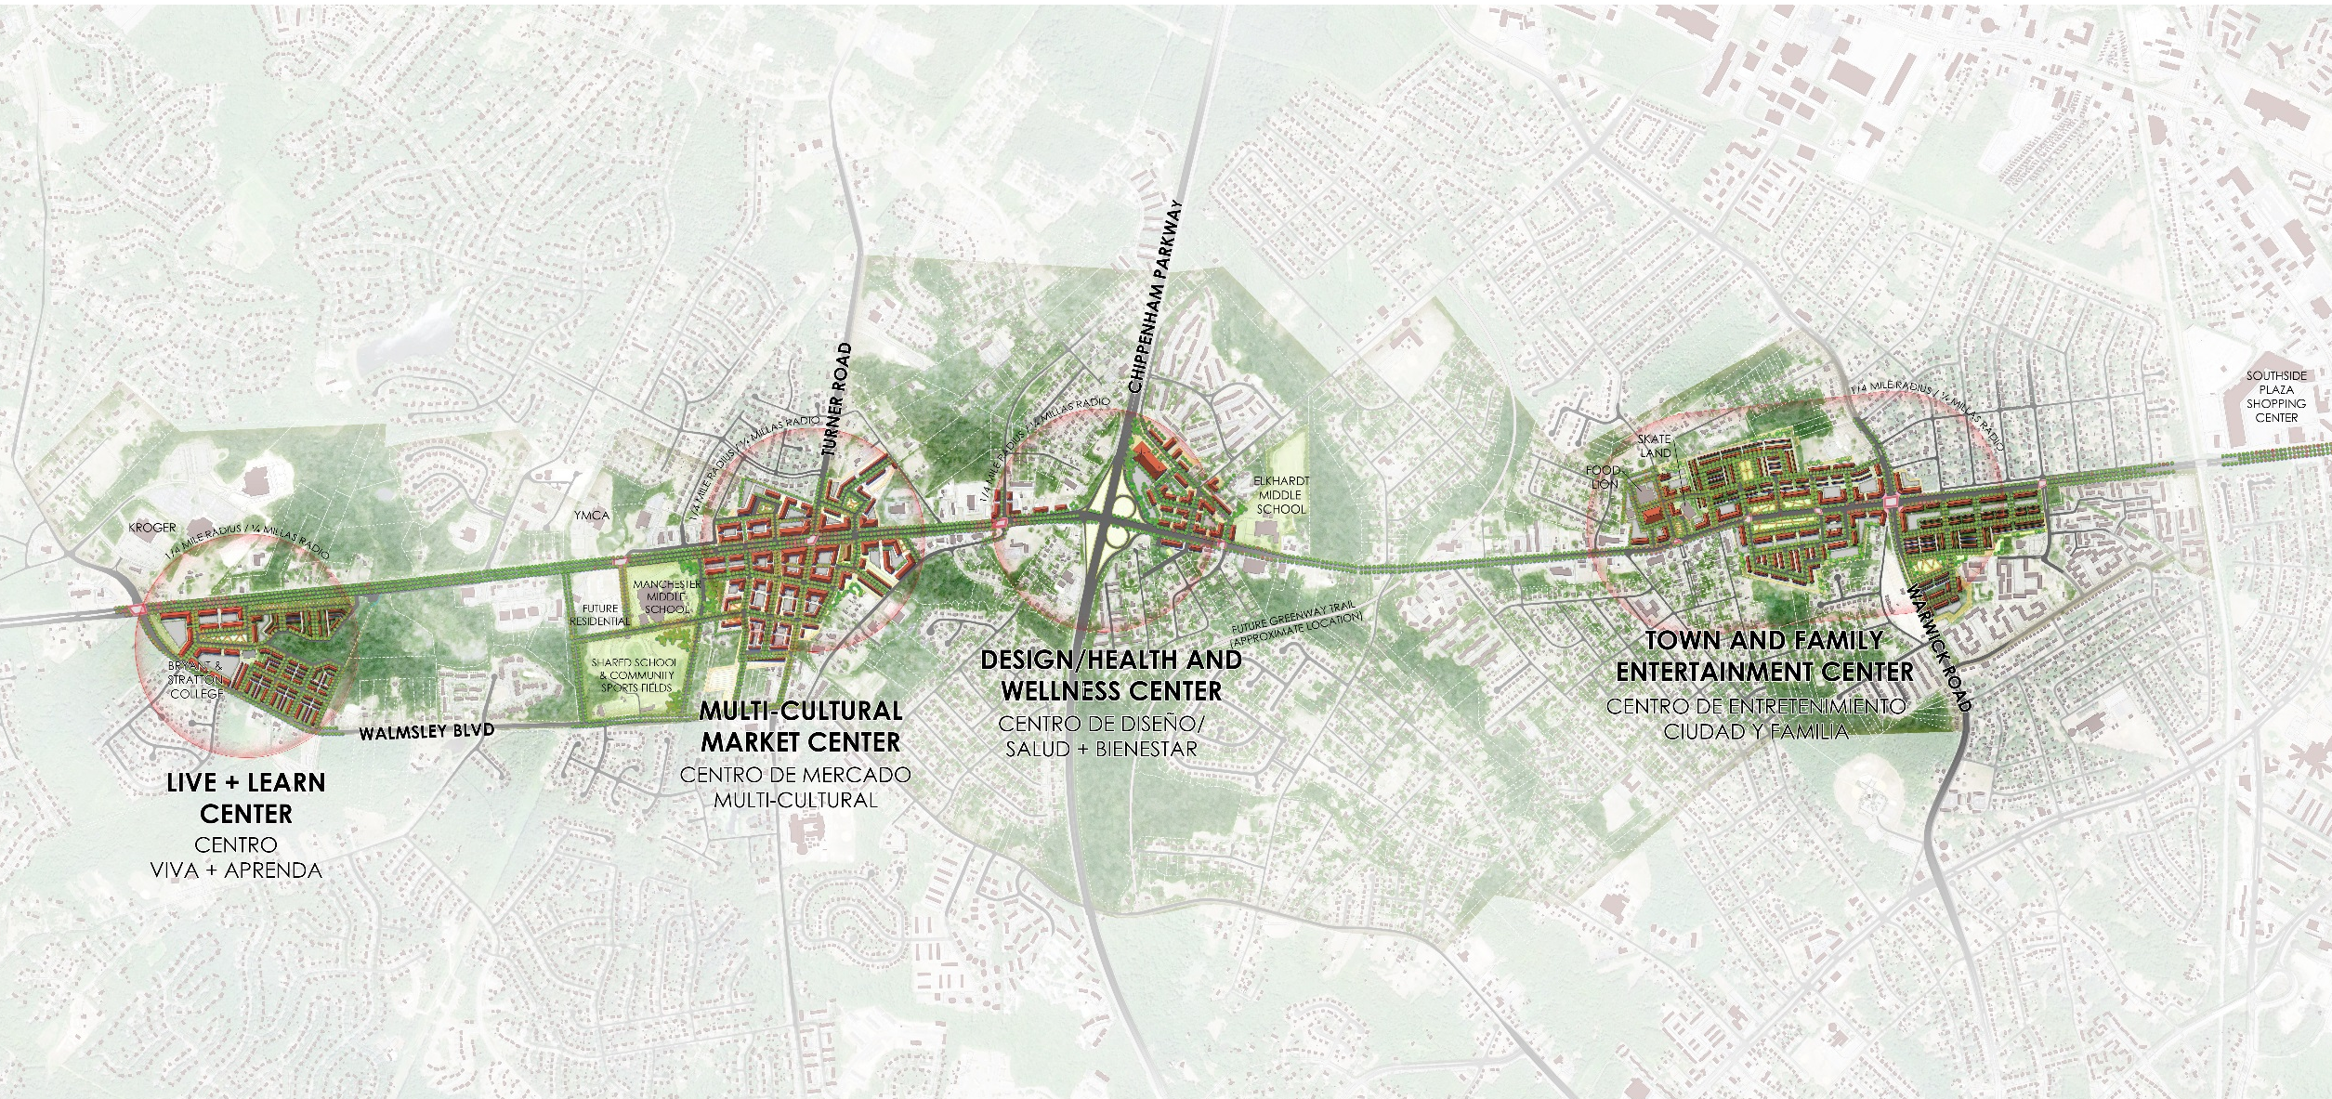
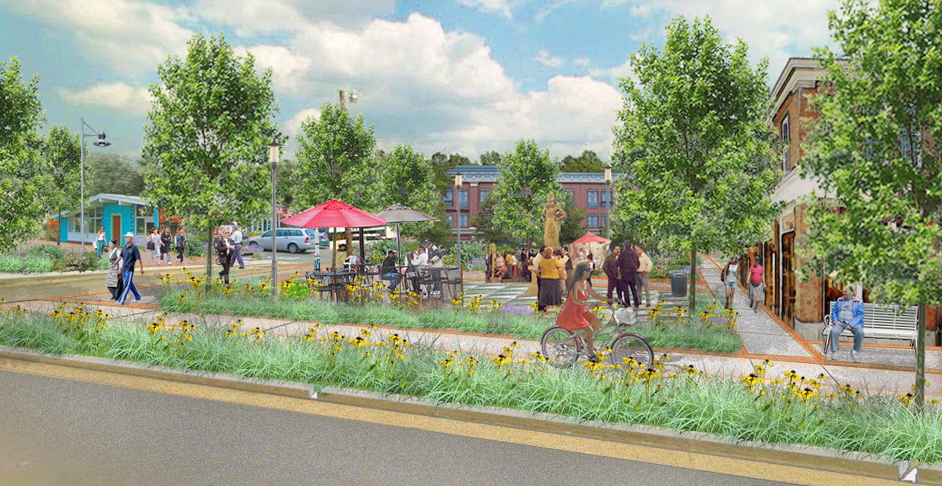
IMPLEMENTATION STRATEGIES | LAND USE & URBAN DESIGN – SIMILAR PROJECTS

Slide 42
Thank you for your time

