Slide 1

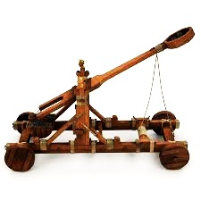


PUMPKIN CHUNKIN’
Exploring the Engineering Design Process
MINI UNIT: 14 – 32 class periods

Slide 2


DEFINING THE PROBLEM AND BRAINSTORMING
PUMPKIN CHUNKIN’: Lessons 1 and 2
DIRECTIONS: Format your engineering notebook to look exactly like the “Drill” below. Be sure to answer questions in complete sentence.
Lessons 1 and 2: Defining the Problem and Brainstorming 12/1
Objective: Students will BRAINSTORM design solutions to an engineering problem.
Drill: Review the Pumpkin Chunkin’ Rules and rubrics provided:
What is Pumpkin Chunkin’? What is the design challenge that our class will be developing a solution for?
What are some of the requirements for our design solution outlined in the rulebook.

Slide 3
DEFINING THE PROBLEM AND BRAINSTORMING
PUMPKIN CHUNKIN’: Lessons 1 and 2
DIRECTIONS: Record the problem statement your class generates in your engineering notebook for future reference.
Over the next few weeks, we will be going through the engineering design process to design a pumpkin launching device that meets the requirements outlined in the rulebook.
As a class, let’s develop a problem statement for the Pumpkin Chunkin’ Challenge:
Example Problem Statement: Robinson Nature Center wants students to have the chance to compete in an engineering competition whose goal is to hit a target with a pumpkin.
Example Design Statement: Design a pumpkin launching device that can throw a 4 – 10 lb pumpkin 77ft in distance and 10 ft in height. The device must be easily transported and built within a $100 budget.
What is the difference between a problem statement and
a design statement?

Slide 4
DEFINING THE PROBLEM AND BRAINSTORMING
PUMPKIN CHUNKIN’: Lessons 1 and 2
DIRECTIONS: Record boxed statements in your engineering notebook for future reference.
Once engineers have identified the problem, they begin brainstorming solutions.
Brainstorm: Any technique used by a design team to generate ideas.

Slide 5
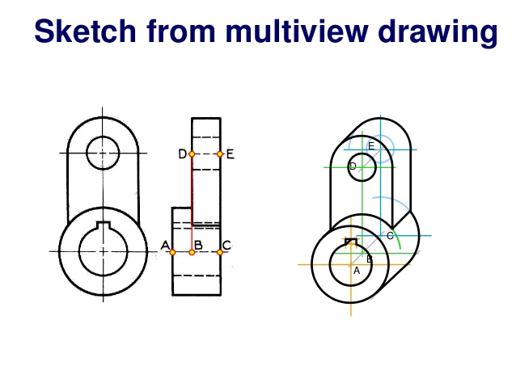
DEFINING THE PROBLEM AND BRAINSTORMING
PUMPKIN CHUNKIN’: Lessons 1 and 2
DIRECTIONS: Record boxed statements in your engineering notebook for future reference.
When engineers brainstorm, they may draw sketches to capture their ideas. Two different drawing techniques can be used to capture an idea in 3-D.
Pictorial Sketch: A type of drawing that gives the illusion of three dimensions, by showing an object’s height, width and depth in a single view.
Multi-view Sketch: A type of drawing that portrays an object as a series of two or more two-dimensional views arranged in a specific pattern.

Slide 6
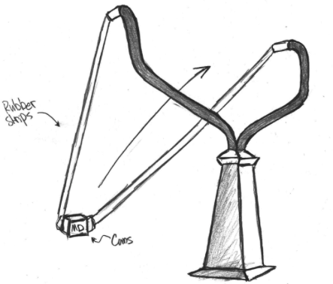
DEFINING THE PROBLEM AND BRAINSTORMING
PUMPKIN CHUNKIN’: Lessons 1 and 2
DIRECTIONS: You have 15 minutes to draw a pictorial or multi-view sketch of at least one idea for a pumpkin launching device in your engineering notebook. Be sure to title and date your sketches (example: Pumpkin Chunkin’ Launcher Brainstorm, Design #1 Multi-view sketch). Write one complete sentence under your drawing explaining how it works. Label your drawing as either a pictorial or multi-view sketch. CHALLENGE: Label your sketch with possible building materials that could be used to make your design.
EXAMPLE: Pumpkin Chunkin’ Launcher Brainstorm:
Design #1 (Pictorial):
My idea is to build a giant slingshot to launch the pumpkin.
To make it work…

Slide 7

DEFINING THE PROBLEM AND BRAINSTORMING
PUMPKIN CHUNKIN’: Lessons 1 and 2
DIRECTIONS: Re-draw a quick sketch of your favorite launcher idea on the Post-It note provided. When you are finished, stick it to the front board so everyone can view your idea.
Can we sort the Post-It notes into general categories?
How could we label the groups of launching devices we brainstormed?

Slide 8
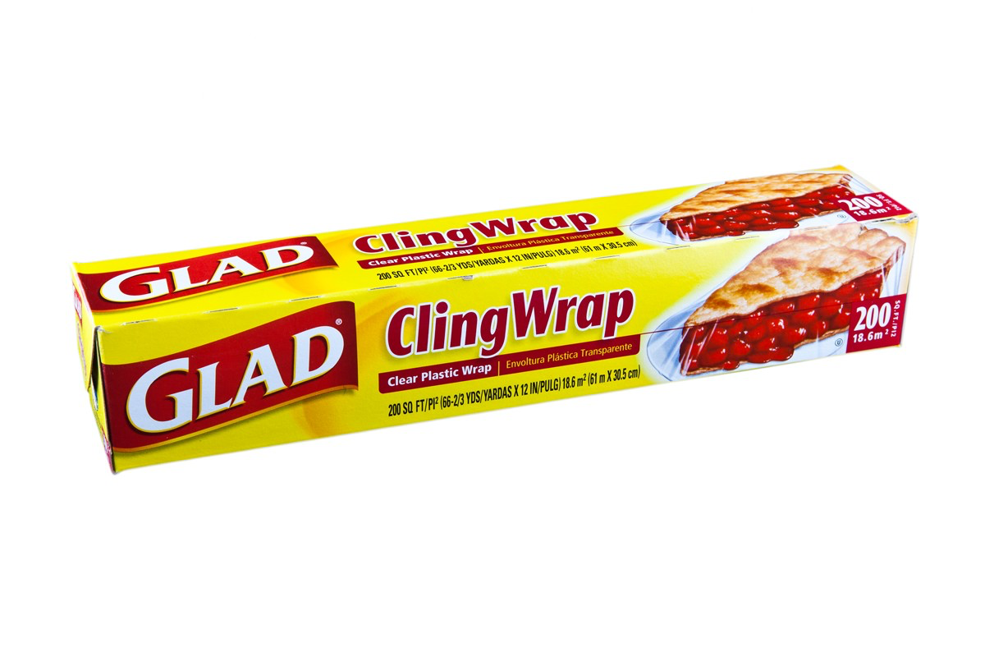
DEFINING THE PROBLEM AND BRAINSTORMING
PUMPKIN CHUNKIN’: Lessons 1 and 2
WRAP-UP
Key Question: How can we use the design process to solve an engineering problem?
The first step in the design process is “defining the problem.” Engineers will identify the most important information about the design project.
Once the design problem has been identified, engineers begin brainstorming solutions.

Slide 9

DEFINING THE PROBLEM AND BRAINSTORMING
PUMPKIN CHUNKIN’: Lessons 1 and 2
DIRECTIONS: Format your engineering notebook to look exactly like the “Exit Ticket” below. Be sure to answer questions in complete sentence.
Exit Ticket:
Which design that either you or a classmate brainstormed in class today, would you be most interested in researching further? Why

Slide 10
RESEARCH AND GENERATE IDEAS
PUMPKIN CHUNKIN’: Lesson 3
DIRECTIONS: Format your engineering notebook to look exactly like the “Drill” below. Be sure to answer questions in complete sentence.
Lesson 3: Research and Generate Ideas 12/1
Objective: Students will COMPARE different design ideas found through research to generate the best solution for a design problem
Drill:
Why would researching launching devices be beneficial to generating a design solution for the Pumpkin Chunkin’ challenge?

Slide 11
RESEARCH AND GENERATE IDEAS
PUMPKIN CHUNKIN’: Lesson 3
Today, you will be conducting research on several different launching devices to generate new ideas for your Pumpkin Chunkin’ machine.
Let’s generate a list of launching devices that we can research further:

Slide 12
RESEARCH AND GENERATE IDEAS
PUMPKIN CHUNKIN’: Lesson 3
DIRECTIONS: Record boxed statements in your engineering notebook for future reference.
Engineers will complete research to help establish facts and to inspire new ideas before designing a solution to a problem
Research: The systematic study of materials and sources in order to establish facts and reach new conclusions.

Slide 13
RESEARCH AND GENERATE IDEAS
PUMPKIN CHUNKIN’: Lesson 3
DIRECTIONS: You and your group have been assigned a specific launching mechanism to research further. Your job it to write a 1-paragraph summary of how the machine works and to draw a simple picture of the machine’s design. You must also prepare a “works cited” list, detailing where you found your information in case we want to revisit the source in the future. Be sure to use correct MLA format when citing your sources. Be prepared to share the information you discover with the class.

Slide 14
RESEARCH AND GENERATE IDEAS
PUMPKIN CHUNKIN’: Lesson 3
WRAP-UP
Key Question: How can we use the design process to solve an engineering problem?
Engineers conduct research in order to establish facts and reach new conclusions about a design problem

Slide 15
RESEARCH AND GENERATE IDEAS
PUMPKIN CHUNKIN’: Lesson 3
DIRECTIONS: Format your engineering notebook to look exactly like the “Exit Ticket” below. Be sure to answer questions in complete sentence.
Exit Ticket:
What launching mechanism that was presented in class do you think would be the most successful at launching a pumpkin? Why?
What specific components of the mechanism you identified in question one could you incorporate into your pumpkin launcher design?

Slide 16
INDENTIFYING CRITERIA AND SPECIFYING CONSTRAINTS
PUMPKIN CHUNKIN’: Lesson 4
DIRECTIONS: Format your engineering notebook to look exactly like the “Drill” below. Be sure to answer questions in complete sentence.
Lesson 4: Identifying Criteria and Specifying Constraints 12/1
Objective: Students will WRITE a design brief summarizing the criteria and constraints for a given design problem
Drill: Imagine you are designing a shoe. You have the following materials to choose from: aluminum foil, canvas, cotton fabric, felt, foam, newspaper, plastic, and rubber.
What material(s) would select to build your shoe out of?
Why did you choose these materials?
IF YOU FINISH EARLY: Draw a sketch of the shoe you would design. Be sure to label what material each part of the shoe is made out of.

Slide 17
INDENTIFYING CRITERIA AND SPECIFYING CONSTRAINTS
PUMPKIN CHUNKIN’: Lesson 4
DIRECTIONS: Record boxed statements in your engineering notebook for future reference.
You chose a particular material to make your shoe out of because you believed it, compared to other materials, would better suit the function of the shoe you were designing. Engineers must consider the function and limitations of their device before they begin designing.
Criteria: Standards by which something may be judged or decided
Constraints: A limit or restriction to a design process
Engineers must consider both criteria and constraints when designing a solution to a problem.

Slide 18
INDENTIFYING CRITERIA AND SPECIFYING CONSTRAINTS
PUMPKIN CHUNKIN’: Lesson 4
DIRECTIONS: Record boxed statements in your engineering notebook for future reference.
Criteria: Standards by which something may be judged or decided
Constraints: A limit or restriction to a design process
An example of criteria and constraints with our shoe example would be:
Constraint = durability Criteria = being waterproof

Slide 19
INDENTIFYING CRITERIA AND SPECIFYING CONSTRAINTS
PUMPKIN CHUNKIN’: Lesson 4
DIRECTIONS: You have 5 minutes to identify the criteria and constraints for our Pumpkin Chunkin’ design challenge with a partner. Be sure to record your thoughts in chart or other organized way in your engineering notebook.
CRITERIA | CONSTRAINTS
Which criteria would we categorize as vital? Strongly desired? Marginally desired? Unessential? Why?
Which criteria should we spend the most time and resources developing? Why?

Slide 20
INDENTIFYING CRITERIA AND SPECIFYING CONSTRAINTS
PUMPKIN CHUNKIN’: Lesson 4
DIRECTIONS: Record boxed statements in your engineering notebook for future reference.
When beginning a project, engineers will produced a design brief in which they identify the criteria and constraints of the project.
Design brief: A written plan that identifies a problem to be solved, its criteria and constraints.
Design briefs are important because they encourage thinking about all aspects of the problem to be solved before a solution is attempted.

Slide 21
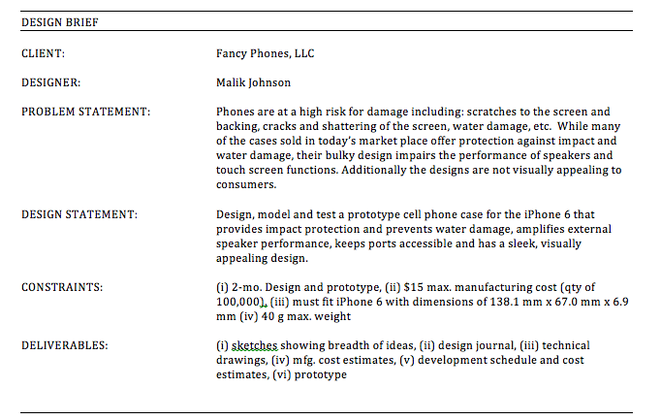
INDENTIFYING CRITERIA AND SPECIFYING CONSTRAINTS
PUMPKIN CHUNKIN’: Lesson 4
DIRECTIONS: Identify where the criteria and constraints are identified in the design brief pictured below. Mark these locations on your handout.

Slide 22
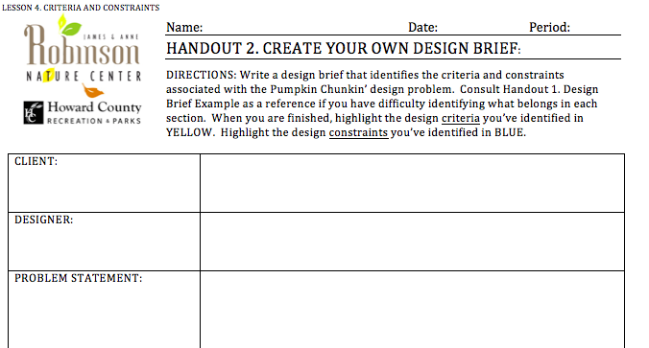
INDENTIFYING CRITERIA AND SPECIFYING CONSTRAINTS
PUMPKIN CHUNKIN’: Lesson 4
DIRECTIONS: You have 15 minutes to write a design brief for the Pumpkin Chunkin’ design challenge. Before beginning, review the grading rubric to ensure you understand how you are being evaluated and that you include all components of the assignment.

Slide 23
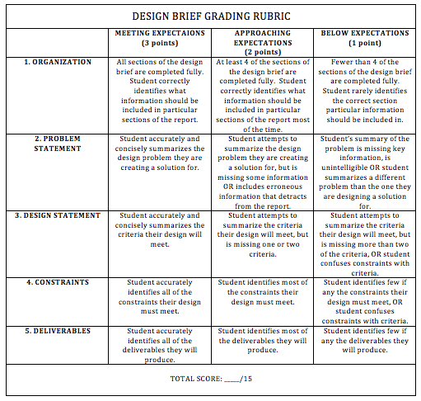
INDENTIFYING CRITERIA AND SPECIFYING CONSTRAINTS
PUMPKIN CHUNKIN’: Lesson 4

Slide 24
INDENTIFYING CRITERIA AND SPECIFYING CONSTRAINTS
PUMPKIN CHUNKIN’: Lesson 4
WRAP-UP
Key Question: How can we use the design process to solve an engineering problem?
When solving an engineering challenge, engineers must make sure they’ve thought about all aspects of a problem
This involves identifying the criteria and constraints associated with the problem
It is important to determine which criteria are vital, strongly desired and unessential to ensure resources are allocated appropriately
Engineers use design briefs to clearly and concisely record the criteria and constraints of a given problem, so that they are able to refer to the decisions they’ve made at any time

Slide 25
INDENTIFYING CRITERIA AND SPECIFYING CONSTRAINTS
PUMPKIN CHUNKIN’: Lesson 4
DIRECTIONS: Format your engineering notebook to look exactly like the “Exit Ticket” below. Be sure to answer questions in complete sentence.
Exit Ticket:
Consider our shoe design problem from the beginning of class. Identify the criteria and constraints you would consider if you were designing the shoe
CRITERIA | CONSTRAINTS

Slide 26
EXPLORING POSSIBILITIES
PUMPKIN CHUNKIN’: Lesson 5
DIRECTIONS: Format your engineering notebook to look exactly like the “Drill” below. Be sure to answer questions in complete sentence.
Lesson 5: Exploring Possibilities 12/1
Objective: Students will DESIGN solutions that meet the criteria and constraints in an engineering problem
Drill: Look through your engineering notebook and find the sketches you made during our first Pumpkin Chunkin’ brainstorming session. Review the criteria and constraints we identified for this engineering problem during class yesterday.
Which of your drawings best meets the design criteria and constraints that we’ve identified? Why?
What could you change about this design to make it better meet the design criteria and constraints that we’ve identified? How would these changes accomplish this goal?
IF YOU FINISH EARLY: Begin sketching your design included the new elements you identified in question 2 in your engineering notebook.

Slide 27
EXPLORING POSSIBILITIES
PUMPKIN CHUNKIN’: Lesson 5
DIRECTIONS: You have 7 minutes to redraw your pumpkin launcher design with the modifications identified in question #2 from the drill.
What are the two types of sketching we discussed during Lesson 2. Brainstorm?

Slide 28
EXPLORING POSSIBILITIES
PUMPKIN CHUNKIN’: Lesson 5
DIRECTIONS: Today we are going to use the “stepladder method” of brainstorming to generate design ideas. This process is particularly useful for groups that have a mix of both introverts and extroverts and guarantees that everyone’s ideas are heard. We’ve already completed the first two steps.
Step 1. Clearly define the problem and criteria
Step 2. Allow group members time to create ideas individually
Step 3. Two group members come together and share their ideas and brainstorm new ideas that develop as a results of the sharing process.
Step 4. A third member is added who presents his or her ideas to the other two members and then listens to the ideas from the original two members. After all of the ideas have been shared, time is allowed to brainstorm new ideas.
Step 5. Repeat step 4 by adding one new group member at a time until all members have joined an shared ideas.

Slide 29
EXPLORING POSSIBILITIES
PUMPKIN CHUNKIN’: Lesson 5
DIRECTIONS: Present the “final” sketch your group came up with as a result of the stepladder brainstorm. Explain your drawing and ideas and tape your sketch to the front board.

Slide 30
EXPLORING POSSIBILITIES
PUMPKIN CHUNKIN’: Lesson 5
DIRECTIONS: You have been given three sticky notes. When I say go, quietly and respectfully place a sticky note on the three designs you think best meet the design criteria and constraints we’ve established. We will evaluate these ideas more thoroughly tomorrow.

Slide 31
EXPLORING POSSIBILITIES
PUMPKIN CHUNKIN’: Lesson 5
WRAP-UP
Key Question: How can we use the design process to solve an engineering problem?
When solving an engineering challenge, engineers revisit solution ideas they generated earlier in the design process and build upon them
At this point in the design process, it’s important to consider the criteria and constraints of the problem when generating and modifying ideas.
The stepladder method is a useful brainstorming technique when exploring the possibilities because is allows team members to express, expand, combine and twist ideas generated by the group to come to an even better design

Slide 32
EXPLORING POSSIBILITIES
PUMPKIN CHUNKIN’: Lesson 5
DIRECTIONS: Format your engineering notebook to look exactly like the “Exit Ticket” below. Be sure to answer questions in complete sentence.
Exit Ticket:
Which design presented by a group today do you think best meets the design criteria and constraints your class identified? Why (support your answer with specific evidence)?

Slide 33
SELECT AN APPROACH
PUMPKIN CHUNKIN’: Lesson 6
DIRECTIONS: Format your engineering notebook to look exactly like the “Drill” below. Be sure to answer questions in complete sentence.
Lesson 6: Select an Approach 12/1
Objective: Students will EVALUATE design solutions to an engineering problem using a decision matrix
Drill: Think back to the phone case design brief you read during Lesson 4. Identifying Criteria and Constraints.
If you were comparing several different cell phone case designs, how would you decide which solution was the best?

Slide 34
SELECT AN APPROACH
PUMPKIN CHUNKIN’: Lesson 6
DIRECTIONS: Record boxed statements in your engineering notebook for future reference.
A decision matrix is used to help engineers decide which solution to a design problem is the best. It’s a tool that prevents us from being “married to an idea” and biased in our decision-making.
Decision Matrix: A chart used by engineers to quantify their opinions of two or more design ideas by assessing each idea according to a series of important considerations.

Slide 35
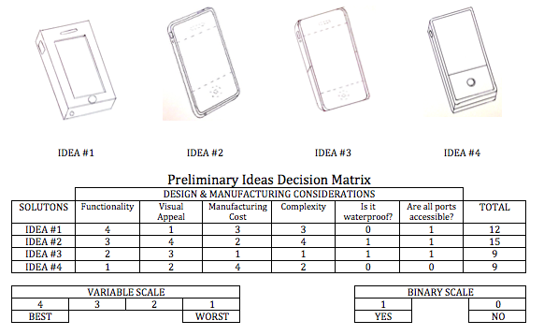
SELECT AN APPROACH
PUMPKIN CHUNKIN’: Lesson 6
DIRECTIONS: Examine the decision matrix comparing several phone case design solutions pictured below. Consider the following questions while reading: What are the considerations used to compare the designs? How are the design solutions scored? What is the difference between points awarded using a variable scale versus a binary scale? How can we tell which design idea is the best?

Slide 36
SELECT AN APPROACH
PUMPKIN CHUNKIN’: Lesson 6
MORE INFORMATION ABOUT DECISION MATRIXES
Two number scales may be used to evaluate solution ideas in a decision matrix: a variable scale and a binary scale.
The variable scale can include a range of values that is more than two. Ideas can be ranked based on how well they meet an important consideration.
A binary scale is used when an idea is evaluated based on a specific criteria or a question. Zero indicates “No” and one indicates “Yes.”
If a team decides a particular consideration is more important than another, for example the functionality is twice as important as the visual appeal, a multiplier may be used to give weight to the more important category

Slide 37
SELECT AN APPROACH
PUMPKIN CHUNKIN’: Lesson 6
DIRECTIONS: You have 5 minutes to brainstorm at least three “considerations” you think we should evaluate our pumpkin-launching devices by. Two of your considerations should be able to be judged on a variable scale. One of your considerations should be able to be judged on a binary scale.

Slide 38
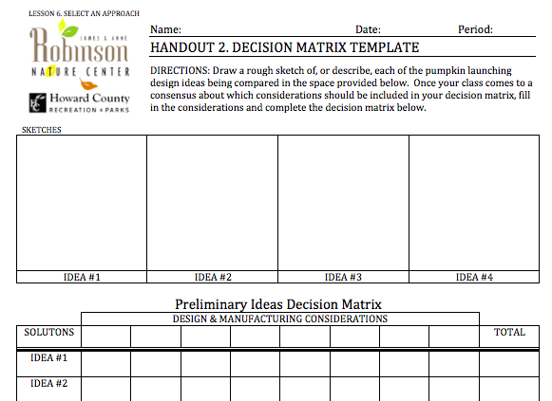
SELECT AN APPROACH
PUMPKIN CHUNKIN’: Lesson 6
DIRECTIONS: We must now agree on which “considerations” we will include in our decision matrix. Which “considerations” should we definitely include? Why? Which ones can we eliminate? Why?

Slide 39
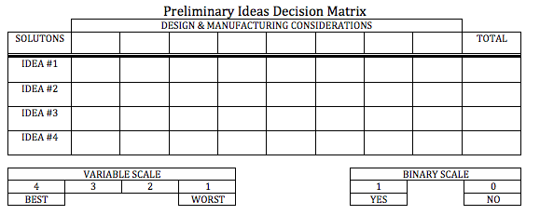
SELECT AN APPROACH
PUMPKIN CHUNKIN’: Lesson 6
Average the totals from each team member’s decision matrix to determine the idea with the highest score.

Slide 40
SELECT AN APPROACH
PUMPKIN CHUNKIN’: Lesson 6
WRAP-UP
Key Question: How can we use the design process to solve an engineering problem?
When solving an engineering challenge, engineers must determine which design solution they’ve developed is best.
A useful tool for objectively evaluating design solutions is a decision matrix.
A decision matrix is a chart engineers use to quantify their opinions of two or more design ideas by evaluating each idea according to a series of important considerations.
Decision matrixes allow engineers to come to consensus about which idea has the greatest potential for development into a successful working solution.

Slide 41
SELECT AN APPROACH
PUMPKIN CHUNKIN’: Lesson 6
DIRECTIONS: Format your engineering notebook to look exactly like the “Exit Ticket” below. Be sure to answer questions in complete sentence.
Exit Ticket:
Do you believe that the pumpkin launching mechanism design with the highest score from the decision matrix has the greatest potential for development into a successful working solution? Why or why not?

Slide 42
DEVELOP A DESIGN SOLUTION
PUMPKIN CHUNKIN’: Lesson 7
DIRECTIONS: Format your engineering notebook to look exactly like the “Drill” below. Be sure to answer questions in complete sentence.
Lesson 7: Develop a Design Solution 12/1
Objective: Students will CREATE a design proposal for an engineering problem consisting of CAD drawings, text descriptions and/or hand drawings
Drill: Imagine you just bought an Ikea bookshelf. It requires assembly.
What would the manufacturer provide you to help you assemble your bookcase?
What information is included in the document you identified in question 1?

Slide 43
DEVELOP A DESIGN SOLUTION
PUMPKIN CHUNKIN’: Lesson 7
DIRECTIONS: Record boxed statements in your engineering notebook for future reference.
At this point, you have selected a design solution. Before building a prototype or model, a clear, documented description of the design is required. Engineers document this information in a “design proposal.”
Design proposal: A written document that clearly specifies how to build a model or prototype of a final design. The design proposal should include documents that specify (1) materials, (2) dimensions and (3) processes used in the construction.

Slide 44
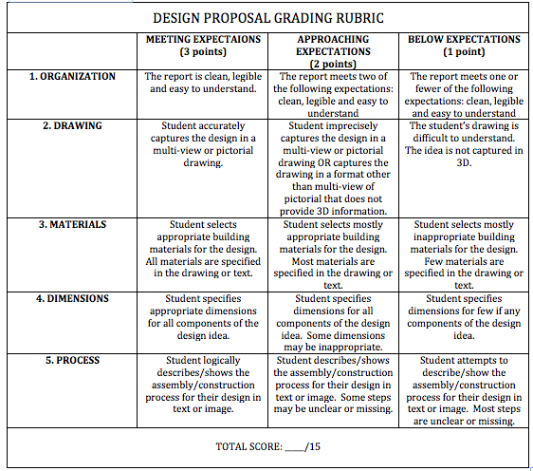
DEVELOP A DESIGN SOLUTION
PUMPKIN CHUNKIN’: Lesson 7
DIRECTIONS: You have the rest of the class period to begin working on your design proposal. Be sure to consult the rubric as you work to ensure you’re meeting all expectations!

Slide 45
DEVELOP A DESIGN SOLUTION
PUMPKIN CHUNKIN’: Lesson 7
WRAP-UP
Key Question: How can we use the design process to solve an engineering problem?
When solving an engineering challenge, engineers must complete the preparations to build a prototype or model of their chosen design.
Engineers document how to build their prototype or model in a “design proposal.”
A design proposal should include documents that specify (1) materials, (2) dimensions and (3) processes used in the construction.

Slide 46
DEVELOP A DESIGN SOLUTION
PUMPKIN CHUNKIN’: Lesson 7
DIRECTIONS: Format your engineering notebook to look exactly like the “Exit Ticket” below. Be sure to answer questions in complete sentence.
Exit Ticket:
Compare your design proposal to the grading rubric. If you were grading your design proposal, what grade would you give yourself? Why?

Slide 47
MAKING A MODEL OR PROTOTYPE
PUMPKIN CHUNKIN’: Lesson 8
DIRECTIONS: Format your engineering notebook to look exactly like the “Drill” below. Be sure to answer questions in complete sentence.
Lesson 8: Making a Model or Prototype 12/1
Objective: Students will BUILD the design solution they outlined in their design proposal
Drill: Today we will begin building our model/prototype pumpkin launching device.
What safety protocol should we follow to ensure we have a safe classroom environment?

Slide 48
MAKING A MODEL OR PROTOTYPE
PUMPKIN CHUNKIN’: Lesson 8
DIRECTIONS: Record boxed statements in your engineering notebook for future reference.
At this point in the design process, you will begin building a model or prototype of your pumpkin launching device.
Model: A detailed three dimensional representation of a design that is used to communicate, explore or test and idea. Models may be scaled down or scaled up from the intended size and may be made from different materials than the final product.
Prototype: A one-of-a-kind working model of a solution that is developed for testing purposes. A prototype is manufactured according to the information contained in the design proposal.

Slide 49
MAKING A MODEL OR PROTOTYPE
PUMPKIN CHUNKIN’: Lesson 8
WRAP-UP
Key Question: How can we use the design process to solve an engineering problem?
When solving an engineering challenge, engineers may create models of the solution to communicate, test or explore a design idea.
Engineers may also choose to build a prototype using the specifications outlined in the design proposal to test their design solution.

Slide 50
MAKING A MODEL OR PROTOTYPE
PUMPKIN CHUNKIN’: Lesson 8
DIRECTIONS: Format your engineering notebook to look exactly like the “Exit Ticket” below. Be sure to answer questions in complete sentence.
Exit Ticket:
Why might it be useful/practical to build a model before building a prototype of a design solution? What are the benefits? What are the trade-offs?

Slide 51
TEST AND EVALUATE
PUMPKIN CHUNKIN’: Lesson 9
DIRECTIONS: Format your engineering notebook to look exactly like the “Drill” below. Be sure to answer questions in complete sentence.
Lesson 9: Test and Evaluate 12/1
Objective: Students will COLLECT and effectively DISPLAY data that can be used to evaluate the quality of their design solution and make improvements based on evidence collected from testing
Drill: Look back at your “Rules and Regulations” packet for Pumpkin Chunkin’.
How is your pumpkin launching mechanism going to be evaluated on competition day?
Which criteria can you evaluate and refine through testing?
How can you evaluate how well your machine meets this criteria?

Slide 52

TEST AND EVALUATE
PUMPKIN CHUNKIN’: Lesson 9
1
2
3
Which picture shows the target practice results of the best archer? How do you know?
How would you describe what’s going on in Picture 1? Picture 3? Picture 2?

Slide 53
TEST AND EVALUATE
PUMPKIN CHUNKIN’: Lesson 9
DIRECTIONS: Record boxed statements in your engineering notebook for future reference.
Accuracy: A measurement of how close you are to the actual value.
Precision: The ability of a measurement to be consistently reproduced.
Which picture shows a target with high accuracy, but low precision?
Which picture shows a target with high precision but low accuracy?
Which picture shows a target with both high precision and accuracy?
1
2
3

Slide 54
TEST AND EVALUATE
PUMPKIN CHUNKIN’: Lesson 9
Let’s Brainstorm ways to measure accuracy and precision for our pumpkin launcher.
DIRECTIONS: Create a table in your engineering notebooks in which you can record launch data.

Slide 55
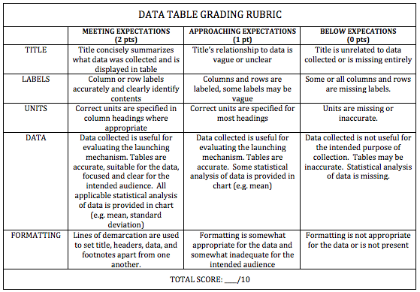
TEST AND EVALUATE
PUMPKIN CHUNKIN’: Lesson 9
Analyze the data you’ve collected:
What can we conclude from the data we collected?
Was our launcher accurate? Why or why not?
Was our launcher precise? Why or why not?

Slide 56
TEST AND EVALUATE
PUMPKIN CHUNKIN’: Lesson 9
Analyze the data you’ve collected:
What can we conclude from the data we collected?
Was our launcher accurate? Why or why not?
Was our launcher precise? Why or why not?

Slide 57
EXTENSION:
Standard Deviation
PUMPKIN CHUNKIN’: Lesson 9
How can we determine how precise our machine is?

Slide 58
EXTENSION:
Standard Deviation
PUMPKIN CHUNKIN’: Lesson 9
DIRECTIONS: Record boxed statements in your engineering notebook for future reference.
How can we determine how precise our machine is?
Standard deviation: A measurement of how spread out a set of numbers are. A standard deviation close to zero indicates the data points are very close to the mean of the set, whereas a high standard deviation indicates the data points are spread out over a wide range of values.
We can calculate standard deviation for the distance and height data we collected. This will give you an idea of how consistent your machine is, meaning how likely it is to hit the same spot on the target every time it’s fired. The closer the standard deviation you calculate is to zero, the more consistent your machine is!

Slide 59

EXTENSION:
Standard Deviation
PUMPKIN CHUNKIN’: Lesson 9
DIRECTIONS: Record boxed statements in your engineering notebook for future reference.
This is the formula for standard deviation:
σ = standard deviation
Ν = number of data points
Σ = for each value x, complete the computation in parentheses and then take the sum of the values
x_{i} = individual data points
μ = mean (average) of the data points
We will break this complicated equation down into simple steps, so you can easily solve the problem!

Slide 60
EXTENSION:
Standard Deviation
PUMPKIN CHUNKIN’: Lesson 9
DIRECTIONS: Record boxed statements in your engineering notebook for future reference.
For the following problem lets pretend we have the following distance data:
TRIAL | DISTANCE
1 | 70 m
2 | 90 m
3 | 50 m
HOW TO: Calculating Standard Deviation
STEP | WHAT IT LOOKS LIKE
1. Calculate the mean (average) of your data points | (70m + 90m + 50m)/3 = 70m
2. Subtract the mean from each data point | 70m – 70m = 0m 90m – 70m = 20m 50m – 70m = -20m
3. Square each number you calculated in step 2 | (0m)² = 0 m² (20m)² = 400 m² (-20m)² = 400 m²
4. Calculate the mean of the squared numbers you determined in step 3 | (0 m² + 400 m² + 400 m²)/3 = 266.6m²
5. Take the square root of the mean you calculated in step 4. This is the standard deviation of your data. | √266.6m² = 16.3m

Slide 61
EXTENSION:
Standard Deviation
PUMPKIN CHUNKIN’: Lesson 9
DIRECTIONS: Record boxed statements in your engineering notebook for future reference.
Calculate the standard deviation for your distance and height data.
HOW TO: Calculating Standard Deviation
STEP | WHAT IT LOOKS LIKE
1. Calculate the mean (average) of your data points | (70m + 90m + 50m)/3 = 70m
2. Subtract the mean from each data point | 70m – 70m = 0m 90m – 70m = 20m 50m – 70m = -20m
3. Square each number you calculated in step 2 | (0m)² = 0 m² (20m)² = 400 m² (-20m)² = 400 m²
4. Calculate the mean of the squared numbers you determined in step 3 | (0 m² + 400 m² + 400 m²)/3 = 266.6m²
5. Take the square root of the mean you calculated in step 4. This is the standard deviation of your data. | √266.6m² = 16.3m

Slide 62
TEST AND EVALUATE
PUMPKIN CHUNKIN’: Lesson 9
WRAP-UP
Key Question: How can we use the design process to solve an engineering problem?
When solving an engineering challenge, engineers test prototypes they’ve built to evaluate how well their design solution solves the problem
It may be useful to measure accuracy and precision when evaluating a design solution

Slide 63
TEST AND EVALUATE
PUMPKIN CHUNKIN’: Lesson 9
DIRECTIONS: Format your engineering notebook to look exactly like the “Exit Ticket” below. Be sure to answer questions in complete sentence.
Exit Ticket:
Is our pumpkin launcher accurate and/or precise? Why or why not?
What could we change about our launcher’s design to improve its accuracy and precision? You may draw or write your response to this question.

Slide 64
REFINING THE DESIGN
PUMPKIN CHUNKIN’: Lessons 10 and 11
DIRECTIONS: Format your engineering notebook to look exactly like the “Drill” below. Be sure to answer questions in complete sentence.
Lessons 10 and 11: Refining the Design and Creating or Making the Final Design Solution 12/1
Objective: Students will EVALUATE the quality of their design solution and make improvements based on evidence collected from testing
Drill: Review the data you collected during the “Testing and Evaluating” phase of the design process.
Does our testing and evaluation indicate that all of the criteria and specifications have been satisfied? Why or why not?
What aspects of our design should we consider tweaking? Why?

Slide 65
REFINING THE DESIGN
PUMPKIN CHUNKIN’: Lessons 10 and 11
Let’s brainstorm design solutions that address the shortcomings that testing has revealed about our launching machine.
SHORTCOMINGS | DESIGN SOLUTIONS

Slide 66
REFINING THE DESIGN
PUMPKIN CHUNKIN’: Lessons 10 and 11
DIRECTIONS: Using the copy of the schematic drawings from the design proposal provided, add modifications to our design to ensure our machine better meets the criteria and constraints we’ve identified. When you are finished drawing, write a paragraph explaining what modifications you’ve made and why they are necessary.

Slide 67
REFINING THE DESIGN
PUMPKIN CHUNKIN’: Lessons 10 and 11
Let’s re-test our launching device using the same tests you agreed upon for the “Testing and Evaluating” phase of the design process. Collect data in tables in your engineering notebook.

Slide 68
REFINING THE DESIGN
PUMPKIN CHUNKIN’: Lessons 10 and 11
DIRECTIONS: Compare your data for our modified pumpkin launcher, to the data we originally collected. Did our modifications improve our machine? Are we better meeting the design criteria and constraints? Why or why not?

Slide 69
REFINING THE DESIGN
PUMPKIN CHUNKIN’: Lessons 10 and 11
WRAP-UP
Key Question: How can we use the design process to solve an engineering problem?
It’s rare that design projects are successful on the first try.
When solving an engineering challenge, engineers must evaluate data from testing to make informed decisions about refining their design.
Engineer’s will continue refining a design until all of the criteria or specification have been satisfied, at which point they “create or make” the mature product.

Slide 70
REFINING THE DESIGN
PUMPKIN CHUNKIN’: Lessons 10 and 11
DIRECTIONS: Format your engineering notebook to look exactly like the “Exit Ticket” below. Be sure to answer questions in complete sentence.
Exit Ticket:
After refining a design solution, engineer’s proceed to the next step in the design process “Creating or Making.” At this phase, a product may be commercially fabricated. There are two general categories for commercial production: mass production and custom production.
What do you think the difference between mass and custom production is?
Do you think our build was more similar to mass or custom production? Why?

Slide 71
COMMUNICATING PROCESS AND RESULTS
PUMPKIN CHUNKIN’: Lesson 12
DIRECTIONS: Format your engineering notebook to look exactly like the “Drill” below. Be sure to answer questions in complete sentence.
Lesson 12: Communicating Process and Results 12/1
Objective: Students will PRODUCE a final design document that effectively communicates design decisions
Drill: Review the Pumpkin Chunkin’ documentation scoring rubric:
Look through your engineering notebook. “Dog-ear” pages where you can find information required for documentation.
The final documentation may be presented as a website or video. If given the option, which documentation form would you prefer?

Slide 72
COMMUNICATING PROCESS AND RESULTS
PUMPKIN CHUNKIN’: Lesson 12
DIRECTIONS: Record boxed statements in your engineering notebook for future reference.
When a design solution is complete, engineers communicate the details of their design in a final design document. Robinson Nature Center has requested that the final design document be presented in a particular form.
Final design document: A complete set of design documentation prepared at the final stages of the design process. The final design documentation communicates clearly and completely what the design is and how well the design solves the problem. Final documentation should include all of the necessary charts, graphs, calculations, CAD drawings, modeling, simulations and text descriptions that, taken as a whole, represent the final design.

Slide 73
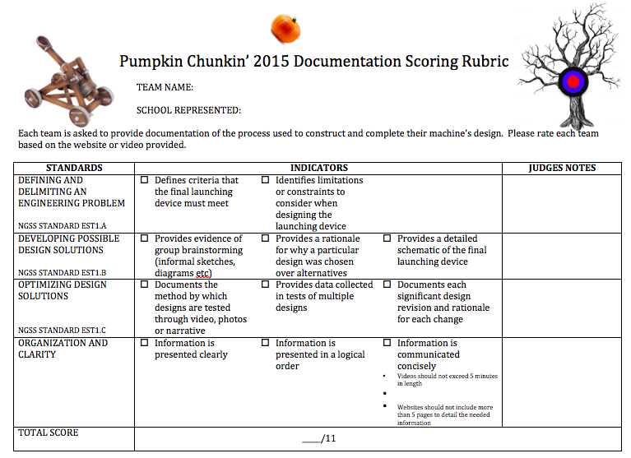
COMMUNICATING PROCESS AND RESULTS
PUMPKIN CHUNKIN’: Lesson 12
How will judges evaluate you on competition day?

Slide 74
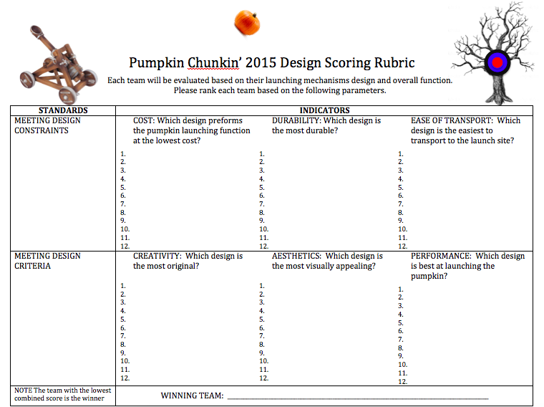
COMMUNICATING PROCESS AND RESULTS
PUMPKIN CHUNKIN’: Lesson 12
How will judges evaluate you on competition day?

Slide 75
COMMUNICATING PROCESS AND RESULTS
PUMPKIN CHUNKIN’: Lesson 12
Does our documentation contain all of the components outlined in the scoring rubric? If not, what is missing?
Is our documentation concise? Clear? Logically presented? If not, how can we improve it?

Slide 76
COMMUNICATING PROCESS AND RESULTS
PUMPKIN CHUNKIN’: Lesson 12
WRAP-UP
Key Question: How can we use the design process to solve an engineering problem?
When a design solution is complete, engineers communicate the details of their design in a final design document
Final documentation should include all of the necessary charts, graphs, calculations, CAD drawings, modeling, simulations and text descriptions that, taken as a whole, represent the final design.

Slide 77
COMMUNICATING PROCESS AND RESULTS
PUMPKIN CHUNKIN’: Lesson 12
DIRECTIONS: Format your engineering notebook to look exactly like the “Exit Ticket” below. Be sure to answer questions in complete sentence.
Exit Ticket:
Compare your final design document to the rubric(s) provided.
If you were evaluating your (contribution to the) project, what score would you give yourself? Why?

