Slide 1

North Columbia Fire Station
Capital Project No. FY2018 F5976
Community Meeting Presentation

Slide 2
Agenda
Introductions
Proposed Concept
    Site Design
    Building Design
Design and Construction Schedule
Q&A
Next Steps
North Columbia Fire Station Capital Project No. F5976
Inspirational. Resilient. Functional. Home.

Slide 3
Intro (by Facilities)
Content by Richard and Sharon
North Columbia Fire Station Capital Project No. F5976
Inspirational. Resilient. Functional. Home.

Slide 4
County Design Team
Bureau of Facilities
Mark Stromdahl, AIA - Bureau Chief
Sharon Walsh, AIA - Division Chief, Design & Construction
Richard Gasparotti, RA - Howard County Project Manager
Fire and Rescue
Christine Uhlhorn - Assistant Chief, Bureau of Logistics
Martin P. LePore - Battalion Chief, Bureau of Logistics
Kevin Henry - Captain, Bureau of Logistics
Mike Rund - Lieutenant, Bureau of Logistics
Josh Burchick, Lieutenant - Engine #7
James Love, Captain - Truck #7
AECOM
Jeannie Gasper, AIA, Project Manager
Mark Crosnicker, Fire Station Architect
Dave Moriconi, Civil Engineering Project Manager
North Columbia Fire Station Capital Project No. F5976
Inspirational. Resilient. Functional. Home.

Slide 5
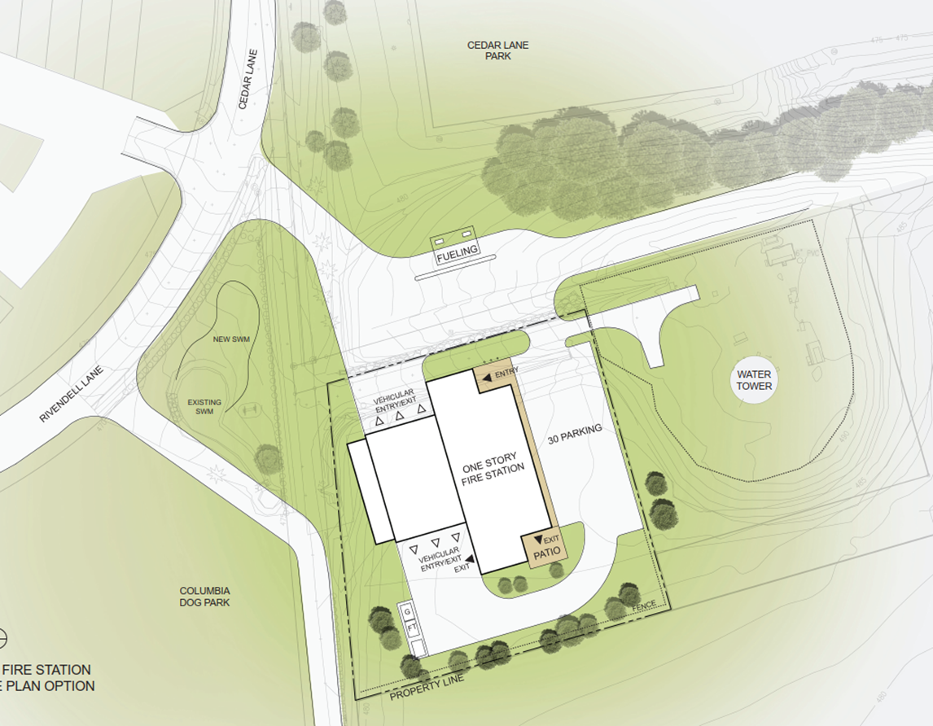
Site Design Option
3-Bay Fire Station
County Fueling Station
Road Realignments
  Columbia Dog Park
  Water Tower
  Future Staff Entrance for Police HQ
Traffic Signaling
North Columbia Fire Station Capital Project No. F5976
Inspirational. Resilient. Functional. Home.

Slide 6
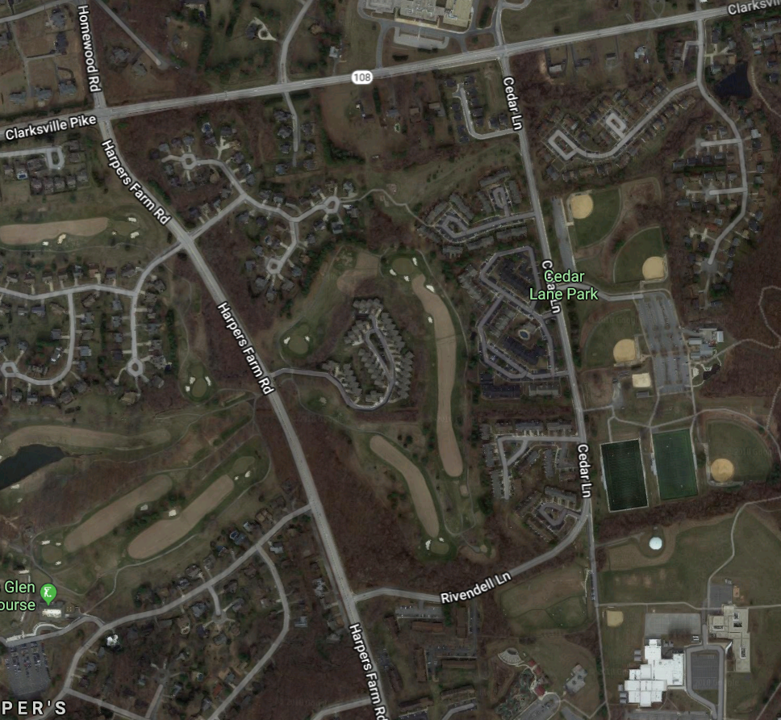
Traffic Signals
Rivendell Lane and Harper’s Farm Road
  Fire Department Light
Harper’s Farm Road and MD-108
  Preemption Only
Cedar Lane and MD-108
  None requested
North Columbia Fire Station Capital Project No. F5976
Inspirational. Resilient. Functional. Home.

Slide 7
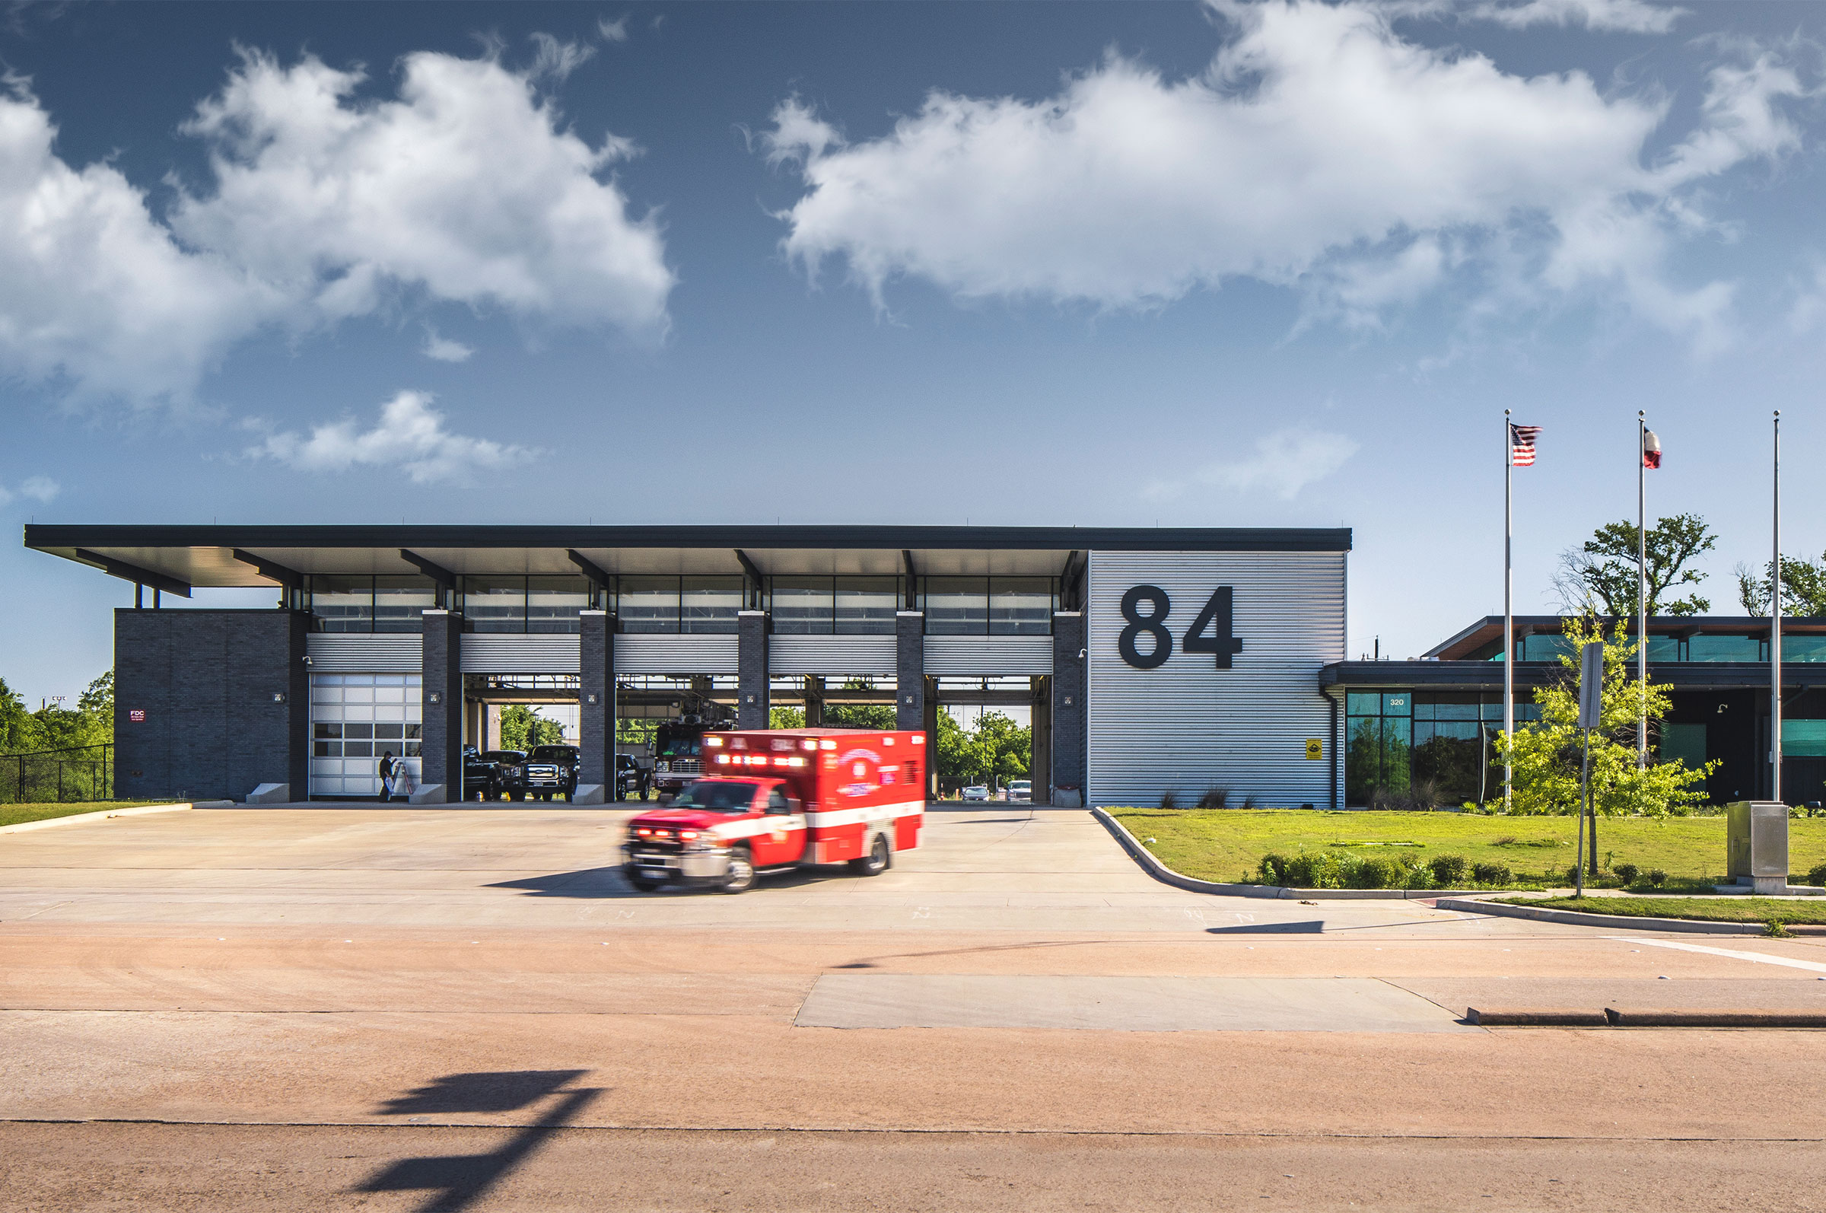
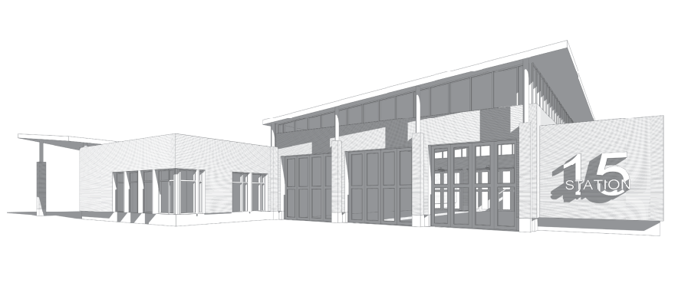
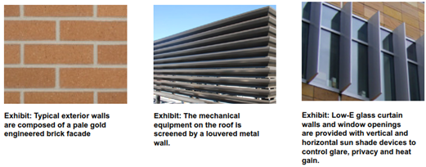
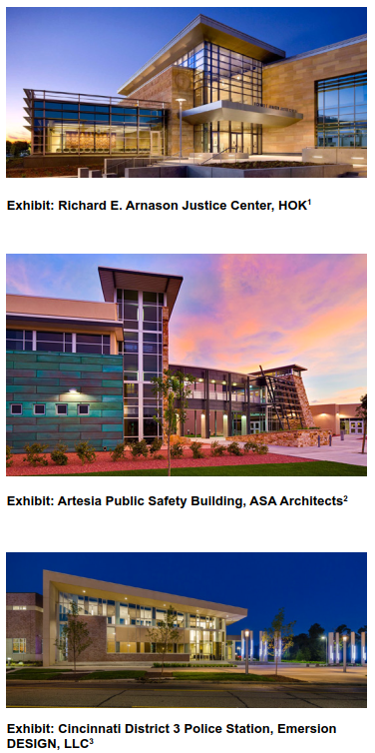
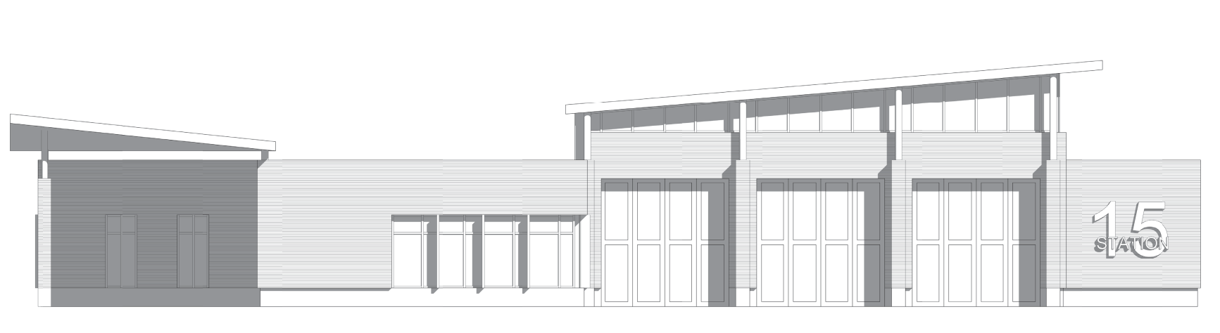
Building Design Option
Exhibit: Houston Fire Station 84, BRW Architects
Perspective View (Site Entry)
North Elevation (Apparatus Bays)
North Columbia Fire Station Capital Project No. F5976
Inspirational. Resilient. Functional. Home.

Slide 8
Design & Construction Schedule
Kick-Off
Occupancy
Design/Zoning/Permits
Bid
Construction
Early 2018
Late 2019
Early 2020
Mid 2021
North Columbia Fire Station Capital Project No. F5976
Inspirational. Resilient. Functional. Home.

Slide 9
Next Steps
Geotechnical Investigation
Site Development Plan Submission
SRC Meeting
FDP Revision/ Subdivision Plats
North Columbia Fire Station Capital Project No. F5976
Inspirational. Resilient. Functional. Home.

