Slide 1

General Information for Election Judges
Board of Elections
Phone: 410-313-5820

Slide 2
Message from the Election Director
I sincerely appreciate everyone who has volunteered to be an election judge during the COVID-19 global pandemic. Without people like you, we could never hold an in-person election in 2020. You can add yourselves to the list of heroes ensuring that democracy continues in these not so normal times!
Our training for this Presidential General Election is quite unique, in the fact that it is totally virtual. You will go through this informational presentation, watch videos for the judge type that you are assigned, take the quizzes that are online, and then have an opportunity to get any questions you may have answered at any one of our Q and A sessions that will be mandatory to attend, of course, virtually.
Please enjoy the training videos. My staff was tasked with making the entire training syllabus come to life in video in a short timeframe…I think you will appreciate the information that is contained in these videos. It tells and shows you exactly what you will need to do to be an election judge.
The videos will be available for you for the duration of the election process. Watch them as much as you want, at your own pace, on your own time. Write down questions for the Q and A session, which will be a mix of simple Q and A, video streaming to see something you would like to see, and any new information that we have been given to help you succeed.
Once again, from me, my staff, and the Board at the Howard County Board of Elections, thank you for participating as an Election Judge in the 2020 election.
-Guy Mickley, Election Director

Slide 3
General Information on the Presidential General Election

Slide 4
Election Dates and Voting Hours
EARLY VOTING
Monday, October 26 through Monday, November 2, 2020. Polls open at 7:00am and close at 8:00pm
ELECTION DAY
Tuesday, November 3, 2020. Polls open at 7:00am and close at 8:00pm
ALL JUDGES MUST ARRIVE AT THEIR ASSIGNED LOCATION BY 6:00AM ON ANY DAY OF VOTING.
ANY VOTER IN HOWARD COUNTY CAN VOTE AT ANY EARLY VOTING CENTER DURING EARLY VOTING OR ANY VOTE CENTER ON ELECTION DAY.

Slide 5
Election Judges’ Voting Options
You have two different ways that you can vote for this election, either in-person or by mail.
You may vote on the day that you work in an Early Voting Center or a Vote Center, or you may vote on your own time.
If you do not want to vote in-person while you are working, you may apply for a mail-in ballot at the State Board of Elections’ website.

Slide 6
Closing Time for Vote Centers
All voters who are in line to be checked in at 8:00 pm are allowed to vote. The vote centers are officially closed after the last person who was in line by 8:00 pm finishes voting.
Extended voting hours may be ordered. When this occurs, all election judges must continue to work. When the extended voting hours end, all voters who are in line to be checked in are allowed to vote.

Slide 7
Changes from the Norm for 2020
1. Chief Judges will not pick up supplies before the election, and there will not be a Monday evening meeting before Election Day. The staff will be setting your Vote Center up for you, both in Early Voting and Election Day, and all of your supplies will be in the vote center when you arrive.
2. Your Vote Center, with the exception of a few, will consist of multiple rooms in a facility. We have spread the check-in process, voting process, and provisional process out across the area. We will be providing two-way radios for each vote center.
3. There will be floor monitors at every location. These judges will be performing cleaning of equipment, sanitizing voter hands as they walk in the door, giving voters their Voter Packet of a pen and “I Voted” sticker, and directing voters through the various rooms of a Center.
4. Your Early Voting Center or Election Day Vote Center will have support of a staff member through video chatting or by phone call. We will provide instructions to the Chief Judges as to how to operate our video chat mechanism.
5. Every center will meet all CDC guidelines for physical distancing between any place that a voter or judge will occupy. All judges will be provided with masks, gloves, and hand sanitizer. There will be plexi-glass sneeze guards on any tabletop where a voter would have action with a judge. Of course, it goes without saying, that social distancing continues to be a part of this process from start to finish.

Slide 8
Procedural Changes for 2020
For the 2020 Presidential General Election, there are some important changes to the voting process.
The ballot issue judge will tell each voter: “You have two ways to mark your ballot – either by hand or with the electronic device. Which do you prefer?”
Make sure that at least five (5) voters use the ballot marking device during the day. If five (5) voters have not used the ballot marking device by 1:00 p.m. direct voters to use the ballot marking device until 5 voters have used it.
Please note: You will have four (4) BMDs at each vote center. You only need five (5) voters a day total- not per BMD.
For new judges: The ballot marking device is the accessible voting machine used in the State of Maryland. You will learn more about this if you are a Voting Judge.

Slide 9
Mail-In Ballot Drop-Off
Voters are now permitted to take their voted mail-in ballots to a vote center. Voted mail-in ballots will have their own secure “Mail-In Ballot Bag” (yellow canvas bag) that will be taken back to the board of elections at the end of voting.
Please Note: If there is a drop box at the location that you are working, you will tell the voter to take the ballot to the drop box instead of placing a ballot in a yellow bag. At centers with a drop box, there will be no yellow bag.
Drop boxes will be at all Early Voting Centers (which will also be Vote Centers on Election Day- Long Reach High School, Meadowbrook Athletic Complex, Wilde Lake High School, Marriotts Ridge High School and Reservoir High School), Lisbon Elementary School, Laurel Woods Elementary School, and Elkridge Landing Middle School.

Slide 10
Same Day Registration
Individuals who are not registered to vote may now register at a Vote Center, show proof of residency and vote on Election Day. This is known as Same Day Registration (SDR). Same Day Registration already occurs during early voting.
One pollbook (typically, the last pollbook in the set), will have a scanner attached to scan a driver’s license to start the SDR process.
A Chief Judge MUST be at the table when performing an SDR.
More on SDR will be in your instructional videos if you are a Check-In Judge or a Chief Judge. Provisional Judges, Voting Judges, and Floor Monitors will not perform SDR.

Slide 11
Personal Protective Equipment (PPE)
All Vote Centers will be equipped with plexiglass shields for check-in tables, ballot issue tables, provisional tables, and chief judge tables.
Face masks, hand sanitizer, and gloves will be provided for all election judges. There will be a limited amount of face shields available. If you have PPE that you are comfortable wearing, you are allowed to wear it on the day you work, as long as it meets CDC guidelines for PPE.
Every voter that comes into the polling place will be sprayed with hand sanitizer (please, only spray their hands) as a first step in the voting process by a Floor Monitor.
Every voter will receive their own pen and “I Voted” sticker in a bag.
Cleaning of surfaces and equipment will be done to the specifications of the cleaning document that will be shared with ALL judges.

Slide 12
Voter ID Policy
You may not ask a voter for identification to vote in the State of Maryland.
If a voter offers an ID, you may accept it, but the voter must state his or her name, address, and month and day of birth.
Please note that all SDR voters will have to show proof of residency. This is the exception to the rule.

Slide 13
Children Accompanying Voters
Children who are 17 years of age or younger may go with a voter into the voting area. The child must stay with the voter and must not disturb or interrupt normal voting procedures.
You may not question the age of a child. If the parent or guardian states that the child is 17 year of age or younger, then that is the age of the child.
Anyone 18 years of age or older must complete a Voter Assistance Form if he or she goes with a voter into the voting area.

Slide 14
Electronic Equipment in the Vote Center
Voters may not use electronic devices inside the Vote Center rooms. Prohibited devices include radios, televisions, cameras, cell phones, tablets, and computer equipment. There are some exceptions to this rule:
If both chief judges agree, members of the media may use cameras in a Vote Center and within the “No Electioneering Zone” as long as they do not interfere with the voting process and do not put the privacy of voters at risk.
The Howard County Board of Elections allows a judge to use a cell phone or tablet in the Vote Center on Election Day and Early Voting, as long as there is no voter in front of the judge. If you have to make or take a phone call, tell your Chief Judge, and step outside the Vote Center door to do so. Please do not abuse this privilege.
Law enforcement officers and emergency workers may also use electronic devices when they are doing their jobs.
Please Note: Voters may bring printed materials into the Vote Center. This includes sample ballots, voter’s guides from newspapers, and campaign literature. Voters may use electronic devices while waiting in line outside of the polling room.

Slide 15
Judge Guidelines and Rules of Security Behavior

Slide 16
General Rules and Expected Behavior
You may NOT wear campaign buttons, t-shirts or other political items. Electioneering by election judges is not permitted.
Do not talk about candidates or political issues among your fellow election judges, voters, or anyone inside the voting room and within the “No Electioneering Zone.” The “No Electioneering Zone” is 100 feet from the front outside entrance of a Vote Center or Early Voting Center.
Help all voters promptly and courteously. Watch for voters who need assistance.
You may NOT leave the polling place at any time, so be sure to bring your food, your drinks, and your medication with you the morning of the election day that you are assigned to work. (If you want to take a walk around the building to get more steps in, that is fine, but you may not walk across the street or go somewhere in your car. You must stay on the Vote Center premises.)

Slide 17
Tips for Election Judges
Dress comfortably and appropriately. Inappropriate items include halter tops, midriff tops, mini skirts, short shorts, and sweatpants. Dress in layers so that you can acclimate to the conditions in the vote center.
Do not bring family members or friends with you to help. Keep conversations with family members, friends, and neighbors brief and focused on the voting process.
Remain at your work station at all times. Only leave your work station when you are on an assigned break, using the restroom, helping a voter, or following directions from a Chief Judge.

Slide 18
Security Rules for All Judges
Unauthorized collection, transmission, sharing, or disclosure of voter information is prohibited and will result in immediate removal from office and possible civil and/or criminal penalties.
Always wear your name tag and assistance sticker.
Do not deviate from the approved Election Judges Manual without approval of the Election Director.
Make sure that all paperwork is complete.
Report any security problems to the Board of Elections right away. Security problems include incomplete or missing paperwork, voided tamper tape, broken seals, unsecured facilities or voting equipment.
Do not use voting equipment that has missing or damaged tamper tape or seals. Call your Rover immediately. Record all such events in the Election Day Log.

Slide 19
Security Rules for All Judges (con’t.)
Report any suspicious, threatening, or harassing behavior to the Board of Elections. Record all such incidents in the Election Day Log.
Do not allow any unauthorized person to touch the voting equipment. A voter is only allowed to touch his or her own voter authority card (VAC), ballot, or ballot activation card.
If you have a problem with the voting equipment, contact your Rover right away and record the issue in the Election Day Log.
Make sure all ballots, ballot activation cards, and voter authority cards are accounted for as required.
Do not share confidential supervisor passwords with anyone and keep in a sealed envelope until needed.
Make sure that all memory sticks, compact flash cards/adapters and keys are placed in the Clear Zipper Bag and given to the local board of elections at the end of the election.
If there is an emergency that is a threat to public safety, call 911 immediately. Then, contact the local board of elections.

Slide 20
Assisting Voters
in the
Vote Center

Slide 21
Voter Assistance- In General
Be polite and respectful.
Do not underestimate people with disabilities.
Do not put a time limit on voting.
Always speak directly to the voter, not to the voter’s helper, companion, or sign language interpreter.
Offer help, but do not insist or be offended if your help is not accepted.

Slide 22
Voter Assistance- In General
Make sure there are signs to show the most accessible path to the polling place. If the accessible entrance is the same as the main entrance, you must still place signage on the door.
Be aware of obstacles and hazards that could cause injury.
Tape down floor mats, rugs, and power cords securely or move them out of the way.
Keep floors as dry as possible.
Make sure the ramps and doors that are accessible to wheelchairs are unlocked. Keep the paths clear.

Slide 23
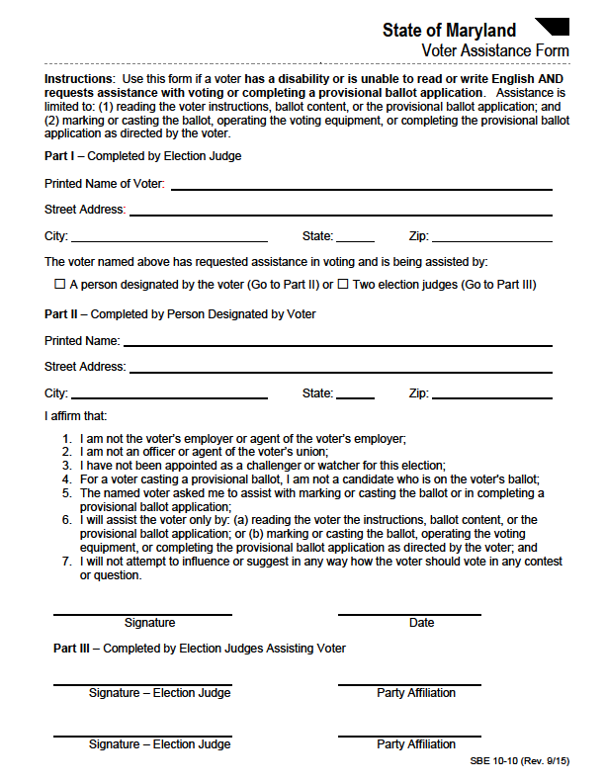
Voter Assistance Form

Slide 24
Completing the
Voter Assistance Form
Fill out Part I of the Voter Assistance Form.
Ask the helper to fill out Part II of the Voter Assistance Form.
Any two judges in the vote center can help a voter fill out a ballot, as long as the two judges are separate parties. This does not mean Democrat and Republican, it can be Bread and Roses and Unaffiliated.
If a pair of bipartisan election judges are helping the voter, the election judges must fill out Part III of the form.
When completed, place the Voter Assistance Form in the Completed Forms Envelope. See a Chief Judge for this envelope if it is not the Chief Judge performing this function.

Slide 25
Is there anyone not allowed to assist a voter?
Any voter may choose anyone to help him or her except:
The voter’s employer or agent of the voter’s employer;
An officer or agent of the voter’s union;
A person appointed as a challenger or watcher for this election; or
A candidate who is on the voter’s ballot.

Slide 26
Voters Who Can Not Sign A Form
If a voter cannot sign his/her VAC, Voter Update Form or any other form, ask the voter to make an “X” on the signature line. This mark can be used as that person’s signature, as an “X” is recognized in the State of Maryland as a valid signature.
Generally, any mark can be used as a signature.
If the voter must make a signature of this nature, you must affirm that you witnessed the voter make the “X” or other mark. You will turn the form over and write an affirmation like, “I, Guy Mickley, witnessed voter, Mickey Mouse, mark an “X” as their signature.” Please sign and date the affirmation statement.
You may use this statement, or the statement found on page 3.5 of your manual.

Slide 27
Voters Who are Blind or Have Low Vision
Read any required information to the voter.
Always ask the voter before assisting or touching the voter.
If you are guiding a voter, offer your arm to the voter, rather than taking the voter’s arm. Give the voter information that is obvious to voters who can see.
If a person uses a service animal, walk on the opposite side of the voter away from the animal. Do not pet or distract a service animal without asking the owner first.
If a person uses a cane, walk on the opposite side of the voter, away from the cane. Do not touch or take the cane from the voter.
Explain how the voter can get your attention if he or she needs help.

Slide 28
Voters with Physical Disabilities
A voter with a physical disability may choose to vote on a ballot marking device from a seated position (wheelchair or chair) or may ask to use an ADA approved voting booth.
Ask before pushing or touching a voter’s wheelchair or equipment.
Ask before helping, in general.

Slide 29
Voters with Speech or Hearing Disabilities
A voter who cannot speak may choose to write down his or her information to give the check-in judge. Check-in judges should have paper and pens available.
Follow the voter’s cues.
Do not speak for the voter.
If a voter does not understand a sentence, try again with different words or write your sentence down.
If you do not understand something the voter has said, ask the voter to say it again. Do not pretend that you understand. If you are still having difficulties understanding, ask the voter to write down what he or she said.
Talk directly to a person, not to his or her helper.
Tip: A check in judge will ask three questions of each and every voter- Name, month and day of birth, and address. If a voter is having trouble understanding you, or you of the voter, write the questions down on a piece of paper for the voter and let the voter respond in writing.

Slide 30
Voters with Cognitive Disabilities
A voter with a cognitive disability may have trouble understanding, reading, writing, or communicating.
Do not challenge a voter’s cognitive ability.
Be prepared to repeat what you say.
Allow extra time to understand the voter and to make sure that the voter understands you.

Slide 31
Disability Quiz
Please take a few minutes and take the disability quiz that can be found on our website. It is a quick true/false quiz that ensures you are ready to service our voters on Election Day.

Slide 32
People and Activities in the Vote Center

Slide 33
Electioneering
Electioneering is any activity that supports an election campaign. Electioneering is illegal in the voting center and within 100 feet of the entrance and exit to the vote center. A sign that reads, “NO ELECTIONEERING BEYOND THIS POINT” will clearly mark the line. The electioneering line is a semi-circle from the doors.
Election judges are forbidden from electioneering. You may not wear or display any partisan political material or express political opinions while you are in the vote center or while performing the duties of an election judge.

Slide 34
Electioneering
Voters are allowed to wear clothing, buttons, or other items with a political message while they are voting but must leave when voting is complete. Generally, a voter in the State of Maryland is allowed to check-in, vote, and leave. If they choose to talk politics or express who they voted for, they must immediately leave the Vote Center.
All day, you should keep an eye on the activity outside of the polling place. Tell anyone who is campaigning within the No Electioneering Zone to stay outside of the marked boundary. If anyone refuses to stay outside the marked boundary, chief judges must call the Board of Elections before contacting law enforcement.
Tip: Voting Judges will want to pay special attention to the booths or BMD after a voter has voted. Many times, a voter will leave political literature gathered from outside at his/her voting location. Make sure if it is left, to pick it up and throw it away before the next voter arrives to vote in the booth or at the BMD.

Slide 35
Exit Polling
Exit polling is just what it sounds like- A pollster will poll voters as they leave a vote center to find out who they voted for when they cast their ballots.
People conducting exit polling must:
Stay outside of the Vote Center rooms;
Not ask questions until after the voter has voted and left the Vote Center rooms;
Tell voters that they do not have to answer the questions; and
Not campaign within the “No Electioneering Zone.”
Not impede the flow of voters to or from the Vote Center.

Slide 36
Challengers and Watchers
To be an official Challenger and Watcher, a person must present a completed certificate to the chief judge upon entry to the Vote Center. (Chief Judge will give the certificate back to the individual.)
The law is very clear- if the person does not have a Challengers and Watchers Certificate, they do not gain entry to the Vote Center, and he/she must leave immediately.

Slide 37
Challengers and Watchers
Challengers and Watchers have the right to:
Be in the vote center room at least 1/2 hour before the polls open.
Be in the vote center room at any time when the polls are open.
Be in the vote center room during the closing of the polls.
Please note: Challengers and watchers must be inside the vote center room before the polls close. If they are not, they do not come in the vote center.
  Challengers and Watchers cannot attempt to:
Find out how a voter voted.
Talk with any voter in a Vote Center room.
Help any voter in voting.
Interfere with the election process.
Keep any voter from talking to an election judge.
Physically touch an original election document or piece of election equipment.
Use a cell phone, laptop, pager, or other electronic equipment at any time in the Vote Center.

Slide 38
Voter Identity Challenges
The right of a person to vote may ONLY be challenged on the basis of identity. In other words, the voter is not who they claim to be…an impersonation.
The challenge must be made before the person is given a voter authority card, or the challenge is invalid.
Anyone, whether official or not, is allowed to enter the Vote Center room for the sole purpose of challenging the identity of other people trying to vote. An unofficial challenger must follow the same rules as an official challenger but must leave the Vote Center as soon as the challenge is made.
Election judges may also challenge the identity of a person trying to vote. If this happens, a chief judge must follow all the rules for challenging a voter’s identity. Election judges are not required to leave the Vote Center after a challenge.
No matter where the challenge comes from, the first thing that every judge must remember is to scream for the Chief Judge…they make the big bucks!
Tip: This does not happen very often. In 25 years of conducting elections, the Election Director has heard of three challenges in Elections. All three were valid challenges, resulting in the voter not voting and simply leaving.

Slide 39
Voter Identity Challenges
If a voter’s identity is challenged:
The Chief Judge will ask the voter for an acceptable form of ID.
Acceptable forms of ID can be found in your Election Judge Manual in Chapter 4.
If the voter presents an acceptable form of ID, tell the voter to return to the check-in line to continue the check-in process.

Slide 40
Voter Identity Challenges
If the voter cannot present an acceptable form of ID:
The challenger and challenged voter must each complete their part of the Affidavit for Challenger & Challenged Voter form. The chief judge must watch the challenger and challenged voter sign the affidavit.
This voter must vote a provisional ballot;
Tell the provisional ballot judge to attach the Affidavit to the outside of the voter’s provisional ballot envelope; and
The chief judge should write the details of the challenge in the Election Day Log.

Slide 41
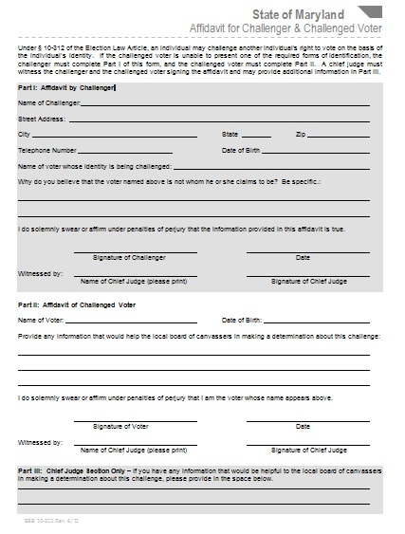
Affidavit for Challenger & Challenged Voter

Slide 42
Vote Center Evaluators
The local board of elections may send people to visit Vote Centers without advance notice. These evaluators will check to see how well the election judges are following the rules. They will check the election judges’ general performance.
Evaluators use a Polling Place Evaluation Form when visiting Vote Centers. During the visit, evaluators may speak with election judges and inspect reports. Evaluators are not allowed to slow down or interrupt the voting process.
Please note: At this time, due to COVID-19, we do not know if there will be any vote center evaluation. The Board of Elections will disseminate the final decision of the State Board of Elections at a future date.

