Slide 1


Census 2020
HOWARD COUNTY
Complete Count Committee
September 20, 2019

Slide 2
Census 2020
Quick Overview of Census
Population Growth
Population Characteristics
Hard to Enumerate Areas

Slide 3
Quick Census Overview
The Decennial Census counts every person in the U.S. Questions asked include:
  How many people living in your home
  Home owned or rented
  Sex, age and race and if Hispanic origin of those living in home
  Relationship of each person living in your home
  Also counts group quarters population
Everyone is required to be counted by law
All information is kept confidential by law

Slide 4
Quick Census Overview
People can respond to the 2020 Census online (first time!), by phone, or by mail.
The CB also conducts the American Community Survey each year.
  This is a sample survey, not 100% count
  Many more questions are asked compared to Decennial Census to get more details on population characteristics

Slide 5
Quick Census Overview
The Decennial Census is important:
  Apportionment (dividing the 435 U.S. House of Representative seats among the 50 states)
  U.S., State, and local political redistricting
  Federal funding (billions of dollars each year)
  Business decisions

Slide 6

Quick Census Overview
2020census.gov

Slide 7

Population Growth

Slide 8
Howard County Trivia
When did Howard County become a county?
In 1851 – only two other MD counties were established later (Wicomico in 1867 and Garrett in 1872)
Initially became the “Howard District” of Anne Arundel County in 1839

Slide 9
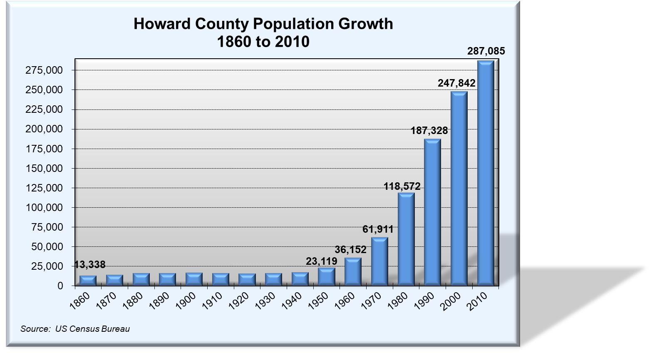

Slide 10
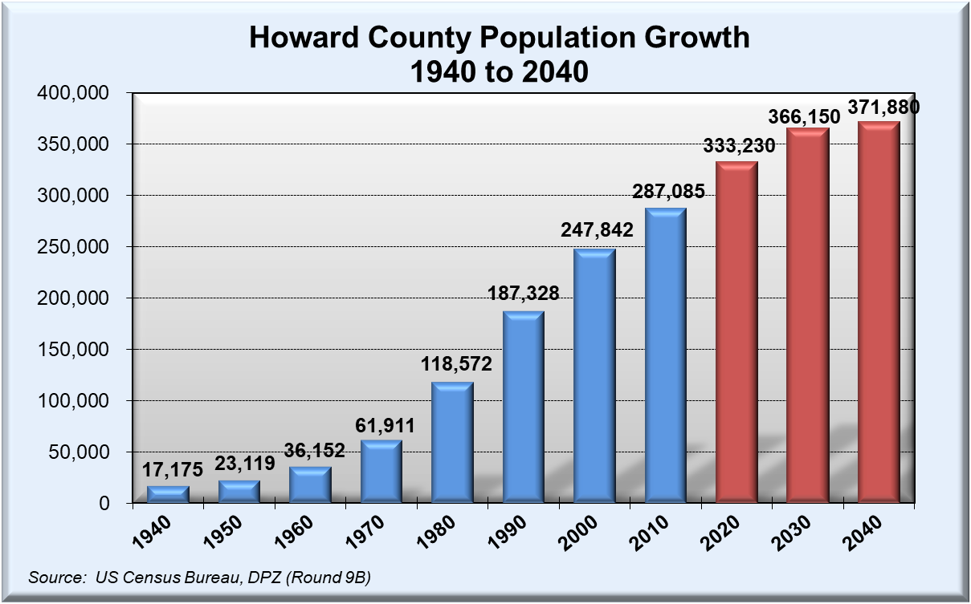

Slide 11
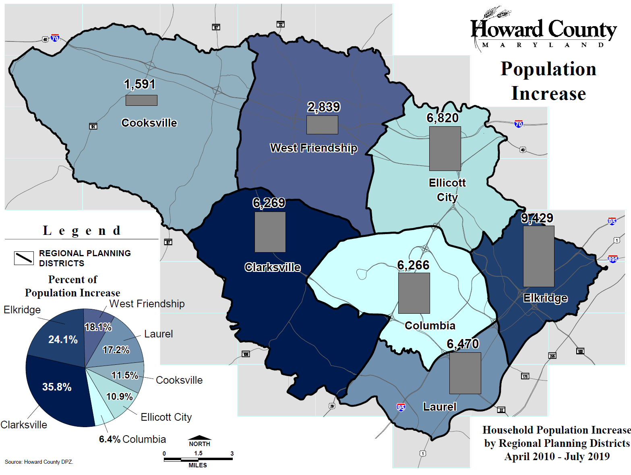

Slide 12

Increasing Diversity

Slide 13
Population by Race, 2000 & 2010

Slide 14
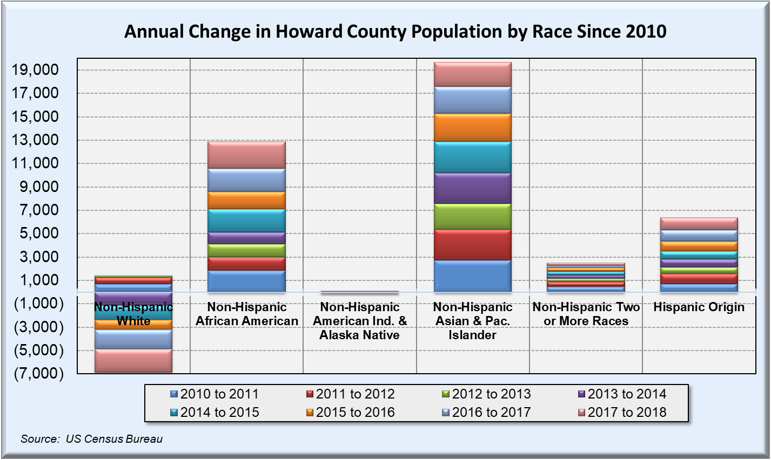

Slide 15
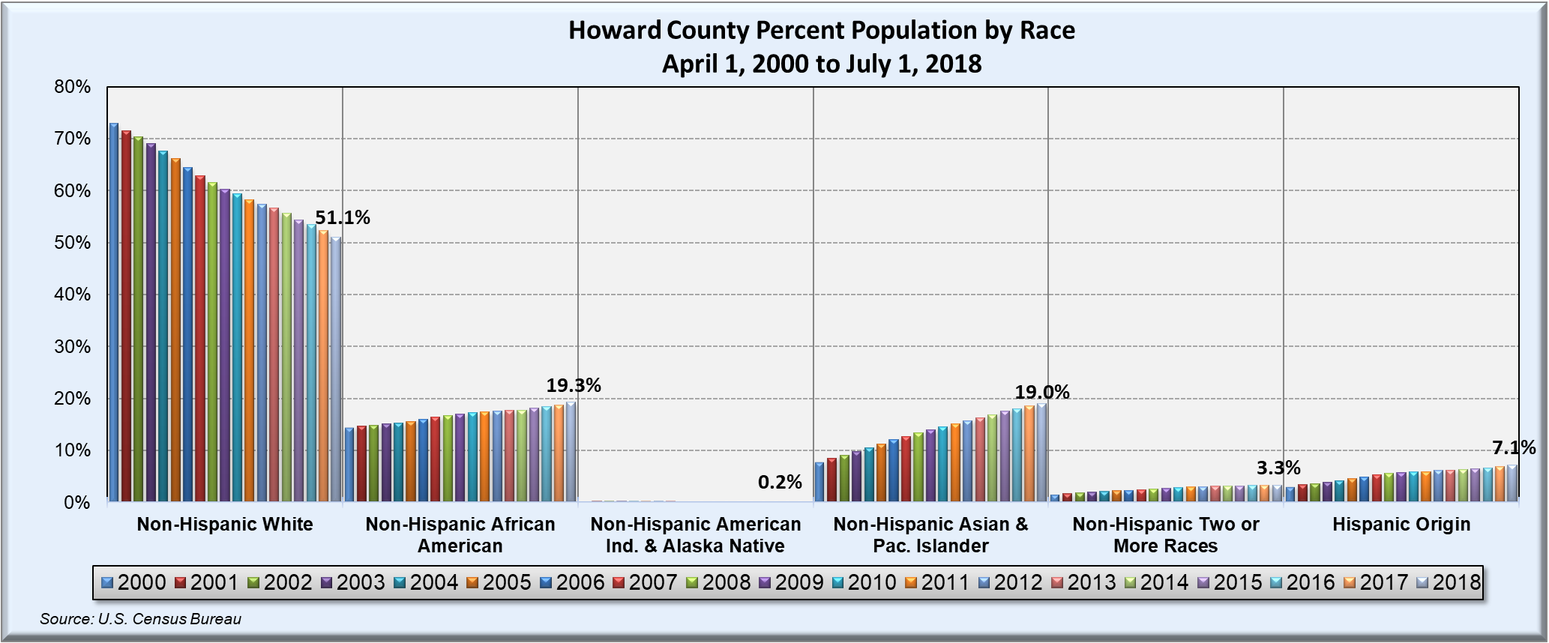
Population by Race, 2000 to 2018
73.0% in 2000
down to
51.1% in 2018

Slide 16
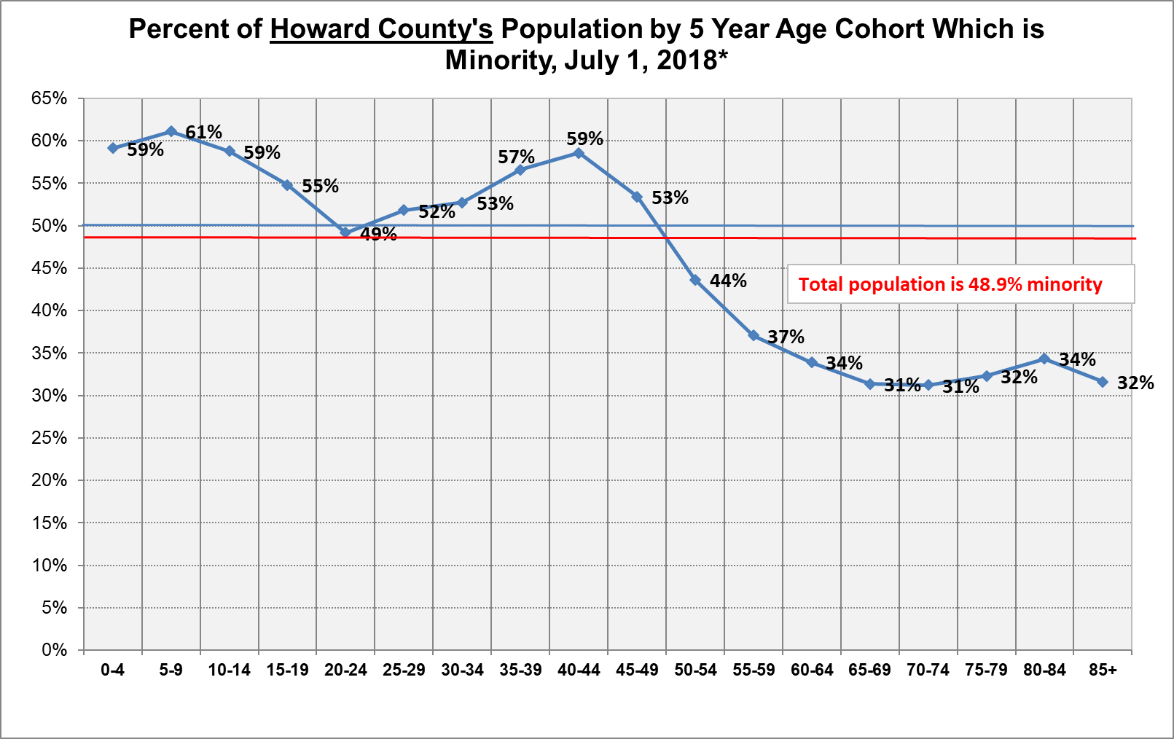


Slide 17
Where are People Coming From?

Slide 18
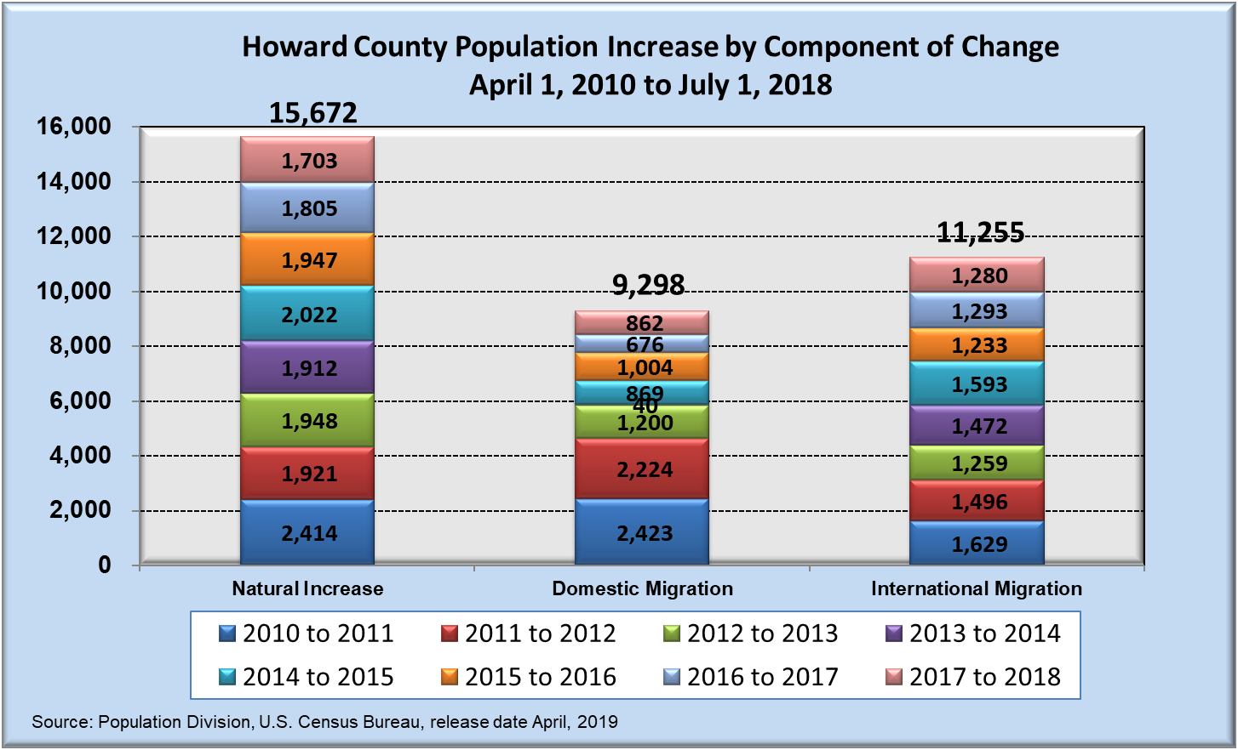

Slide 19
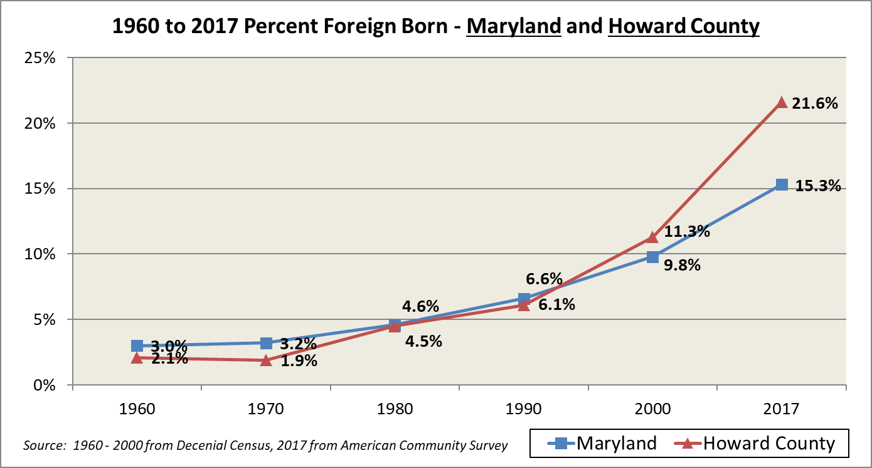
Foreign Born Population, 1960 to 2017

Slide 20
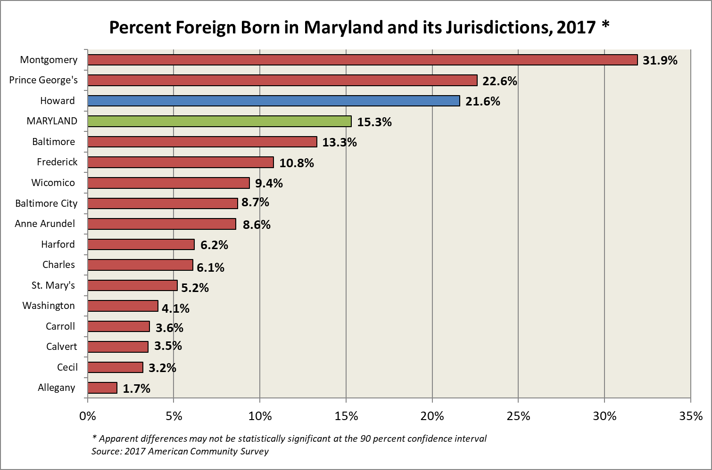

Slide 21
World Region of Birth, Howard County

Slide 22

An Aging Population

Slide 23
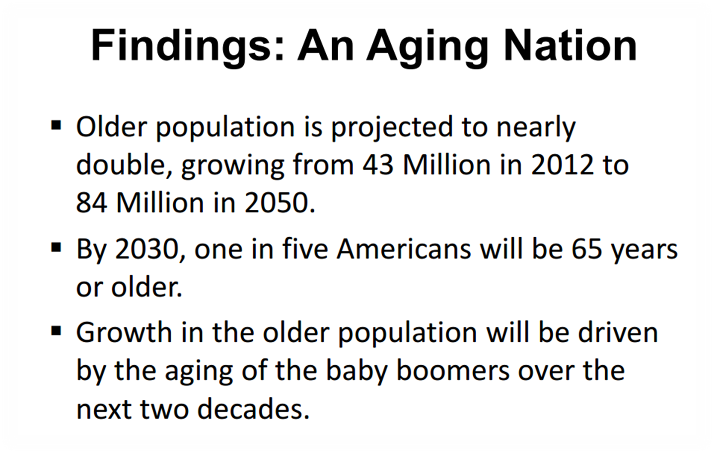

Slide 24
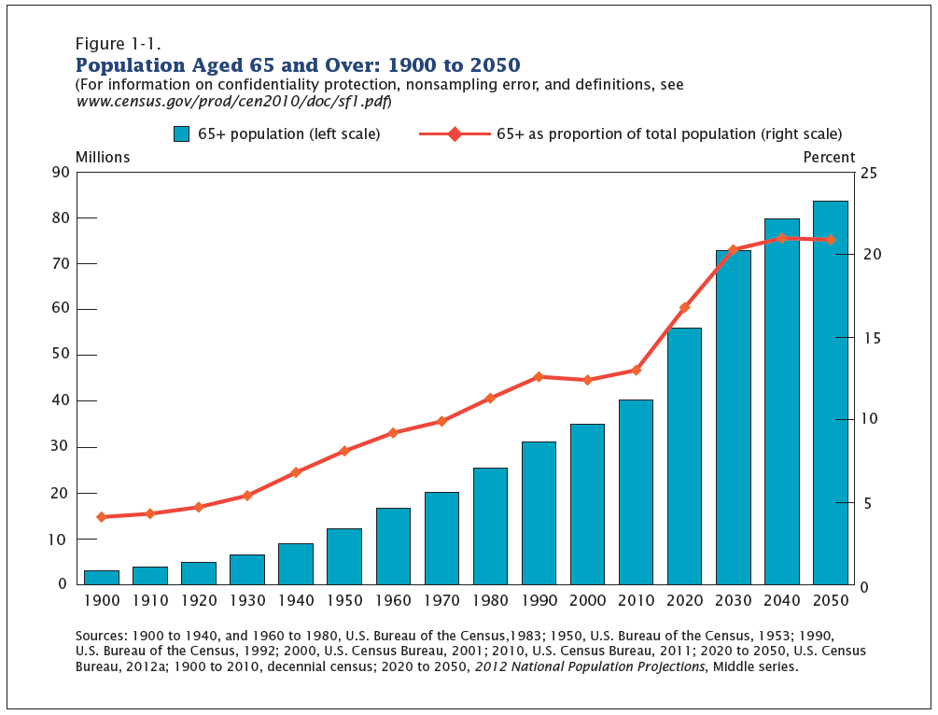
We are almost half-way through an unprecedented increase of those age 65 & older.

Slide 25
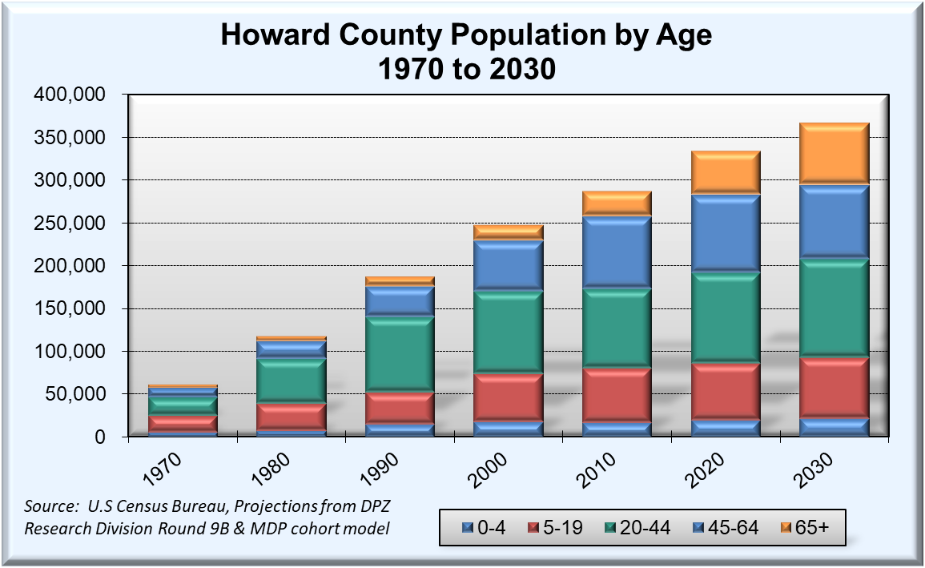
Howard County Population by Age

Slide 26

Income and Poverty

Slide 27
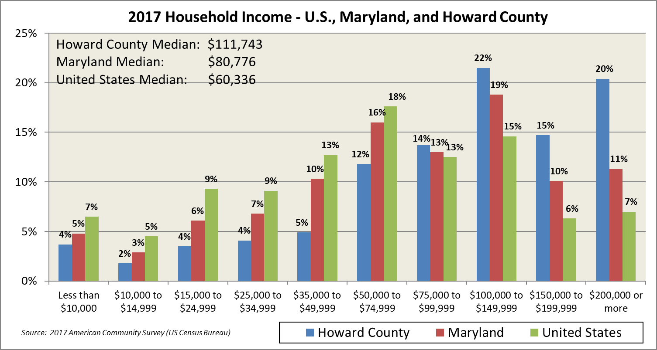
57% of Howard County households make more than $100,000 per year

Slide 28
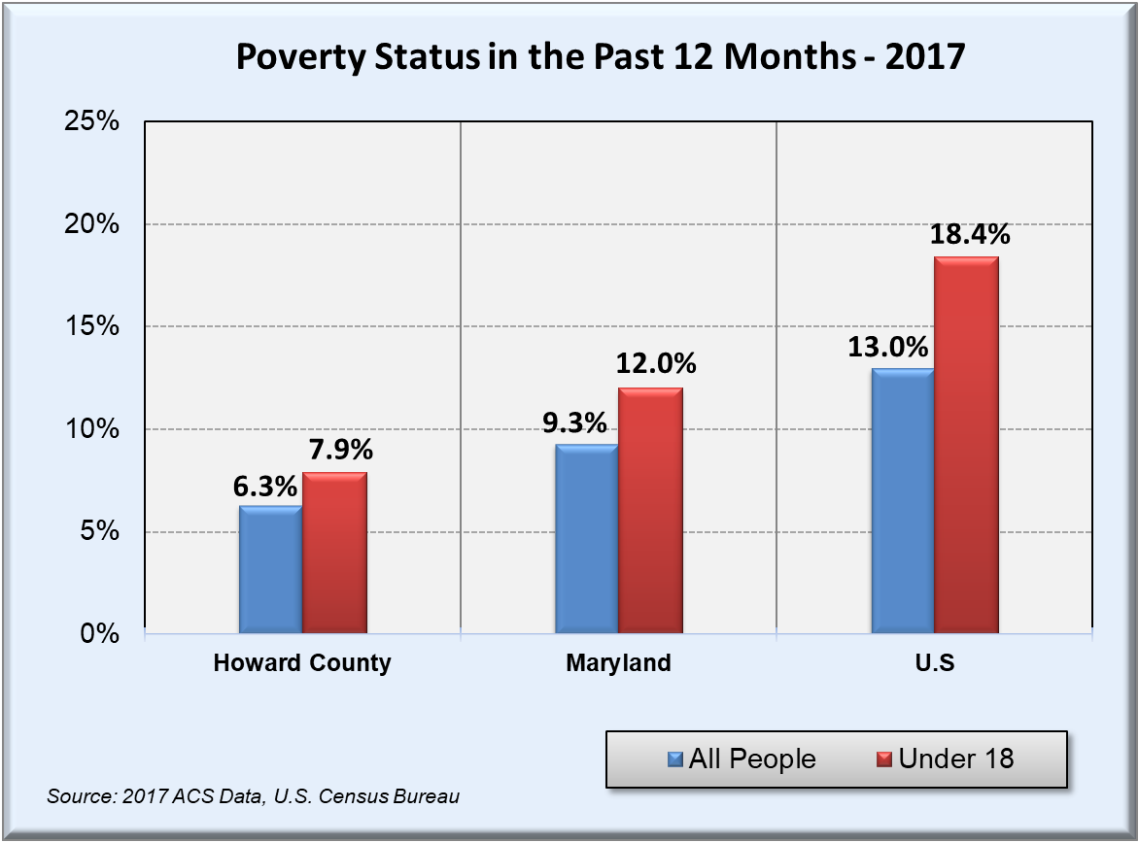

Slide 29
Hard to Enumerate Areas

Slide 30
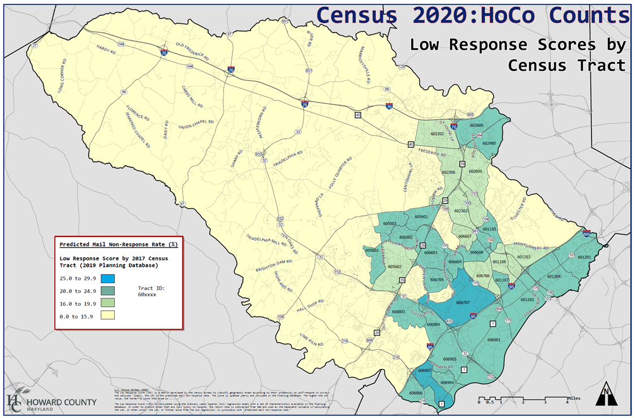

Slide 31
Hard to Enumerate Areas
https://www.census.gov/roam
https://www.censushardtocountmaps2020.us/

Slide 32

Howard County Trivia
How else can I help plan the future of Howard County?
By participating in the upcoming General Plan Update!

Slide 33
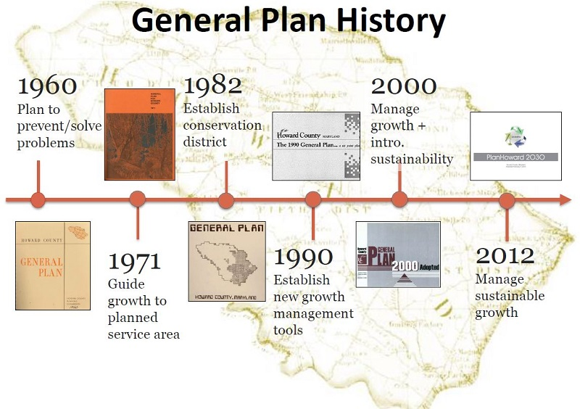

Slide 34
