Slide 1
Hand Washing and Hand Sanitizer Use

Slide 2
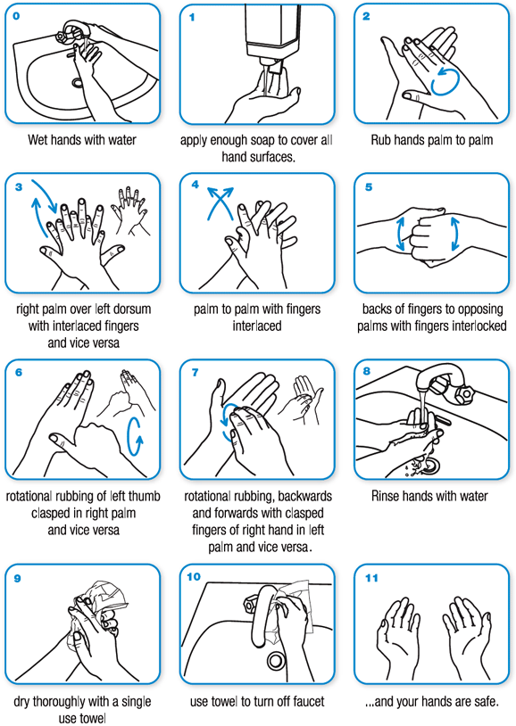
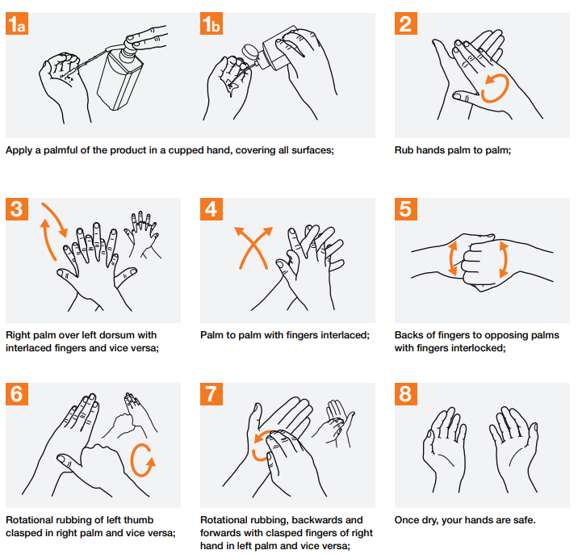
The World Health Organization Recommends…
How to Use Soap and Water
How to Use Hand Sanitizer
Notes:
Sources:
https://www.who.int/gpsc/clean_hands_protection/en/
https://www.who.int/gpsc/5may/How_To_HandRub_Poster.pdf

Slide 3
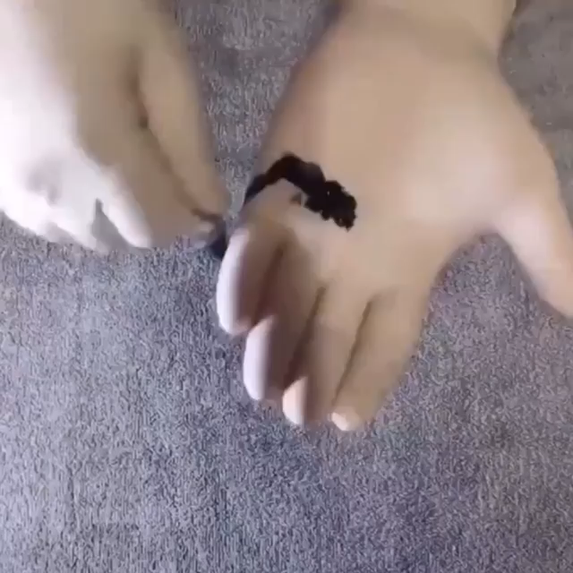
Click on the video to see why it works!

