Slide 1
Doing Business in Howard County
January 21, 2016
Lawrence Twele
Chief Executive Officer
Howard County Economic Development Authority

Slide 2


Fall 2015
Keith Alexander's IronNet nets $32.5 million investment

Slide 3

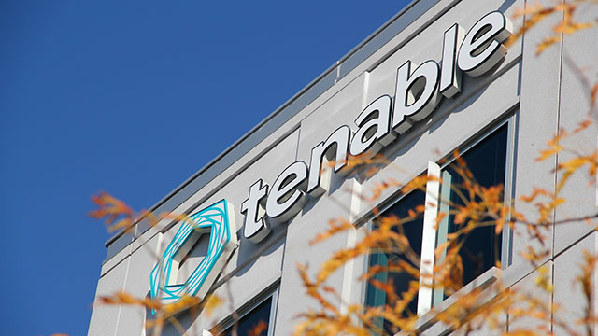
Tenable Network Security raised $250 million - the largest funding of a private cyber security company.

Slide 4
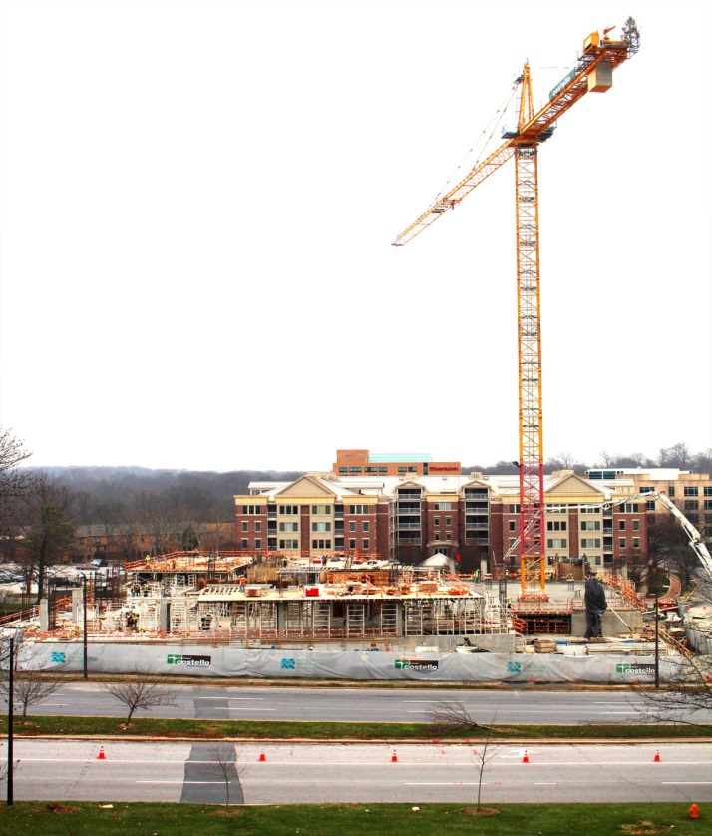
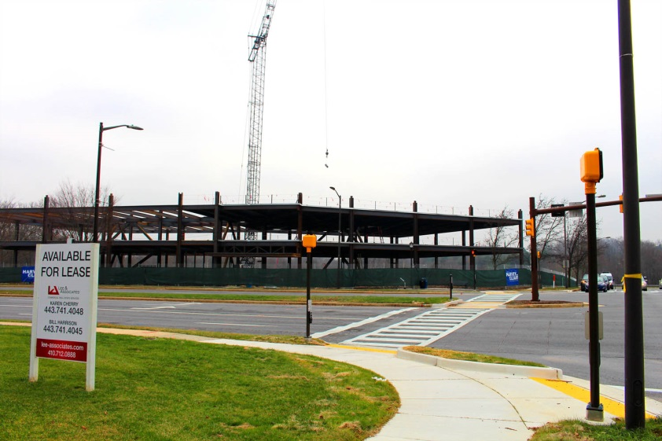
2015 HoCo Business Headlines
Dynamic Business Environment
Two new projects break ground in Downtown Columbia developing 350,000 square feet of Class A office space and 160 residential units!

Slide 5
Howard Co - Steady Job Growth
Market Results
Source: Maryland Department of Labor, Licensing, and Regulation
Note: Q1 and Q2 quarterly average employment numbers were used to calculate 2015 figure

Slide 6
Regional Job Growth
Market Results
Source: National Association of Counties

Slide 7
Top Employment Sectors
Source: Maryland Department of Labor, Licensing, and Regulation

Slide 8
Low Unemployment Rate
Market Results
Source: Maryland Department of Labor, Licensing, and Regulation

Slide 9
HoCo Business Establishment
Size-Class Distribution

Slide 10
Strong Office Space Trends
Market Results
Source: CoStar

Slide 11
Industrial Space Trends
Source: CoStar

Slide 12
Construction Activity
433% growth!
31% growth!
Source: Baltimore Metropolitan Council

Slide 13
Share of Commercial and Industrial Tax Base
2015

Slide 14
Commercial and Industrial Tax Base

Slide 15
Growing our job base
Strategies
  Business Development
  Innovation
  Marketing

Slide 16
Future job growth
According to Plan Howard 2030
  “….based on current zoning and available land there is capacity for 78,000 new jobs in Howard County.”
    This equals approximately 25-30 years of new job growth at current rates

Slide 17
HCEDA’s Business Development
Site and real estate consulting
Government approvals assistance
Advisor, supplier, customer intro’s
Workforce development & training
Business market development
Financial incentives
  Focus areas
  International
  Cyber
  Redevelopment

Slide 18
Pipeline Activity

Slide 19
Small Business Financing
Loans Approved | Number | Avg Size
$2,580,000 | 19 | $161,000
Revenue Size | Number
Start up | 5
<$1M | 9
>$1M | 5
Sector | Number
IT | 8
Mfg/Production | 4
Service | 6

Slide 20

Business Incubator
Advisor, supplier, customer intro’s
Workforce development & training
SCORE/SBDC/EIR
Howard Tech Council
Small Business Resource Center

Slide 21
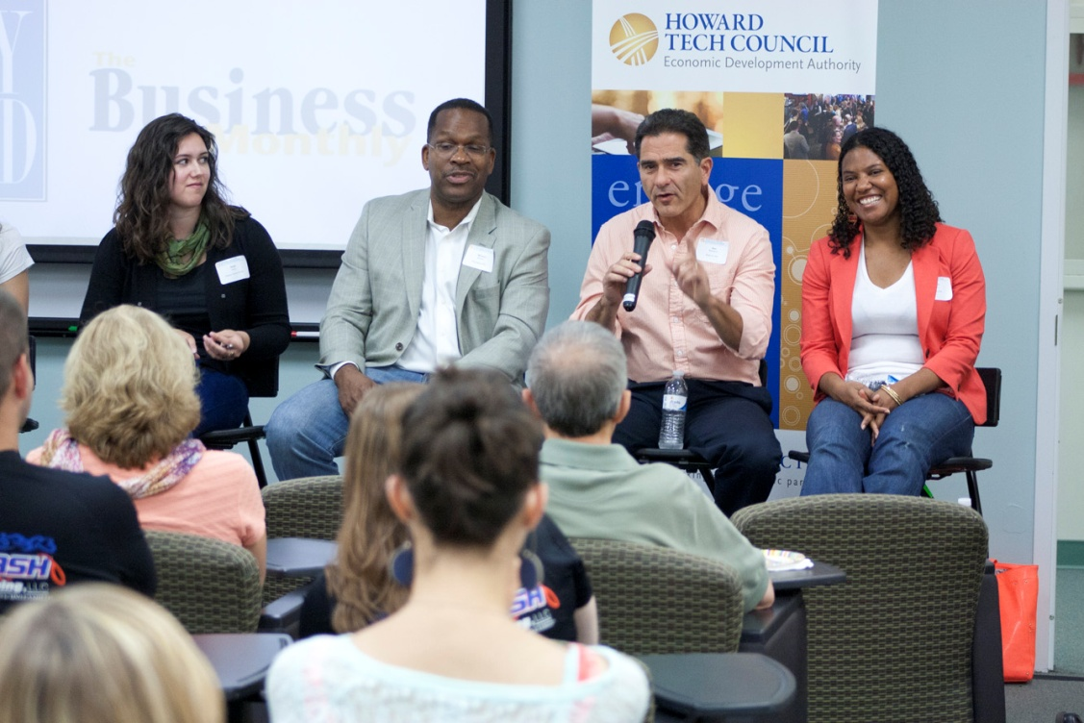
6,000 Annual visitors
23 Resident Companies
64 Affiliates

Slide 22
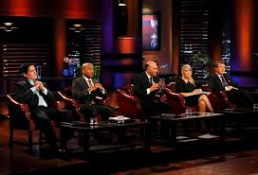
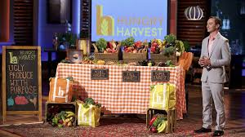
Our Most Recent Success
Hungry Harvest - Food with Purpose
  Wins Shark Tank $100,000 Investment

Slide 23

Our Most Recent Success
Pet Medical Records and compliance App for Veterinarians raises $1 Million investment

Slide 24
Our Most Recent Success
Mechanical Paradox: A Stem Education Program Qualifies for Maryland State Championships
Women In Technology: From monthly programs to first ever “Hackathon”
Junior Achievement: Business of the Future

Slide 25
Going Forward
MCE is one of two innovation centers led by people who have run, operated and led a public or private company
Targets our Segments
(Cyber, Health Analytics, Supply Chain Security, Agriculture, Regenerative Medicine)
Exploits our Geography and Core Constituents
Delivers Go-to-Market Focus and Associated Programs
\

Slide 26
Going Forward
Establish an Exciting Location for
Early Stage Companies to Grow
  Common Space & Fixed Accommodations
  High Speed Connectivity
  Parking
  Non-Rent Dependent
\

Slide 27
Going Forward
Establish an Investment Fund
(The Price of Innovation Poker)
Step one: Incentive Fund
        to stay, prosper and grow roots in Howard county
Step two: Angel/A Round
        investment in targeted industry and technology that meets the goals of the EDA and Howard County
\

Slide 28
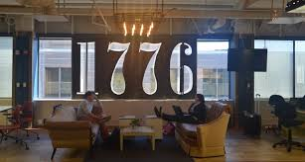

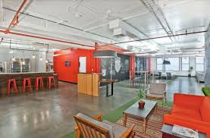
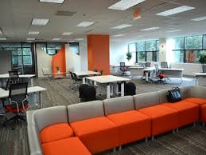
Our Competition
30+ Regional Incubators from “Mach37” in Virginia to Baltimore's “Betamore”, from DC's “1776” to UMBC’s Research Park
Grade A Office Space
Entrepreneurial Programs vs. Go-to-Market Strategy

Slide 29
Challenges
Marketing vs. our competition
Innovation Tools
  Facility
  Investment/Retention Fund
  Marketing/Outreach

