Slide 1

Howard County
Industry Day
Public-Private Partnership
Circuit Courthouse Project
June 16, 2017

Slide 2

Daryl E. Paunil, P.E.
Chief, Bureau of Facilities
Department of Public Works

Slide 3
Allan H. Kittleman
Howard County Executive

Slide 4
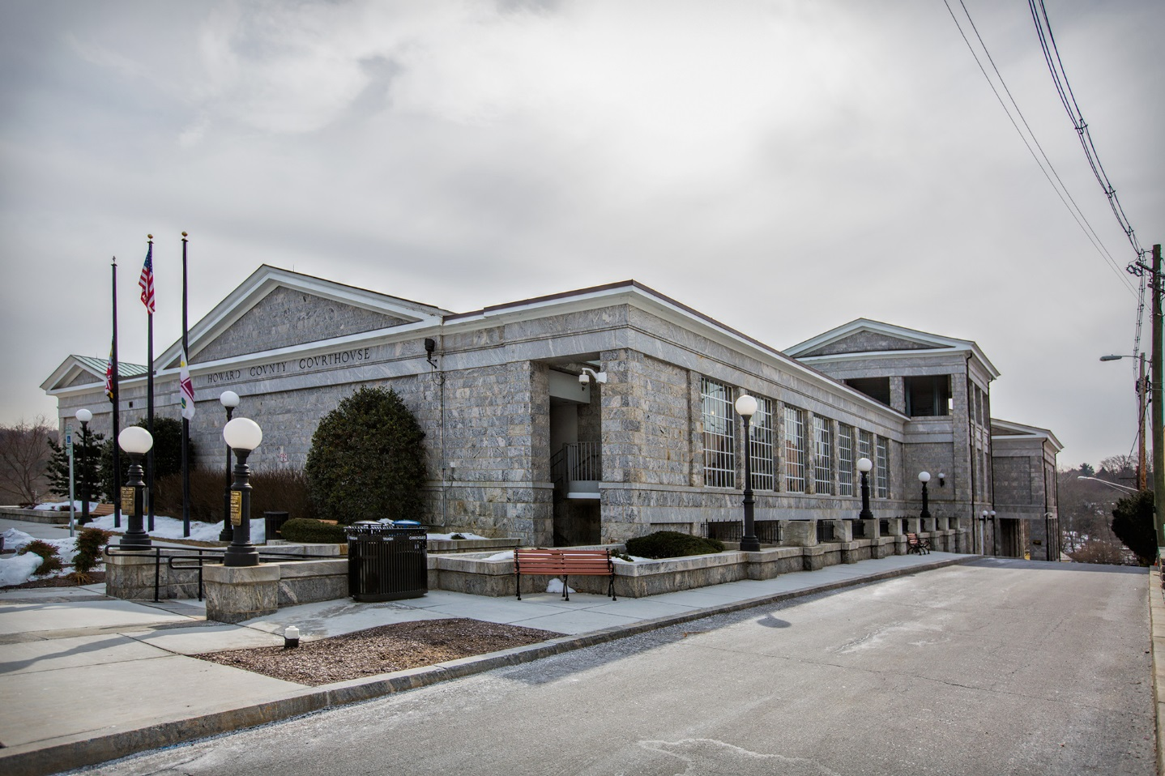
WHY WE NEED A NEW COURTHOUSE
The existing facility for the
Circuit Court for Howard County is 174 years old.

Slide 5
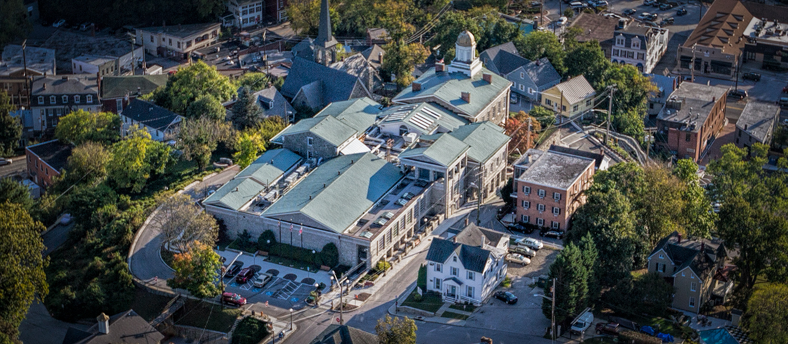
WHY WE NEED A NEW COURTHOUSE
The existing facility for the
Circuit Court for Howard County is 174 years old.

Slide 6
WHY WE NEED A NEW COURTHOUSE
The County has undergone significant population growth since 1970:
1970 61,911
1990 187,328
2000 247,000
2010 287,000
Current estimated population 313,000

Slide 7
WHY WE NEED A NEW COURTHOUSE
Most courthouse services are no longer located
in the courthouse:
Sheriff’s Office
State’s Attorney
Land Records

Slide 8
WHY WE NEED A NEW COURTHOUSE
Technology infrastructure cannot accommodate changes to meet state requirements for electronic filing.
Technology can no longer support modern courtroom needs, such as projecting images of evidence during trials.
Security issues and challenges.
Current courthouse is not ADA compliant.

Slide 9
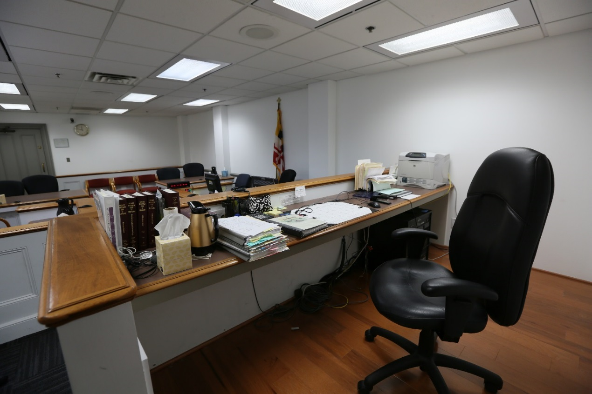
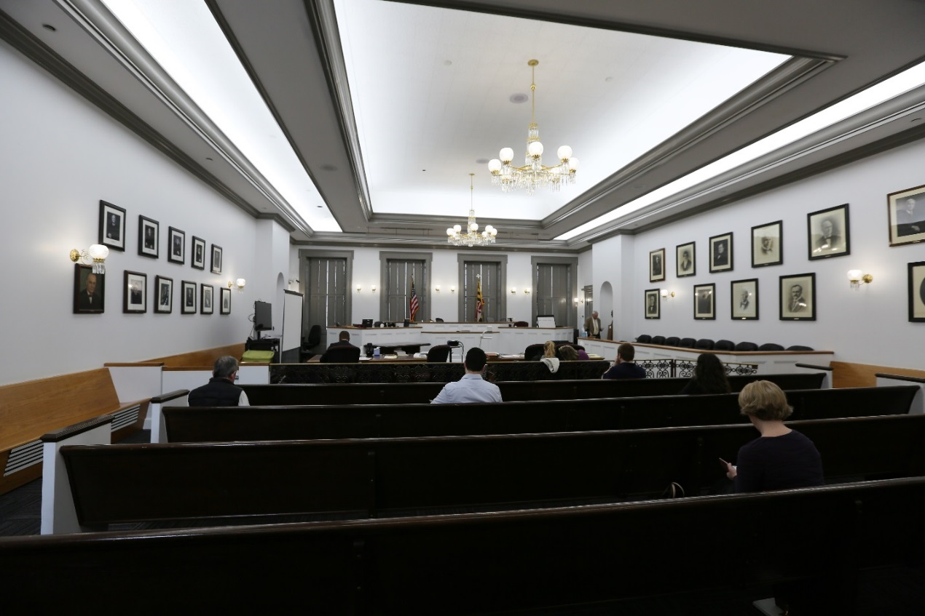
WHY WE NEED A NEW COURTHOUSE
Inadequate courtroom space and undersized courtrooms.

Slide 10
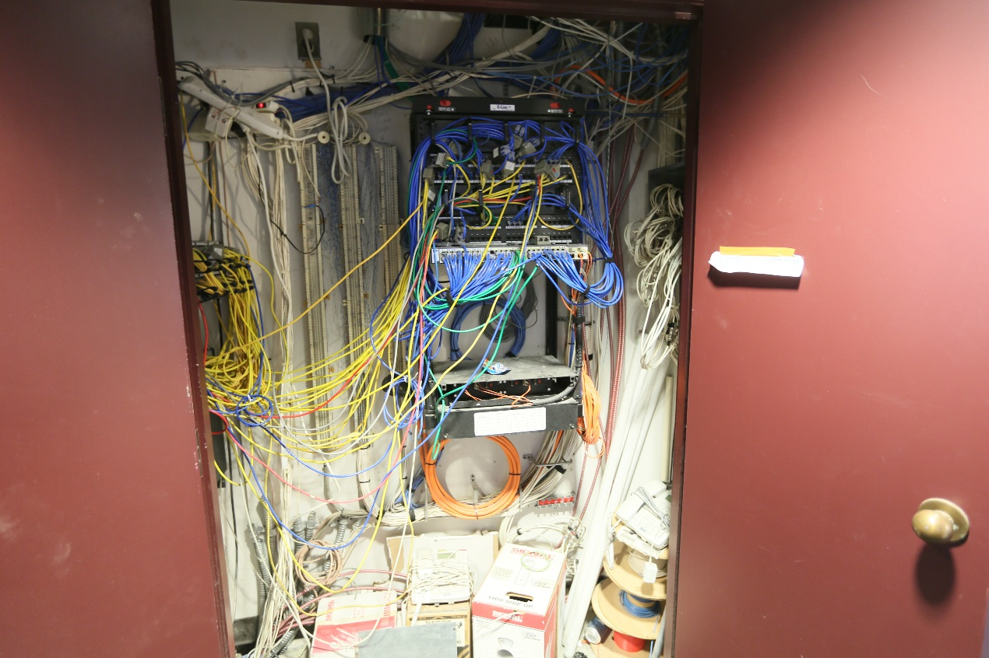
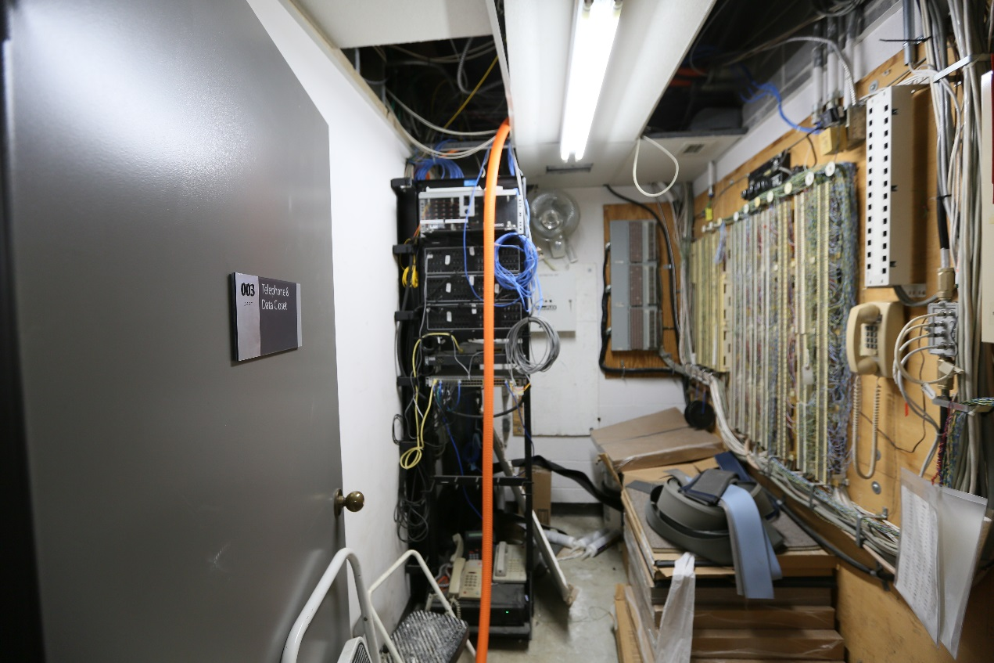
WHY WE NEED A NEW COURTHOUSE
Inadequate technology infrastructure.

Slide 11
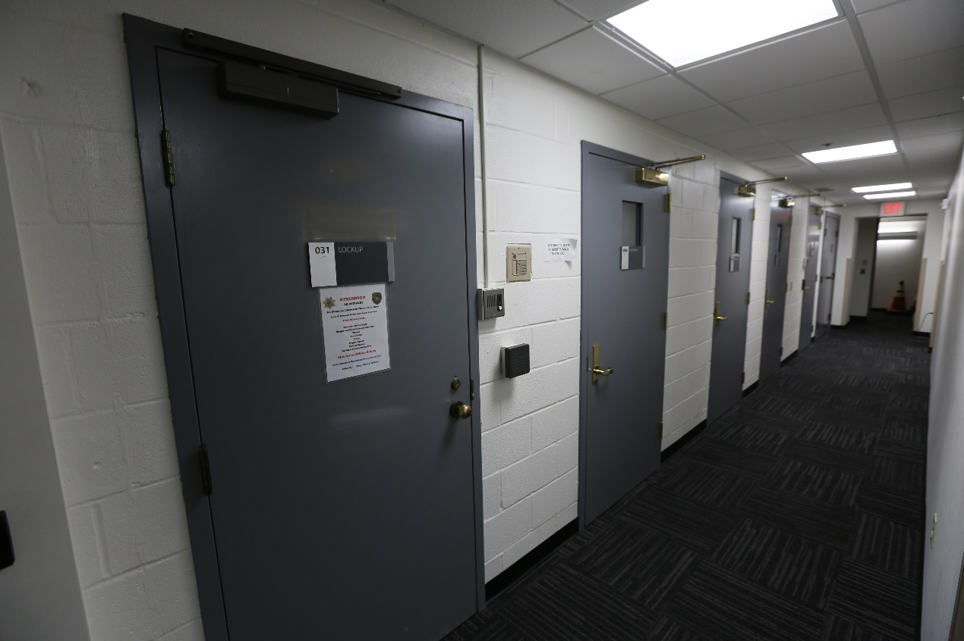
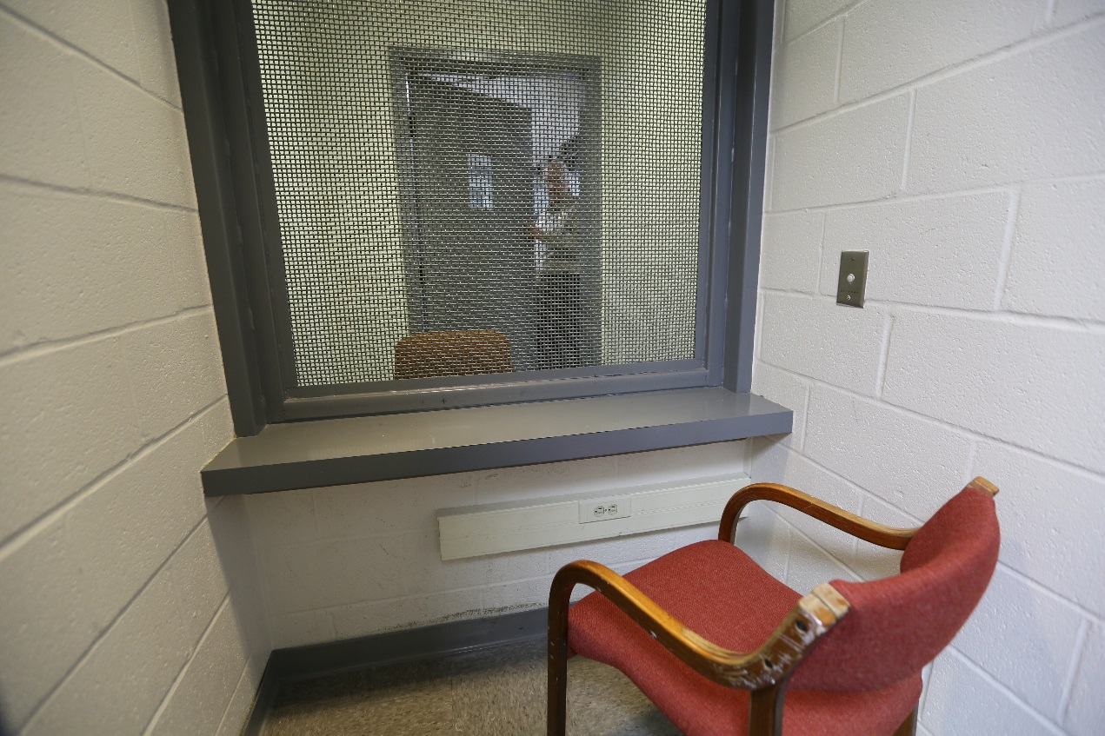
WHY WE NEED A NEW COURTHOUSE
Inadequate security features.

Slide 12
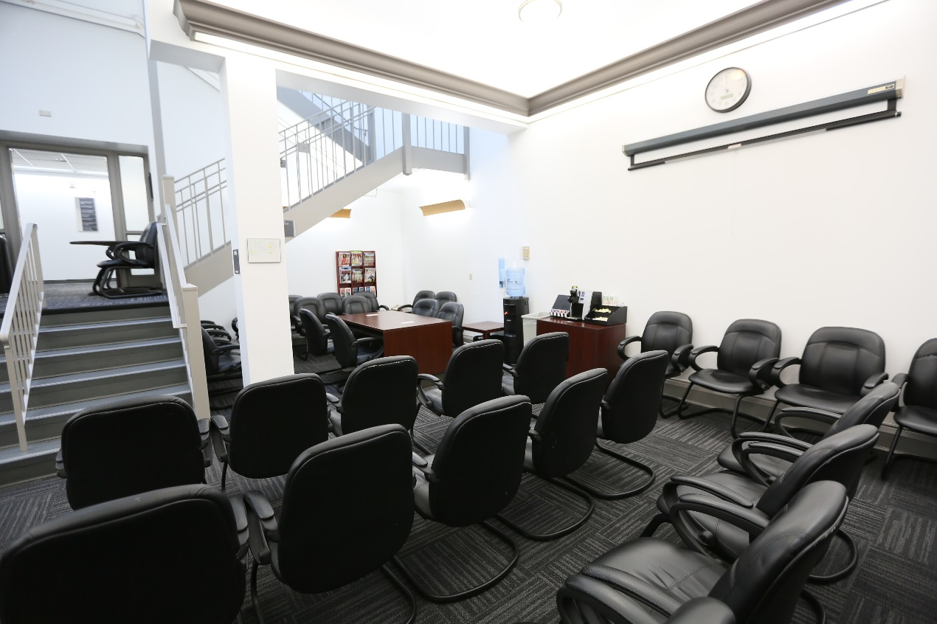
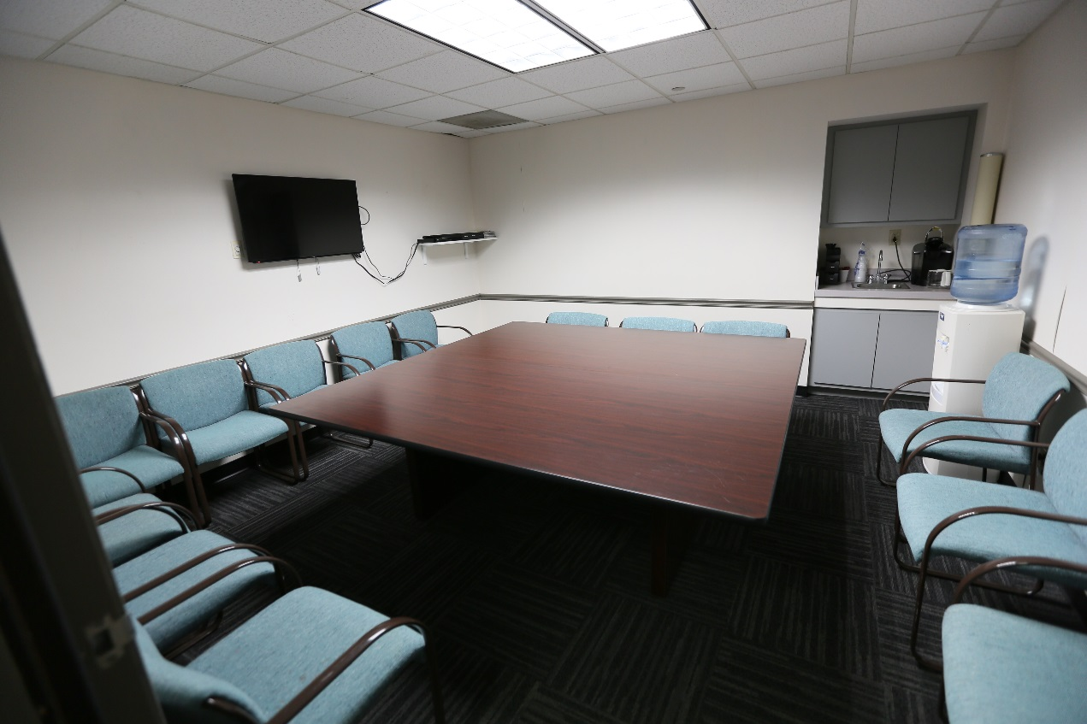
WHY WE NEED A NEW COURTHOUSE
Inadequate jury waiting rooms and
jury deliberation rooms.

Slide 13
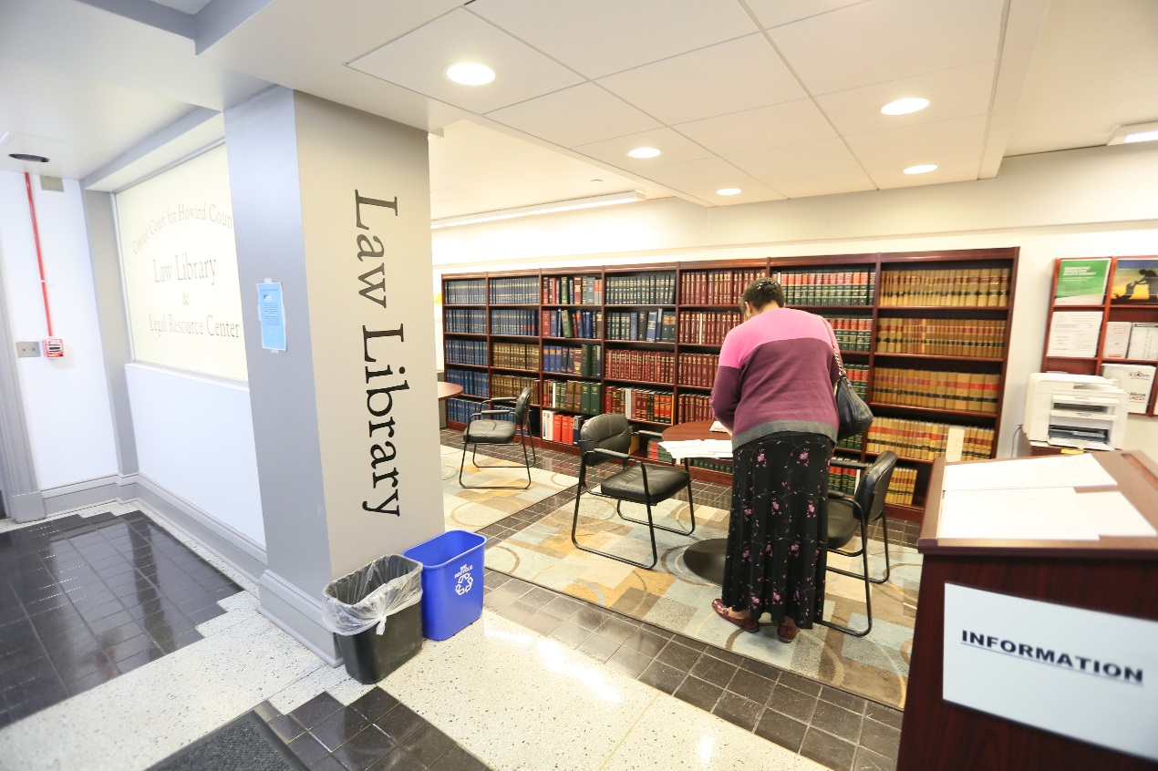
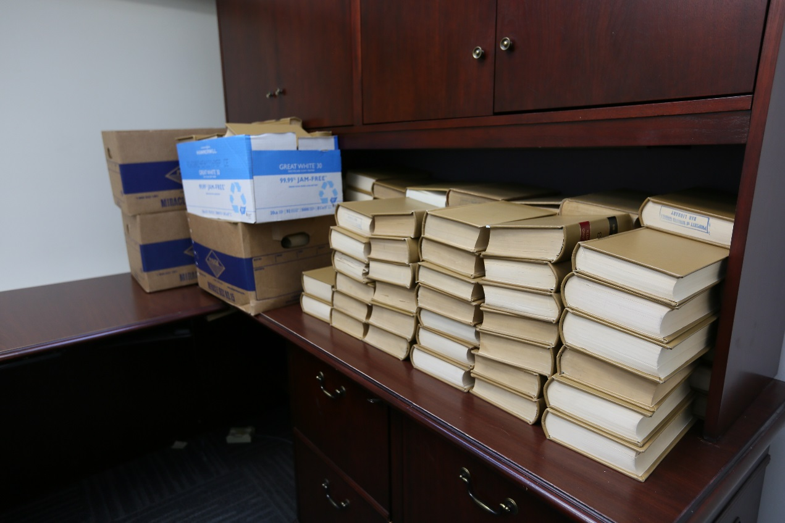
WHY WE NEED A NEW COURTHOUSE
Inadequate law library facilities.

Slide 14
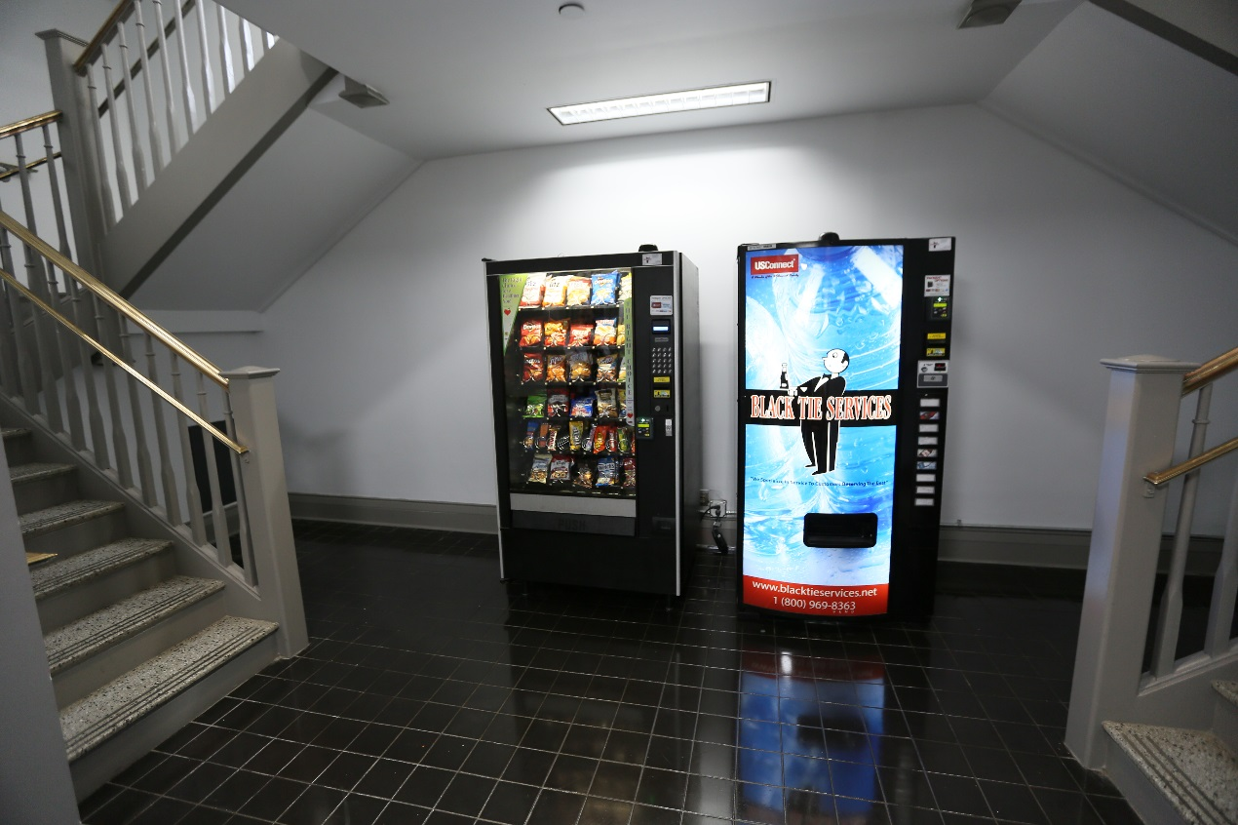
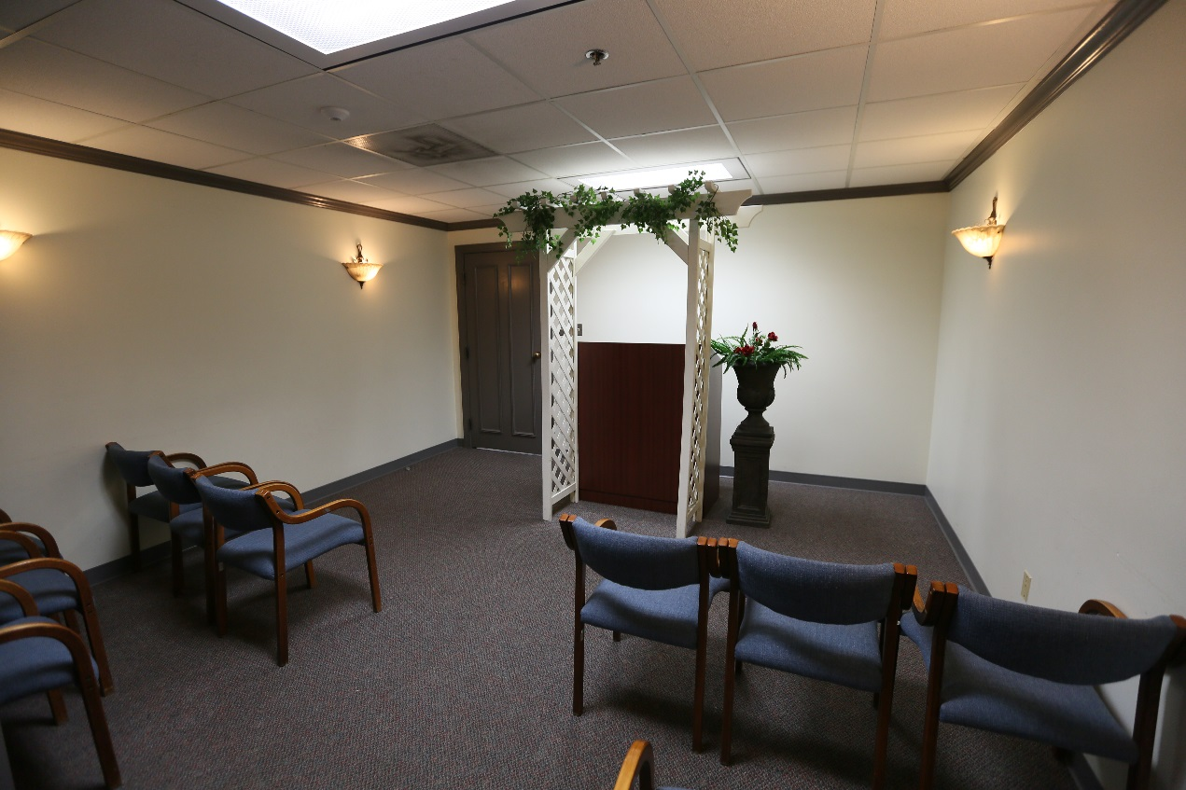
WHY WE NEED A NEW COURTHOUSE
Inadequate public amenities including a lack of
food/beverage service and civil ceremony space.

Slide 15
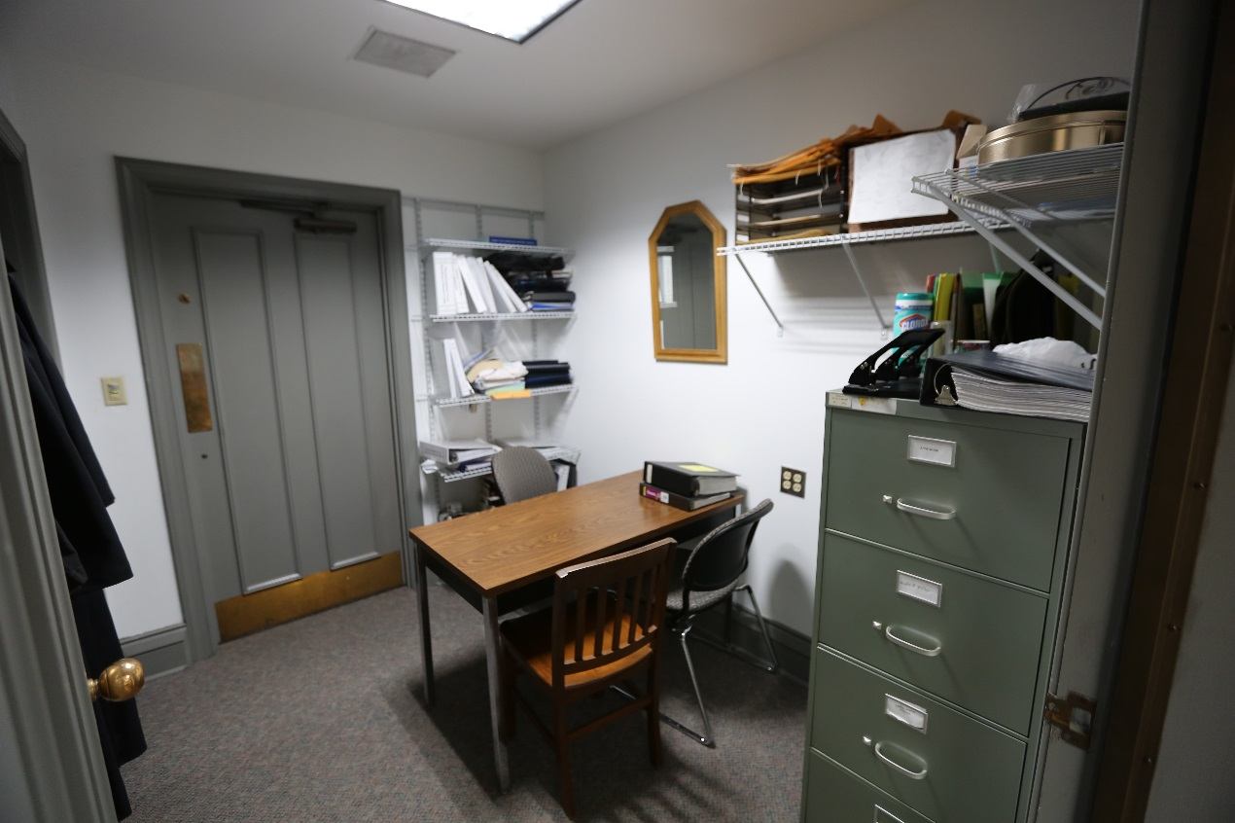
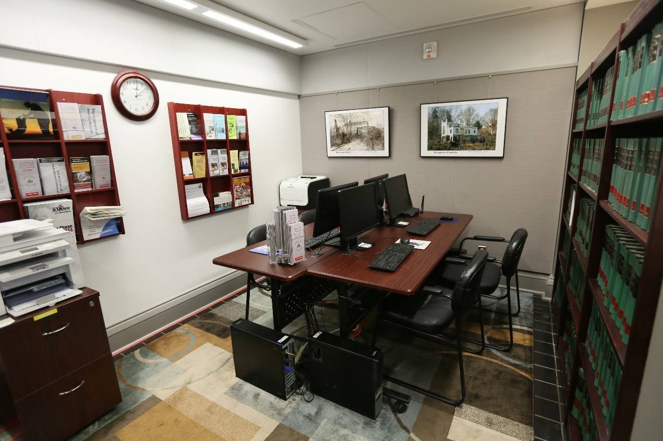
WHY WE NEED A NEW COURTHOUSE
Inadequate office and shared work space.

Slide 16
Honorable Lenore R. Gelfman Administrative Judge
Circuit Court for Howard County

Slide 17
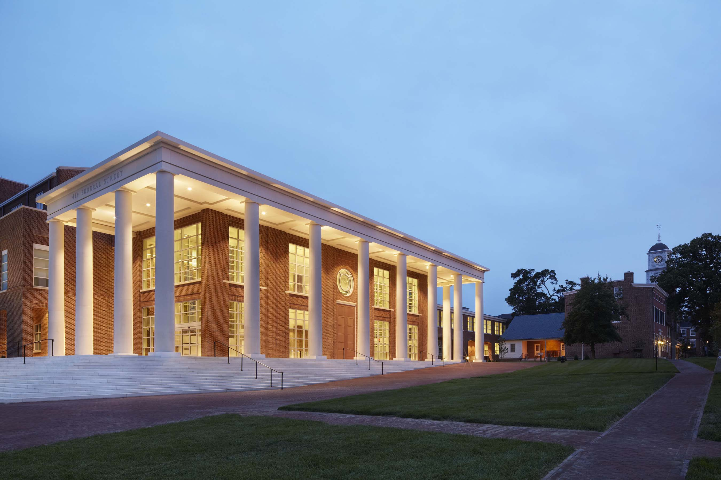
WHAT A MODERN COURTHOUSE PROVIDES

Slide 18
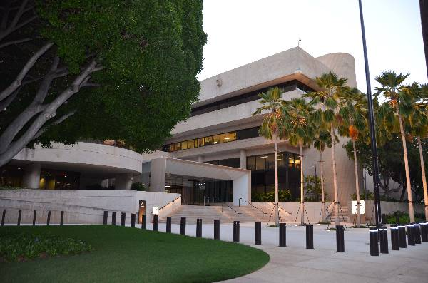
WHAT A MODERN COURTHOUSE PROVIDES

Slide 19
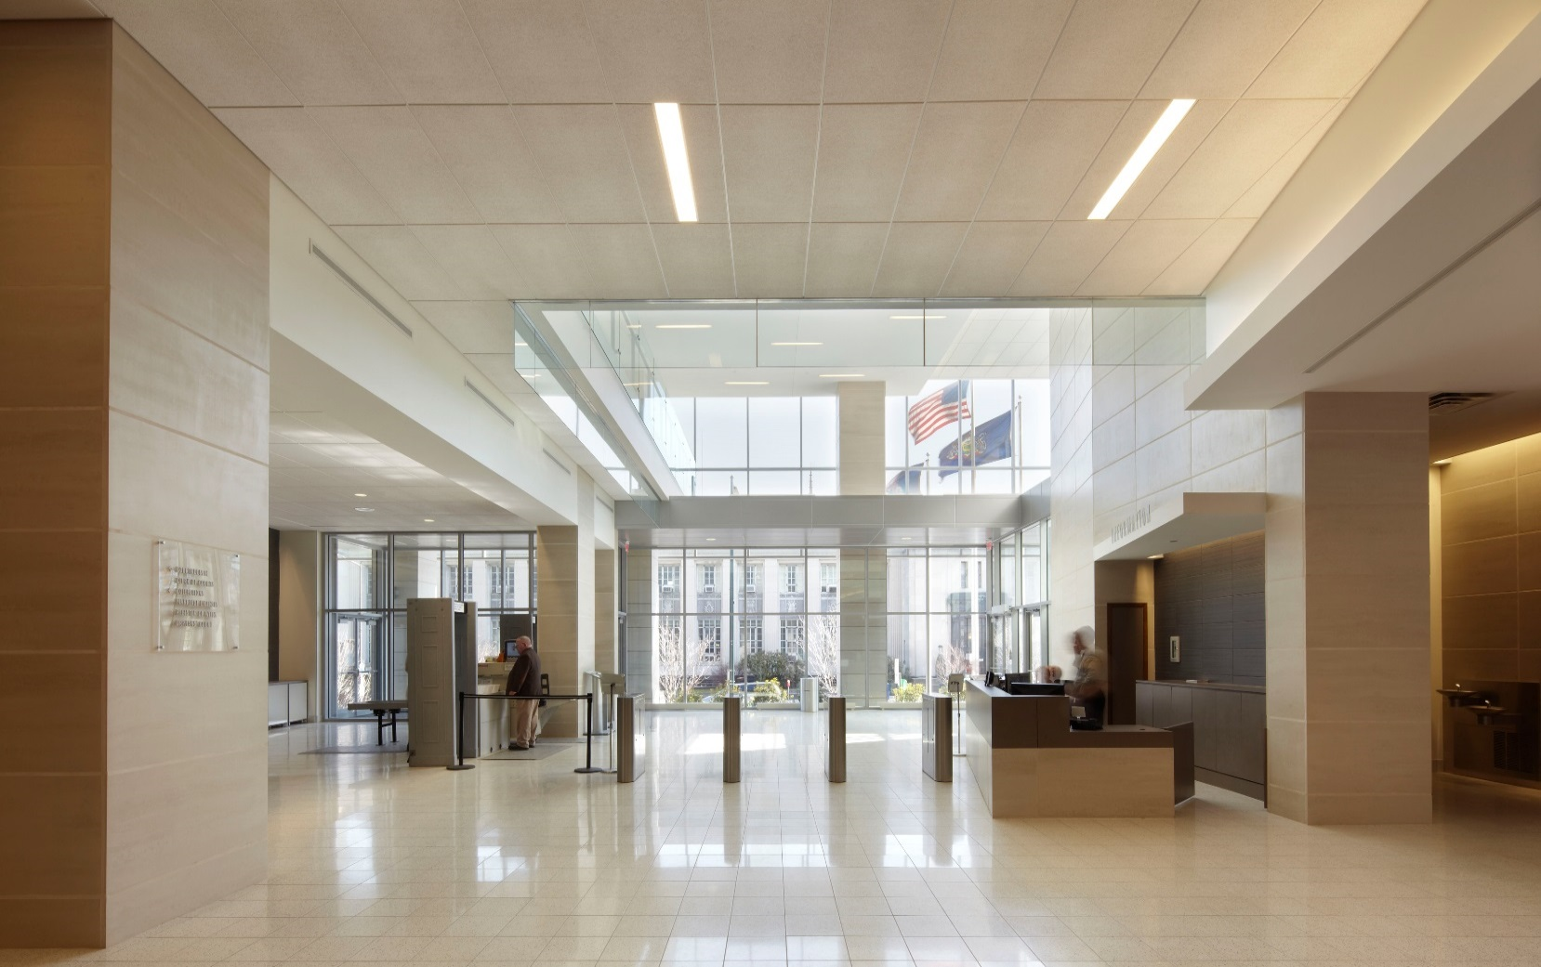
WHAT A MODERN COURTHOUSE PROVIDES

Slide 20
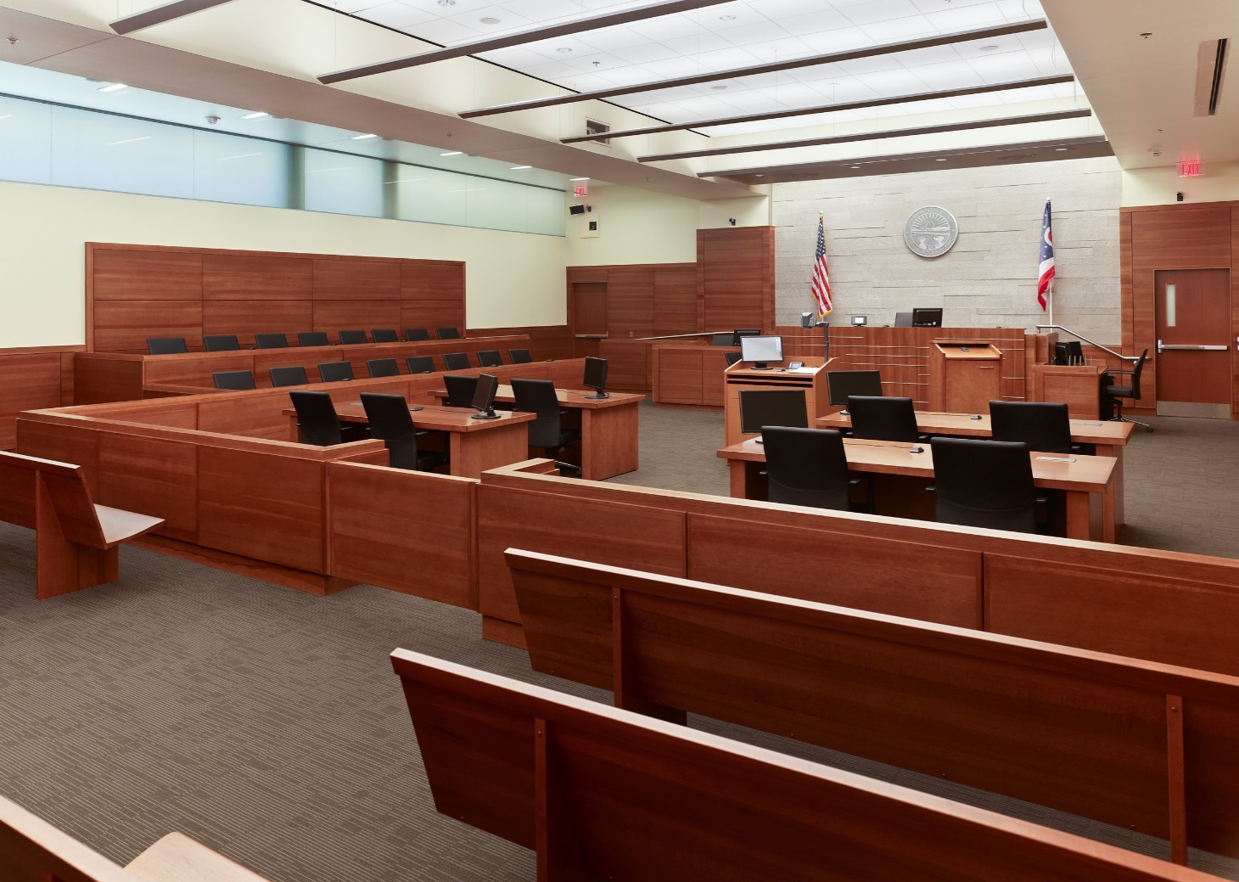
WHAT A MODERN COURTHOUSE PROVIDES

Slide 21
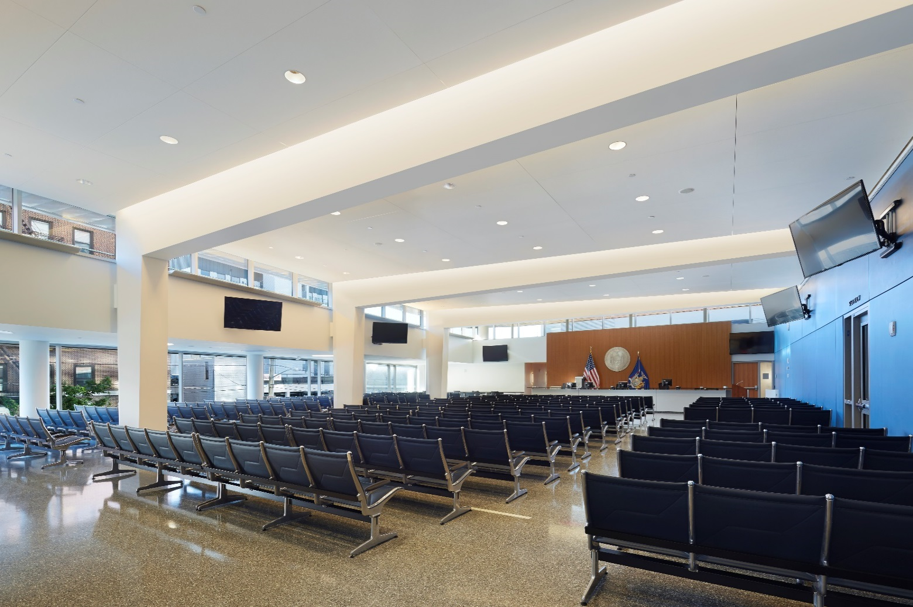
WHAT A MODERN COURTHOUSE PROVIDES

Slide 22
Jon Weinstein
Howard County Council Chairperson

Slide 23
PRESERVING THE PAST IN A NEW LOCATION
The Circuit Court has rich history in its current location and should endeavor to reflect that in its new location.
Ellicott City and Howard County has rich history that needs to be reflected in the new courthouse facility.

Slide 24
CREATING NEW OPPORTUNITIES
  Create commerce at new site.
  Provide exciting variety of opportunities for new uses of the old building and site.

Slide 25
MAKE HISTORY TOGETHER
  Howard County is a national showcase for innovations in government and the services and policies, in technology in the companies and their new products, and in its community through education and nonprofits.
The selected vendor will have the opportunity to create a showcase courthouse within the showcase community that is Howard County.

Slide 26
PROJECT DESCRIPTION
The County seeks a private partner to deliver the best value for County-owned Circuit Courthouse
and garage. Specific objectives include:
Demolition of existing 200,000 sq. ft. Dorsey Bldg. and all site improvements.
Construct a modern, secure 230,000 sq. ft. Courthouse with innovative design and engineering and a 600 space structured parking facility ($140 million).

Slide 27
PROJECT DESCRIPTION
The County seeks a private partner to deliver the best value for County-owned Circuit Courthouse
and garage. Specific objectives include:
3. Achieve LEED Silver certification or better.
4. Blended mix of County and private financing.
High quality, long-term facility operation and
maintenance.

Slide 28

14 of 27 County owned acres
will be made available

Slide 29
DELIVERY MODEL
Procure and deliver the Project as an
“availability-based” P3. Concessionaire responsibilities include:
1. Design, construction and commissioning of the
courthouse and parking garage and any authorized
ancillary space.
2. Private sector financing for the Project to be
specified in the Project Agreement.

Slide 30
DELIVERY MODEL
Procure and deliver the Project as an
“availability-based” P3. Concessionaire responsibilities include:
Facility O & M of courthouse, parking garage, any ancillary retail space and surrounding grounds and roadways.
Handback of O & M of County-owned facilities at the
end of the 30-year term.

Slide 31
COMPLETED MILESTONES
Circuit Courthouse program of Requirements
and Master Plan established.
Resolution No. 27-2017 confirming support by the County Council and County Executive approved.
Approved County bond issuance covering anticipated milestone payment.
Financial, legal and technical advisors contracted.

Slide 32
FINANCIAL STRUCTURE
Total financing needs estimate:
~ $150 million
PUBLIC financing $70 M - $90 M
PRIVATE financing $60 M - $80 M

Slide 33
HOWARD COUNTY PAYMENTS
Milestone payment upon occupancy
Funding included in approved FY 18 capital budget with $105 M bond authorization.

Slide 34
HOWARD COUNTY PAYMENTS
Availability Payments
$8.5 M - $9 M per year estimated (<1% of County General Fund operating budget).
Begin with occupancy for 30-year term, subject to deductions for suboptimal performance and for non-availability.
Secured by Council approved multi-year contract,
consistent with the County Charter and Code.

Slide 35
HOWARD COUNTY’S BOND RATING
The County has consistently secured AAA bond ratings – 20 years in a row, from all three national ratings agencies:
Fitch Ratings
Moody’s Investors Service
S & P Global Ratings

Slide 36
KEY PROCUREMENT STEPS
Request for Expressions of Interest
(July 2017)
Maximum of three, top-ranked teams participate in the Request for Proposal process.

Slide 37
KEY PROCUREMENT STEPS
Request for Proposals
(Fall 2017)
Dialogue to help finalize terms.
Equal Business Opportunity subcontracting goal of 10%.
Data Room will be online upon RFP release date.
(www.howardcountymd.gov/howardcourthouse)

Slide 38
KEY PROCUREMENT STEPS:
PROPOSAL RESPONSES
Competitive selection expected by Q3 of 2018.
P3 Project Agreement will have a
$500,000 stipend for each unsuccessful,
but responsive, team not receiving
the award.

Slide 39




PROJECT TIMELINE:
ACTIONS | 2017 |  | 2018 |  |  |  | 2019 |  |  |  | 2020 |  |  |  | ‘21
 | Q3 | Q4 | Q1 | Q2 | Q3 | Q4 | Q1 | Q2 | Q3 | Q4 | Q1 | Q2 | Q3 | Q4 | J | F
EOI
RFP
COMMERCIAL & FINANCIAL CLOSE
DESIGN
CONSTRUCT

Slide 40
Howard County P3 Team
County Executive
Allan H. Kittleman
Advisory Committee
Howard County Circuit Court
Senior Assistant County Solicitor
Project Management Team
Lonnie Robbins, Project Director
Daryl Paunil, P. E., Project Lead
Financial Team
Howard County
Department of Finance
Procurement Team
Howard County
Office of Purchasing
Technical Team
Howard County
Bureau of Facilities, D.P.W.

Slide 41
HOWARD COUNTY’S COMMITMENT
“All three branches of government, executive, legislative and judicial, agree that the P3 strategy for a new courthouse is the best way to achieve a modern facility that meets the needs of our Circuit Court.”
Allan H. Kittleman
Howard County Executive
“The Court is very appreciative of the vision and cooperation between County Executive Kittleman and the County Council to make a new Circuit Court a reality, enhancing access, efficiency and security for everyone it serves.”
The Honorable Lenore R. Gelfman
Circuit Court for Howard County, Administrative Judge
“This will be a showcase project. There is a lot of attention on it and there's a commitment to getting it done right. This project will result in a modern courthouse that fits the needs of the County and can serve as a model for other communities.”
Jon Weinstein
Howard County Council Chairperson

