Slide 1
Ballot Marking Device Training
Presented by
Howard County Board of Elections

Slide 2
Ballot Marking Device (BMD) Lesson Objectives
Lesson covers the following:
General information
Chief Judges responsibilities for BMD prior to 7 AM Election morning
The process to follow when a voter chooses to use the BMD.
Election supplies necessary
Completion of required paperwork and packing up of machine
Notes:
Example objectives
At the end of this lesson, you will be able to:
Save files to the team Web server.
Move files to different locations on the team Web server.
Share files on the team Web server.

Slide 3
Ballot Marking Device (BMD) – General Info
Any voter may requests to use the BMD.
At least 5 voters should use the BMD by 1:00 PM.
The BMD uses Ballot Activation Cards (BACs) to electronically record a voter’s selections.
The Ballot Marking Device DOES NOT tabulate votes. Only when a voter inserts their BAC or paper card into a scanning unit is their ballot cast.
The BMD is capable of producing an audio ballot with the use of a key pad for a voter who is visually impaired.
The BMD should be used by voters that may have difficulty completing a standard paper ballot; i.e. voters that have spoiled more than 2 ballots.
A Chief Judge is the proctor of the process for voters using the BMD.
An instruction sheet for voters using the BMD is required to be read to them. This sheet and other BMD use signs must be posted by the BMD voting area.
Notes:
How presentation will benefit audience: Adult learners are more interested in a subject if they know how or why it is important to them.
Presenter’s level of expertise in the subject: Briefly state your credentials in this area, or explain why participants should listen to you.

Slide 4
Election Morning Ballot Marking Device (BMD) - Opening
Verify unit serial numbers and left compartment, door tamper tape numbers are correct on the Ballot Marking Device Integrity Report.
Remove tamper tape and place on back of integrity report.
Unlock compartment door with barrel key and flip switch to on.
  Allow 3-5 minutes to boot up (This gives you time to walk away and do other tasks)
Once booted up enter Election security code and press “Accept”.
  Verify information is correct on ready for voting screen and select “OK”.
Secure side compartment door with new tamper tape and record on integrity report.
Verify headphones and keypad are plugged in, with Write–in candidate sheet and BMD instructions posted near by.
Place black privacy sleeve around unit.
Notes:
Lesson descriptions should be brief.

Slide 5
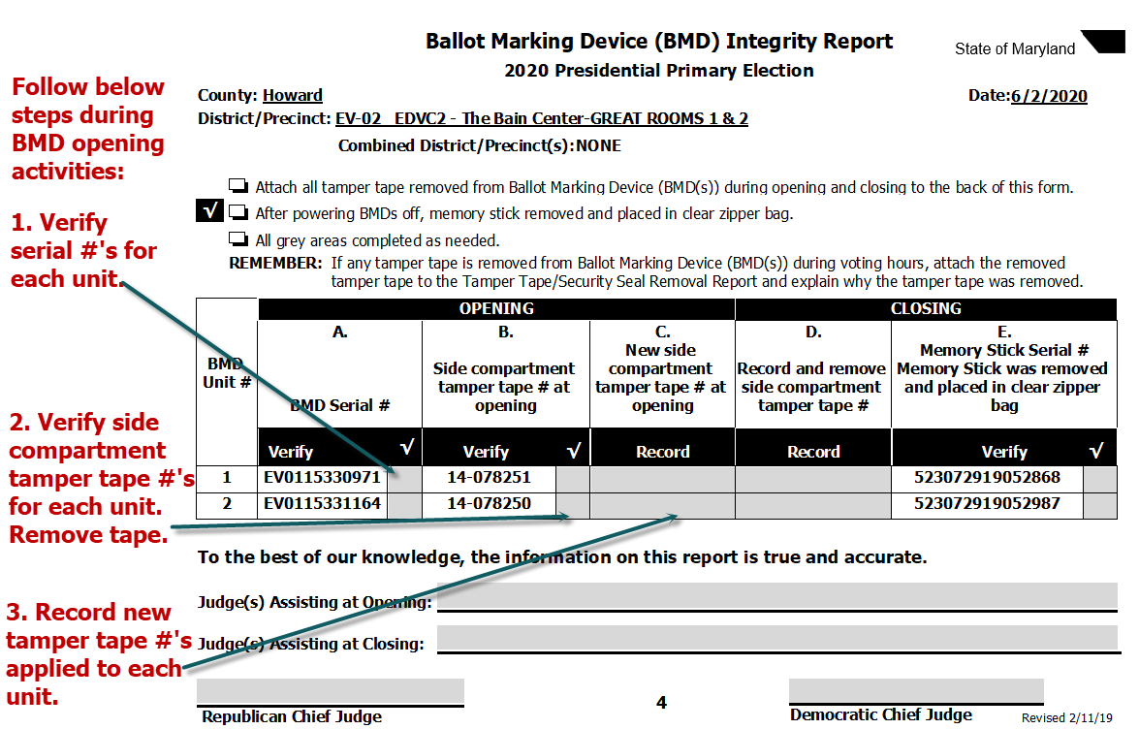
Ballot Marking Device (BMD) Integrity Report

Slide 6
BMD During Voting Hours – The Process
Each voter will be escorted over to BMD by a Chief judge with privacy sleeve and Voter Authority Card (VAC).
  Voter can sit down while Chief judge obtains a Ballot Activation Card (BAC).
Verify VAC is initialed and signed.
Offer to read any of the posted instructions for using the BMD.
Explain how to use the keypad (volume, tempo, screen, repeat, home, pause, up, down, left, back, forward and select)
“To begin voting, insert your card” is where you start by inserting the BAC.
  If audio ballot, make sure voter’s headphones are on and the volume is turned up loud enough prior to inserting BAC.
Chief Judge will use the VAC to choose the voter’s correct ballot style.
  There is 118 different ballot styles to choose. Use the next buttons when needed to locate the correct ballot.
  Place VAC back into clear pouch attached to voter’s privacy sleeve.
Explain to the voter the purpose of the next, zoom, and contrast screen buttons.
Notes:
Lesson descriptions should be brief.

Slide 7
Continued
8. Explain how to select/ deselect a candidate.
  “Vote for one” touch anywhere on new selection.
  Yellow bar and green check mark.
  “Vote for more then one” you must deselect a choice to change your choice.
  “More” button at screen bottom must be pressed to view all candidates before moving on.
  Next and previous buttons to navigate the ballot screens.
  Write-in, enter name using the keyboard that appears on screen.
9. Give the voter some SPACE, back away and allow them to make their selections without being rushed.
10. Summary of selections
  Under voted contests are marked with orange exclamation points.
  Voter may tap on a contest to go back to that contest and make changes.
11. Print card screen
  Voter taps print card button
  Once printed, voter places BAC in privacy sleeve.
  Voter may now go to a scanner to cast their ballot.
12. Wipe down BMD with provided disinfectant after each voter is finished.
13. Voter may insert BAC back into BMD to show their selections if they chose.

Slide 8
Ballot Marking Device (BMD)-Closing Activities
  Remove tamper tape placing on back of integrity report.
  Use barrel key to unlock and turn witch to “off”.
  Wait 3-5 minutes until unit is completely off, THEN remove USB stick placing in clear zipper bag.
  Pack back into case and place into black cart.
  EARLY VOTING you will be instructed by BOE staff on what to do with memory stick.
Notes:
Lesson descriptions should be brief.

Slide 9
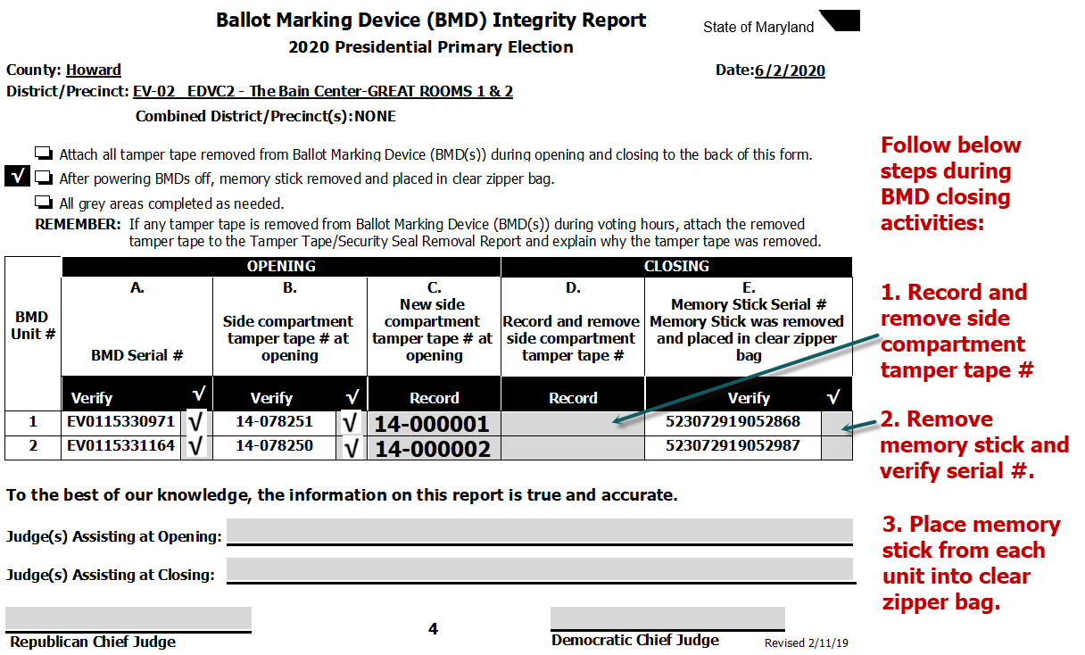
Ballot Marking Device (BMD) Integrity Report

