Slide 1
Scanning Unit Training
Presented by
Howard County Board of Elections

Slide 2
Scanning Units Lesson Objectives
General information
Chief Judges responsibilities for Scanning Unit(s) prior to 7 AM Election
morning
Explaining what Voting Unit Judges will be doing while at the Scanning Unit
Election supplies necessary
Completion of required paperwork and packing up of unit
Notes:
Example objectives
At the end of this lesson, you will be able to:
Save files to the team Web server.
Move files to different locations on the team Web server.
Share files on the team Web server.

Slide 3
Scanning Units – General Information
The Scanning Unit or DS200 is where Ballots or BACs are cast by each voter.
The Unit can run on battery but notify BOE of power outage immediately.
        There is always an emergency ballot bin to hold ballots.
Public Count which will show how many ballots have been cast, and the Protected Count will show the number of ballots cast in the unit’s lifetime (Ex: Mileage).
VACs will be collected and deposited in the Orange VAC bag hanging on the side of the Unit.
        One VAC equals one ballot cast at the unit.
If a jam occurs, notify your Chief Judge immediately, they have a key to open and fix the issue.
There must always be a judge by each scanning unit no matter what.
No Provisional Voters can cast their ballot here.
Notes:
How presentation will benefit audience: Adult learners are more interested in a subject if they know how or why it is important to them.
Presenter’s level of expertise in the subject: Briefly state your credentials in this area, or explain why participants should listen to you.

Slide 4
Scanning Units – Chief Judges Opening Processes
Verify all seals
      Right, Left, 3 Red locks and serial number on back of unit.
Open emergency slot to make sure it is empty.
      Make sure it is locked back up after checking.
Open the blue ballot bin and put back in unit lifting flaps so ballot can fall into bin from scanning unit.
Unlock and open the scanning unit lid.
Verify the back tamper tape.
Unlock and open screen, verify tamper tape and wait for unit to load.
Enter election code
      The configuration report will print
      Open Polls
      Zero report will print, this will take some time complete other tasks while waiting.
      Tape one zero report to wall next to unit and staple second zero report to integrity report.
Verify election information.
      Go to voting mode.
Notes:
Lesson descriptions should be brief.

Slide 5
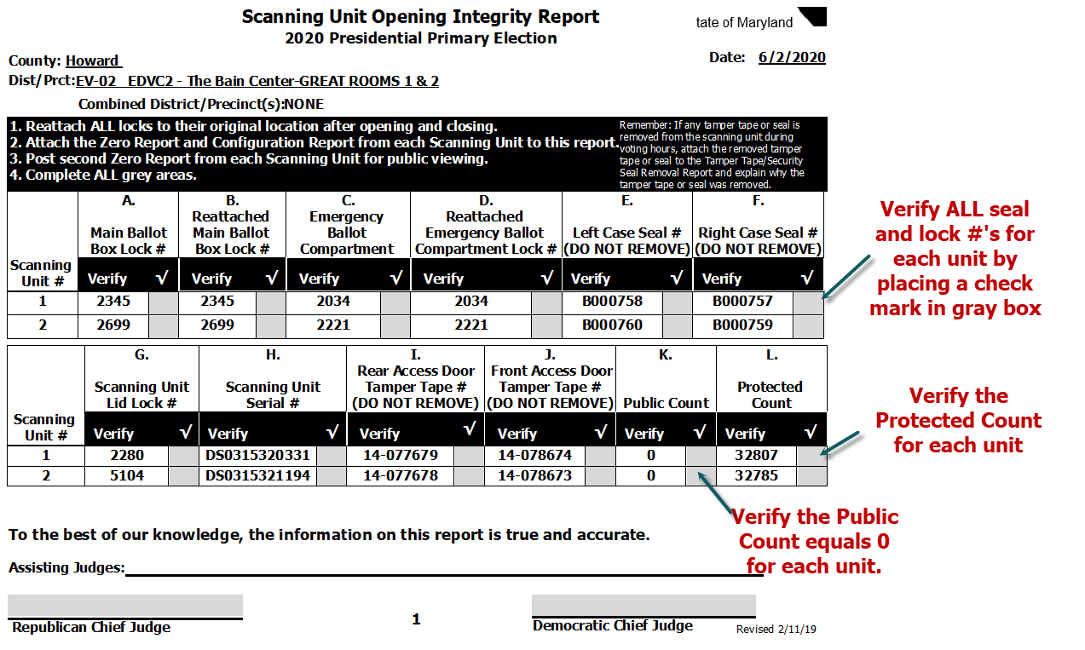
Scanning Unit Opening Integrity Report

Slide 6
Election Supplies Needed for Voting Unit
Ensure the following supplies are stationed with judges by scanning unit(s):
A bin to put used privacy sleeves into to be cleaned.
The orange Voter Authority Card (VAC) bag attached to the side of the unit.
Green apron
Voters will already have I-Voted Stickers and a pen in their baggies handed to them at the beginning of the voting process
Paper clips.
  Throughout the day make sure the VACs are being put into stacks of 25 and paperclip them together. (This makes the process of closing a lot easier)
Notes:
Lesson descriptions should be brief.

Slide 7
Scanning Units During Voting Hours – The Process
Politely ask for the voters VAC located in the clear pouch on their privacy sleeve.
Ask them to remove their ballot from the privacy sleeve and insert into the scanning unit.
      Forwards, backwards and upside down the ballot will be accepted
Inform voter of the “Thank You For Voting Screen” with the American flag in the background, make sure they look for it.
You can listen and hear the ballot drop into the bin as an indicator the ballot has been cast.
Once the ballot has been cast take the privacy sleeve and place into bin to be cleaned.
Place VAC in Orange VAC bag only after voter has cast their ballot
When things are slow bundle VACs in 25s with one paper clip.
Do not look at the screen and stand back to the side of the unit to insure voter privacy.
Notes:
Lesson descriptions should be brief.

Slide 8
Scanning Units During Voting Hours – The Process Continued
If there seems to be an issue, kindly ask, “May I take a look at the screen to assist you.”
Inserting a Blank ballot, a message will appear. The voter has two options “Return” or “Cast Ballot.”
If someone does not want to vote a particular contest which is an undervote, the ballot will be cast without a problem.
Overvoting a contest, a message will appear with that contest. The voter has two options “Return” or “Cast Ballot.”
    Returning the ballot, the voter will need to spoil their ballot and receive a new one.
    Casting the ballot only the overvoted contested will not be counted.
Blue Ballot Bins can hold up to 1600 ballots if the Public Count gets near that, notify Chief Judge who will notify the BOE and a new bin will be brought out.

Slide 9
Scanning Units – Chief Judges Closing Processes
Remove tamper tape and open side compartment, press the “close polls” button, “close polls” on screen.
    Wait for voting results to print out. Once complete tape one on wall and staple one in binder.
Once the results are finished printing press “Finished turn off.”
    Wait for screen to COMPLETELY turn off. (No lights are on at all)
    Pull stick
    Close screen
    Lock
    Pull lid down
    Lock lid
Pull blue ballot bin.
    Take Spoiled ballot envelope from ballot issuance and place inside bin.
    Seal the blue ballot bin with the red tags and lock it.
    Close unit door lock it and re-seal it with red lock.
Orange VAC bag
    Zip closed
    Seal with the yellow seal provided
Notes:
Lesson descriptions should be brief.

Slide 10
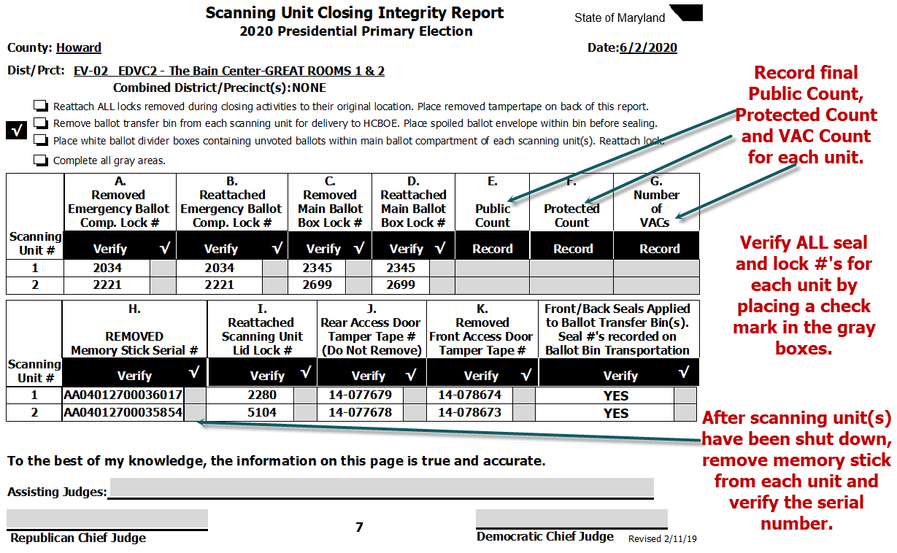
Scanning Unit Closing Integrity Report

