Slide 1
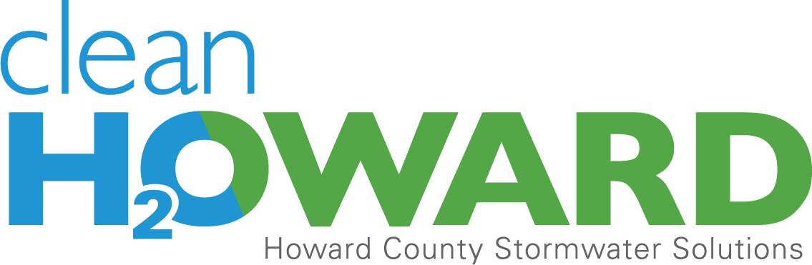
The Stormwater Challenge
Presentation to the Howard County
Spending Affordability Committee
January 21, 2016

Slide 2
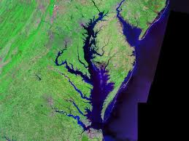
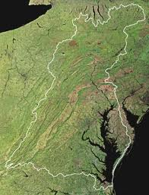
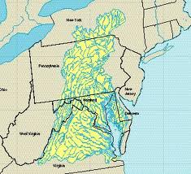
The Chesapeake Bay Watershed

Slide 3

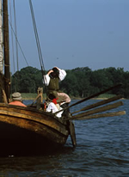
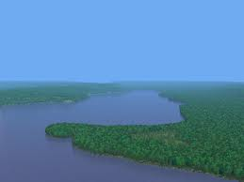
Captain John Smith’s Journal 1607
“An aboundance of fish, lying so thicke with their heads above the water, as for want of nets (our barge driving amongst them) we attempted to catch them with a frying pan: but we found it a bad instrument to catch fish with: neither better fish, more plenty, nor more variety for smal fish, had any of us ever seene in any place so swimming in the water, but they are not to be caught with frying pans”

Slide 4
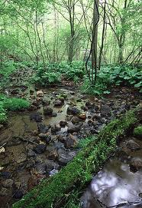
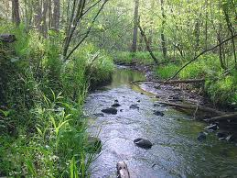
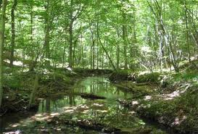
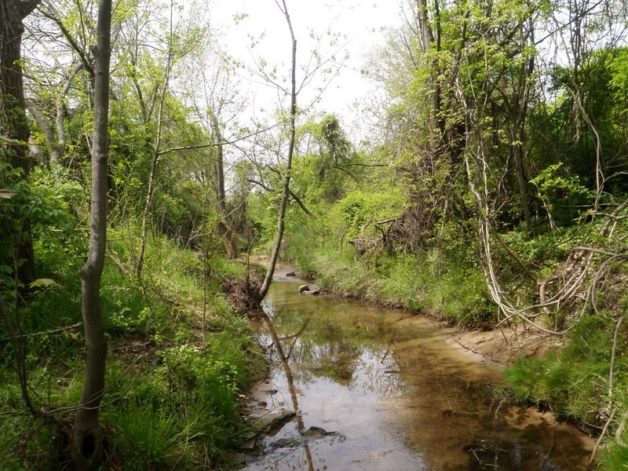
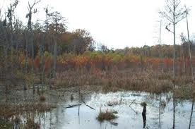
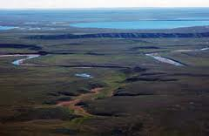
Healthy Piedmont and Coastal Plain Streams of the Chesapeake Watershed

Slide 5
Population Growth

Slide 6
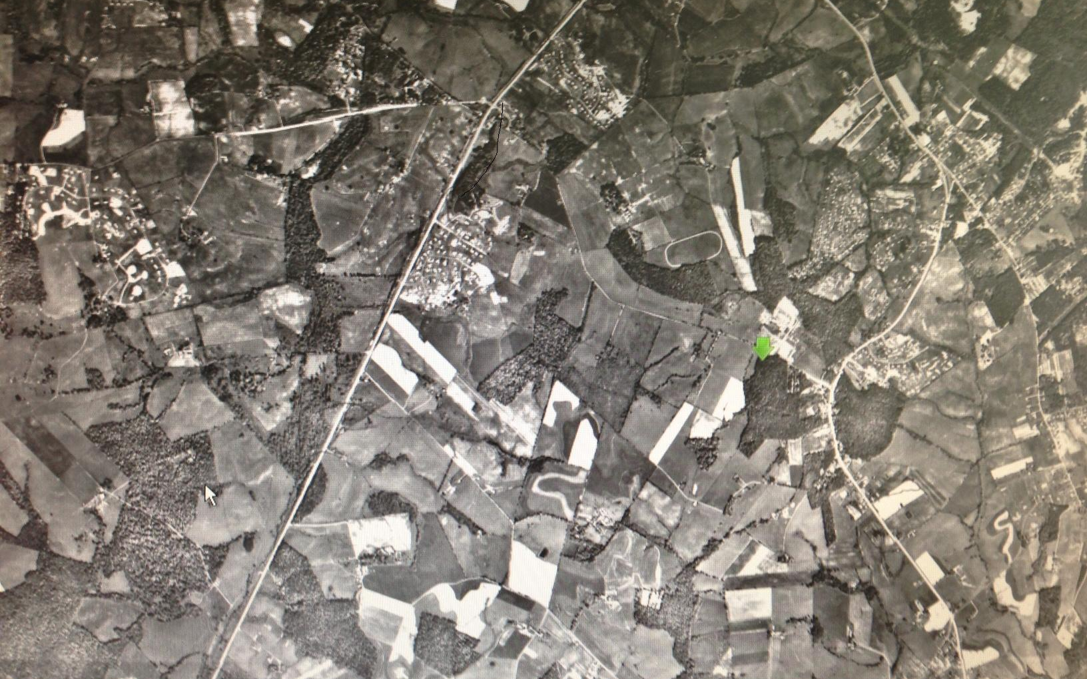
Howard County Land Use 1965
Howard High School

Slide 7
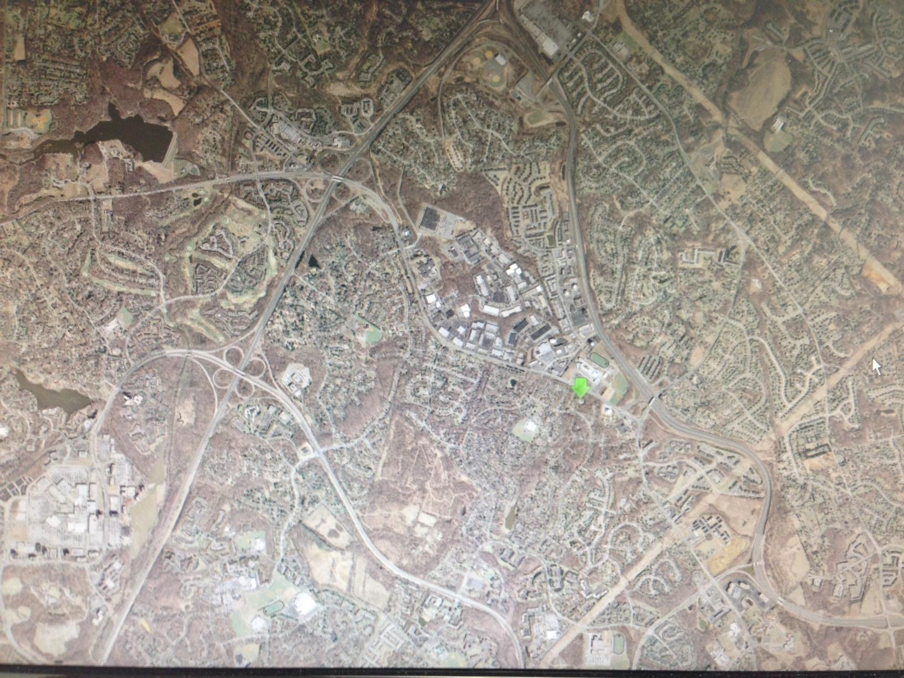
Howard County Land Use 2011
Howard High School

Slide 8
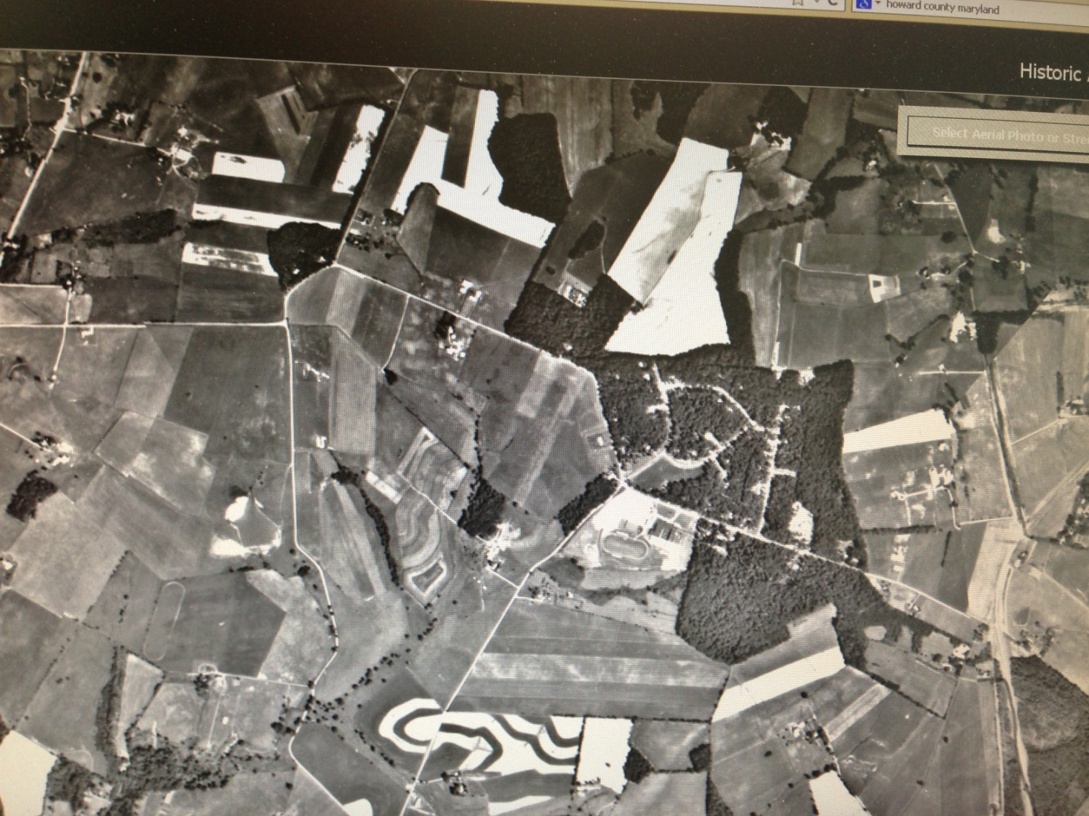
Howard County Land Use 1970
Glenelg High School

Slide 9
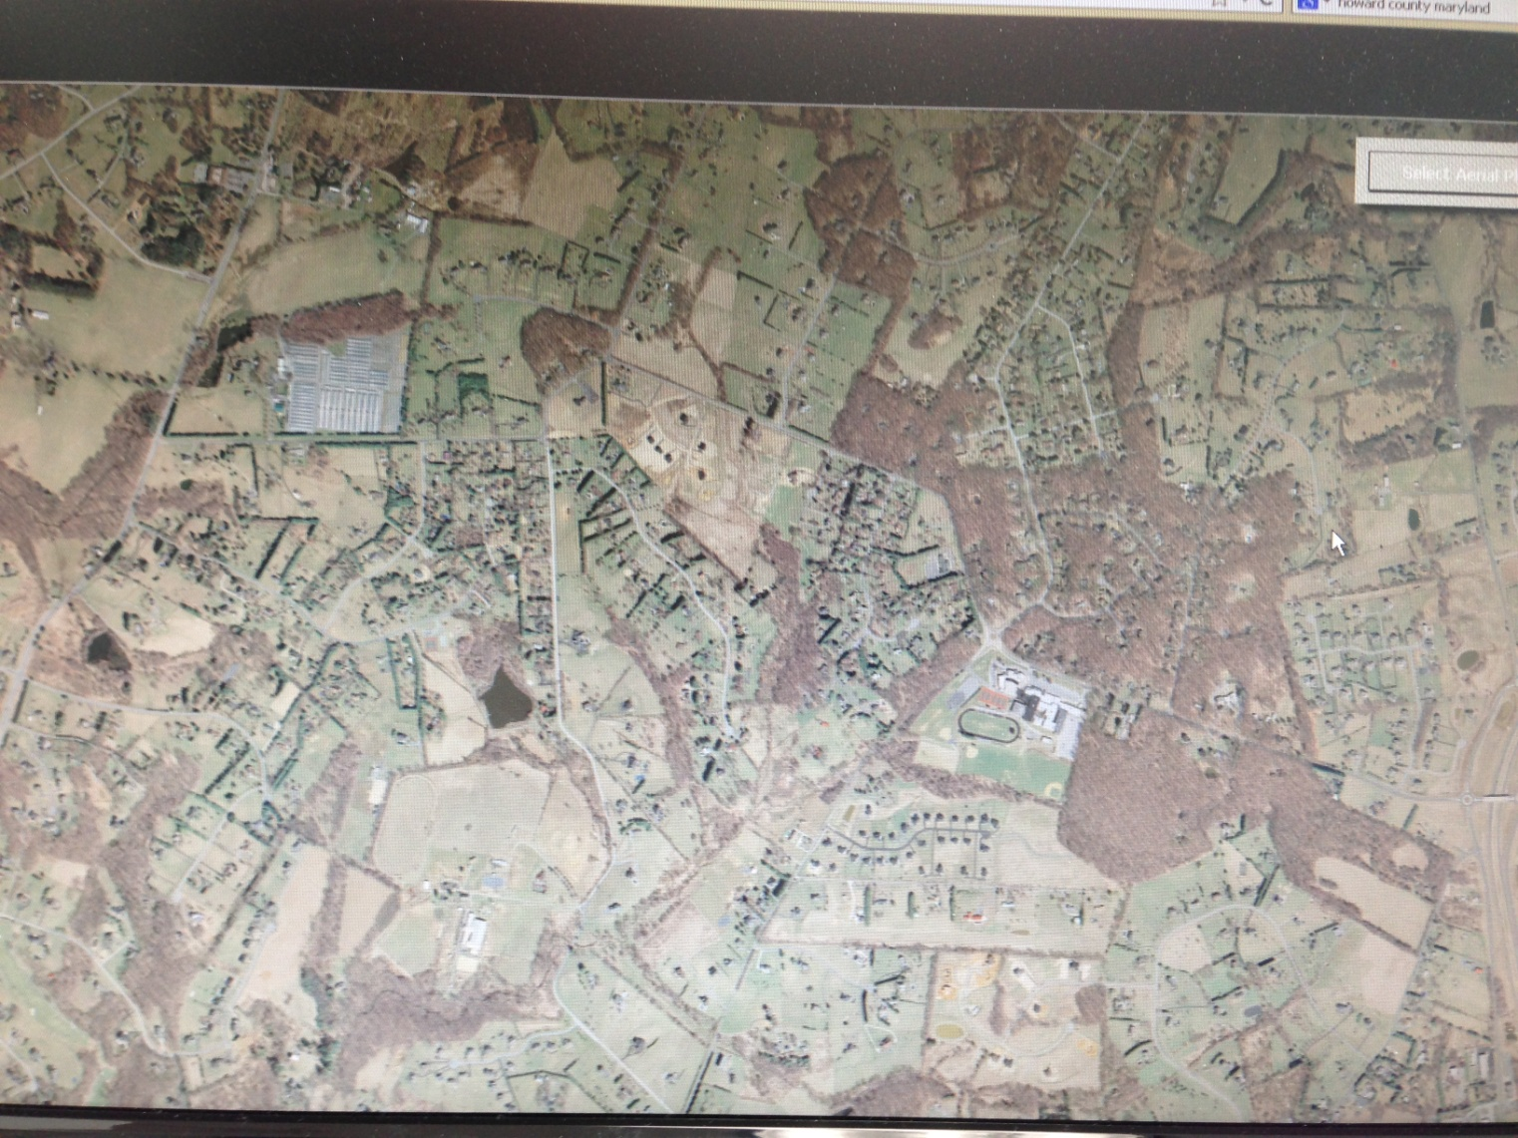
Howard County Land Use 2011
Glenelg High School

Slide 10
The Evolution of
Stormwater Management
Get the water off the road
      Inlets to Outfall, no flow control
Control the flow in large regional ponds
      First order streams piped losing biological diversity
Manage for better water quality
      Pond forebays, sand filters, riparian buffers
Control runoff flow and quality at the source
      On-site controls ie. Cisterns, raingardens, green roofs

Slide 11
Countywide
Impervious Area Status

Slide 12
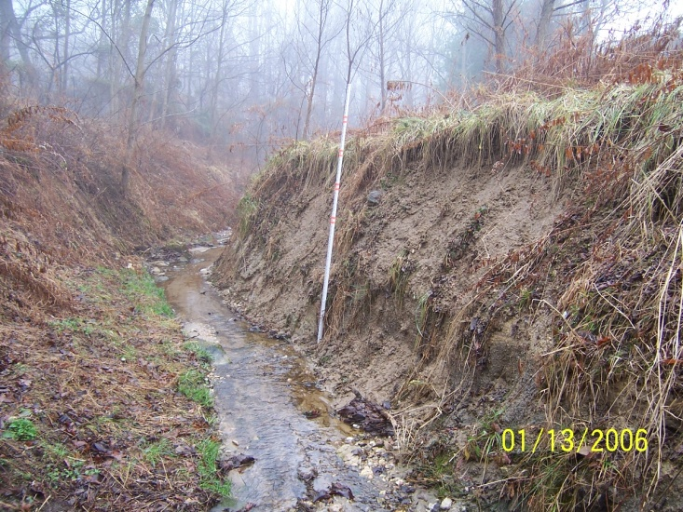
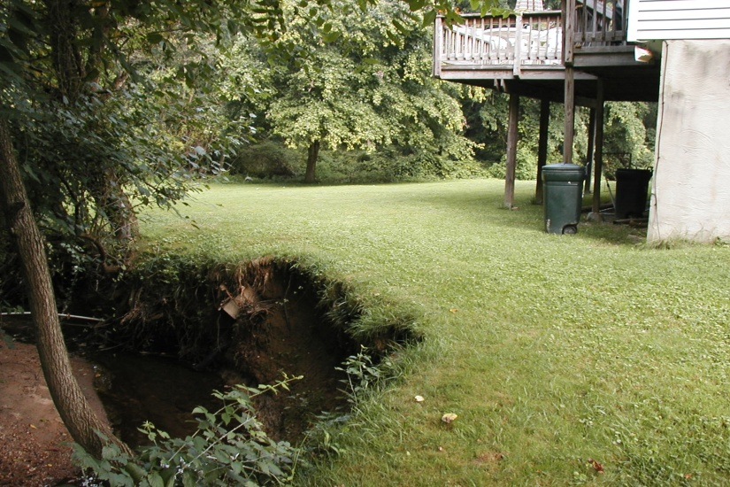
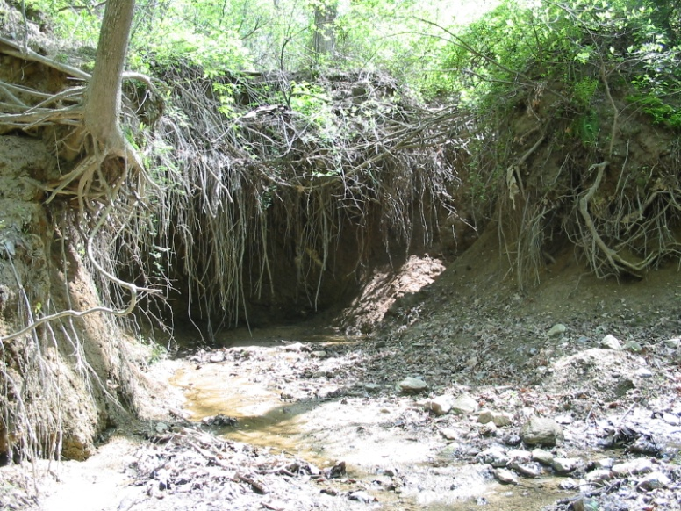
Stream Erosion

Slide 13
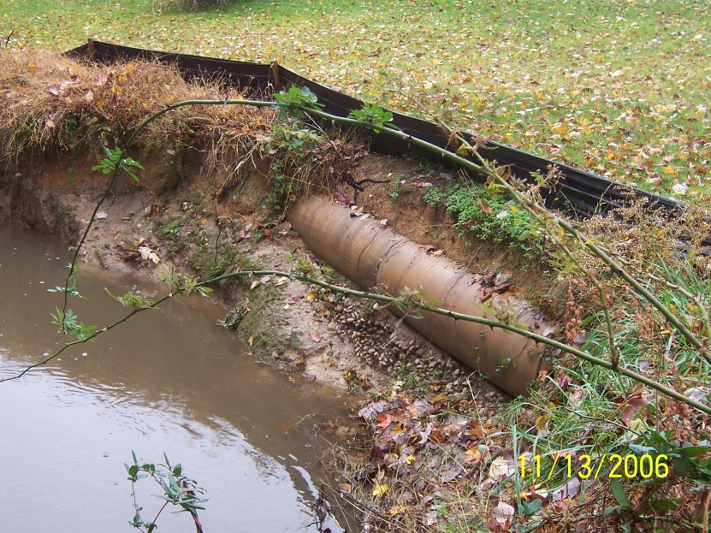
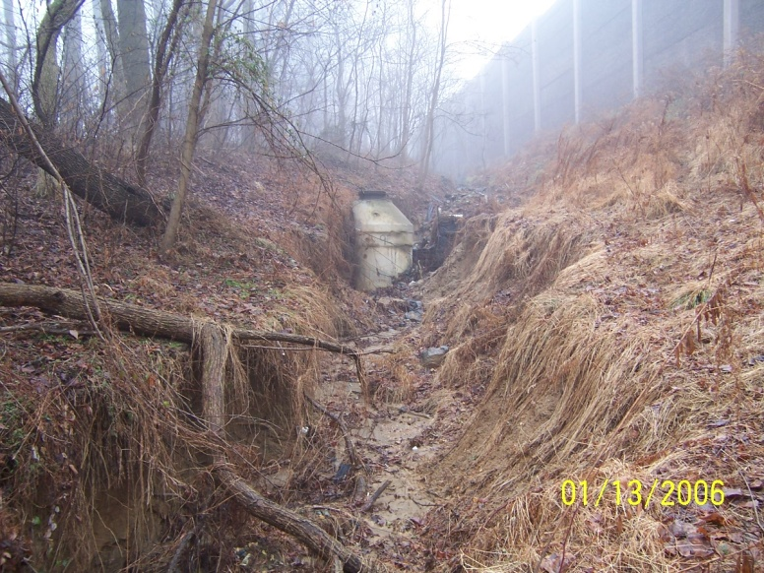
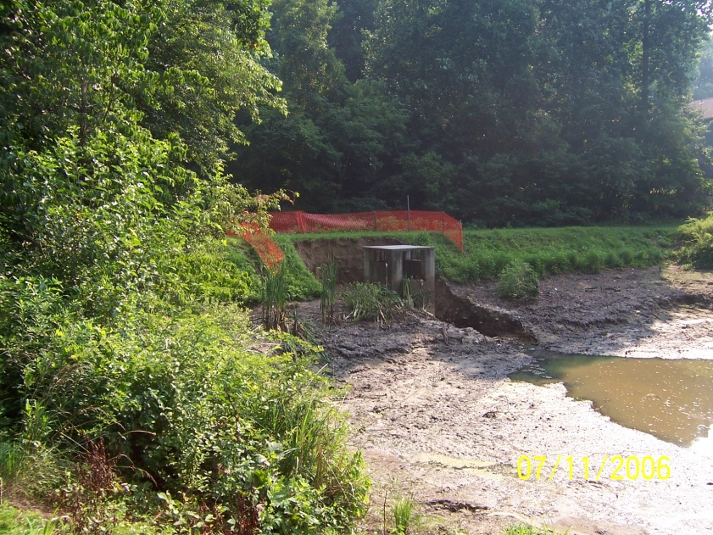
Infrastructure Impacts

Slide 14
The Solutions are Known
From Simple
To Complex
Rain Barrels
Rain Gardens
Porous Pavers
Less Fertilizer
No Litter
No Vehicle leaks
Less Pet Waste
Trees
Stream Restoration
Pond Retrofits
Bio-Swales
Sand Filters
Curb bump-outs
Asphalt Reductions
Green Roofs
Behavior Change

Slide 15
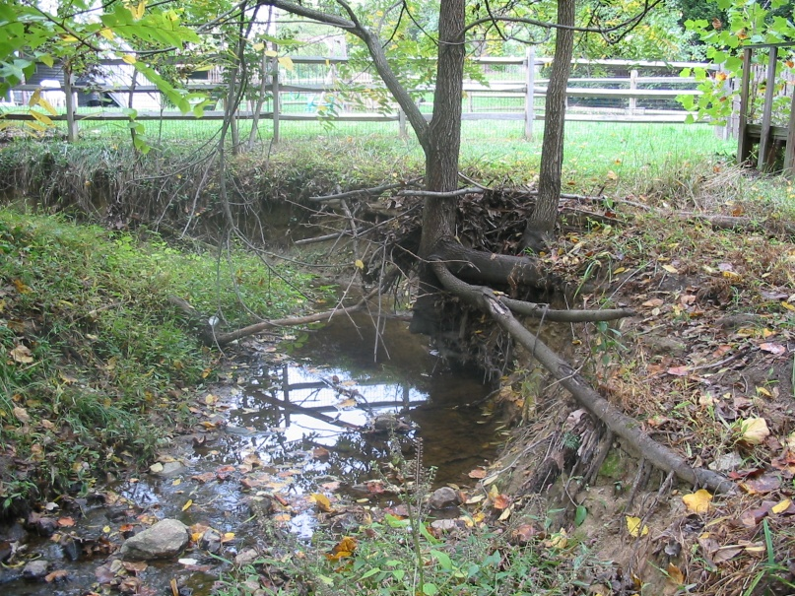
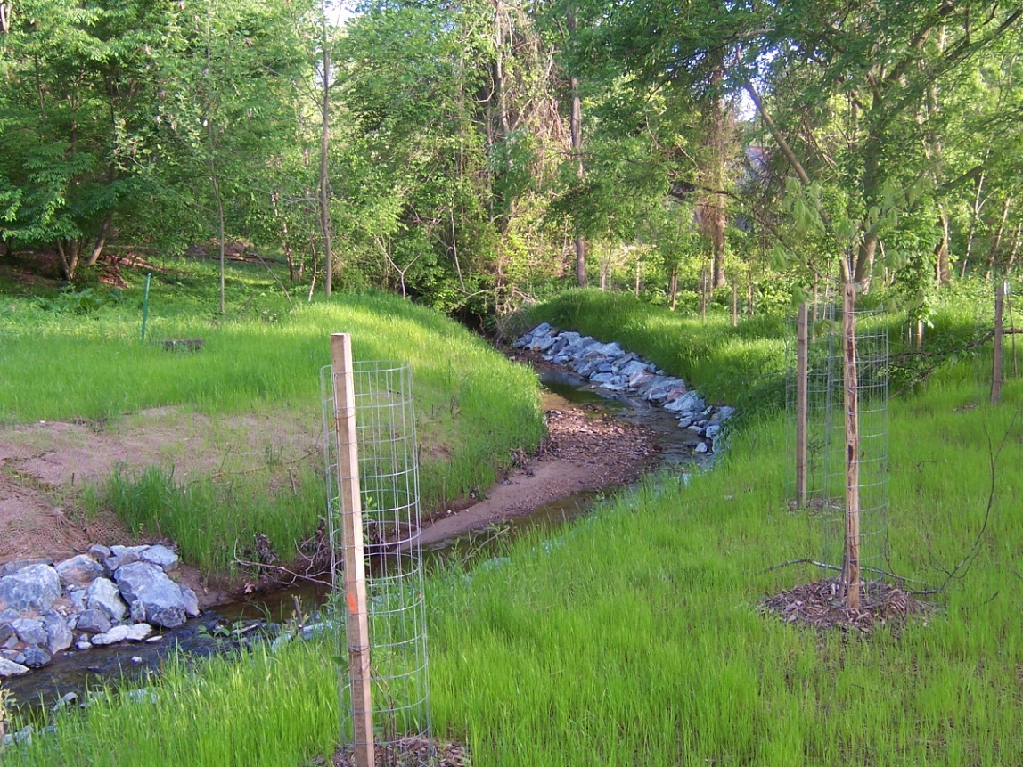
Stream Restoration

Slide 16
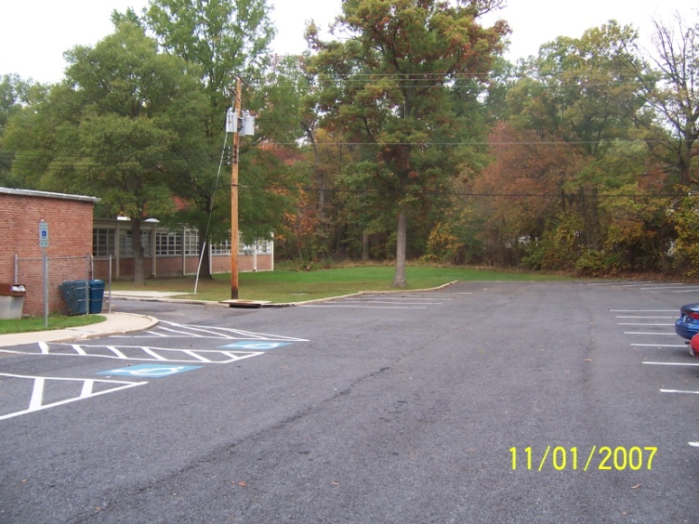
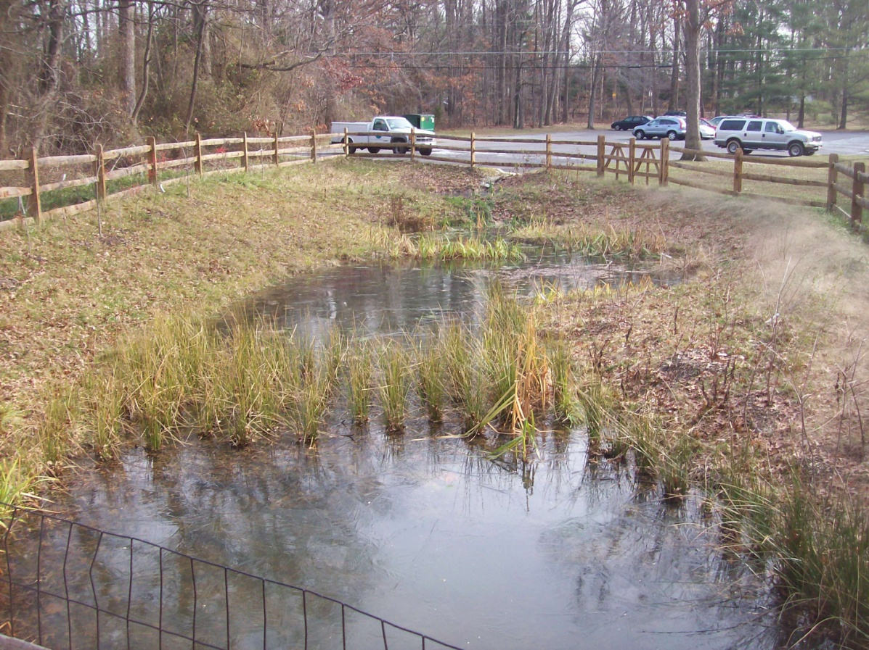
Wet Ponds

Slide 17
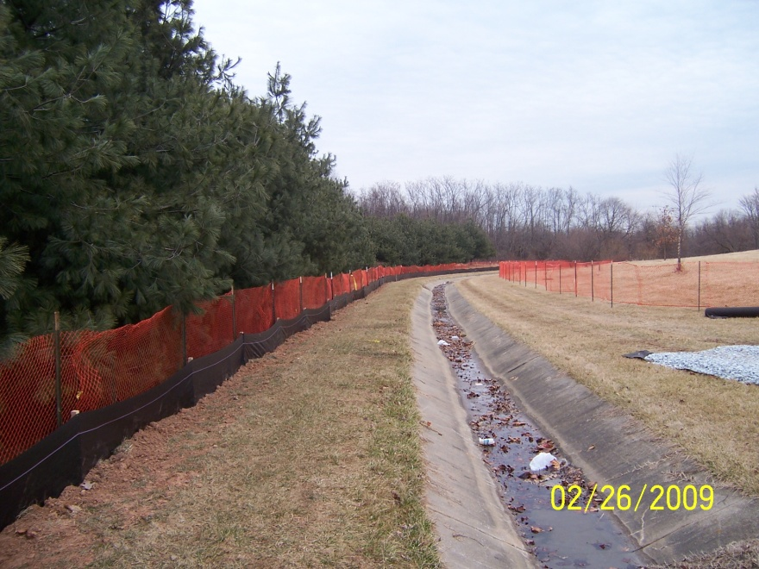
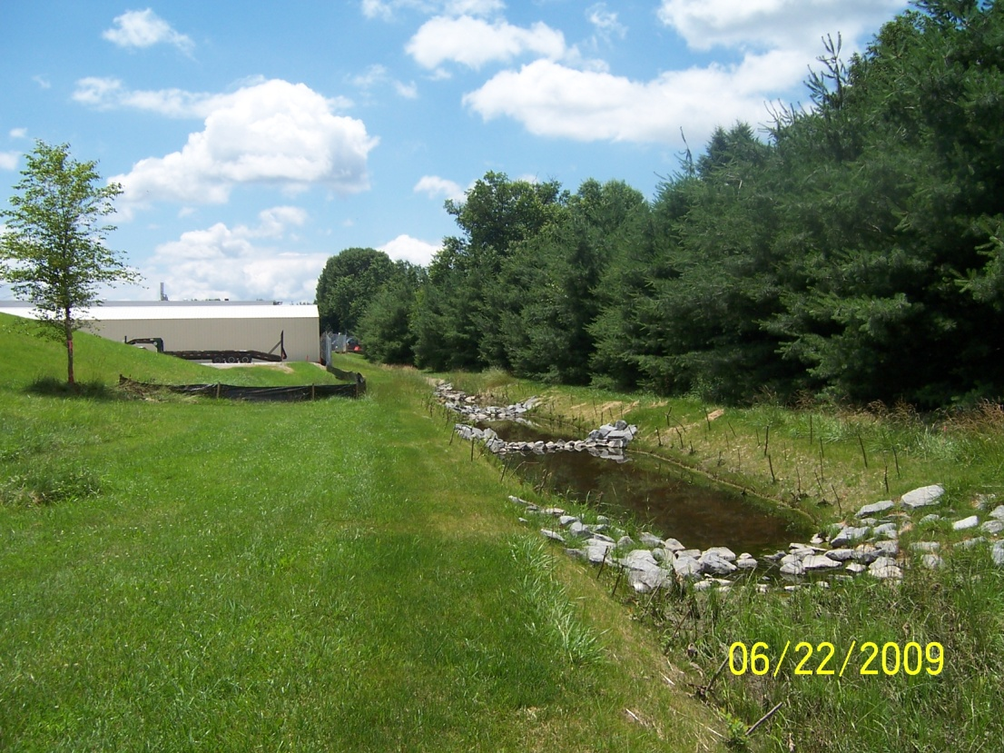
Culverts to Bio-swales

Slide 18
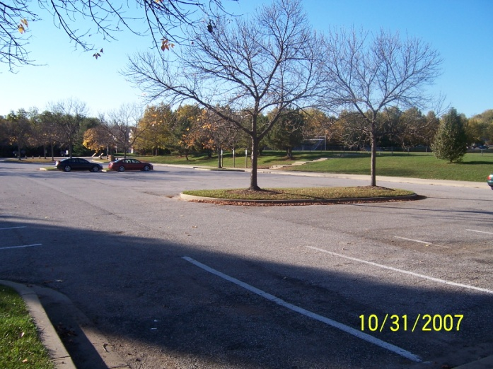
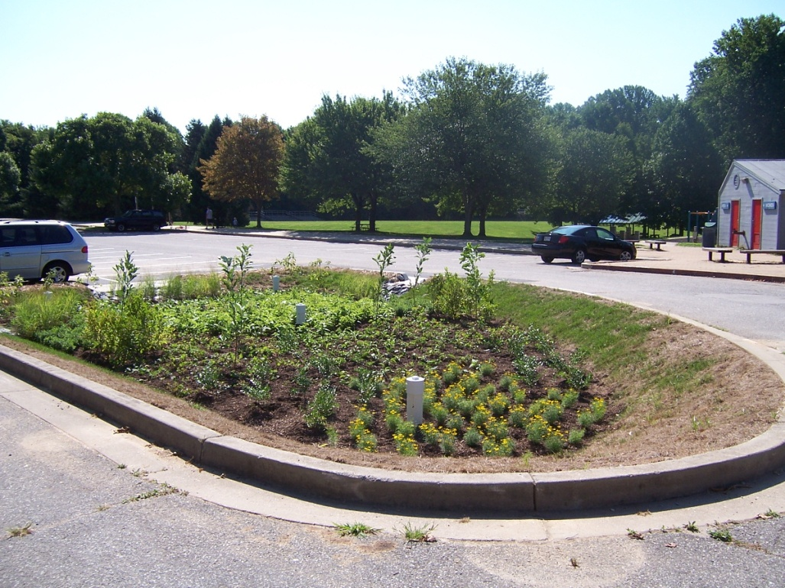
Bio-Retention

Slide 19
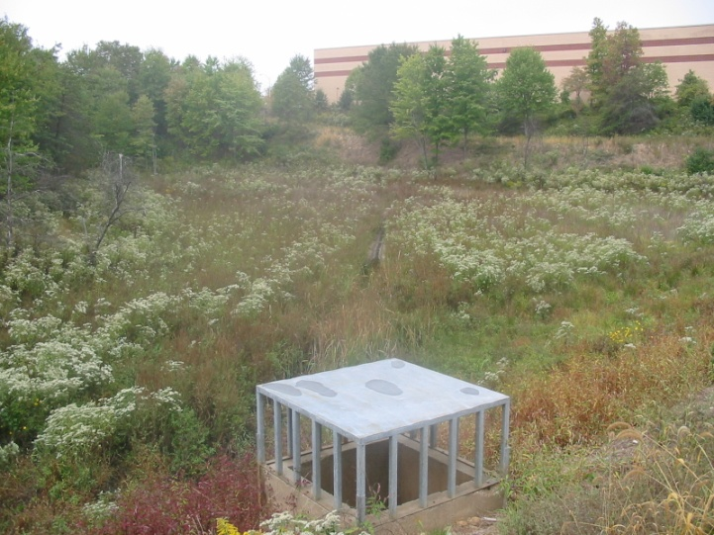
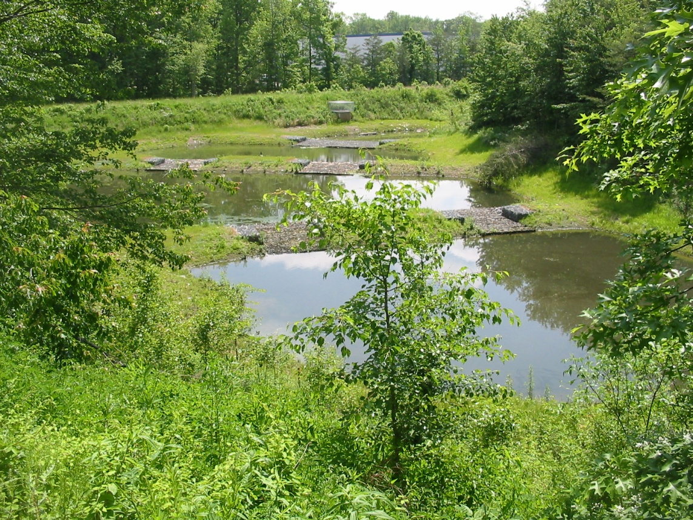
Pond Retrofits

Slide 20
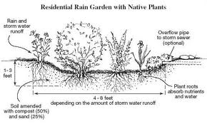
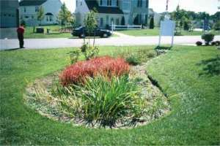
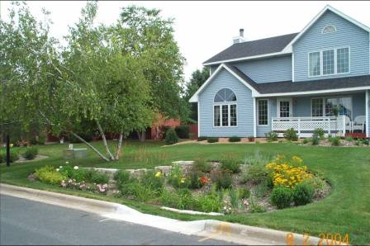
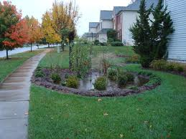
Rain Gardens

Slide 21
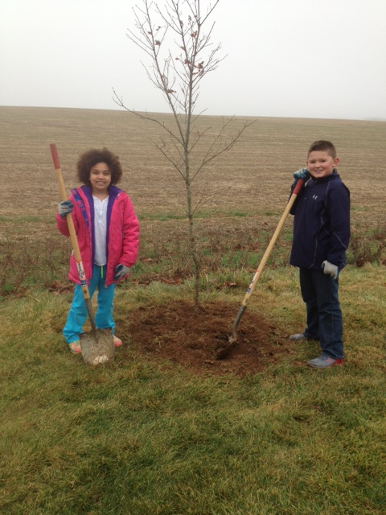


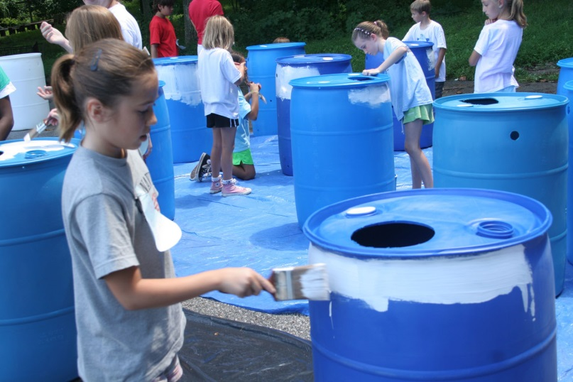
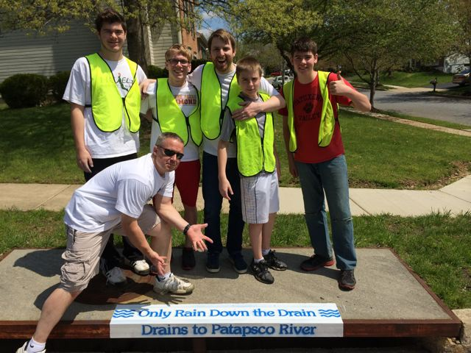
Outreach and Education

Slide 22
Current Stormwater System
Over 5,000 stormwater management structures
Over 23,000 stormdrain inlets and a lesser number of outfalls
700 miles of stormwater pipes and drainage ditches
Total Infrastructure assets over $675 M

Slide 23
The Problem
Stormwater Management Regulations came much later than the imperviousness of the built community
We are on the right track but we are challenged to get there faster
The cost of repairs, retrofits and new controls far exceeds the historic funding levels
Unlike water/sewer, trash, or electricity; funding for maintenance and new controls remains a challenge

Slide 24
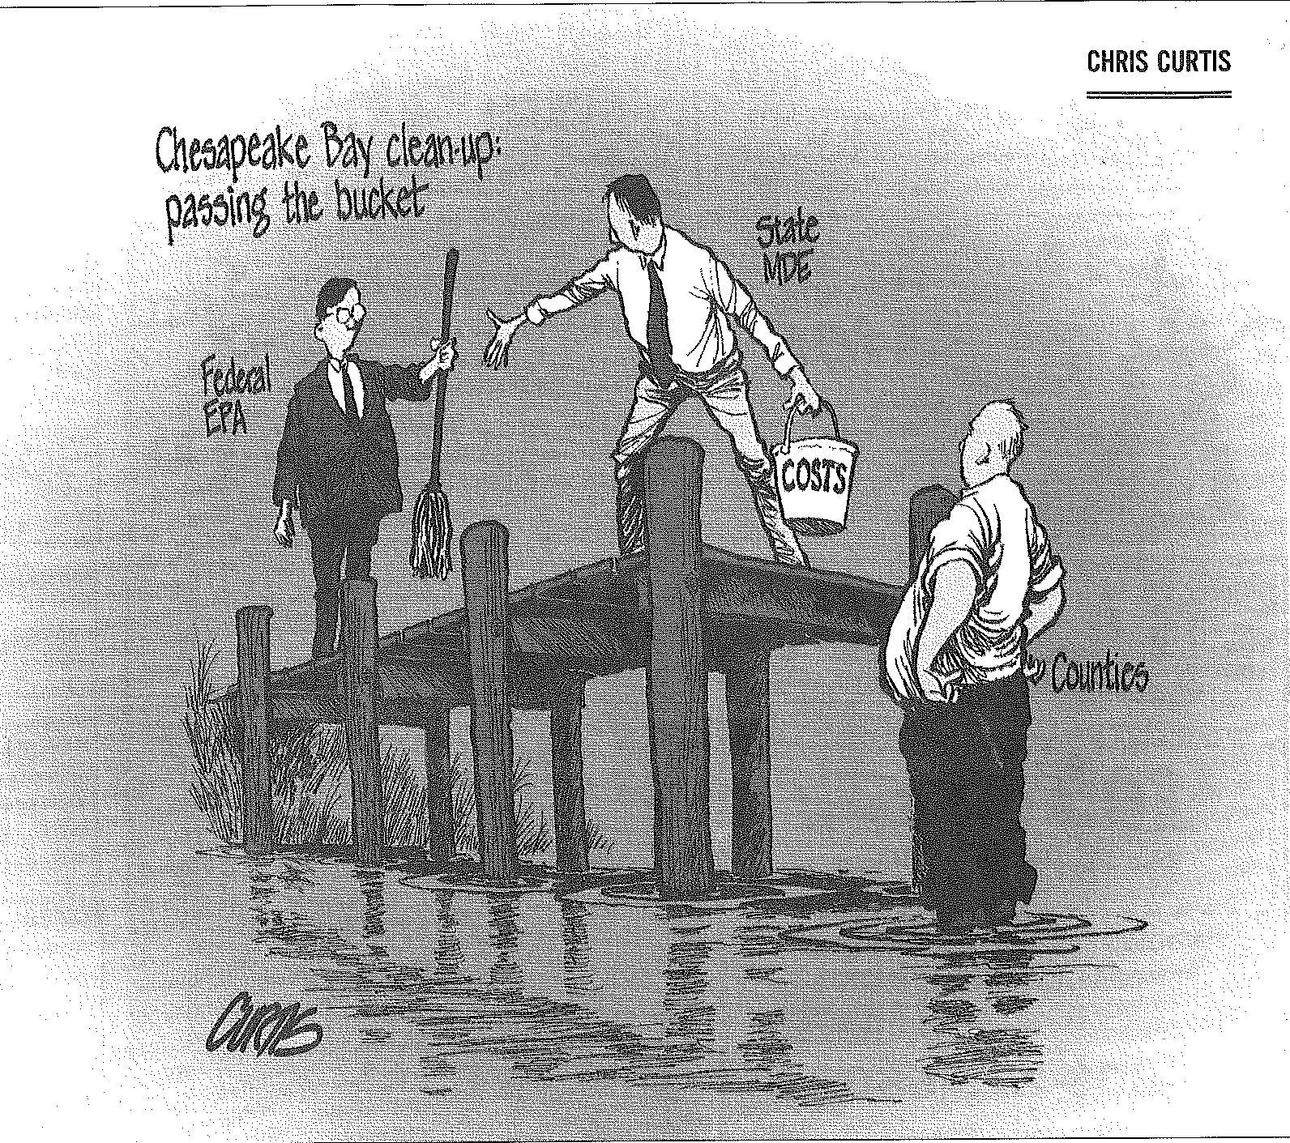

Slide 25
Regulatory Mandates
MS4
Municipal Separate Storm Sewer System
TMDL
Total Maximum Daily Load
WIP
Watershed Implementation Plan
HB 987
Watershed Protection and Restoration Fund
SB 863
Repeal Watershed Restoration Fee Mandate

Slide 26
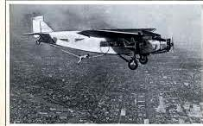
  Stormwater mandates are analogous to maintaining an airplane in flight!

Slide 27
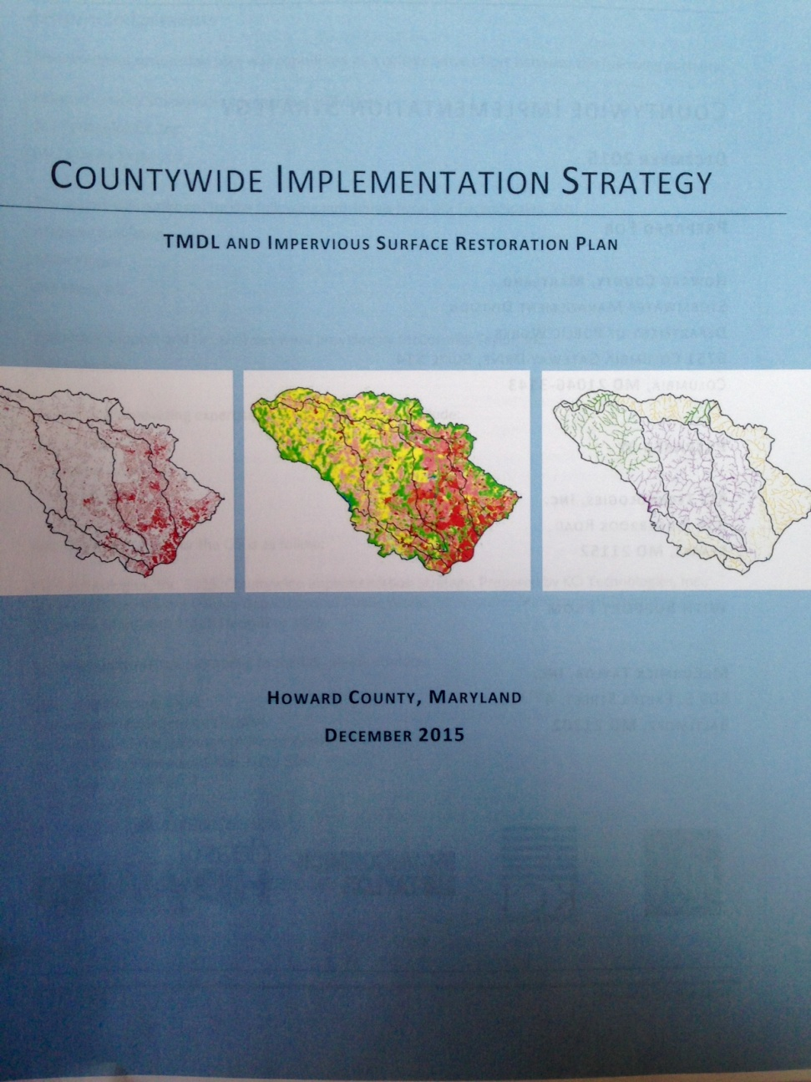

Slide 28
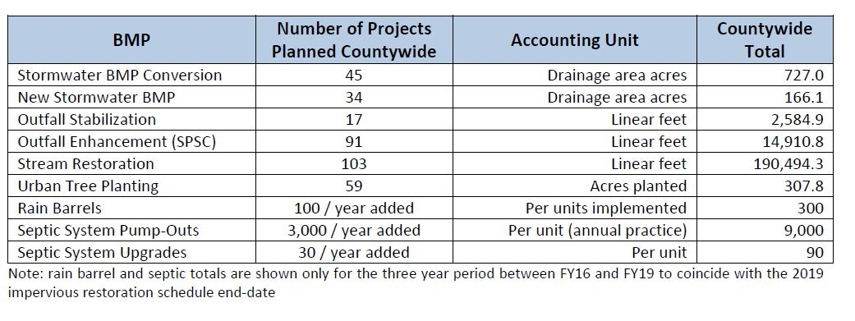
Planned MS4 compliance Strategies

Slide 29
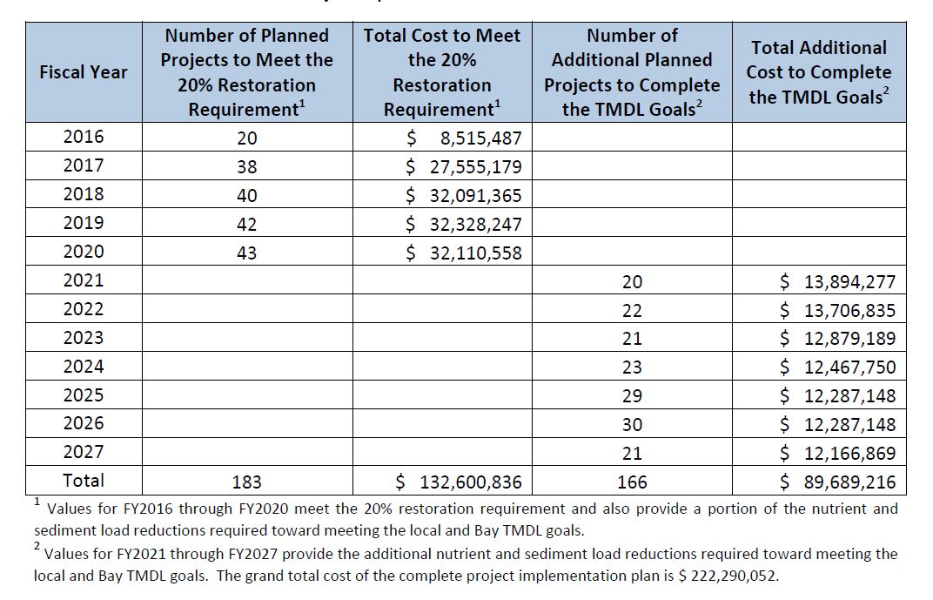
Fiscal year schedule of project implementation and cost

Slide 30
What is the Cost of Compliance?
20% of untreated impervious = 2,044 acres
Cost varies by practice : $20 - $100,000 per acre
Average per acre cost = $65,000
Capital cost for new practices = $133,000,000
Avg. annual capital cost 5 permit years = $26,000,000
Estimated annual operating cost = $4,000,000
Additional cost to meet TMDL by 2025 = $89,700,000
Total to comply by 2025 = $226,700,000

Slide 31
Important Program Dates
December 18, 2014 - MS4 permit issued to County
December 18, 2015 – Implementation Strategy to MDE
July 1, 2016 – Financial Assurance Plan due to MDE
December 18, 2016-2019 – MS4 annual reports and FAP due to MDE
December 18, 2019 – MS4 permit compliance deadline
2025 – TMDL mandates to be completed

Slide 32
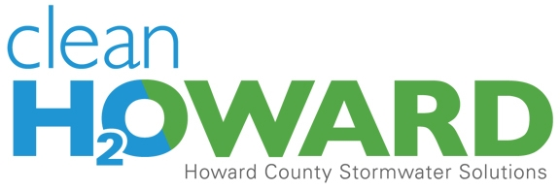
Jim Caldwell, Director
Office of Community Sustainability
jcaldwell@howardcountymd.gov
www.cleanwaterhoward.com

