Slide 1

Spending Affordability
Advisory Committee
September 21, 2016
Chief Gary L. Gardner

Slide 2
HCPD Overview
472 Authorized Police Positions
  9 Current Vacancies
203 Authorized Civilian Positions
  15 Current Vacancies
Over 100 Volunteers
  Auxiliary (14 current Auxiliary Officers)
  Mounted Patrol (6 currently)
  Animal Control (78 currently)
  VIPs

Slide 3
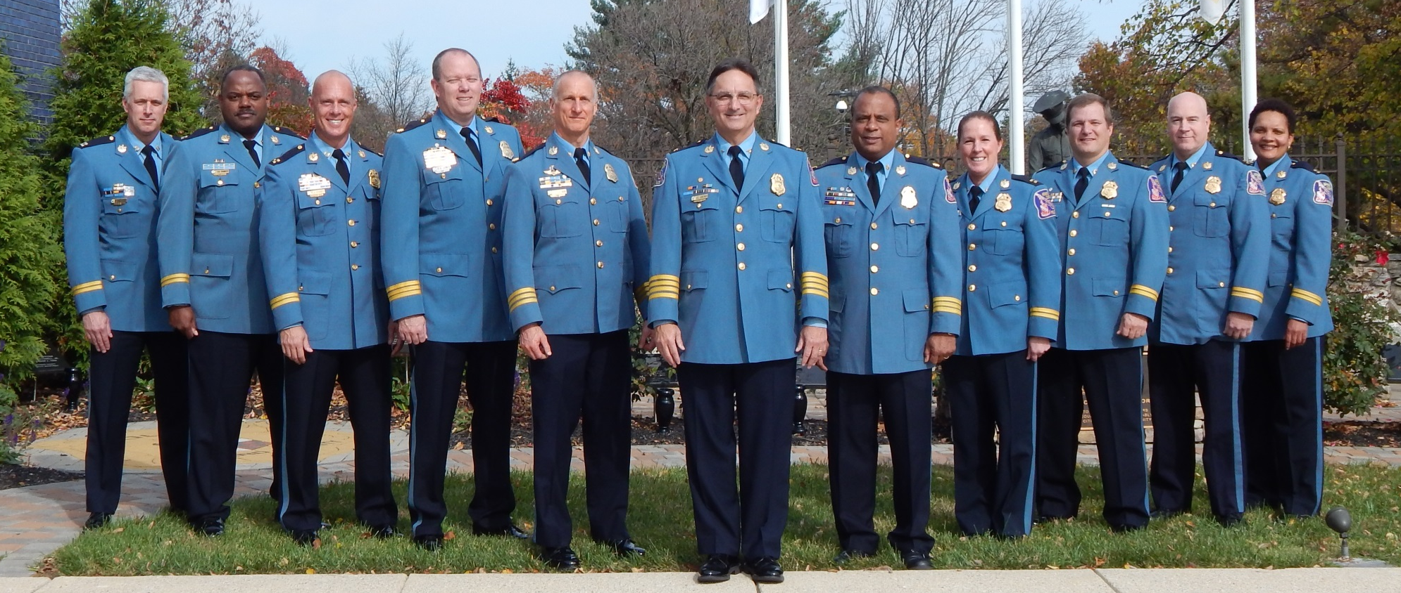
A Period of Great Change
66% of Command Staff Has Changed

Slide 4
Quick Crime Snapshot
Type | 2014 | 2015 | 5 Year Average | Compared to 2014
Homicide | 5 | 2 | 4 | Down 60%
Street Robbery | 136 | 157 | 153.8 | Up 15.4%
Commercial Robbery | 61 | 65 | 48.4 | Up 6.6%
Aggravated Assault | 332 | 370 | 331.8 | Up 11.4%
Burglary | 880 | 765 | 999.2 | Down 13.1%
Vehicle Theft | 202 | 173 | 236.2 | Down 14.4%
Thefts from Vehicles | 1,667 | 1,558 | 1,788.4 | Down 6.5%

Slide 5
Challenges We Face
Crime
Facility Issues
Special Event Management
National Issues & Trends

Slide 6
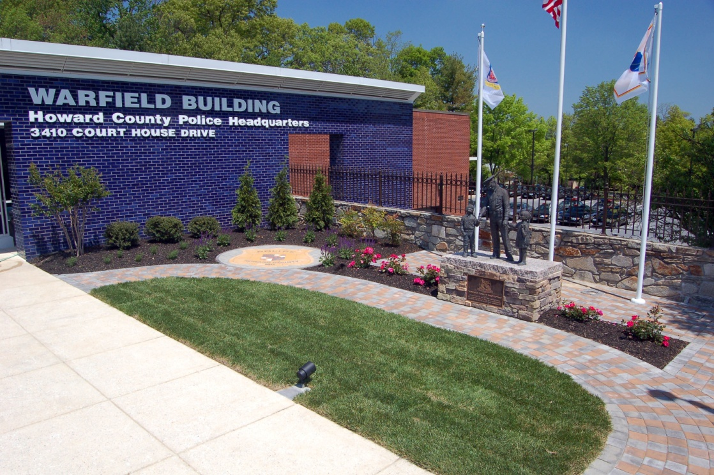
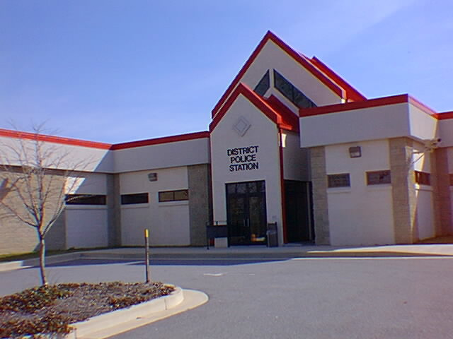
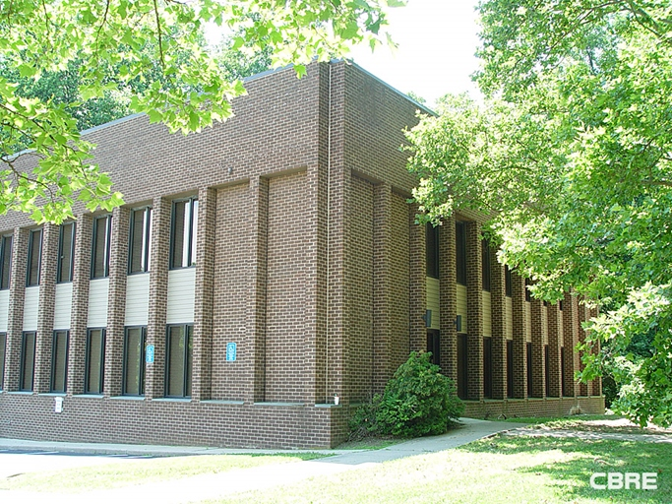
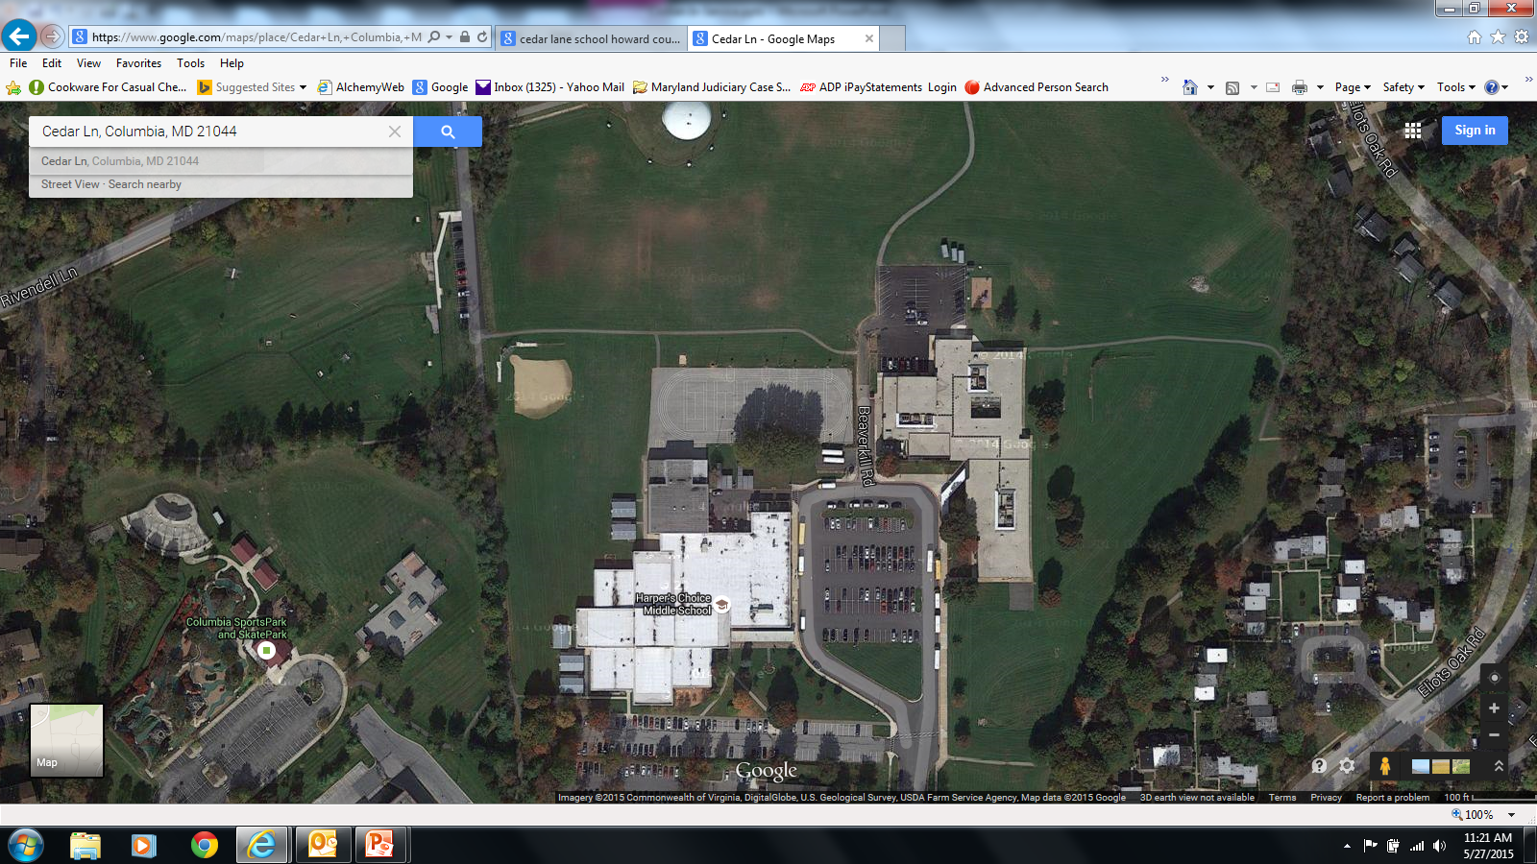
Facility Update
Grempler Building
Possible Location of a new 3rd District

Slide 7
Special Events Management
Special Events/Merriweather
Increase each year with special event requests (half marathons, triathlons, 5Ks, Walks, Bike Rides, Concerts).
In excess of $1 Million dollars in CY2015
Impacts other overtime staffing needs; saturation patrols, traffic safety.

Slide 8
Special Events Management
 | Special Events | Number of Events | Merriweather | Number of Events | Total | Total Number of Events
2015 | $423,253 | 169 | $642,232 | 32 | $1,065,486 | 201
2014 | $329,250 | 173 | $487,211 | 29 | $816,461 | 202
2013 | $281,231 | 139 | $552,716 | 33 | $833,947 | 172

Slide 9
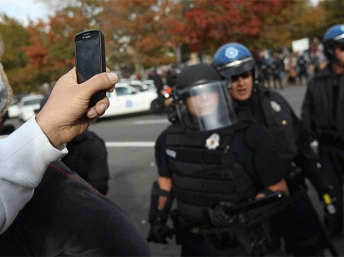

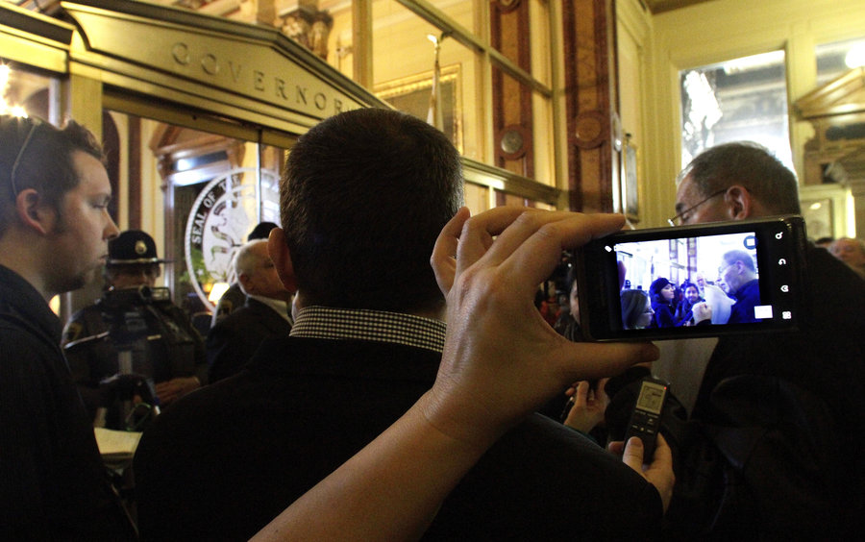

Local Incidents: Instant National News
Notes:
Chief will speak of how local events elsewhere impact HCPD
24/7 Media Blitz fuels the Frenzy
Everyone having instant video + Social Media

Slide 10
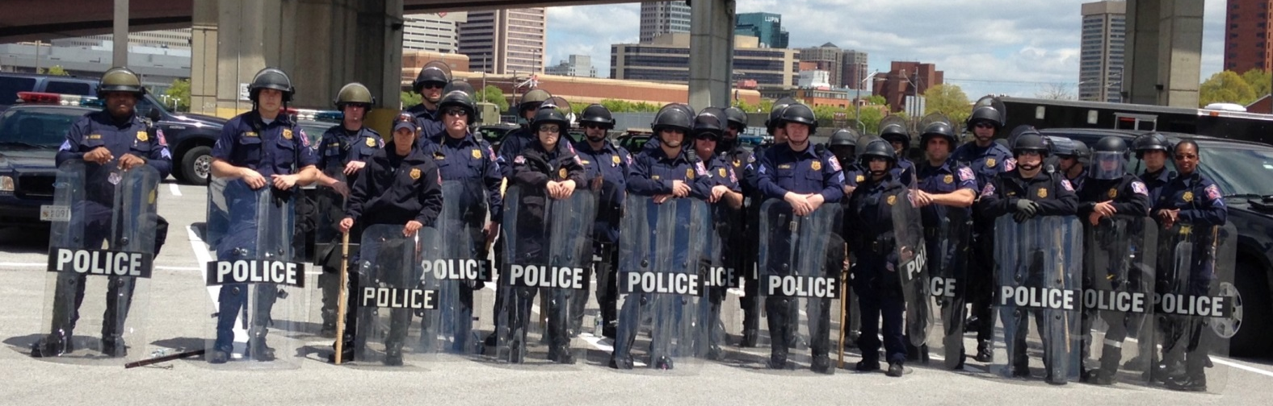
Local Agency Support
$374,000 Returned

Slide 11
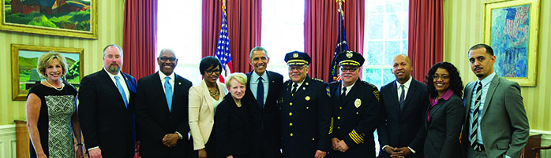
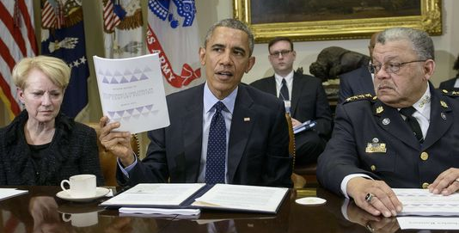
President’s Task Force
21st Century Policing Recommendations
Notes:
Possibly Discuss the President’s Task Force
Discuss the report of recommendations
The HCPD is currently reviewing each recommendation
Many we are already ahead of…
Others we are evaluating
Interested parties may view the entire report on-line. Simply search for 21st Century Policing Report

Slide 12
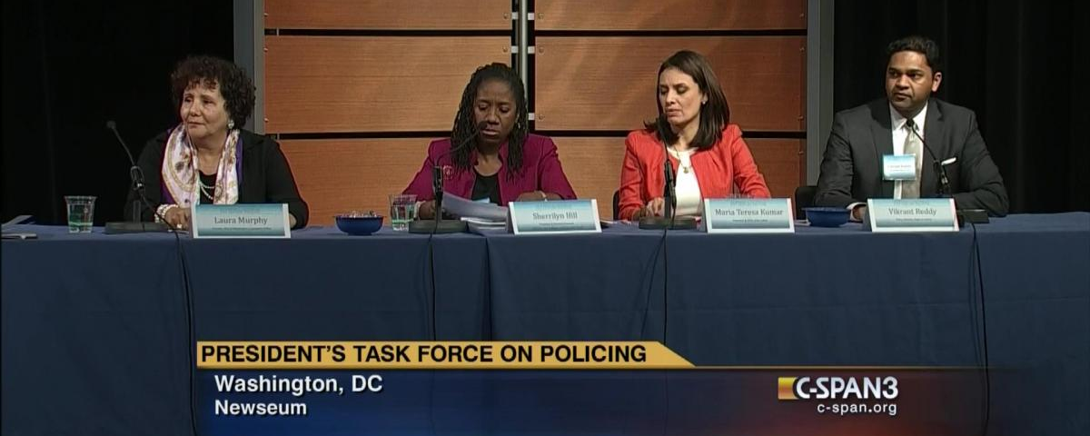
Six Pillars of Plan
Building Trust and Legitimacy
Policy and Oversight
Technology and Social Media
Community Policing and Crime Reduction
Officer Training and Education
Officer Safety and Wellness.

Slide 13
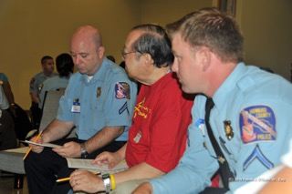
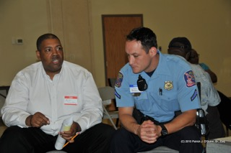

Council Resolution & CAC
Four topic areas
Community Policing Programs
Neighborhood Community Resource Offices
Technology
Training
Notes:
Speak of the value of the CAC’s work in response to the Council’s Resolution 16.
A resolution requesting that the Howard County Police Department’s Citizen Advisory Council establish a Committee on Community Policing and make recommendations related to community policing.
Speak of the outcome of the recent Community Forums
Announced by the County Council in June.
Only about 3 citizens attended first forum
25 attended the second (but many we invited)
Low turnout truly symbolizes that our communities DO NOT have issues with police)
Engaging our community – not allowing things to become like recent nation-wide hotspots.

Slide 14
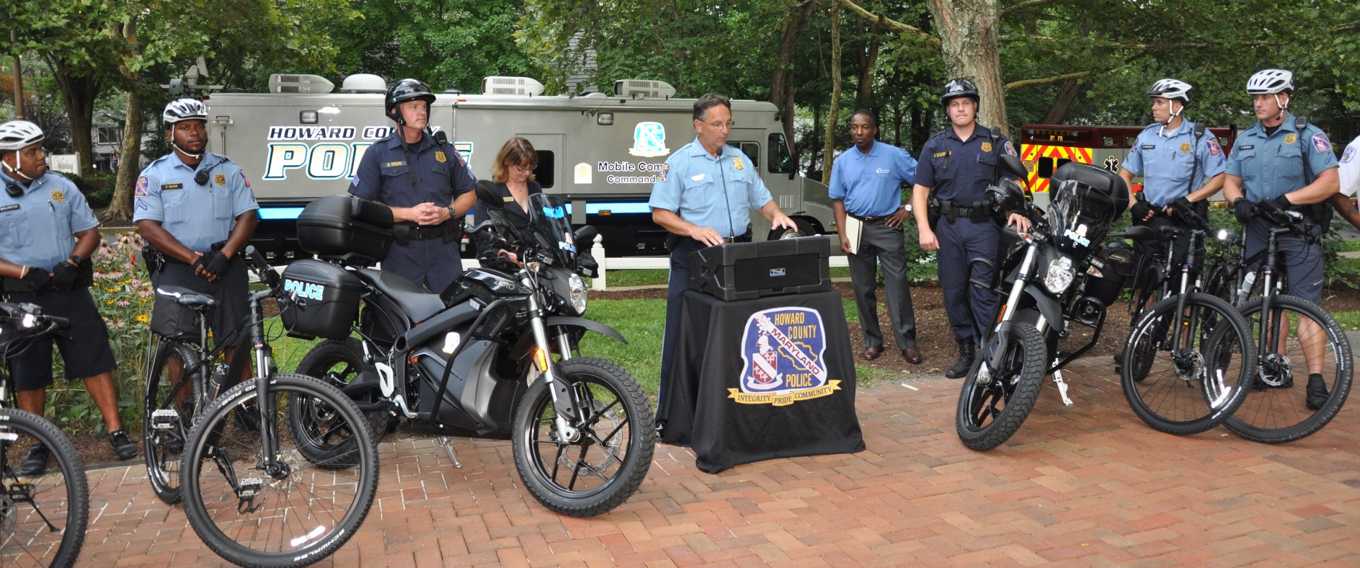
HCPD Recent Initiatives
Community Outreach
Community Partnerships
New Pathway Patrol
Human Trafficking
Mental Health Services
Narcan Overdose Program
Five Year Strategic Plan

Slide 15

Training Initiatives
State-of-the-Art Firearms Simulator
De-escalation training
Customer service training
Continual, updated cultural diversity training
Expanding Taser/Less Lethal (Bean Bag)
Active Shooter
Recruit Academy Community Policing Project (Autism Society)

Slide 16





Social Media
Twitter: @HCPDNews
Facebook:
www.facebook.com/
HowardCountyPoliceDepartment
Instagram: @HoCoPolice
Nextdoor:
www.Nextdoor.com/
HowardCountyPoliceDepartment
Social media aids Howard police in Ellicott City burglary arrest
Sept, 18, 2015
By Andrew Michaels
Howard County police cited the power of social media after charging two people in an Ellicott City burglary last month. Police said residents answered the department's social media posting for help with the case.
Scott Matthew Onofrio, 46, and Kelly Ann Wallace, 22, both of no fixed address, were charged with burglary and theft for their involvement in a burglary on Aug. 11 in the 9400 block of Dunloggin Road.
According to police, investigators were assisted by residents after posting the following request for information on Facebook and Nextdoor.
Notes:
Social Media is taking off as an effective medium to both engage the community and shave vital info
Everyone is encouraged to follow our on-line presence
Numbers growing daily
Facebook – Likes = 22,000. Posts reach 174,000
Twitter – 35,000 followers
NEXT DOOR was newest addition in August.
Nextdoor is a social networking service for neighborhoods. It allows users to connect with people who live in their neighborhood and nearby neighborhoods.
It limits access to posts to the people in each neighborhood or those nearby, which can increase privacy. It has been characterized by The Washington Post as part of a wave of community focus in the United States.

Slide 17

“Making a Difference”

