Slide 1


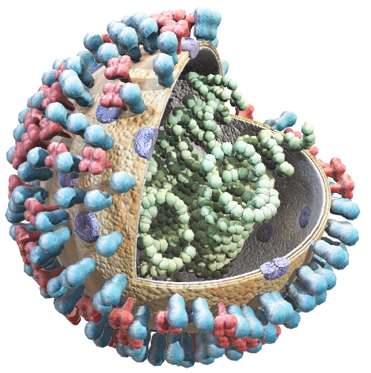
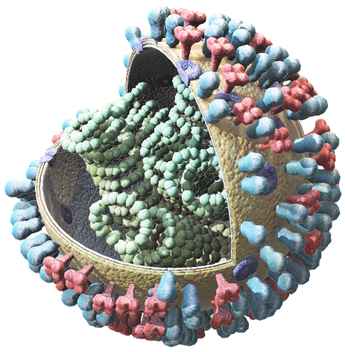
SARS-CoV-2 (the virus itself)
COVID-19 (the disease it causes)
Spread Facts – Not Germs!

Slide 2
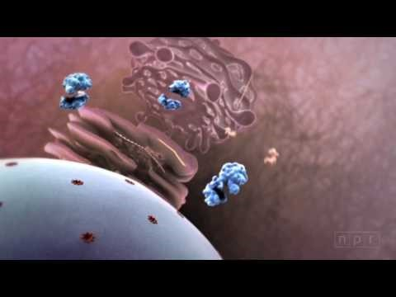
How A General Virus Works
Video: https://www.youtube.com/watch?v=Rpj0emEGShQ

Slide 3

Disease Expert Breaks Down Pandemic Scenes From Film & TV
Video:
Video: https://www.youtube.com/watch?v=feGHmv_eDcw

Slide 4
Steps to Prevent Illness
Specific CDC Guidance For COVID-19

Slide 5

Know how it Spreads
There is currently no vaccine to prevent coronavirus disease 2019 (COVID-19).
The best way to prevent illness is to avoid being exposed to this virus.
The virus is thought to spread mainly from person-to-person.
  Between people who are in close contact with one another (within about 6 feet).
  Through respiratory droplets produced when an infected person coughs, sneezes or talks.
  These droplets can land in the mouths or noses of people who are nearby or possibly be inhaled into the lungs.
  Some recent studies have suggested that COVID-19 may be spread by people who are not showing symptoms.
Notes:
https://www.cdc.gov/coronavirus/2019-ncov/about/prevention.html?CDC_AA_refVal=https%3A%2F%2Fwww.cdc.gov%2Fcoronavirus%2F2019-ncov%2Fabout%2Fprevention-treatment.html

Slide 6
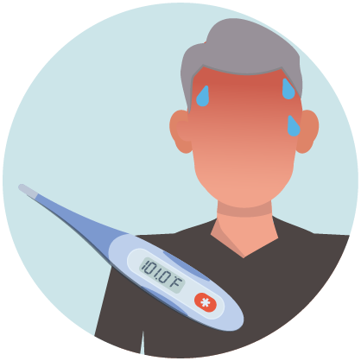
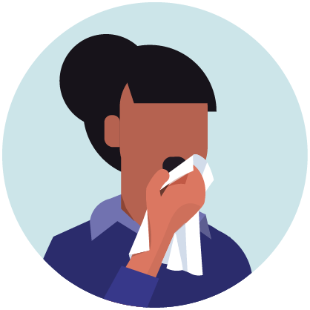
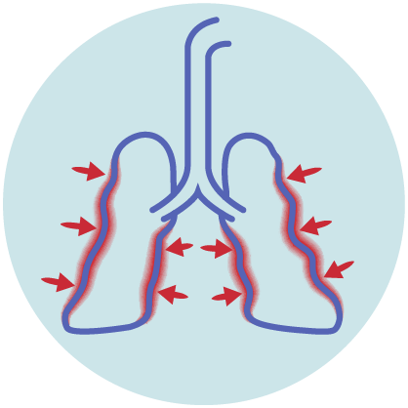
Know The Symptoms
Reported illnesses have ranged from mild symptoms to severe illness and death for confirmed coronavirus disease 2019 (COVID-19) cases.
These symptoms may appear 2-14 days after exposure (based on the incubation period of MERS-CoV viruses).
  Fever
  Cough
  Shortness of breath
Notes:
https://www.cdc.gov/coronavirus/2019-ncov/symptoms-testing/symptoms.html

Slide 7


Clean Your Hands Often
Wash your hands often with soap and water for at least 20 seconds especially after you have been in a public place, or after blowing your nose, coughing, or sneezing.
If soap and water are not readily available, use a hand sanitizer that contains at least 60% alcohol. Cover all surfaces of your hands and rub them together until they feel dry.
Avoid touching your eyes, nose, and mouth with unwashed hands.
Notes:
https://www.cdc.gov/coronavirus/2019-ncov/about/prevention.html?CDC_AA_refVal=https%3A%2F%2Fwww.cdc.gov%2Fcoronavirus%2F2019-ncov%2Fabout%2Fprevention-treatment.html

Slide 8

Avoid Close Contact
Avoid close contact with people who are sick
Stay home as much as possible
Put distance between yourself and other people.
  Remember that some people without symptoms may be able to spread virus.
  Keeping distance from others is especially important for people who are at higher risk of getting very sick.
Notes:
https://www.cdc.gov/coronavirus/2019-ncov/about/prevention.html?CDC_AA_refVal=https%3A%2F%2Fwww.cdc.gov%2Fcoronavirus%2F2019-ncov%2Fabout%2Fprevention-treatment.html

Slide 9
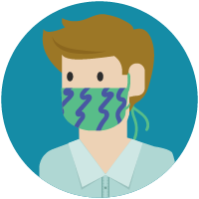
Use Cloth Face Cover
You could spread COVID-19 to others even if you do not feel sick.
Everyone should wear a cloth face cover when they have to go out in public, for example to the grocery store or to pick up other necessities.
  Cloth face coverings should not be placed on young children under age 2, anyone who has trouble breathing, or is unconscious, incapacitated or otherwise unable to remove the mask without assistance.
The cloth face cover is meant to protect other people in case you are infected.
Do NOT use a facemask meant for a healthcare worker.
Continue to keep about 6 feet between yourself and others. The cloth face cover is not a substitute for social distancing.
Notes:
https://www.cdc.gov/coronavirus/2019-ncov/about/prevention.html?CDC_AA_refVal=https%3A%2F%2Fwww.cdc.gov%2Fcoronavirus%2F2019-ncov%2Fabout%2Fprevention-treatment.html
https://www.youtube.com/watch?time_continue=42&v=tPx1yqvJgf4&feature=emb_title

Slide 10
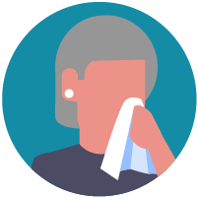
Cover Coughs and Sneezes
If you are in a private setting and do not have on your cloth face covering, remember to always cover your mouth and nose with a tissue when you cough or sneeze or use the inside of your elbow.
Throw used tissues in the trash.
Immediately wash your hands with soap and water for at least 20 seconds. If soap and water are not readily available, clean your hands with a hand sanitizer that contains at least 60% alcohol.
Notes:
https://www.cdc.gov/coronavirus/2019-ncov/about/prevention.html?CDC_AA_refVal=https%3A%2F%2Fwww.cdc.gov%2Fcoronavirus%2F2019-ncov%2Fabout%2Fprevention-treatment.html

Slide 11

Clean and Disinfect
Clean AND disinfect frequently touched surfaces daily. This includes tables, doorknobs, light switches, countertops, handles, desks, phones, keyboards, toilets, faucets, and sinks.
If surfaces are dirty, clean them: Use detergent or soap and water prior to disinfection.
Notes:
https://www.cdc.gov/coronavirus/2019-ncov/about/prevention.html?CDC_AA_refVal=https%3A%2F%2Fwww.cdc.gov%2Fcoronavirus%2F2019-ncov%2Fabout%2Fprevention-treatment.html

Slide 12
To Disinfect
To disinfect:
Most common EPA-registered household disinfectants will work. Use disinfectants appropriate for the surface.
Diluting your household bleach.
To make a bleach solution, mix:
  5 tablespoons (1/3rd cup) bleach per gallon of water
  OR
  4 teaspoons bleach per quart of water
Follow manufacturer’s instructions for application and proper ventilation. Check to ensure the product is not past its expiration date. Never mix household bleach with ammonia or any other cleanser. Unexpired household bleach will be effective against coronaviruses when properly diluted.
Alcohol solutions.
Ensure solution has at least 70% alcohol.
Other common EPA-registered household disinfectants.
Products with EPA-approved emerging viral pathogens pdf icon[7 pages]external icon claims are expected to be effective against COVID-19 based on data for harder to kill viruses. Follow the manufacturer’s instructions for all cleaning and disinfection products (e.g., concentration, application method and contact time, etc.).
Notes:
https://www.cdc.gov/coronavirus/2019-ncov/about/prevention.html?CDC_AA_refVal=https%3A%2F%2Fwww.cdc.gov%2Fcoronavirus%2F2019-ncov%2Fabout%2Fprevention-treatment.html

Slide 13

Soft Surfaces
For soft surfaces such as carpeted floor, rugs, and drapes
Clean the surface using soap and water or with cleaners appropriate for use on these surfaces.
Launder items (if possible) according to the manufacturer’s instructions. Use the warmest appropriate water setting and dry items completely.
OR
Disinfect with an EPA-registered household disinfectant.
Notes:
https://www.cdc.gov/coronavirus/2019-ncov/community/disinfecting-building-facility.html?CDC_AA_refVal=https%3A%2F%2Fwww.cdc.gov%2Fcoronavirus%2F2019-ncov%2Fprepare%2Fdisinfecting-building-facility.html

Slide 14

Electronics
For electronics, such as tablets, touch screens, keyboards, remote controls, and ATM machines
Consider putting a wipeable cover on electronics.
Follow manufacturer’s instruction for cleaning and disinfecting.
  If no guidance, use alcohol-based wipes or sprays containing at least 70% alcohol. Dry surface thoroughly.
Notes:
https://www.cdc.gov/coronavirus/2019-ncov/community/disinfecting-building-facility.html?CDC_AA_refVal=https%3A%2F%2Fwww.cdc.gov%2Fcoronavirus%2F2019-ncov%2Fprepare%2Fdisinfecting-building-facility.html

Slide 15

Laundry
For clothing, towels, linens and other items
Launder items according to the manufacturer’s instructions. Use the warmest appropriate water setting and dry items completely.
Wear disposable gloves when handling dirty laundry from a person who is sick.
Dirty laundry from a person who is sick can be washed with other people’s items.
Do not shake dirty laundry.
Clean and disinfect clothes hampers according to guidance above for surfaces.
Remove gloves, and wash hands right away.
Notes:
https://www.cdc.gov/coronavirus/2019-ncov/community/disinfecting-building-facility.html?CDC_AA_refVal=https%3A%2F%2Fwww.cdc.gov%2Fcoronavirus%2F2019-ncov%2Fprepare%2Fdisinfecting-building-facility.html

Slide 16

Cleaning and disinfecting your building or facility if someone is sick
Close off areas used by the person who is sick.
Open outside doors and windows to increase air circulation in the area. Wait 24 hours before you clean or disinfect. If 24 hours is not feasible, wait as long as possible.
Notes:
https://www.cdc.gov/coronavirus/2019-ncov/community/disinfecting-building-facility.html?CDC_AA_refVal=https%3A%2F%2Fwww.cdc.gov%2Fcoronavirus%2F2019-ncov%2Fprepare%2Fdisinfecting-building-facility.html

Slide 17

Cleaning and disinfecting your building or facility if someone is sick
Clean and disinfect all areas used by the person who is sick, such as offices, bathrooms, common areas, shared electronic equipment like tablets, touch screens, keyboards, remote controls, and ATM machines.
If more than 7 days since the person who is sick visited or used the facility, additional cleaning and disinfection is not necessary.
  Continue routing cleaning and disinfection.
Notes:
https://www.cdc.gov/coronavirus/2019-ncov/community/disinfecting-building-facility.html?CDC_AA_refVal=https%3A%2F%2Fwww.cdc.gov%2Fcoronavirus%2F2019-ncov%2Fprepare%2Fdisinfecting-building-facility.html

Slide 18
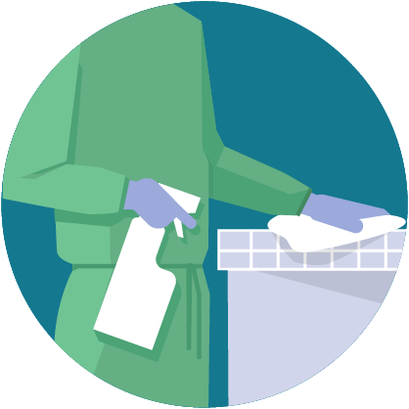
When Cleaning
Wear disposable gloves and gowns for all tasks in the cleaning process, including handling trash. Additional personal protective equipment (PPE) might be required based on the cleaning/disinfectant products being used and whether there is a risk of splash.
Gloves and gowns should be removed carefully to avoid contamination of the wearer and the surrounding area.
Notes:
https://www.cdc.gov/coronavirus/2019-ncov/community/disinfecting-building-facility.html?CDC_AA_refVal=https%3A%2F%2Fwww.cdc.gov%2Fcoronavirus%2F2019-ncov%2Fprepare%2Fdisinfecting-building-facility.html

Slide 19
When Cleaning
Wash your hands often with soap and water for 20 seconds.
  Always wash immediately after removing gloves and after contact with a person who is sick.
  Hand sanitizer: If soap and water are not available and hands are not visibly dirty, an alcohol-based hand sanitizer that contains at least 60% alcohol may be used. However, if hands are visibly dirty, always wash hands with soap and water.
Notes:
https://www.cdc.gov/coronavirus/2019-ncov/community/disinfecting-building-facility.html?CDC_AA_refVal=https%3A%2F%2Fwww.cdc.gov%2Fcoronavirus%2F2019-ncov%2Fprepare%2Fdisinfecting-building-facility.html

Slide 20
When Cleaning
Additional key times to wash hands include:
  After blowing one’s nose, coughing, or sneezing.
  After using the restroom.
  Before eating or preparing food.
  After contact with animals or pets.
  Before and after providing routine care for another person who needs assistance (e.g., a child).
Notes:
https://www.cdc.gov/coronavirus/2019-ncov/community/disinfecting-building-facility.html?CDC_AA_refVal=https%3A%2F%2Fwww.cdc.gov%2Fcoronavirus%2F2019-ncov%2Fprepare%2Fdisinfecting-building-facility.html

Slide 21
What To Do If You Are Sick
Specific CDC Guidance For COVID-19

Slide 22

If You are Sick, Stay Home
Stay home: Most people with COVID-19 have mild illness and are able to recover at home without medical care. Do not leave your home, except to get medical care. Do not visit public areas.
Stay in touch with your doctor. Call before you get medical care. Be sure to get care if you have trouble breathing, or have any other emergency warning signs, or if you think it is an emergency.
Avoid public transportation: Avoid using public transportation, ride-sharing, or taxis.
Notes:
https://www.cdc.gov/coronavirus/2019-ncov/if-you-are-sick/steps-when-sick.html

Slide 23

If You are Sick, Isolate From Home
Stay away from others: As much as possible, you stay away from others. You should stay in a specific “sick room” if possible, and away from other people and pets in your home. Use a separate bathroom, if available. See COVID-19 and Animals is you have questions about pets.
Notes:
https://www.cdc.gov/coronavirus/2019-ncov/if-you-are-sick/steps-when-sick.html

Slide 24
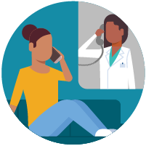
If You Are Sick, Call Ahead Before Visiting Your Doctor
Call ahead: Many medical visits for routine care are being postponed or done by phone or telemedicine.
If you have a medical appointment that cannot be postponed, call your doctor’s office, and tell them you have or may have COVID-19. This will help the office protect themselves and other patients.
Notes:
https://www.cdc.gov/coronavirus/2019-ncov/if-you-are-sick/steps-when-sick.html

Slide 25
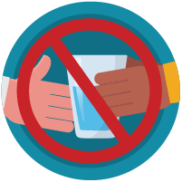
If You Are Sick, Avoid Sharing Personal Household Items
Do not share: Do not share dishes, drinking glasses, cups, eating utensils, towels, or bedding with other people in your home.
Wash thoroughly after use: After using these items, wash them thoroughly with soap and water or put in the dishwasher.
Notes:
https://www.cdc.gov/coronavirus/2019-ncov/if-you-are-sick/steps-when-sick.html

Slide 26

If You Are Sick, Clean “High Touch” Surfaces Everyday
Clean high-touch surfaces in your isolation area (“sick room” and bathroom) every day; let a caregiver clean and disinfect high-touch surfaces in other areas of the home.
Clean and disinfect: Routinely clean high-touch surfaces in your “sick room” and bathroom. Let someone else clean and disinfect surfaces in common areas, but not your bedroom and bathroom.
  If a caregiver or other person needs to clean and disinfect a sick person’s bedroom or bathroom, they should do so on an as-needed basis. The caregiver/other person should wear a mask and wait as long as possible after the sick person has used the bathroom.
High-touch surfaces include phones, remote controls, counters, tabletops, doorknobs, bathroom fixtures, toilets, keyboards, tablets, and bedside tables.
Notes:
https://www.cdc.gov/coronavirus/2019-ncov/if-you-are-sick/steps-when-sick.html

Slide 27
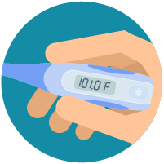
If You Are Sick, Monitor Your Symptoms
Common symptoms of COVID-19 include fever and cough. Trouble breathing is a more serious symptom that means you should get medical attention.
If you are having trouble breathing, seek medical attention, but call first.
  Call your doctor or emergency room before going in and tell them your symptoms. They will tell you what to do.
Wear a cloth face covering (covers your nose and mouth): Put on the cloth face covering when you leave your house or when around other people. You don’t need to wear the cloth face covering if you are alone. If you can’t put on a cloth face covering (because of trouble breathing for example), cover your coughs and sneezes in some other way. Try to stay at least 6 feet away from other people. This will help protect the people around you.
Follow care instructions from your healthcare provider and local health department: Your local health authorities may give instructions on checking your symptoms and reporting information.
Notes:
https://www.cdc.gov/coronavirus/2019-ncov/if-you-are-sick/steps-when-sick.html

Slide 28
Know When to Seek Medical Attention
If you develop emergency warning signs for COVID-19 get medical attention immediately. Emergency warning signs include*:
  Trouble breathing
  Persistent pain or pressure in the chest
  New confusion or inability to arouse
  Bluish lips or face
*This list is not all inclusive. Please consult your medical provider for any other symptoms that are severe or concerning.
Notes:
https://www.cdc.gov/coronavirus/2019-ncov/if-you-are-sick/steps-when-sick.html

