Slide 1

Complete Streets Implementation Team
Implementation Phase: Meeting #7
July 1, 2020

Slide 2
Agenda
Introduction
Review and approval of June meeting minutes
Community Engagement Plan
Design Manual
Project prioritization
Brief updates
  Sidewalk policy
Next steps

Slide 3
COMMUNITY
ENGAGEMENT PLAN

Slide 4
Capital Projects

Slide 5

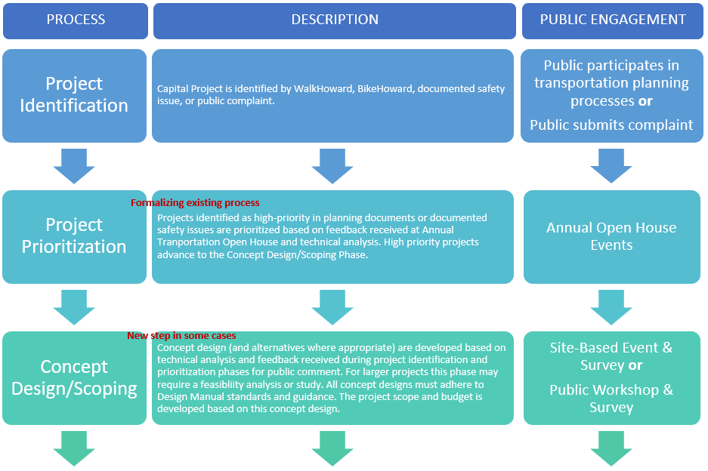
Capital Project Process (2 slides)

Slide 6
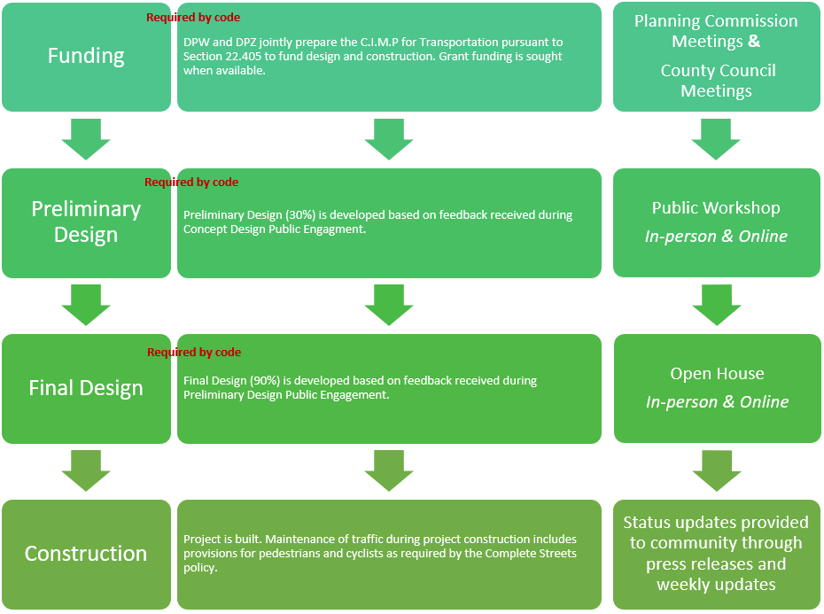
Capital Project Process (2 of 2)

Slide 7
Preliminary Design Workshop Checklist
See page 3 of pdf

Slide 8
Capital or Operating?
Capital Project Process
  Would apply to all bridge projects (B) and road construction projects (J)
  Would apply to some road resurfacing projects (H), sidewalk/curb projects (K), and traffic/intersection projects (T)
Operating Project Process
  Would apply to some road resurfacing projects (H), sidewalk/curb projects (K), and traffic/intersection projects (T)

Slide 9
Example
Sidewalk/curb projects (K)
  Some are complex
    Guilford Rd Pedestrian Bike Improvements: three phase complex project in an area experiencing growth and a new high school
    Bicycle Plan Projects
    Pedestrian Plan Projects
  Some are simple
    School route pathways or sidewalks
    Routine sidewalk walkway extensions
    Sidewalk repair program

Slide 10
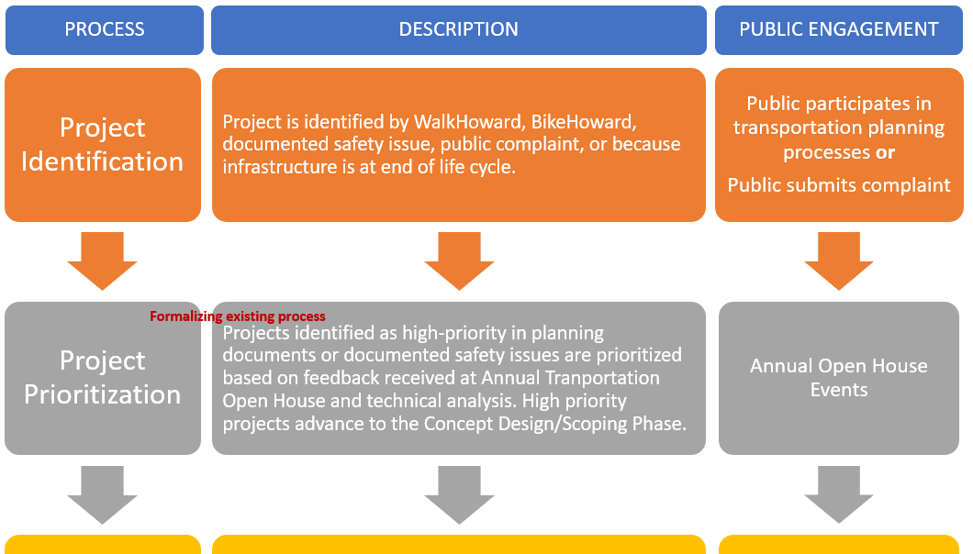
Operational Project Process

Slide 11
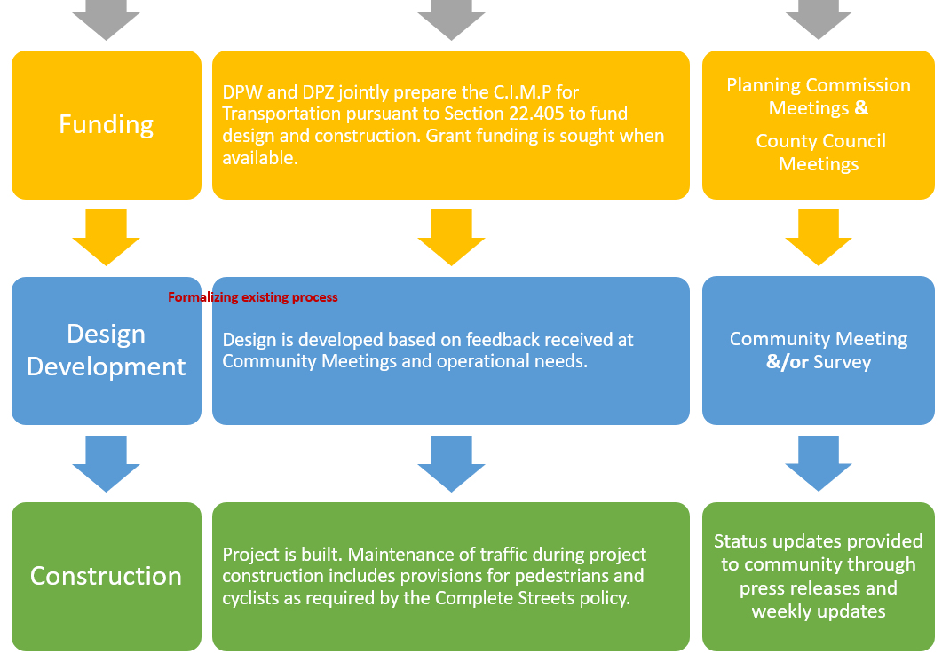

Slide 12
Developer Projects
See pages 5-8 of pdf for higher-resolution versions of the following slides

Slide 13
Major Subdivision

Slide 14
Site Development Plan

Slide 15
Minor Subdivision

Slide 16
Developer Projects
Would apply to Major Subdivisions and Commercial Site Development Plans
Would NOT apply to Minor Subdivisions and non-Commercial Site Development Plans

Slide 17
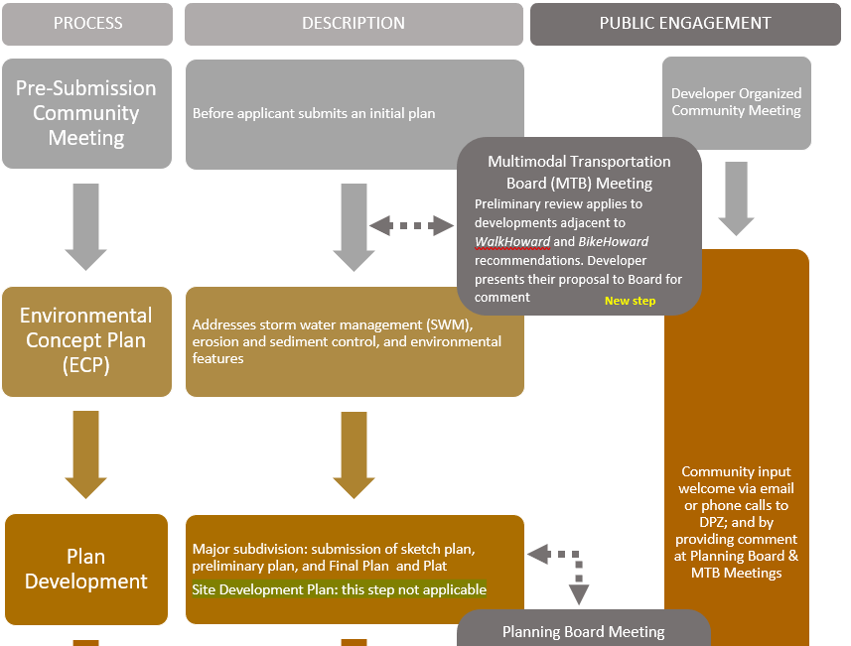
Developer Project Process

Slide 18
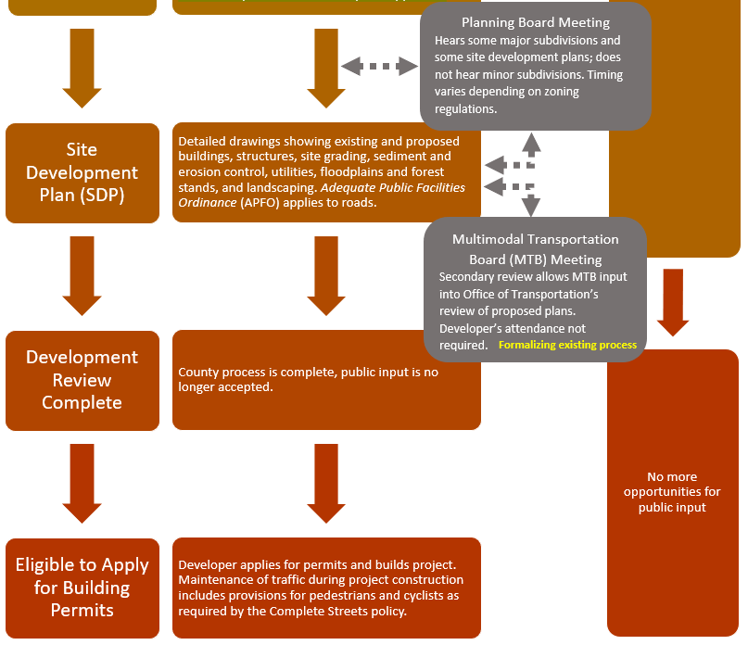

Slide 19
CEP Next Steps
Develop remaining checklists for Capital, Operational, and Developer flow charts
Revise document structure where appropriate so text interfaces well with checklist format
Full rough draft available for CSIT review by August Meeting
Revised draft available for CSIT review by September meeting
Final draft ready for Council review in October

Slide 20
DESIGN MANUAL

Slide 21
Design Manual
Chapter 1 (Introduction and General Information) will be rewritten to incorporate Complete Streets principles, project delivery process, community engagement, etc.
Chapter 2 (Design of Roads) and Volume IV typical sections will be updated based on the street typology
Chapters 3 (bridges) and 5 (traffic) will also be updated
Chapter 4 (APFO) will not be updated under this effort, except for possibly minor “housekeeping” items

Slide 22
Design Manual – Chapter 1 Outline
1.1 Introduction (primarily new content)
  A. How to use this manual
  B. How this manual was developed
  C. Benefits of Complete Streets
  D. Complete Streets policy
  E. Vulnerable Population index and Priority Areas
  F. Authorization

Slide 23
Design Manual – Chapter 1 Outline
1.2 Project Types and Delivery Process (significant rewrite of existing content)
  A. Capital projects
  B. Land development projects
  C. Project prioritization
  D. Community Engagement Plan
  E. Exceptions

Slide 24
Design Manual – Chapter 1 Outline
1.3 Street Types
(significant rewrite of existing content)
  A. Land use context
  B. Transportation context
  C. Typology
  D. Bike Howard overlay
  E. Scenic roadway overlay
  F. Trade-offs

Slide 25
Design Manual – Chapter 1 Outline
Other sections of Chapter 1 will have less significant modifications
  1.4 Engineering Reports
  1.5 Surveys
  1.6 Construction Plans
  1.7 Construction Specifications
  1.8 Record Drawings
  1.9 Definitions
  1.10 Abbreviations

Slide 26
Design Manual – Chapter 4
One modification is needed to comply with the Complete Streets policy:
  Section 4.9.2.A.2: In Table 2, change “eight-foot-wide bike path” to “ten-foot-wide shared use pathway”
Some sections may benefit from modification or clarification:
  4.2.C. If collector classifications are combined, wording needs to be revised
  4.3.C.3. Background growth rate of 3% or 6% may be worth reconsidering
  4.9.1.C. Pedestrian Level of Service (PLOS) and Bicycle Level of Service (BLOS) may require clarification

Slide 27
Design Manual
As noted last time, updates will be reviewed by the core team before being brought to the CSIT

Slide 28
PROJECT PRIORITIZATION

Slide 29
Project prioritization
Internal meeting held on June 19
  Senior staff from the Administration, Budget, Transportation, DPW, and DPZ participated
  The goal is to better understand the County’s current capital budget development process to help determine how to introduce prioritization in a way that effectively advances Complete Streets while avoiding unnecessary disruption to the existing process
  Discussed the requirement in the Complete Streets policy to have a prioritization process for transportation projects; all attendees acknowledged this is necessary
  Considered how prioritization may work for individual projects vs “programs of projects”
  Will follow up with individual or small group interviews about how prioritization can fit into the budget development process

Slide 30
Project prioritization questions
How are transportation projects added or adjusted in the capital program?
  1. How are transportation projects added to the capital program each year?
  2. Is there clear guidance and definition of criteria used for selecting capital projects?
  3. How do transportation projects move from:
    a. Concept to design?
    b. Design to engineering?
    c. Engineering to construction?

Slide 31
Project prioritization questions
Use of condition assessments
  4. Are there projects that should be evaluated using an asset inventory and condition assessment process, that are not currently evaluated using this process?
  5.How is the allocation of funding determined between system preservation and new/expansion projects?

Slide 32
Project prioritization questions
Financial determinations
  6. How is allocation of funds related to county goals and policy priorities?
  7. How is the allocation of funds for program levels (rather than individual projects) determined each year?
  8. Are feasibility studies conducted prior to committing to potential projects? Is there funding allocated each year for new feasibility studies?
  9. How are yearly cashflows determined for multi-year projects?
  10. What process is used for project controls? Is there an internal project status reporting process and review for approval of modifications in scope, budget and schedule?

Slide 33
Project prioritization questions
Public involvement
  11. How is the public involved in the creation of the capital budget?

Slide 34
Project prioritization
Anticipated schedule (revised)
  Meetings and interviews in late June into early July
  Initial draft, testing, and iteration in July and early August
  Refined draft to core team by August 19 meeting
  Adjustments as needed
  Refined draft to CSIT by September 2 meeting
  Adjustment as needed
  Approval by core team at September 16 meeting
  Approval by CSIT at October 7 meeting
  Delivery to Council in October

Slide 35
BRIEF UPDATES

Slide 36
Sidewalk policy
[content]

Slide 37
NEXT STEPS

Slide 38
Next steps
Next meeting
  Wednesday, August 5, 3:00 pm
Action items from this meeting

