Slide 1

Bicycle Advisory Group
Meeting
November 17, 2020
Howard County Office of Transportation
3430 Court House Drive, Ellicott City, MD 21043
3:00 p.m.
Held via WebEx

Slide 2
Responsibilities of the Bicycle Advisory Group
Advise and inform the Office of Transportation on transportation matters
Provide additional subject matter expertise to the Office of Transportation
Provide feedback and technical assistance on the implementation of master plans and other initiatives and policy issues

Slide 3
Review and Approval
Today’s Agenda
September 15, 2020 Minutes

Slide 4
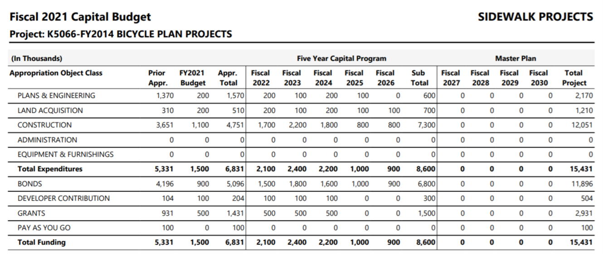
Key Topic: FY 2022 Capital Budget Development
$1.5 million of FY22 County Funding split between:
$825k for K5066 and $675k for N3963 (paving of Patuxent Branch Trail)

Slide 5
Key Topic: FY 2022 Capital Budget Development
Bike Infrastructure Projects, FY 21 and FY22 Proposed | Budget Area
Cedar Lane Pathway | K5066
North Laurel Connections signage and pathway project | K5066
Dobbin Road Pathway | K5066
Robert Fulton Drive Shared-Use Path | K5066
BLP/MD 32 Park-and-ride access improvements | K5066
Road Diet Projects (Oakland Mills Rd, Tamar Drive, Columbia Road) | K5066
Route 1 Safety Projects | K5066
Countywide Bicycle Wayfinding | K5066
North Chatham Road Contraflow Bike Lane | K5066
Misc. signage, stencilling, storm drain grates, etc | K5066
South Entrance Trail | T7107
Clarkesville Pike Streetscape | T7108
Surface Upgrade for the Patuxent Branch Trail | N3963
Sanner Road Bike Lanes | J4230
*Projects in green need construction funding from grants

Slide 6
Business from Last Meeting
HCPD – Police awareness/training on policy of citation of aggressive drivers when video submitted by bicyclists
DPW – Micro surfacing
DPW – Recommendation for markings through intersections
Rec and Parks and CA – Slippery bridges
Recs and Parks – Bike Rest Stops

Slide 7
Brief Updates
Legislation prohibiting parking in bike lanes (CB49-2020) – passed; effective December 7
Complete Streets
    Completion of Community Engagement Plan and
    Transportation Improvement Prioritization System (TIPS)
    Presentation to County Council, November 9
    Design Manual due by October 2021
    Website - now includes links to Complete Streets projects
Police Department
    Some locator signage on pathways displaced; relocation in process

Slide 8
Brief Updates (continued)
CA Pathways mobile app
    Discontinued
108 and Shepard Lane Design
    River Hill Board has a Webex meeting scheduled with County Thursday 11/19/20 at 7pm

Slide 9
Brief Update: BAG
BAG membership
  Required by County Code
    Howard County Student, selected by Voices for Change
    Howard County Student, selected by the Howard County Association of Student Councils
  At the discretion of the OoT Administrator
    Representative for retailers within Howard County
BAG chair and vice-chair
    Two-year terms

Slide 10
Upcoming Events
2020
Virtual Transportation Town Hall, November 18 at 6pm
E-Scooter Sharing Permit Award – Mid-December (with mid-March operational start)
2021
Phase 3, General Paratransit fare increase, January 1
Reinstating RTA fares, January 2
Annual BikeHoward Open House (virtual), Jan/Feb

Slide 11
Open Discussion
Among BAG Members

Slide 12
Adjournment
Next meeting
January 12, 2021
at 3:00 PM
Thank you for attending

